Slide 1
American Steel: EAF Through and Through (Sustainably)
National Slag Association Annual Meeting September 16, 2024

Slide 2
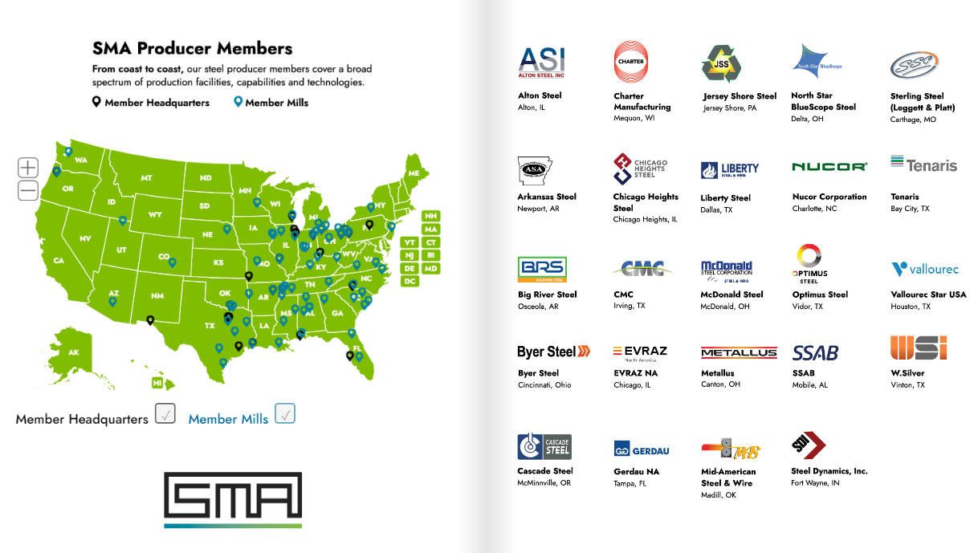
*Not Shown: Timken Steel

Slide 4
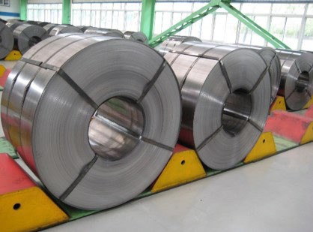
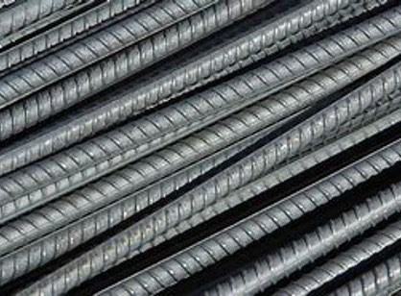
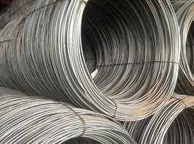
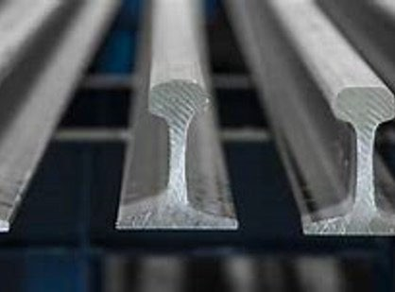
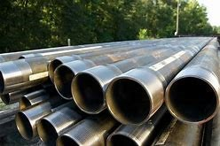
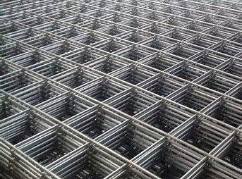
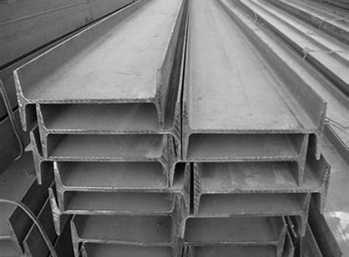
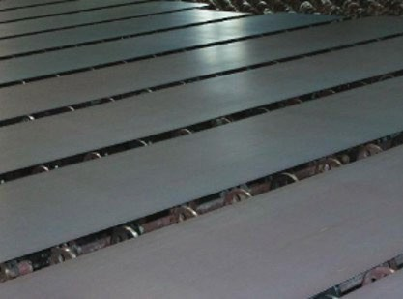
EAF and SMA Dominance in All Product Categories
Automotive – 50 %
Rebar – 99%
Wire Rod – 99%
Light Shapes – 99%
OCTG, Pipe – 60%
Wire Mesh – 99%
Structural Beams – 95%
Steel Plate – 85%
Source: SMA, AIST, Wiley Law

Slide 5
Recent Investments 2022-2025
Project | Capacity (Tons) | Product | Est. Cost | Est. Start Date | Location
Nucor West Virginia Greenfield Mill ª | 3 million | Sheet | US$ 3.1 billion | 2024 | WV
US Steel/Big River 2 Mill ^{u} | 3 million | Sheet | US$ 3 billion | 2024 | AR
SDI Sinton Greenfield Mill ^{c} | 3 million | Sheet | US$ 2 billion | 2022 | TX
Nucor Brandenburg Greenfield Mill ^{c} | 1.2 million | Plate | US$ 1.7 billion | 2023 | KY
AM/NS Calvert Meltshop ^{u} | 1.5 million | Slab | US$ 1 billion | 2024 | AL
North Star Blue Scope Expansion ^{c} | ~937,000 | Sheet | US$ 700 million | 2022 | OH
Nucor Gallatin Expansion ^{c} | 1.6 million | Sheet | US$ 650 million | 2022 | KY
EVRAZ North America Rail Mill ^{u} | 670,000 | Long Rail | US$ 500 million | 2023 | CO
Highbar Greenfield Mill ª | 600,000 | Rebar | US$ 500 million | TBD | AR
US Steel/Big River NGO Line ^{u} | 200,000 | Electrical Steel | US$ 450 million | 2024 | AR
Nucor Berkeley Galv Line ª | 500,000 | Galvanized Sheet | US$ 425 million | 2024 | NC
Source: Company announcements, AIST, IHS Markit
a – announced, u – underway, c - completed

Slide 6
Recent Investments 2022-2025
Project | Capacity (Tons) | Product | Est. Cost | Est. Start Date | Location
Nucor Berkeley Galv Line ª | 500,000 | Galvanized Sheet | US$ 425 million | 2024 | AR
Nucor Crawfordsville Modernization ª | NA | Sheet/Galv. Sheet | US$ 400 million | 2024 | IN
Nucor Lexington Micro-Mill ª | 430,000 | Rebar | US$ 350 million | 2024 | NC
Pacific Steel Mojave Micro-Mill ª | 380,000 | Rebar | US$ 350 million | TBD | CA
Nucor Berkeley Modernization ª | NA | Sheet | US$ 200 million | 2024 | NC
CMC Arizona 2 Micro-Mill ^{u/c} | 500,000 | Rebar/Merchant Bar | US$ 300 million | 2023 | AZ
CMC W. Va. Micro-Mill ª | 500,000 | Bar | US$ 450 million | 2025 | WV
US Steel/Big River Galvanizing Line ^{u} | 325,000 | Galv./ Galvalume | US$ 280 million | 2024 | AR
SDI Sinton Galv/Paint Combo ^{u} | 540,000 | Coated Sheet | US$ 225 million | 2024 | TX
SDI Heartland Galv/Paint Combo ^{u} | 540,000 | Coated Sheet | US$ 175-$200 m. | 2024 | IN
Nucor Gallatin Tube Mill ^{u} | 250,000 | HSS, Mech. Tube | US$ 164 million | 2023 | KY
Nucor Kingman Meltshop ^{u} | 600,000 | Steel/Bar | US$ 100 million | 2023 | AZ
a – announced, u – underway, c - completed
Source: Company announcements, AIST, IHS Markit

Slide 7
U.S. Domestic Production – 1978-Present
Data – USGS Iron & Steel - 2024

Slide 8
U.S. Ferrous Material Collection, Import-Export, and Consumption 2000-Present (2023)
Data – USGS Iron & Steel Scrap - 2024

Slide 9
Ferrous Material Collection/Consumption (2000-2023) Steel Production – total and by process (1978-2024) – (U.S.) in millions of metric tons
9/16/2024
9

Slide 10
Notes:
The slide here displays the domestic iron and steel sector’s GHG emissions from the BOF and EAF furnaces operating in the US from 2012, to 2022, as collected and reported to the US Environmental Protection Agency. The slide also provides the production of new steel product by the domestic iron and steel industry, as reported by the US Geologic Survey for integrated and EAF mills.
EAF steel production is inherently more energy efficient/more environmentally sustainable/less environmentally impactful, and the emissions of greenhouse gases proves this point, where EAF operations routinely emit from 66 to 75% less total GHG emissions per ton of steel produced than by the integrated process.
2022 emissions data shows that EAF operations (78 reporting facilities in this year, up four from 2021) produced steel at .246 tons of GHG emissions per ton of steel produced.
2022 emissions data shows that integrated operations (9 reporters in this year, same as 2021) produced steel at 1.58 tons of GHG emissions per ton of steel produced.

Slide 11
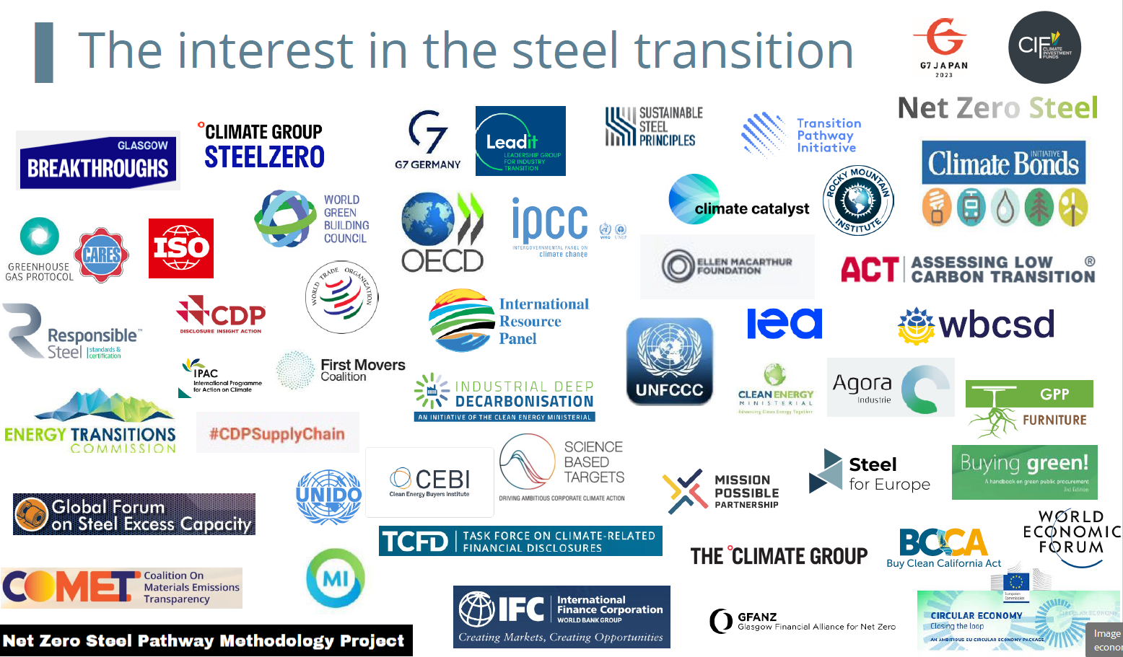
Lots of folks are Interested in Green Steel

Slide 12
Decarbonization Strategies
Hydrogen Hubs
Carbon Capture
Small Modular Reactors
Solar
Biocarbon
Industrial Electrification - EAF
Scrap Optimization and OBMs
Market Green Steel Products

Slide 13
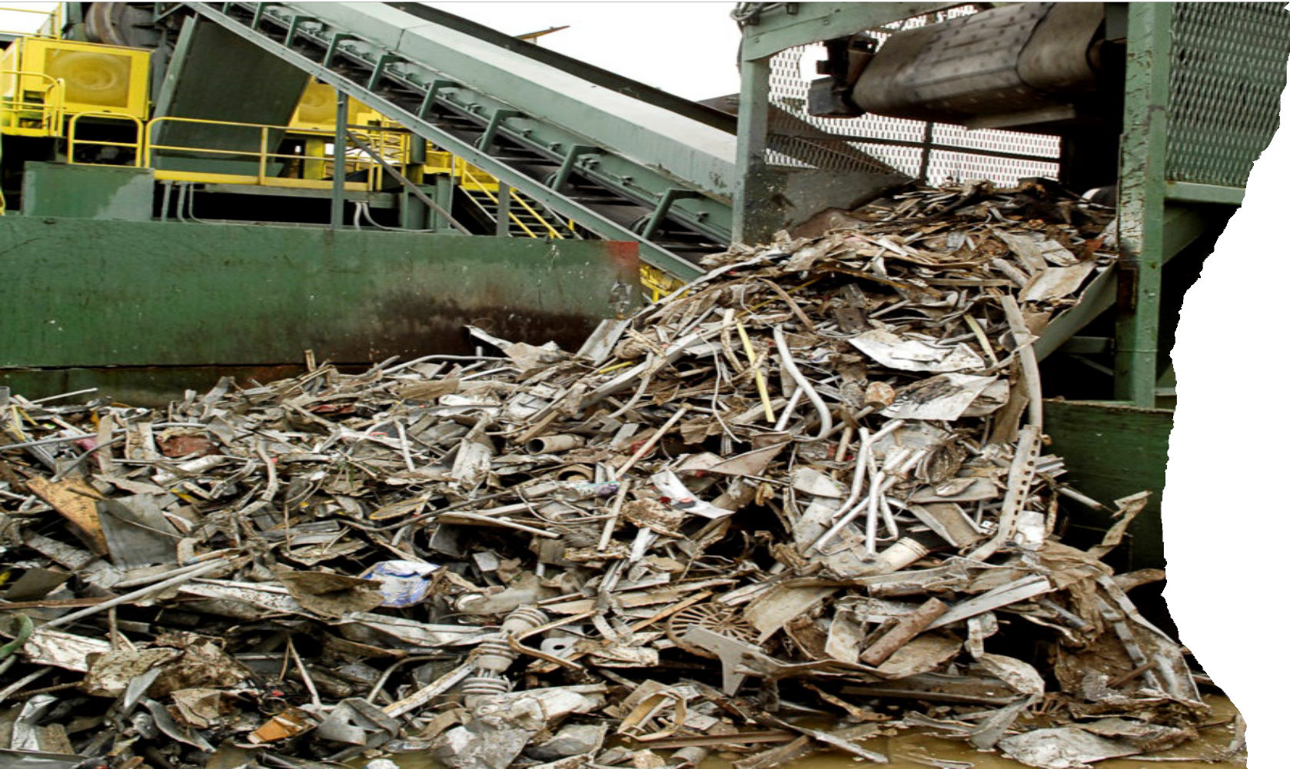
Material and energy efficiency optimization
Decarbonization Strategy:
Maximizing available raw materials such as scrap, OBMs and lower grade iron for steel production will become paramount as demand increases.
Market pressure will require smart technologies and innovations to optimize the metallization of those raw materials, as well as energy applications and overall manufacturing processes..

Slide 14
American Steel’s Carbon Advantage
Source: Climate Leadership Council

Slide 15
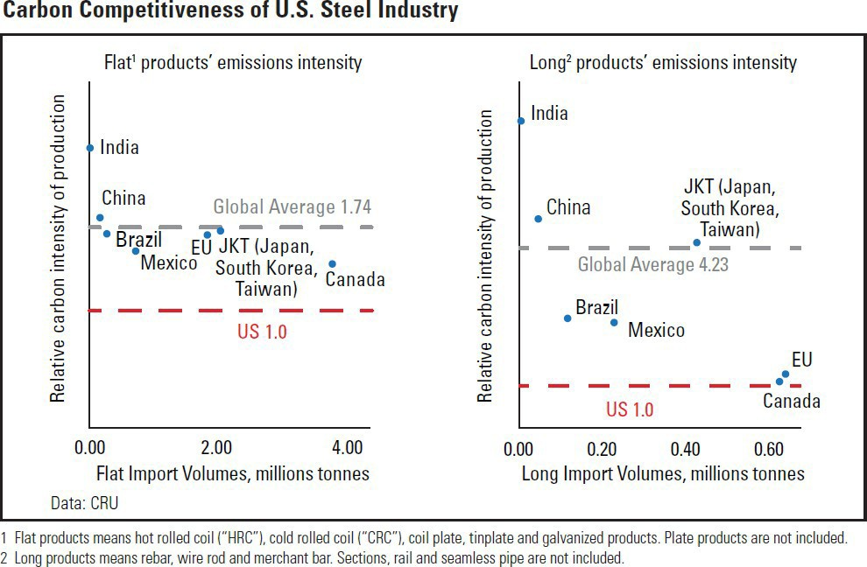
American Steel’s Carbon Advantage
Key Points
U.S. steel producers are 75% - 320% more carbon efficient than global producers
America produces steel while emitting less carbon dioxide than all of our major competitors
Current climate and trade rules do not give American steel producers credit for their cleaner operations
The US steel industry has a major carbon advantage. Steel exporters to the US emit 50- 100+% more CO2 emissions per tonne than US producers on average
The U.S. economy is three times more carbon efficient than that of China and nearly four times as efficient as India
Source: Climate Leadership Council, CRU

Slide 16
Global steelmaking averages for major producing countries – total crude steel
Country | Average Scope 1 emissions intensity t CO2/tcs | Average Scope 2 emissions intensity t CO2/tcs | Total Scope 1 & 2 t CO2 /tcs
Brazil | 1.77 | 0.01 | 1.78
China | 1.92 | 0.09 | 2.01
India | 2.38 | 0.13 | 2.51
Japan | 1.86 | 0.01 | 1.87
Russia | 1.70 | 0.07 | 1.77
South Korea | 1.50 | 0.04 | 1.54
Turkey | 1.33 | 0.07 | 1.41
United States | 0.57 | 0.15 | 0.72
Crude steel carbon intensities (Scope 1 and 2 only)
2.51
2.01
0.13
1.78
0.09
1.87
1.77
0.01
0.01
0.07
1.54
1.41
0.04
0.07
0.72
0.15
Brazil
China
India
Japan
Russia
South Korea
Turkey
United States
DATA: CRU; Differences in figures in the graph and table are attributed to rounding of emissions intensities.
Scope 1
Scope 2
9/16/2024

Slide 17
Global steelmaking averages for major producing countries – BF-BOF crude steel
Country | Average Scope 1 emissions intensity t CO2/tcs | Average Scope 2 emissions intensity t CO2/tcs | Total Scope 1 & 2 t CO2 /tcs
Brazil | 1.92 | 0.00 | 1.93
China | 1.91 | 0.07 | 1.98
India | 2.29 | 0.08 | 2.37
Japan | 1.80 | 0.006 | 1.80
Russia | 1.74 | 0.04 | 1.79
South Korea | 1.59 | 0.01 | 1.60
Turkey | 1.79 | 0.03 | 1.81
United States | 1.36 | 0.03 | 1.39
BF-BOF crude steel CO2 intensities (Scope 1 and 2 only)
2.37
1.93
1.98
0.08
0.00
0.07
1.80
1.79
1.81
0.01
0.04
1.60
0.03
0.01
1.39
0.03
Brazil
China
India
Japan
Russia
South Korea
Turkey
United States
DATA: CRU; Differences in figures in the graph and table are attributed to rounding of emissions intensities.
Scope 1
Scope 2
9/16/2024

Slide 18
CRU’s modelled coverage of the US steel market
CRU Cost Model coverage for US crude steel, 2021, Mt crude steel
US crude steel production by steelmaking production route, 2021, Mt crude steel
CRU Cost Model coverage = 89% of US crude steel production
CRU Steel Cost Model
CRU Crude Steel Market Outlook
BF-BOF
EAF
BF-BOF
EAF
US steel production by product type, Mt product
US EAF steel production by primary OBM inputs, Mt, 2021
0.0
Flats
Longs
Flats
Longs
Scrap EAFs
MPI - EAFs
DRI-EAFs
Hot Metal-EAFs
9/16/2024
DATA: CRU; please note that data presented within this slide is from CRU’s Steel Cost Model unless otherwise stated

Slide 19
CRU’s modelled coverage of the Chinese steel market
CRU Cost Model coverage for Chinese crude steel, 2021, Mt crude steel
Chinese crude steel production by steelmaking production route, 2021, Mt crude steel
CRU Cost Model coverage = 37% of Chinese crude steel production
CRU Steel Cost Model
CRU Crude Steel Market Outlook
BF-BOF
EAF
BF-BOF
EAF
Chinese steel production by product type, Mt product
Chinese EAF steel production by primary OBM inputs, Mt, 2021
0.0
Flats
Longs
Flats
Longs
Scrap EAFs
MPI - EAFs
DRI-EAFs
Hot Metal-EAFs
9/16/2024
DATA: CRU; please note that data presented within this slide is from CRU’s Steel Cost Model unless otherwise stated

Slide 20
CRU’s modelled coverage of the Japanese steel market
CRU Cost Model coverage for Japanese crude steel, 2021, Mt crude steel
Japanese crude steel production by steelmaking production route, 2021, Mt crude steel
3%
CRU Cost Model coverage = 75% of Japanese crude steel production
CRU Steel Cost Model
CRU Crude Steel Market Outlook
BF-BOF
EAF
BF-BOF
EAF
Japanese steel production by product type, Mt product
Japanese EAF steel production by primary OBM inputs, Mt, 2021
0.0
0.0
0.0
Flats
Longs
Flats
Longs
Scrap EAFs
MPI - EAFs
DRI-EAFs
Hot Metal-EAFs
9/16/2024
DATA: CRU; please note that data presented within this slide is from CRU’s Steel Cost Model unless otherwise stated

Slide 21
Because the US produces ~70% of its crude steel through the EAF production route, it has a crude steel emissions intensity that is 50% less than its nearest competitor, and is 65% less than the largest producer in the world, China
Emissions intensity per tonne of steel produced (t CO2/tcs)
Emissions intensities for major global steel producers of crude steel, 2021
4.0
Scope 1
Scope 2
3.5
3.0
2.5
2.51
2.0
1.87
2.01
1.76
1.78
1.41
1.54
1.5
1.0
0.72
South Korea
Russia
Brazil
Japan
China
India
Turkey
0.5
United States
0.0
0
50
100
150
200
250
300
350
400
450
500
550
600
650
700
750
800
Cumulative crude steel production, Mt
DATA: CRU
9/16/2024

Slide 22
Scrap rates of EAF steelmaking have a direct correlation with Scope 1 and 2 emissions intensity – EAF steelmaking in India is the most carbon intensive among the eight countries
(tCO2/tcs)
Emissions intensities for assessed EAF steel producers of crude steel, 2021 (Scope 1 & 2 emissions)
4
United States
Brazil
China
Japan
South Korea
Russia
Turkey
India
3
2
1
0
0
5
10
15
20
25
30
35
40
45
50
55
60
65
70
75
80
85
90
95
100
105
110
115
Scrap consumption for assessed EAF steel producers of crude steel, 2021 (Scope 1 & 2 emissions)
Kg scrap/tcs
1,500
United States
Brazil
China
Japan
South Korea
Russia
Turkey
India
1,000
500
0
0
5
10
15
20
25
30
35
40
45
50
55
60
65
70
75
80
85
90
95
100
105
110
115
Cumulative EAF crude steel production, Mt
DATA: CRU
9/16/2024

Slide 23
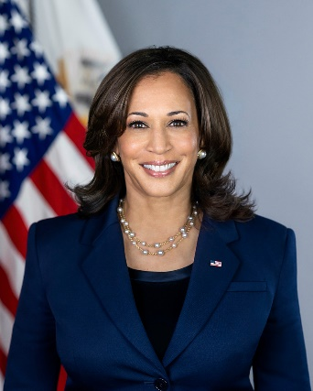
Vice President Kamala Harris
Vice Presidency
Casting the tiebreaking vote as Vice President for the Inflation Reduction Act.
Ike Irby, VP Harris’ Climate Advisor, said that a large environmental focus of hers would be on IRA implementation.
Gina McCarthy, President Biden’s national climate advisor, emphasized that Harris has a unique interest in environmental justice issues.
Harris as Vice President has had a keen interest in climate change and foreign relations.
During a UN global climate summit in Dubai, she told world leaders that “the urgency of this moment is clear. The clock is no longer just ticking, it is banging. And we must make up for lost time.”
Hosted a round table in Bangkok to connect environmental activists with “clean energy experts.”
2020 Presidential Campaign
Proposed a carbon tax.
Favored a ban on hydraulic fracking. (Campaign spokespeople have backtracked on this, saying she no longer supports a ban - likely a bid to win over Pennsylvania – a major natural gas producer and electoral battleground state).
Senator from California
Took positions even left of Biden regarding climate change, like sponsoring the “Green New Deal.”
Enthusiastic EJ supporter.
The Bottom Line: A continuation of and building upon the Biden Administration’s work, with an even heavier emphasis and personal involvement on EJ.

Slide 24
Governor Tim Walz
Vice Presidential Campaign
Received endorsements from Sierra Club, League of Conservation Voters, the Green New Deal Network, former U.S. Climate Envoy John Kerry, Washington State Gov. Jay Inslee and Pres. Obama’s Energy Secretary Steven Chu.
Governorship
Last year, signed a law requiring all Minnesota power plants to use 100% climate-friendly energy by 2040.
Set up climate change sub-cabinet to effectuate this law.
Set up the Minnesota State Competitiveness Fund, designed to help Minnesota applicants secure IRA funds for energy projects.
Adopted tailpipe emissions standards and has generally pushed for a transition to electric vehicles.
Signed the “Frontline Communities Protection Act,” authorizing the Minnesota Pollution Control Agency to conduct cumulative impacts analysis for air permits in EJ areas.
Signed Amara’s Law, one of the strictest PFAS bans in the country.
House Representative
Criticized Pres. Trump’s decision to withdraw from the Paris Agreement.
Opposed offshore drilling expansions and baseline protections from fracking.
Bit of a mixed bag – sided against environmentalists on issues regarding nuclear storage, toxic pesticides, coal ash, logging exemptions and agricultural workers.
The Bottom Line: A heavy emphasis on EJ issues and a particular focus on energy transition policy.

Slide 25
President Donald Trump
Speaking broadly, President Trump effectuated a largely deregulatory agenda.
Rolled back a total 98 environmental rules and left 14 in progress prior to leaving office.
28 of the completed rule amendments related to air pollution and emissions; 2 left in progress.
8 of the completed rule amendments related to water pollution; 1 left in progress.
14 of the completed rule amendments related to infrastructure and planning.
Air Regulations
Changed the way cost-benefit analyses are conducted under the CAA.
Established a minimum pollution threshold at which EPA can regulate GHG emissions from stationary sources.
Eliminated the Obama-era calculation for the social cost of carbon.
Withdrew guidance directing federal agencies to include GHG emissions in environmental reviews.
During his Administration, President Trump withdrew the United States from the global Paris Agreement to limit GHGs.
Project 2025
EPA chapter written by Trump-era Chief of Staff Mandy Gunasekara, includes:
Revisit 2009 greenhouse gas “endangerment” finding.
Numerous TSCA reforms, including exclusion from TSCA reviews exposure pathways, health effects, or subpopulations addressed under other environmental laws or policies; presumption that workplaces are following all OSHA requirements.
Heavy emphasis on cost-benefit analysis, appropriate discount rates, identifying “co-benefits” separately, and acknowledging uncertainties involved in quantifying benefits.
Making public and taking comment on all scientific studies and analyses that support regulatory decision-making.
The Bottom Line: A broad continuation and expansion of deregulatory efforts.

Slide 26
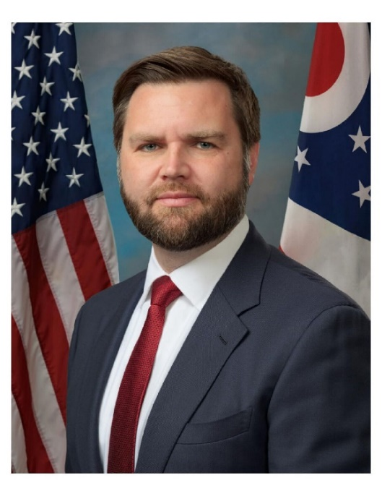
Senator JD Vance
Campaigning for Vice President
Would do away with the IRA.
Senator from Ohio
Vocal supporter of fracking and fossil fuel-friendly policies.
Sponsored a bill that would require the president to seek congressional approval prior to delaying oil and gas leasing.
“I believe that right now is the time to double down on the Ohio energy industry… We need less red tape and fewer restrictions from the federal government.”
Called ESG a “massive racket to enrich Wall Street and enrich the financial sector of this country, at the expense of the industries that actually employ a lot of Ohio’s workers for middle-class jobs.”
Drive America Act would swap IRA’s electric vehicle tax credits for gasoline- and diesel-powered cars.
Relative Newcomer to Politics
Has only been in politics since he was sworn in to the Senate on January 3, 2023.
Has been involved in politics for less than two years – Pres. Trump is a more known political entity here.
Not much activism on environmental issues specifically prior to his political career.
The Bottom Line: A continuation of broadly deregulatory policies and practices, with a particular emphasis on oil and gas.

Slide 27
Election Outcome – November 5, 2024
Vote to decide…

Slide 28
Questions?
Eric Stuart
Vice President, Environment & Sustainability
Steel Manufacturers Association stuart@steelnet.org
202/296-2437 (Office Direct)

