Slide 1
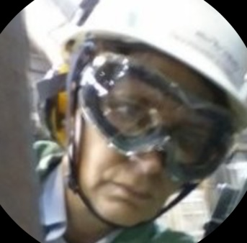
“NOT ALL GLASS IS THE SAME”
Specialty Glass for Molten Metal
By Jane MacPherson
HISTORY OF MACPHERSON AND COMPANY
When to use a molten metal glass specialist or local glazer
Different layer types of safety protection glass
Different types for industrial heat shield glass
Heat reflecting coatings & advantages /disadvantages uses
LEXAN verses Glass for Impact safety
Different Impact EXPLOSION Protection Glass
Window Systems built for impact explosions
Notes:
Official title listed “Radiant Energy Heat Transfer as it pertains to Safety Glass and rolling Blue shield

Slide 2
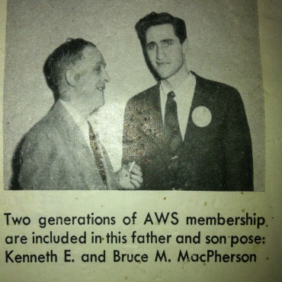
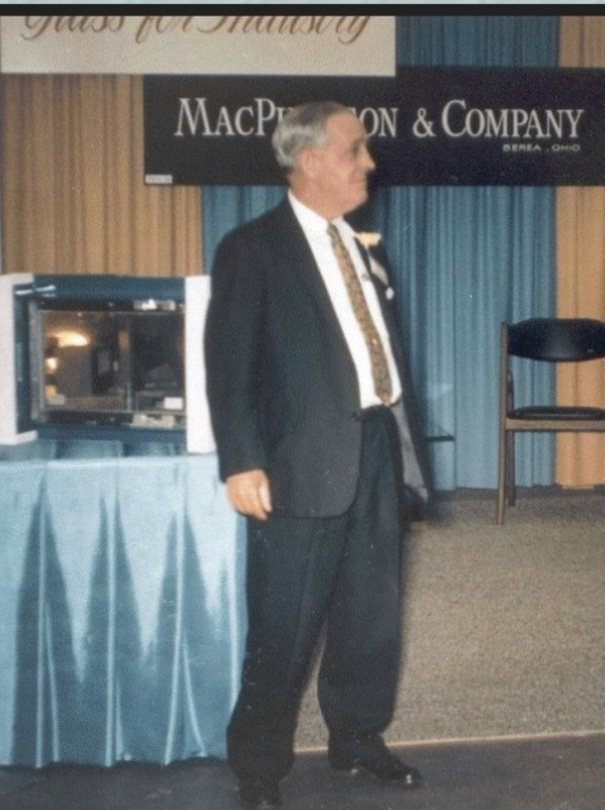
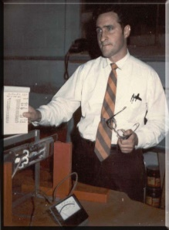

HISTORY OF MACPHERSON & COMPANY
Kenneth Sr & Bruce M. MacPherson
Kenneth MacPherson Sr. started
ALLWELD Welding, 1920s
1st independent Lincoln Electric Weld Shop in Cleveland Ohio
Kenneth MacPherson Sr. cira. 1967
Bruce M MacPherson cira. 1967
Research Engineer, Atomic Energy Commission
1958 Designer on the Polaris Missile
1968 Introduced Explosion Resistant Glass to US
1969 Started MacPherson Engineering
1969 started to work to design window systems with manufacturers for safety window designs
1970 Developed SAFE-SHIELD Glass
1972 ASME Crane Safety Standards
1999 MacPherson Engineering bought
MacPherson and Company
Ken MacPherson Jr
1965 Incorporated MacPherson and Company
Notes:
1920 First weld shop in the City of Cleveland OH
Both Bruce and Ken were certified welders by age 12
1930 portion of the building was rented out a glass glazer, when that man went out of business, he left everything in the building.
Both Ken and Bruce learned to make and install residential and commercial windows as well as weld all through high school.
Ken was a Korean War vet while Bruce was already in Engineering School when the war broke out.
Afterwards Ken got a degree in business and became a sales rep for a glass company.
In 1964 he separated from that company to start his own, then incorporated MacPherson & Company in November 1965.
Bruce served on the Atomic Energy Commission with Oppenheimer, Rocket scientist recognized by President Eisenhower.
Bruce was the first to develop explosion resistant glass here in the USA (Hoogovens) based on research from the Dutch
When Ken and Bruce realized having the impact glass alone wasn’t enough, Bruce started MacPherson Engineering, working with crane manufacturers developed explosion resistant window systems. Using Bruce’s knowledge from working at NASA, chemical formulas, SAFE-SHIELD glass was developed in 1970.

Slide 3
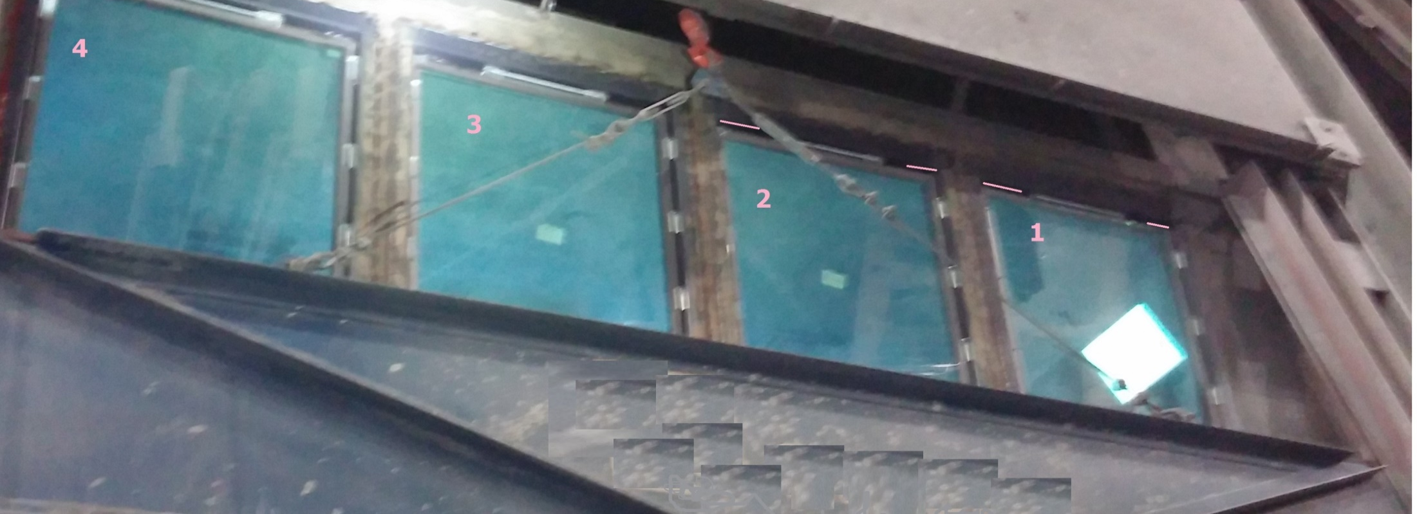
Bruce M. MacPherson’s R&D was the first in the USA for impact glass products for molten metal explosions protection
MacPherson Engineering Inc.
now dba MacPherson & Company
  Today MacPherson continues to be window &
  glass innovators for molten metal safety.
Kenneth Jr started MacPherson and Company as a supplier of BPS glass for industry to reduce the radiant heat transfer into cabins in molten metal operations. Bruce added Engineered Safety Window Systems
Notes:
Properties and strengths of metals I learned from the university. Properties and strengths of glass I learned from my dad.
You will need to keep your local glazer for all your non impact cold operations
Any industrial type impact operations or molten metal operations with or without impact will need engineered window systems.
In some cases, the local glazer can order the specialty glass from the industrial window supplier then repair and replace the specialty windows locally depending on the location to the manufacturer more economically than buying new spare windows.
Locally sourced windows require a professional replace the glass.
Industrial window systems are engineered to utilize spares that so non-professional can change the windows – giving options for glass replacement using “spares”.
1 order new spare
2 order new glass for the spare and replace glass on site with a Philips-head screw driver
3 Replace existing with a fresh spare and send used window to local glazer to replace.

Slide 4
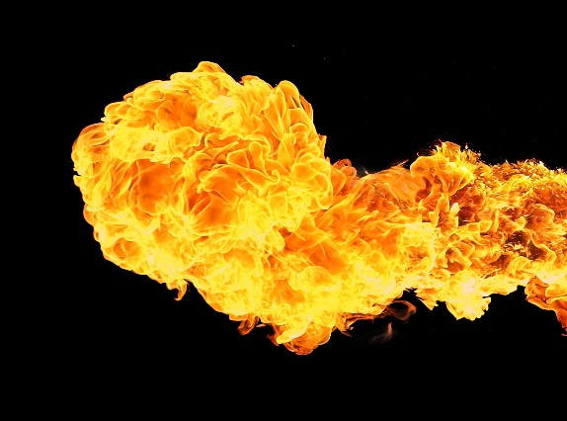

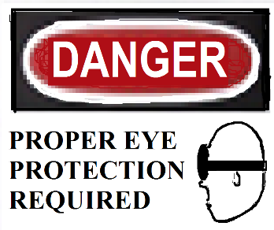
SAFETY GLASS LAYERS OF PROTECTION
Heat Shield, Infra-Red Reflecting (IRR) Glass is the first layer of safety by cutting the radiant heat energy transmitted
IMPACT Resistant, is the middle layer of safety to prevent penetration of molten metal reactions from touching operator
GLARE SHIELD is the layer closest to the operator that cuts the damage of radiant glare on the eyes
OPERATOR
GLARE
IMPACT
IRR
MOLTEN METAL
Notes:
Discussion topic 3 items –
Closest to the heat is heat shield protection layer often called the expendable window / glass – usually comparably inexpensive
Behind the heat shield is the Impact Protection layer – usually always protected by heat shield glass or comes with a heat shield
Closest to the operator is the glare shield - picture of yellow represents the white light Glare Shields prevent eye damage

Slide 5
Infra Red Reflecting (IRR)
COATING ARE ALWAYS SUGGESTED ON
THE HEAT SIDE PROTECTION LAYER
3 Main Types of
Heat Reflecting Glass
Soda Lime – 95% world wide
Borosilicate – refrigerator shelves
Glass Ceramic – fire place glass
Notes:
SUGGESTED HEAT SIDE LAYER is Infra Red Reflecting (IRR) Coating
Main types of Infra Red Reflecting (IRR) glass
Soda Lime – Borosilicate - Glass Ceramic

Slide 6
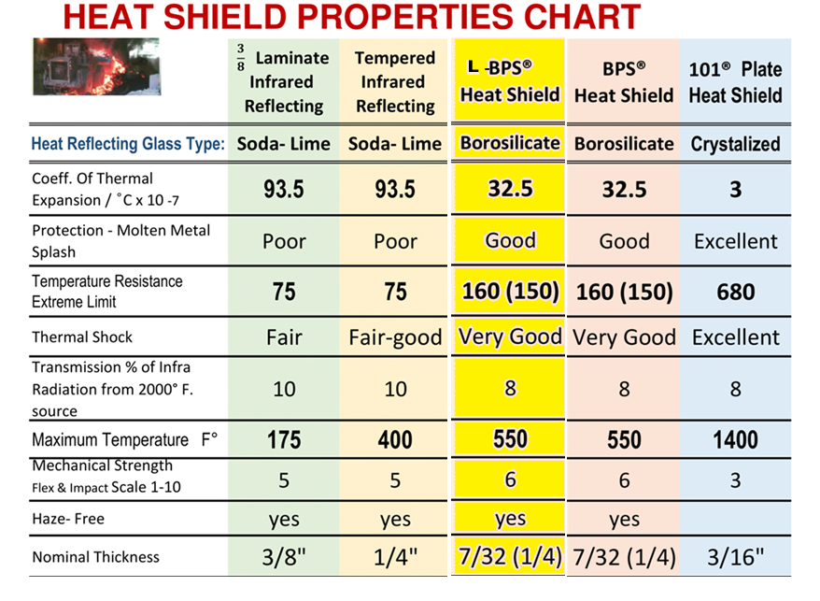
Value is based on the application
Lowest cost
2 x soda lime
40% more BPS
Notes:
The sustained temperature of fracture of the Soda lime is 400F for tempered glass
Annealed Soda lime is 350F
– Soda lime is suggested to be more than 50 feet away because SLAG CAN NOT BE SCRAPE OFF THE GLASS
BPS 550F – best for clarity and less eye strain, applications - splatter CAN BE scrape off and leaves minor chips in the glass like stone chips on car windowshield
101 Glass Ceramic 1400F used if BPS fails same - splatter CAN BE scrape off
For hot applications Temperature Resistance Extreme limits become critical in the decision of what glass to use.
Off this chart for less than 10 feet away is Quartz Glass that is not coated with IRR coating but is scrapable no application for this in the slag industry

Slide 7
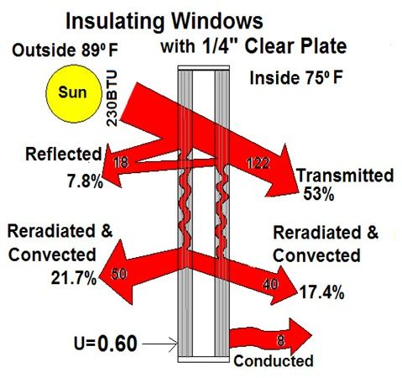
Glass without IRR
First layer of safety is on the heat side of the windows
Cutting the radiant heat energy transmitted through the glass
Has a Total Heat gain of
170 BTU or 74%
Notes:
Compare two layers of non-IRR glass will still cut 53% of the transmitted radiant heat

Slide 8
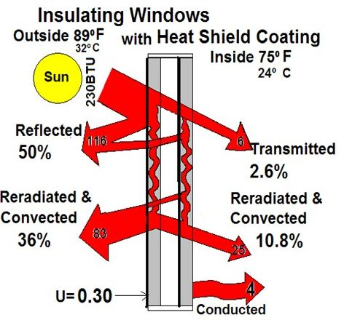
Glass with IRR
Has a Total Heat gain of
35 BTU or 15%
Affects are 60 % savings on the workload of the air conditioners
Reduction of transmitted radiant heat transfer into cab
Reduces operator fatigue, eye strain & headaches
Decrease operator errors and increases safety
Notes:
Compare two layers glass both IRR glass will cut more than 97% of the transmitted radiant heat which
Affects are 60 % savings on the workload of the air conditioners
Reduction of transmitted radiant heat transfer into cab
Reduces operator fatigue, eye strain & headaches
Decrease operator errors and increases safety
Even One layer of regular glass and one layers glass with IRR glass will still cut more than 70% of the transmitted radiant heat

Slide 9
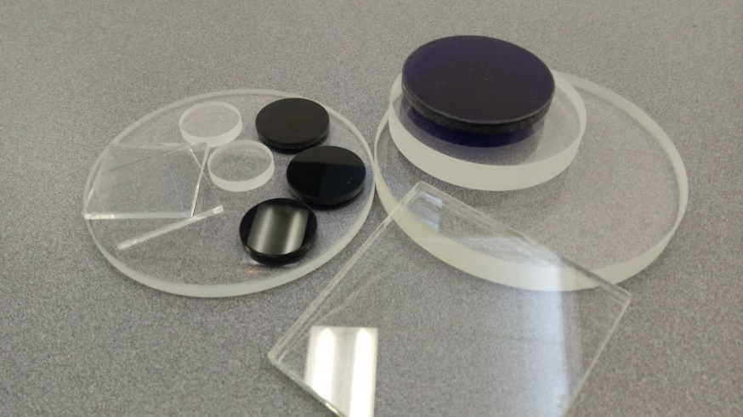
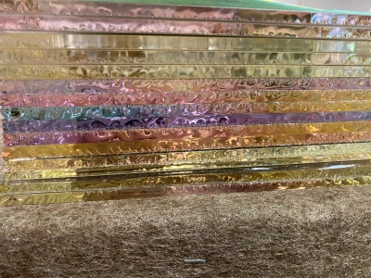
Glass is not a solid
Glass, however, is actually neither a solid or nor a liquid —supercooled.
It is an amorphous solid—a state somewhere between those two states of matter. And yet glass's liquid-like properties are not enough to explain the thicker-bottomed windows, because glass atoms move too slowly for changes to be visible.
Glass Surface is in compression
and interior is in tension
Notes:
Room temperature Glass is closer to a liquid state than a solid so it is amorphous solid
Glass Surface is in compression and interior is in tension which lends to the flexibility

Slide 10
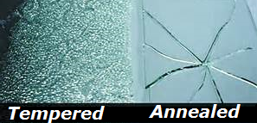
Tempered Infrared Reflecting Glass
  Tempered Glass breaks in safety pattern
  Reflects radiant energy from wide band
  Serviceable up to 450°F. ambient temperature as measured at the glass
  Annealed Glass cracks begin after ~ 300°F
  And Tempered Glass begins after ~ 400°F
Notes:
95% of all glass you come across in your life will be Soda Lime
Annealed soda lime glass is not safety glass because of the way it breaks unless it is part of a laminated than it becomes a safety glass because the lamination holds the glass in place when broke
Tempered Glass breaks in a dice pattern.
Car windshield is laminated and the door glass is tempered.

Slide 11
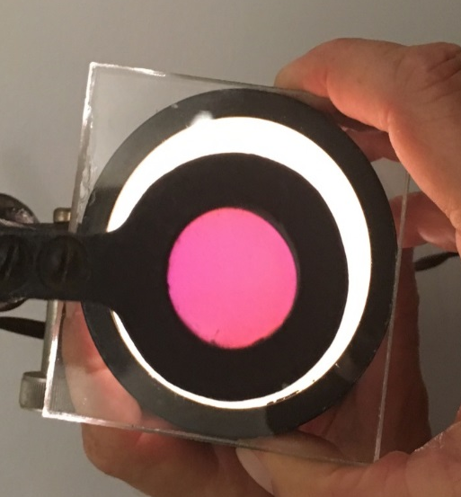
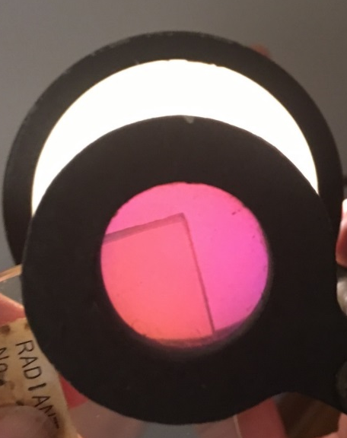
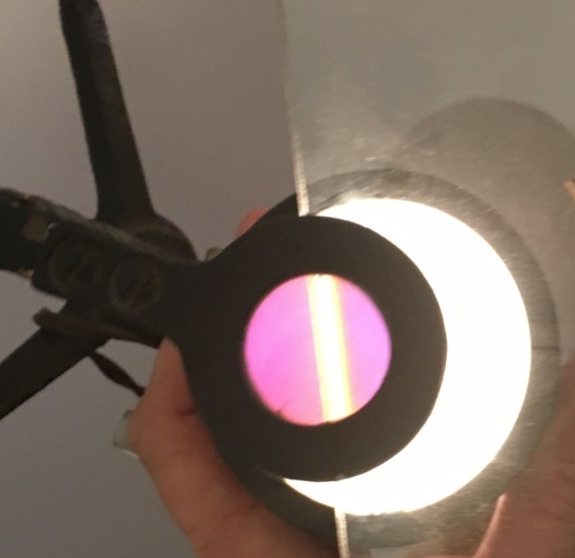
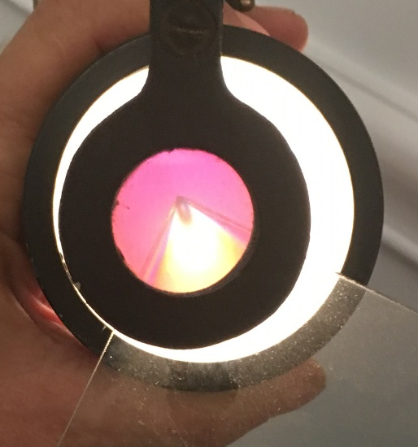
Glass seen under Polarizer
ANNEALED vs TEMPERED
Tempering is a heat treat process with a controlled quench which cools the outer surface quicker than the interior. This creates a mechanical tension in the interior and compression of the outer surface.
There is very little tempering around the edges. Therefore it is suggested to have frames around the glass to protect the edges
ANNEALED
TEMPERED

Slide 12
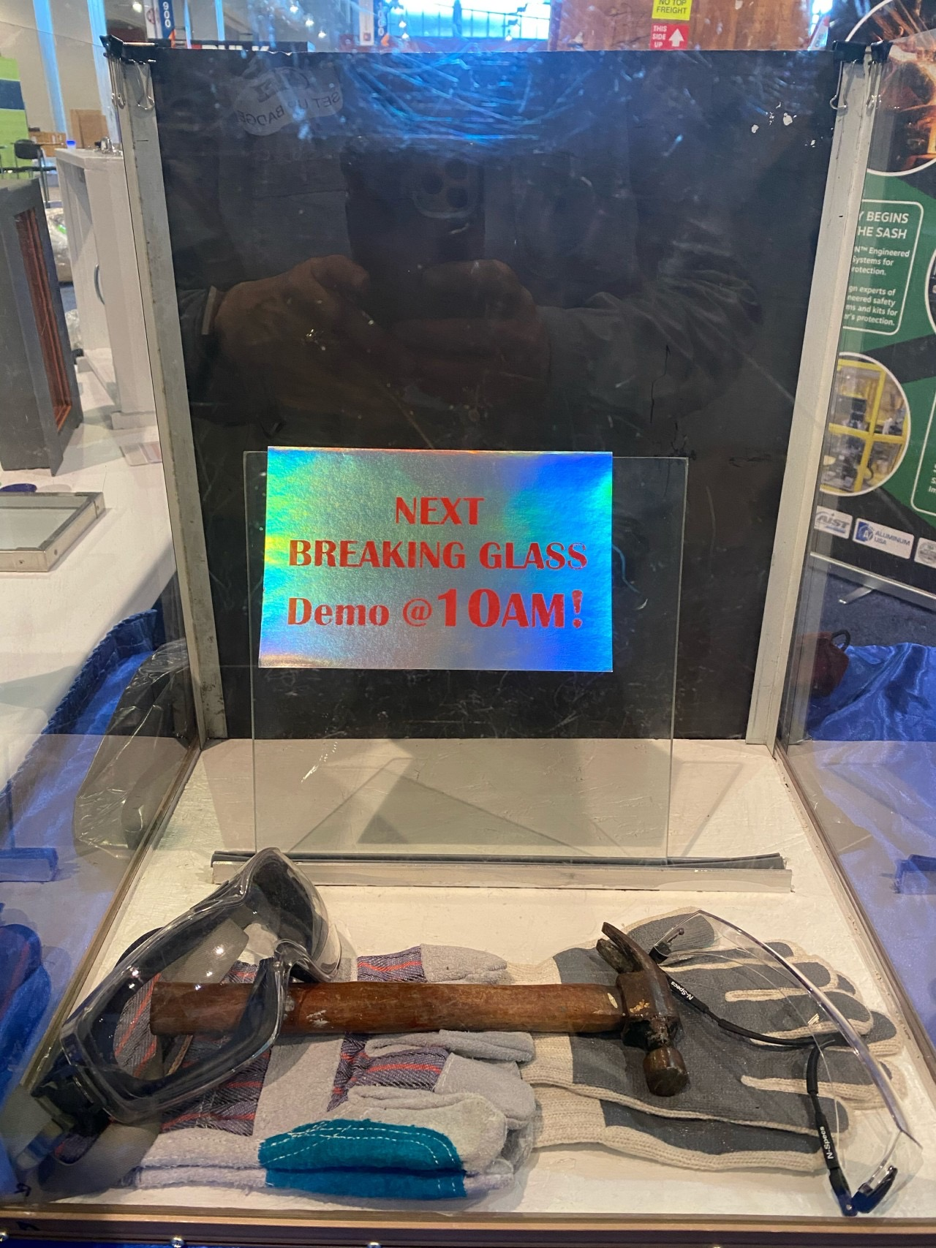
BREAKING GLASS
Notes:
Note in an example of how delicate the tempered edges are
the hammer can pound on the center of the glass all day without breaking
Slight tap on the unprotected edges will instantly cause the glass to crumble

Slide 13
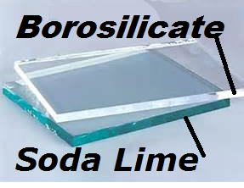
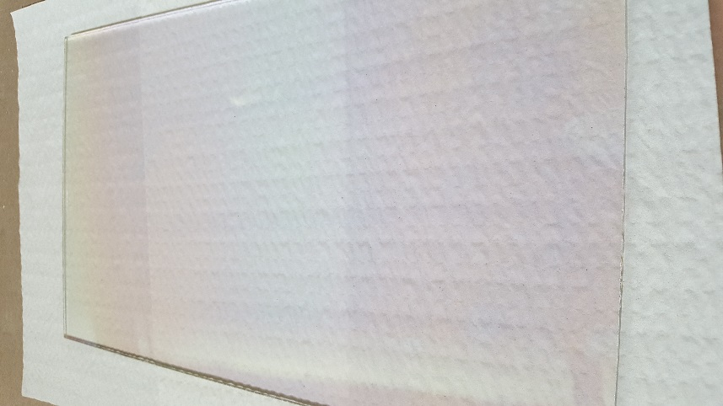
BPS® Borosilicate Heat Shield – outer Pot carriers
  Temperature Resistance Extreme Limit is 160°F it is very good thermal shock resistant
  Also reflects the wide band energy
  Coefficient Of Thermal Expansion / 32.5 ͦC x 10 ⁻⁷
  Does not break in safety pattern – not a safety break glass
  Serviceable to 550°F.
Notes:
You can tell the difference between common (soda lime) glass and the BPS glass when looking at the edge
soda lime has a light blue green/ aqua color - BPS has clear edges or picks up the color of the material it is closest
Borosilicate is used in coffee pots and beakers, where you can take the hot coffee pot and put cold water in it – and the glass doesn’t break.
BPS is scrapable - Unlike Soda Lime is does not break in a safety dice pattern.
Therefore, if it is needed in an overhead operation like crane than you need it to be a laminate
MacPherson & Company’s latest product developed is the L-BPS/HS which is a 1/4" laminated BPS Heat Shield product
101 Glass has an amber tint to the edges, it is scrapable - does not break in a safety dice pattern. No laminate yet to withstand the heat that the 101 can withstand therefore there is no laminate to make it a safety glass. 101 Glass is best for loaders.

Slide 14
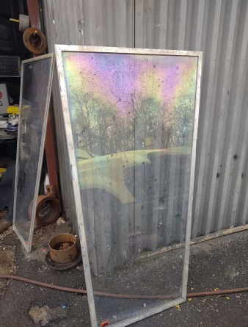
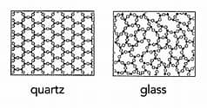
IT HAS BEEN REPORTED TO US BY THE END USERS THAT BPS HOLDS UP BETTER UNDER SPLATTER & IMPACT EVENTS
The reasoning is: Soda lime BPS
The molecular surface of soda lime glass is more porous and softer, therefore, when you scrape off splatter there are deep noticeable craters on the soda lime glass that obscures sight making it unusable.
The molecular surface of the BPS glass is denser and harder, therefore, when you scrape off splatter there are less noticeable craters in the glass. This allows better clarity and operations can continue without replacing.
Used glass after impact event

Slide 15
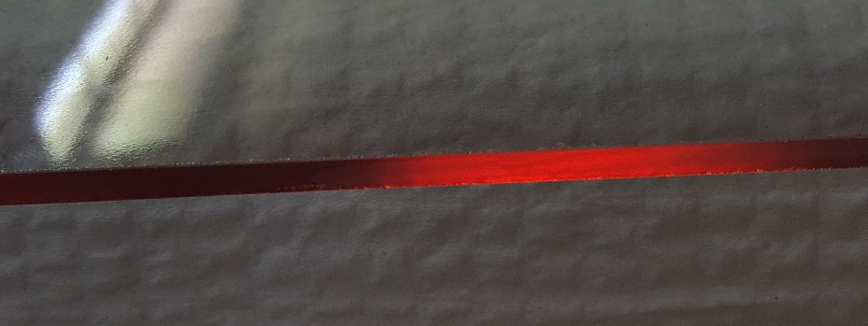
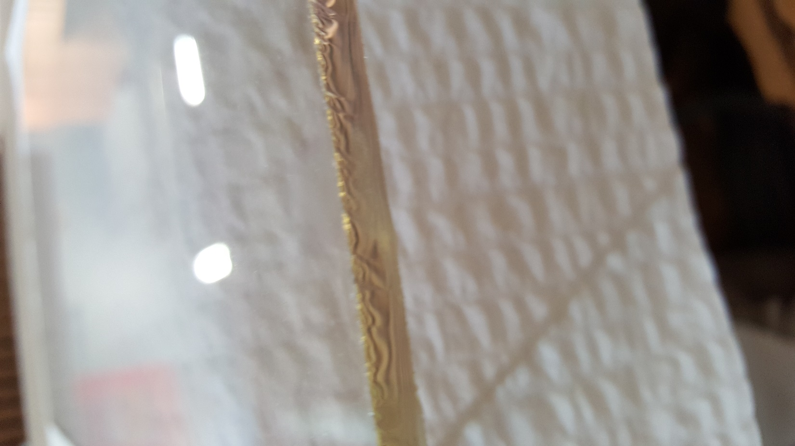
101 Glass Heat Shield (Glass Ceramic/Crystalized)
  Temperature Resistance Extreme Limit is 680 Superior thermal shock - Coeff. Of Thermal Expansion / 3 ͦC x 10 ⁻⁷
  Reflects the wide band energy
  Serviceable to 1400°F.
  Does NOT break in safety pattern

Slide 16
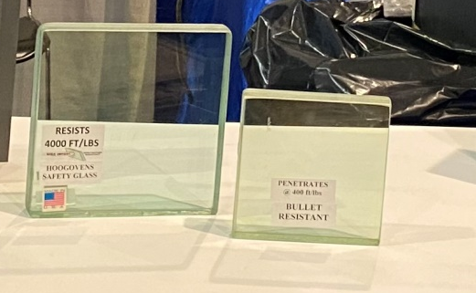
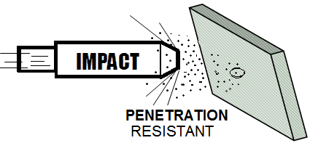
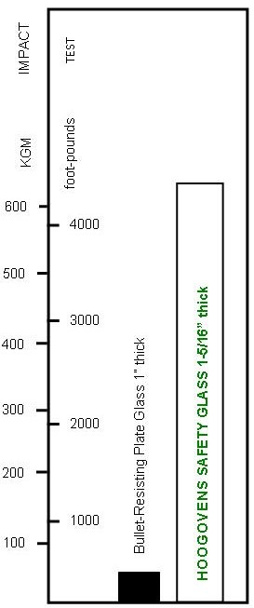
IMPACT LAYER OF PROTECTION
Bullet Resistant fails at 400ft/lbs verses same thickness HOOGOVENS tested for over 55 years, over 4000ft/lbs without penetration
REPLACEMENT WINDOWS
MEET OR EXCEED
UL752BR LEVEL 5
HOOGOVENS Industrial Impact Safety Glass
  Tested in use on 6 continents with no penetration
  Does not have reflective surface
  Heat resistant interlayer
SAFE-SHIELD Impact Glass with IRR
  Provides additional layers of IRR
  Heat resistant interlayer
HS-Impact Glass with IRR and Spall Shield
  Provides additional layers of IRR & Splatter Scrapable
  Heat resistant interlayer
Notes:
Known testing of HOOGOVENS; Netherlands – Australia – USA
Known testing of SAFE-SHIELD Cleveland and Mingo Junction

Slide 17
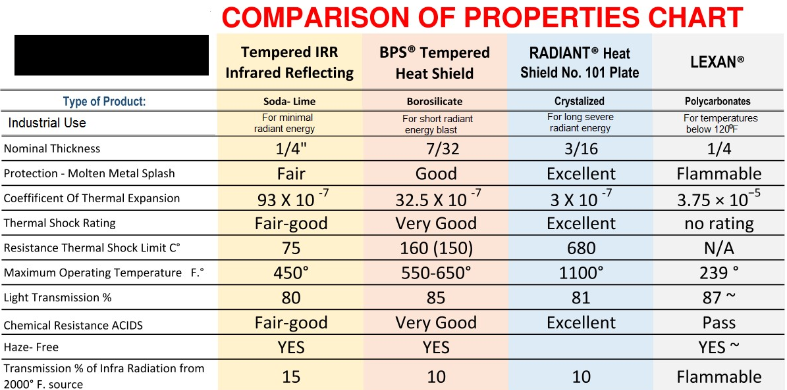

LEXAN verses glass
LEXAN is 125% stronger than glass under 120$°$F
LEXAN at molten metal temperature becomes a flame thrower.
Notes:
Lexan is a polycarbonate (PVB) and type of safety glass that is not recommended in hot metal or steelmaking applications.
Lexan is a polycarbonate that offers the highest impact strength of any transparent product with over 250 times the impact strength of glass in equal sheet thickness. The Vicat softening temperature, rate B/120 145°C (295°F) and deformation begins around 120°F. Most steelmaking applications’ ambient temperature often is above those temperature.
Therefore, Lexan is not ideal for hot metal glass even for the explosion-resistance safety layer.

Slide 18
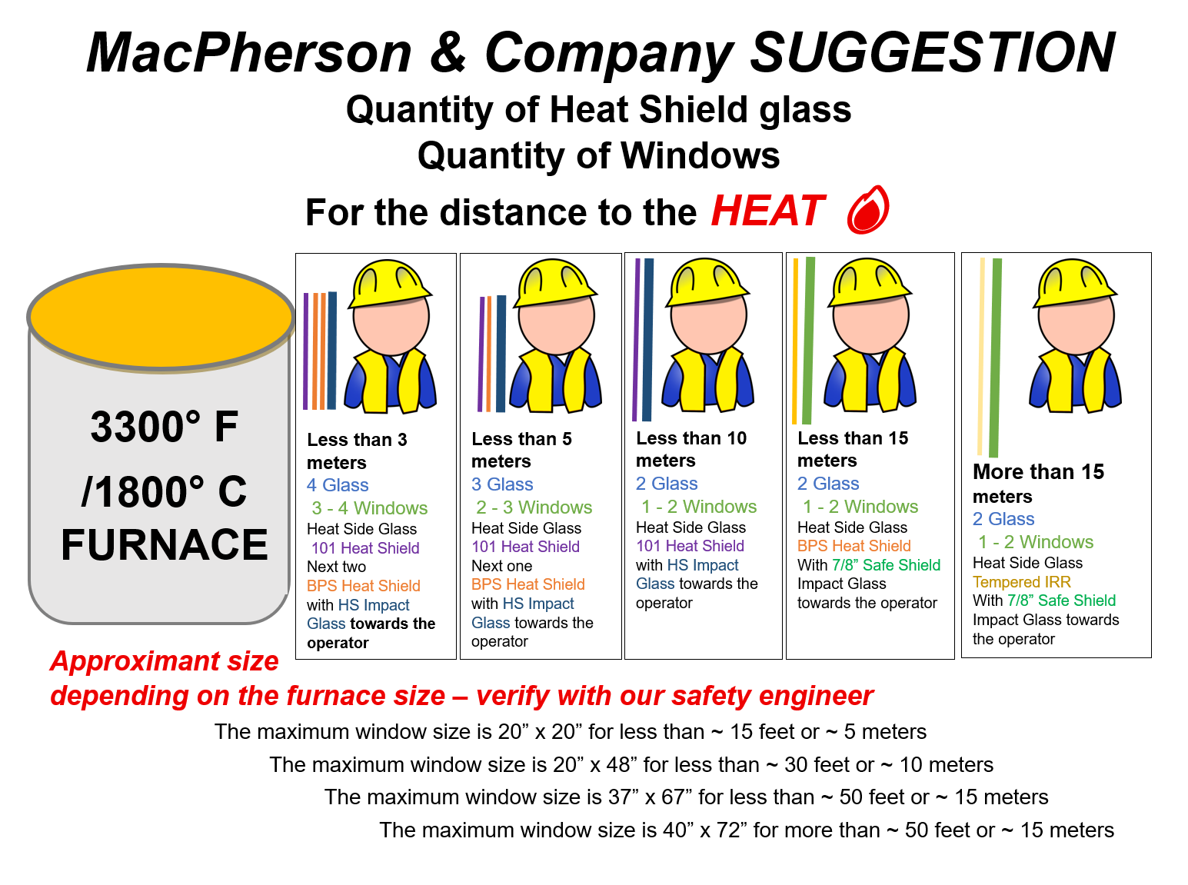

Slide 19

Most casement window sash are made of plastic or wood
IT IS NOT ENOUGH to just have the glass to take these kind of severe impacts,
THE SASH MUST BE
securely attached to a sound structure to be effective. These extreme thermal areas need a strong metal sash!
Notes:
Sash/ outer frame

Slide 20

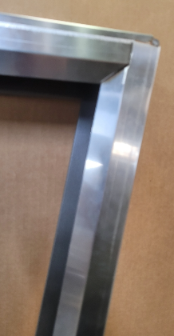
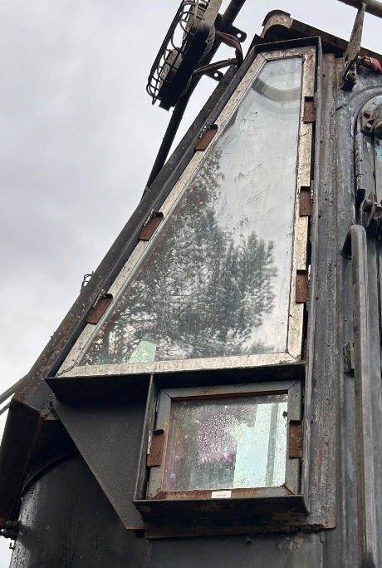
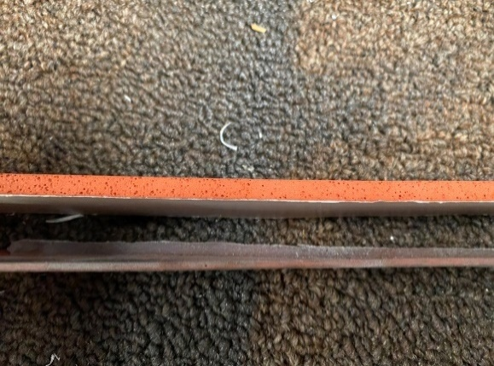
SASH DESIGN FOR MOBILE HOT METAL EQUIPMENT
All sash should be engineered for:
Extreme Heat
High Impact
Vibration Dampening
Noise Reduction
EASY-RELEASE®
Thumb-Push Wedge-Lock
Spring Retainers - equal pressure
Wedge-Lock
Thumb-Press Retainers
Tool-free thumb-press tightening for
fast, easy changing of windows.
InfraRed Reflecting (IRR) coating has an iridescent sheen and is highly directional. Each side is clearly labelled – look for the orange label on the heat-facing side.
Retainer Guards around the center sash to protect the wedges and aids keeping the dust out of cab and between the windows
Silicone Gasket Sealing
Helps keep heat & dust out
Serves up to 550° F. exposed ambient
R&D is always working to improve the products we offer!
In use one year
Used BPS/HS glass after impact
2024

Slide 21
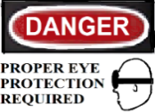
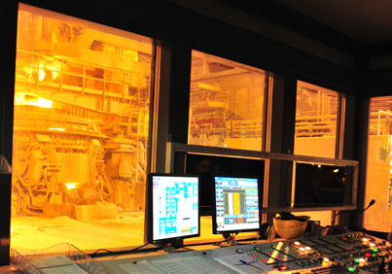

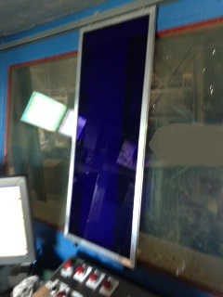

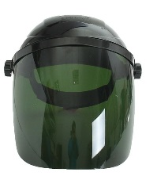
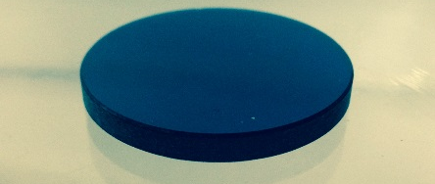
WHY GLARE SHIELDS
Retractable Pull-Down Shade uses are for full window covering
ADDED LAYER OF SAFETY
Traditional mounted
FIXED BLUE SHIELDS
Glasses
SEALED
ROLLERS
& TRACK
for dust
ROLLING GLARE SHIELD
Full Shields
HANDLES
TARGETED EYE PROTECTION BEWTEEN OPERATOR AND MOLTEN METAL
BUT STILL ALLOWS OPERATOR TO SEE ELSEWHERE
Notes:
Not recommended in slag operators

Slide 22
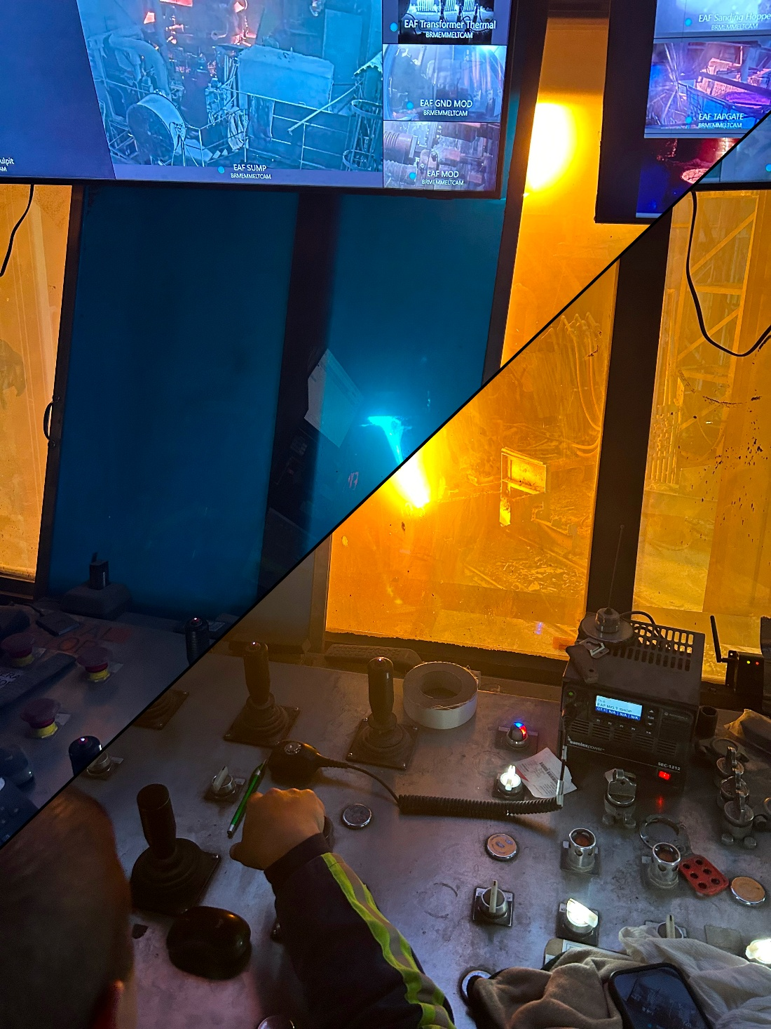
STEEL MAKING BLUE
Also comes in
STEEL MAKING GREEN
MOLTEN
METAL

Slide 23
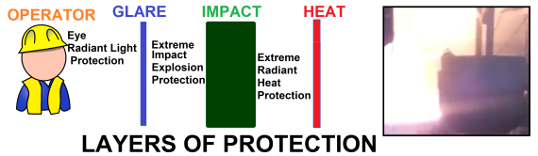
IN REVIEW
WINDOW LAYERS
OF PROTECTION
OPERATOR SAFETY
Notes:
RECAP

Slide 24
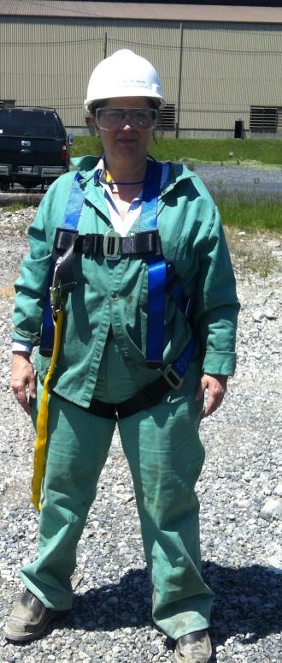
“NOT ALL GLASS IS THE SAME”
Specialty Glass for Slag operations
By Jane MacPherson
QUESTIONS?
MacPherson Engineering Inc.
dba MacPherson and Company
MacPhersonGlass.com
Phone: 440-243-6565
Email: sales@MacPhersonGlass.com
Keywords: Radiant, Safety Glass, Impact Protection
Recognition: Bruce M. MacPherson impact glass R&D pioneer

