Slide 1




Scott McCormick, Chairman, WOMBATT Fatigue Management
Filiberto Morales, V.P. Operations, TMS International
National Slag Association Conference | September 15th to 18th , 2025, Naples, Fl.
© 2025 Confidential

Slide 2

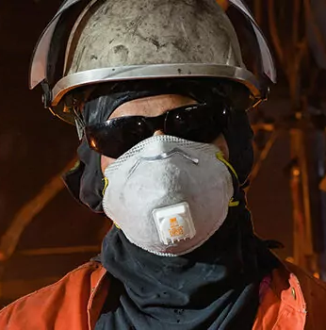
FATIGUE: CHALLENGES IN INDUSTRY
Fatigue causes 13% of industry accidents NSC, 2025
Economic Impact: $US 136.4 B annually from fatigue-related incidents in industry Link
High Risk Tasks: Mobile equipment, furnaces, and very often, 12-hour shifts
Traditional fatigue management methods: self-reports, cameras, and wearables lack predictive power.
Fatigued workers are up to 62% more likely to be involved in accidents than are non-fatigued workers. Safe work Australia, NSC Report
© 2025 Confidential

Slide 3

COGNITIVE AND PHYSIOLOGICAL EFFECTS OF WORKPLACE FATIGUE
Cognitive effects: Impaired judgment, reduced focus, and increased mental errors.
Physical effects: Slower reaction times, diminished coordination, and compromised metabolic health.
Examples: Overlooking safety hazards, taking unnecessary risks, and endangering themselves and others.
© 2025 Confidential
Notes:
Consider how our workers normally get into an accident because of bad decision making. The bad decision making is exacerbated due to impaired judgment and reduced focus caused by fatigue.

Slide 4
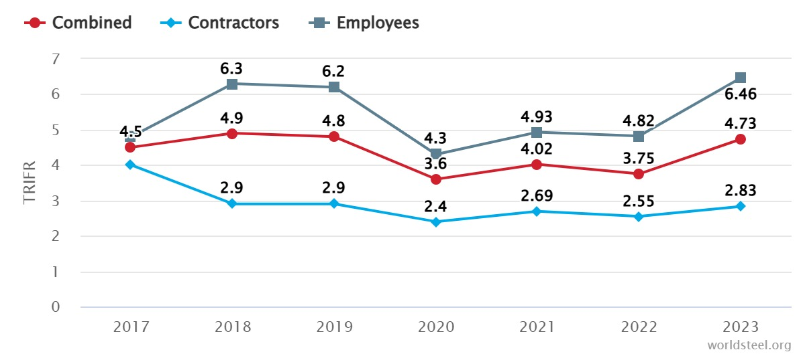
FATIGUE: CHALLENGES IN INDUSTRY
Total recordable injury frequency rate 2017 - 2023
Total recordable injury frequency rate increased from 3.75 in 2022 to 4.73 in 2023. In 2023, there were 61 fatalities reported to Worldsteel. Link
© 2025 Confidential

Slide 5
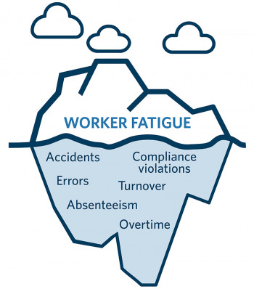
FATIGUE: PROBLEM AND SOLUTION
Problem
Fatigue is a significant accident cause in industry. Over 43% of workers are sleep deprived National Library of Medicine
Current solutions (reaction tests, wearables, cameras) face adoption barriers due to privacy concerns (Work to Zero NSC program)
Solution
Voice Tech: The coming age of voice technology, Predictive and non-invasive Tobias Dengel
WOMBATT-VOZ: Voice Tech fatigue solution adapted from European Space Agency (ESA), Mars 500 astronaut fatigue monitoring program. ESA Mars 500
© 2025 Confidential

Slide 6
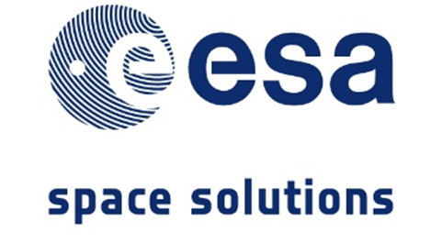


ORIGIN OF WOMBATT VOICE AI TECHNOLOGY POWERED BY ARTIFICIAL INTELLIGENCE
Developed for the European Space Agency’s Mission to Mars
Astronaut fatigue is a top 5 safety risk in Space
90% accuracy validated in astronaut testing
Accepted for use in Space
Space Technology
Mission to Mars
ESA Mission to Mars
Reduced mission risk
© 2025 Confidential

Slide 7
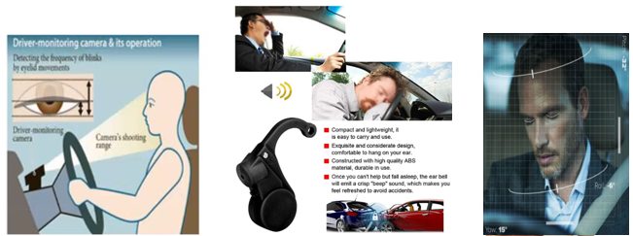
FATIGUE DETECTION PRINCIPLES AND METHODS
Conventional fatigue detection technologies identify fatigue only after it has occurred. They do not provide predictive capabilities, merely reporting an event after is has happen, which limits their effectiveness in preventing incidents. Additionally, these systems are often intrusive, uncomfortable, and poorly received by workers and labor unions.
© 2025 Confidential

Slide 8
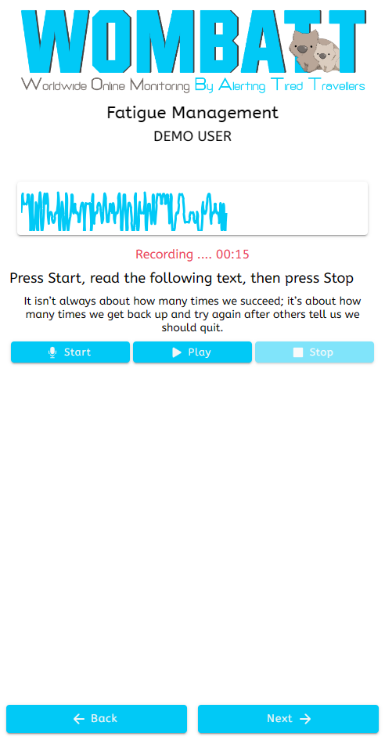
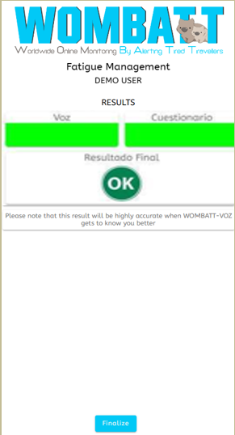
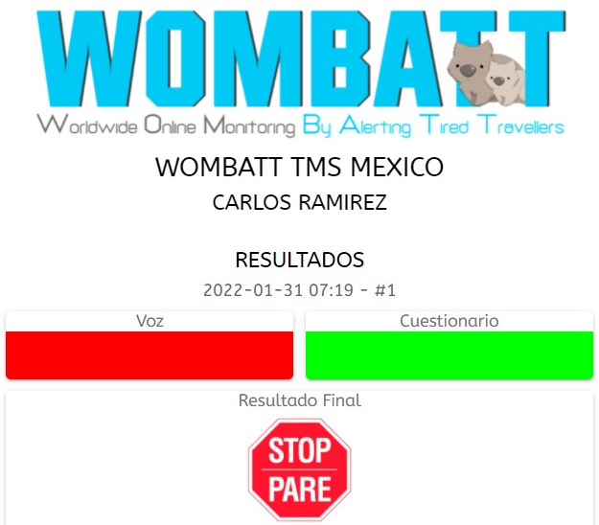

HOW DOES IT WORK?
or
Use the mobile device with the Wombatt-Voz app.
Record 8 to15 second voice sample, three times per shift. It only takes about one minute per day.
Results are delivered within seconds.
Green: You are cleared to work.
Orange: You may continue working, but follow-up is required.
Red: You must contact your supervisor for further instructions.
© 2025 Confidential

Slide 9
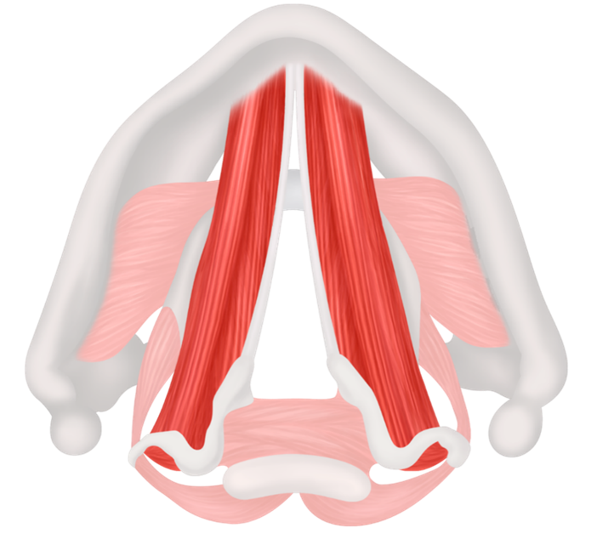

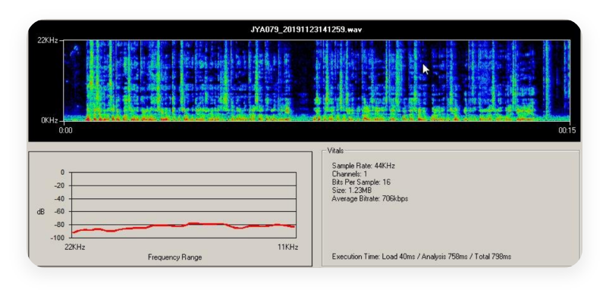
USING WOMBATT VOICE TECH FATIGUE PREDICTION
Wombatt voice technology can predict fatigue before it occurs, enabling proactive intervention and preventing potential incidents.
AI-powered fatigue prediction, up to 5 hours in advance
Analysis of 200+ fatigue-related voice frequencies and multiple vocal muscles
Personalized voice modeling for each user
Non-intrusive and hardware-free solution
Compatible with Android, iOS, and Windows devices
Integration available for onboard mobile equipment systems
© 2025 Confidential

Slide 10


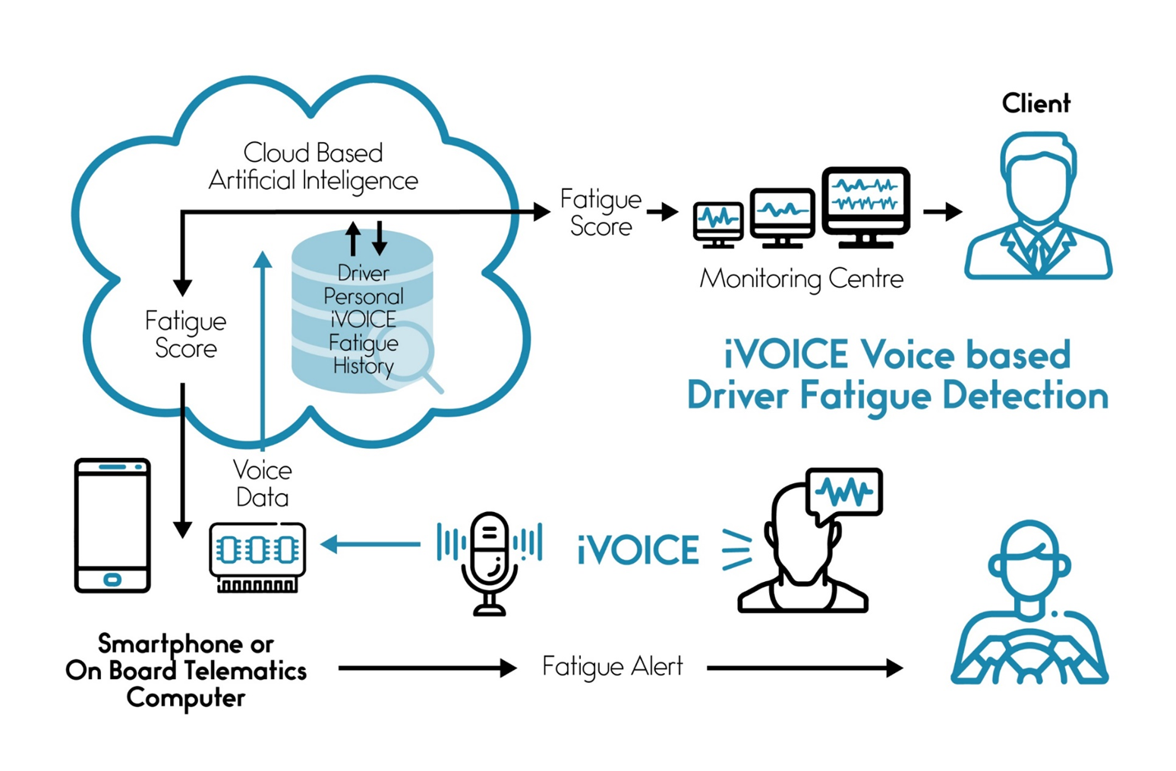

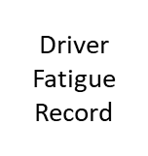


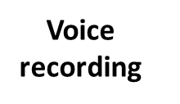

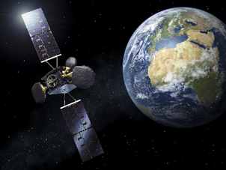

HOW DOES THE SYSTEM COMMUNICATE?
Voice data recorded and transmitted to the cloud
© 2025 Confidential

Slide 11
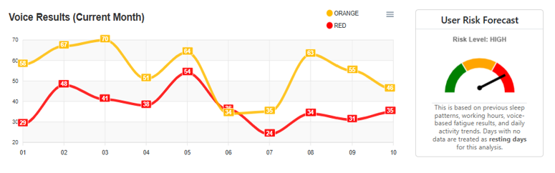
WOMBATT-VOZ DASHBOARD
Instant statistical overview for 15- or 30-day periods
User and group management
Configurable multilingual speech
Real-time online reporting
Instant alert configuration for supervision groups
© 2025 Confidential

Slide 12

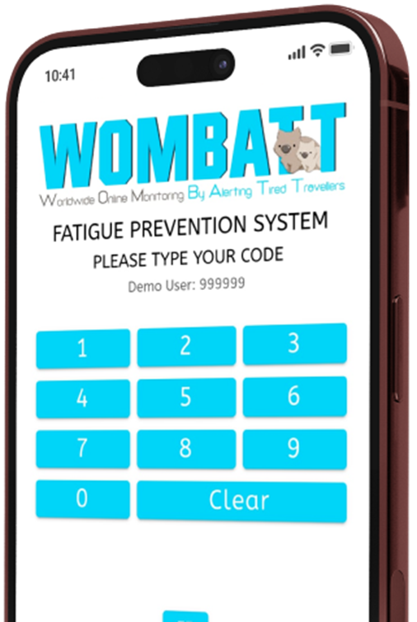
BUILDING A SAFER INDUSTRY
Recap:
Fatigue is a preventable cause of industry accidents.
Impact:
Reducing fatigue saves lives, cuts costs and boosts productivity.
Call to Action:
Implement fatigue management protocols, install the latest AI Voice-Based fatigue prediction technology and prioritize worker well-being.
© 2025 Confidential

Slide 13

FATIGUE MANAGEMENT
REAL LIFE APPLICATION CASE
© 2025 Confidential

Slide 14
FATIGUE MANAGEMENT: BENEFITS FOR SAFETY AND PERFORMANCE
“When staff are well-rested, they make better decisions are more alert and
reduces the risk of safety incidents.” Carlos Ramirez / TMS International
© 2025 Confidential

Slide 15
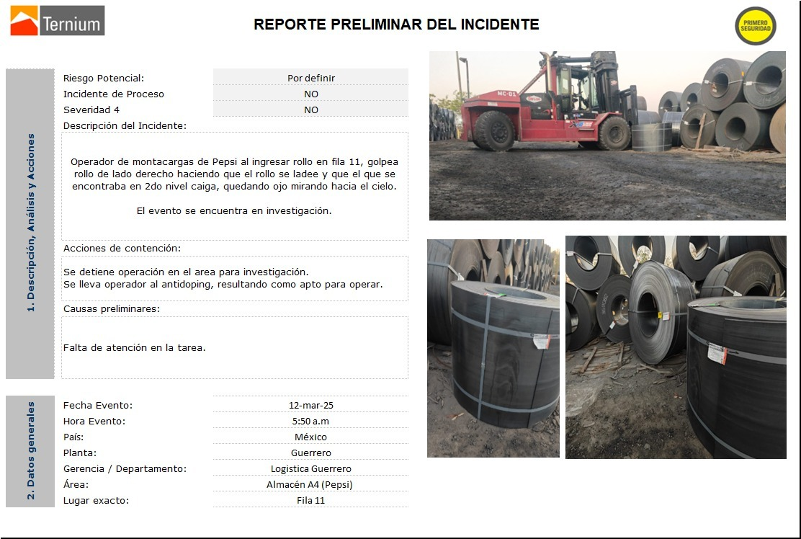
ACTUAL INCIDENT CAUSED BY FATIGUE
An operator fell asleep while driving a 65,000-lb forklift while carrying a 20,000 lbs. steel coil. He kept going and crashed against a pile of coils causing the coil he was carrying to fall and the pile to collapse. His injuries were minor thanks to the use of seatbelt. The incident was classified as a High-Risk with potential for severe damage or fatalities.
The root cause was lack of sleep, since the operator had not slept for 48 hours straight. (new year eve holiday)
After Wombatt implementation, such fatigue risks are now detected before they become an accident thus preventing injuries and equipment damage.
© 2025 Confidential

Slide 16
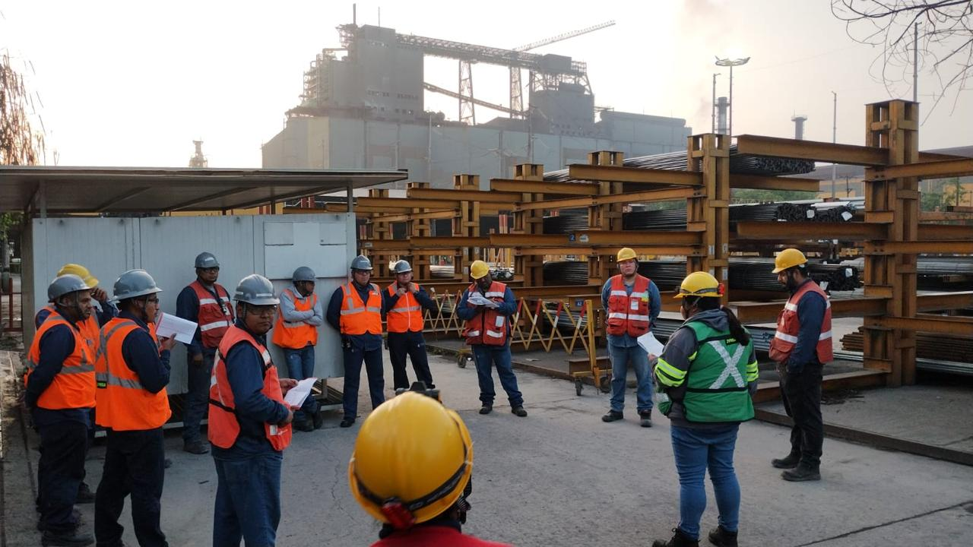
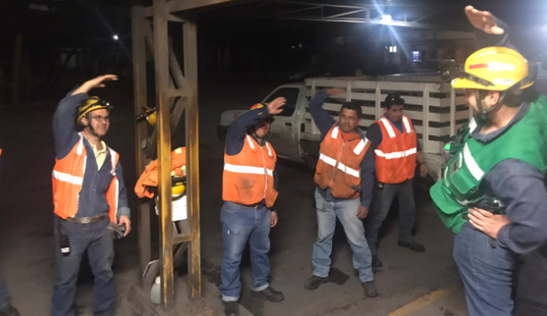
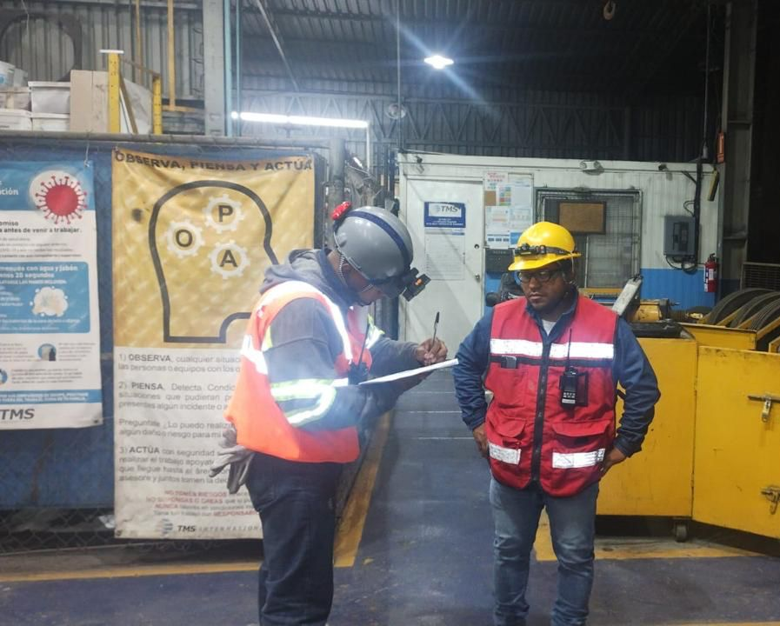
HOW IS FATIGUE MANAGEMENT INTEGRATED INTO DAILY WORK ROUTINES?
DAILY SAFETY TALK
Sharing key safety topics and raising awareness on the importance of proper sleep for health and well-being of operators.
WORKPLACE GYMNASTICS
Calisthenics routines performed at the start of the shift, after lunch, and whenever an operator is identified as fatigued by using Wombatt.
IN PERSON CONTACT PROTOCOL
When an operator shows a fatigued alert, an in-person contact is mandated to decide if they can safely continue working or if other actions like workplace gymnastics should be considered.
© 2025 Confidential

Slide 17


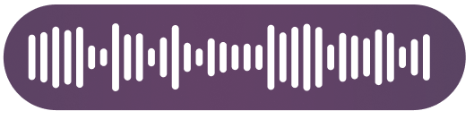
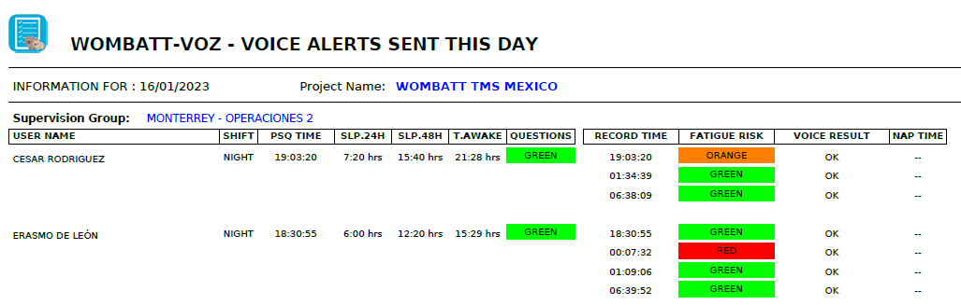
HOW IS FATIGUE MANAGEMENT IMPLEMENTED IN DAILY WORK ROUTINES?
PREVENT
MANAGEMENT DECISION
Contact Fatigue operators on Face-to-Face Protocol
WOMBATT VOICE READING
Operators do 3 voice readings
per shift
CONTROL
DETECT
FATIGUE ALERT
© 2025 Confidential

Slide 18
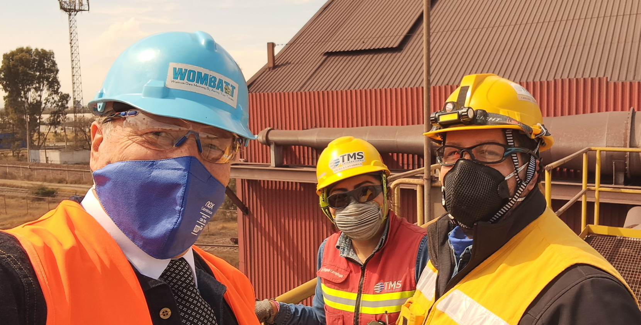
Working together to ensure all employees return home safe each day
QUESTIONS ?
© 2025 Confidential

Slide 19



© 2025 Confidential

