Slide 1

You spoke. We listened.
Purpose-built equipment, delivered on-time
to exceed customer expectations.

Slide 2


Slide 3
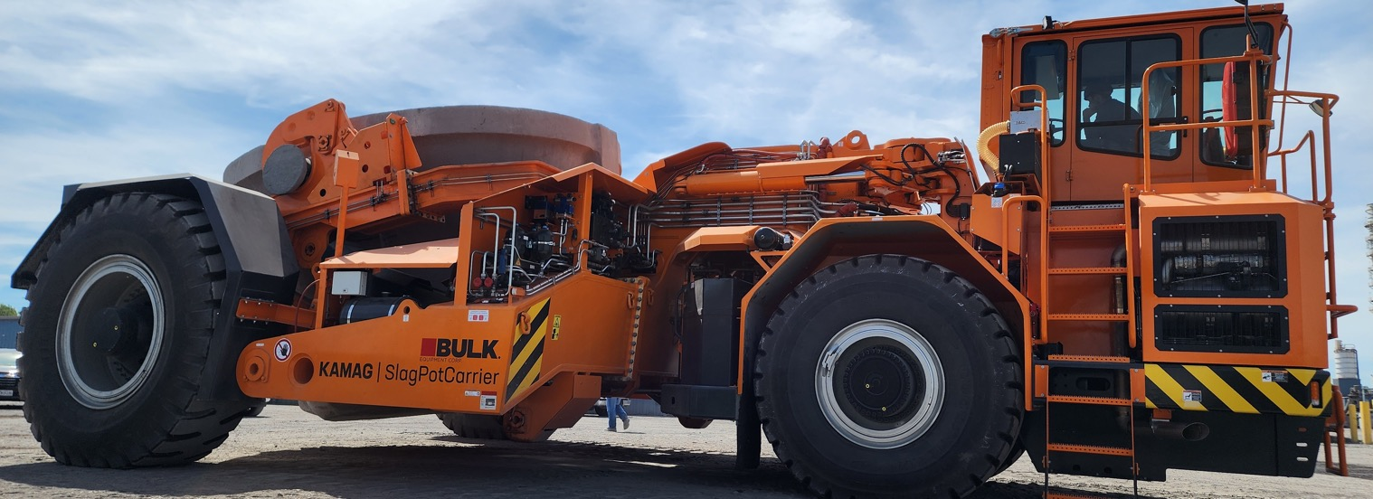
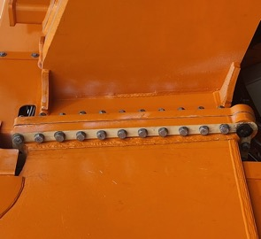
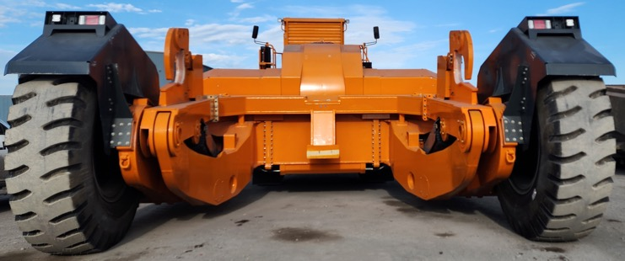
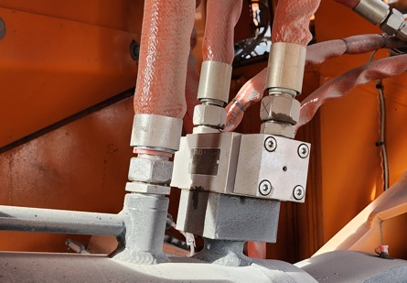
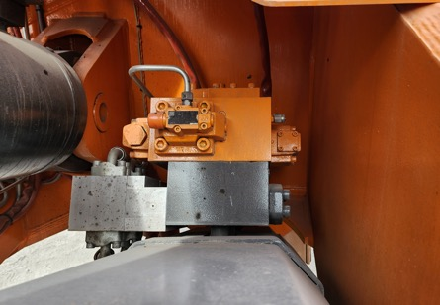
What makes KAMAG pot carriers different?

Slide 4
What happened behind the scenes?

Slide 5
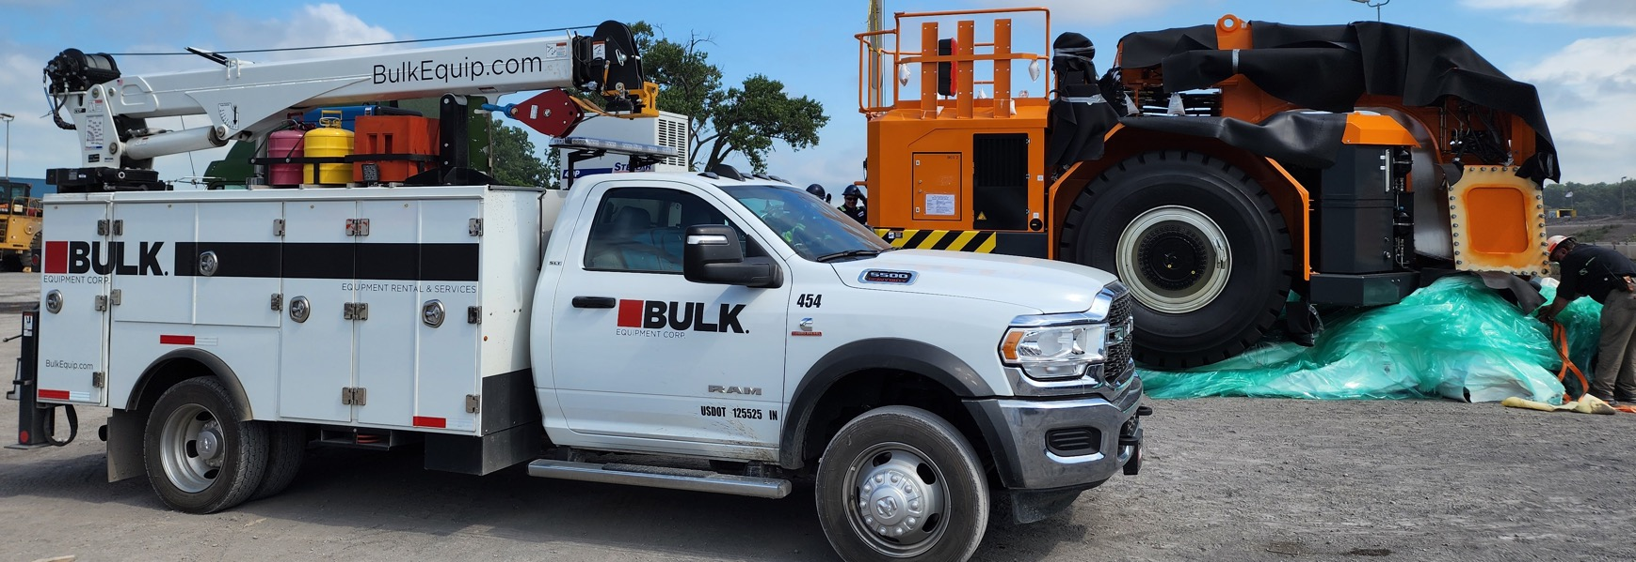
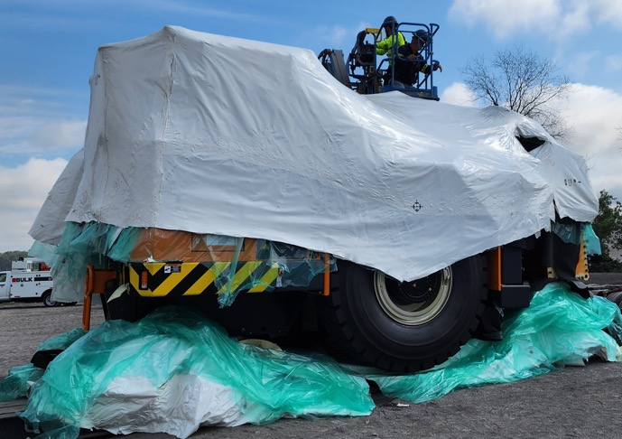
How was shipping handled?

Slide 6
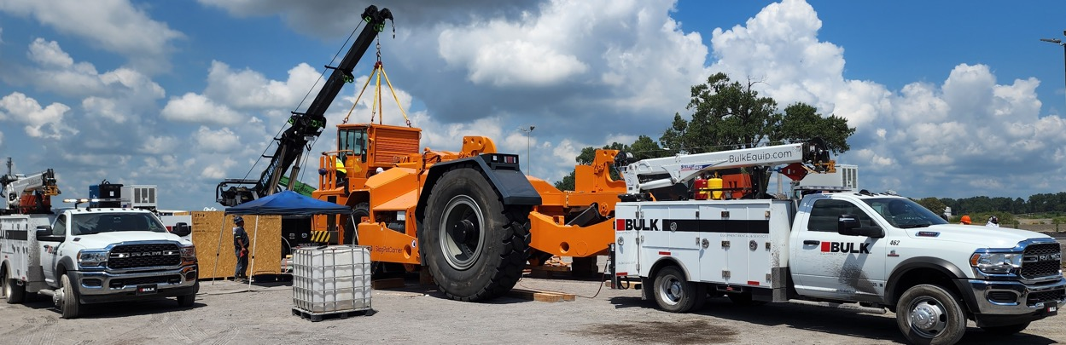
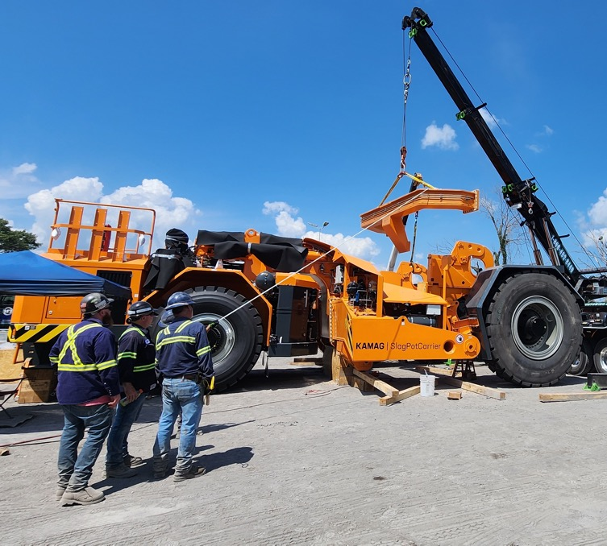
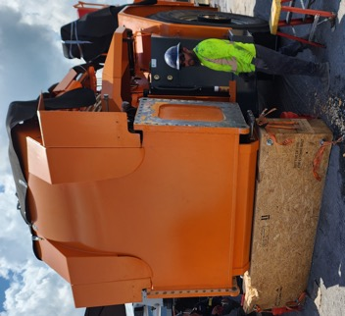
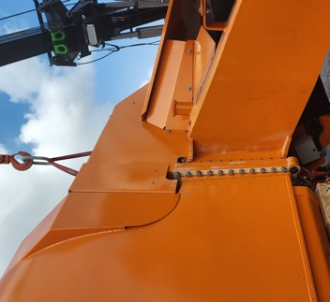
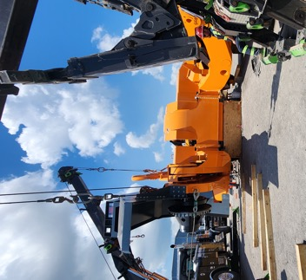
How did assembly compare?

Slide 7
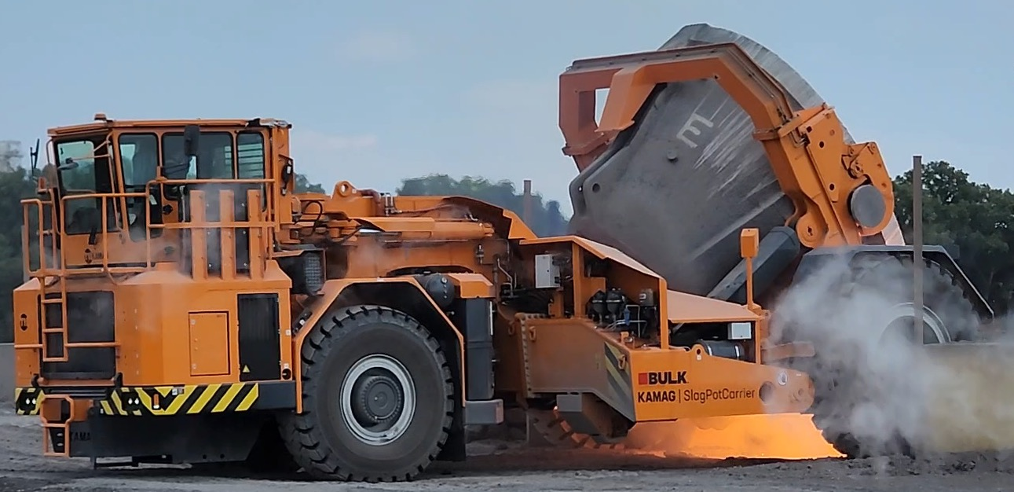
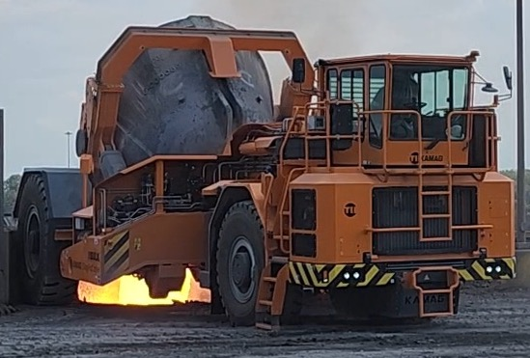
How did testing go?

Slide 8
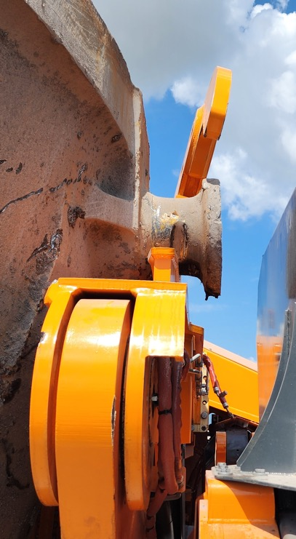
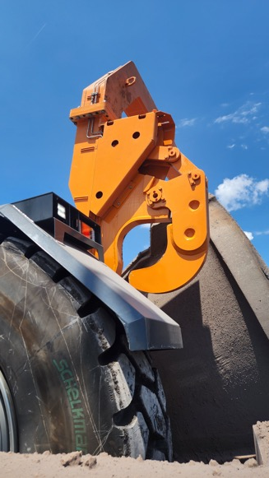
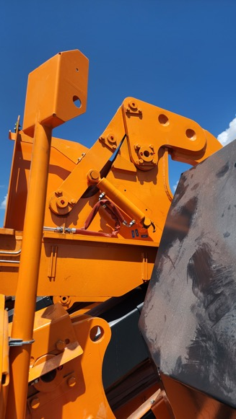
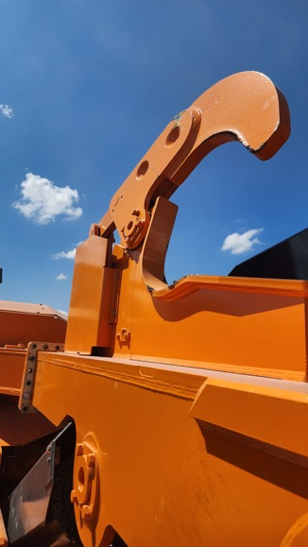
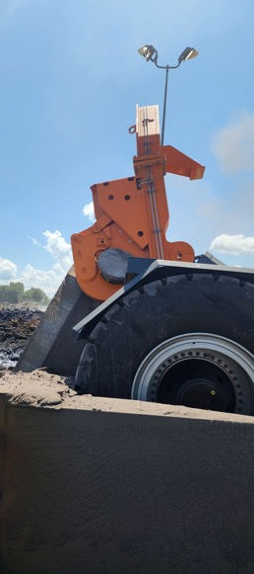
What challenges did we have?

Slide 9
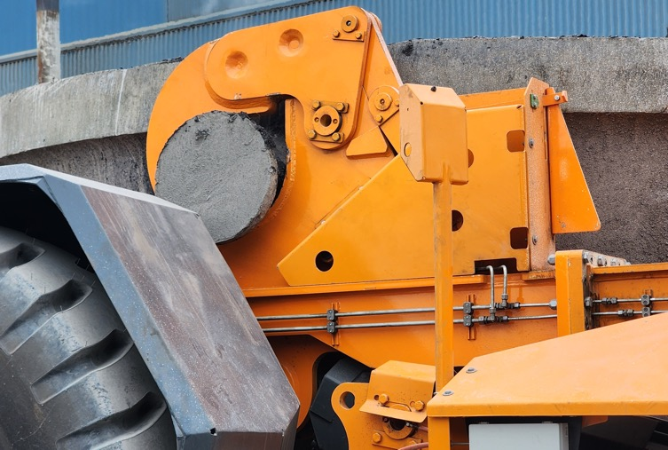
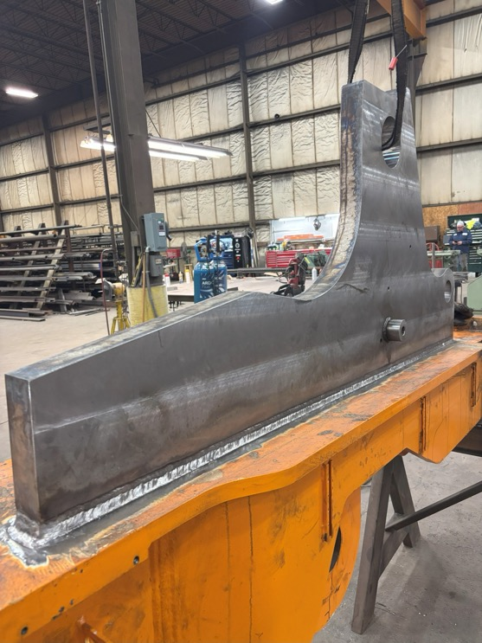
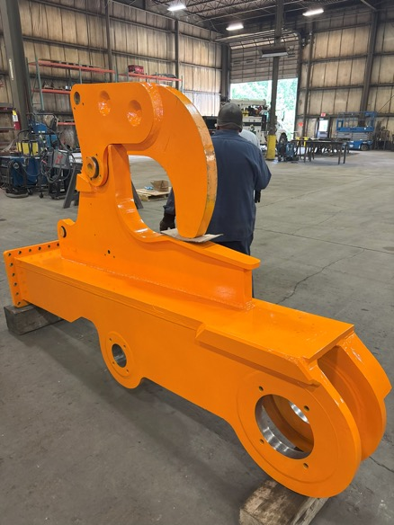
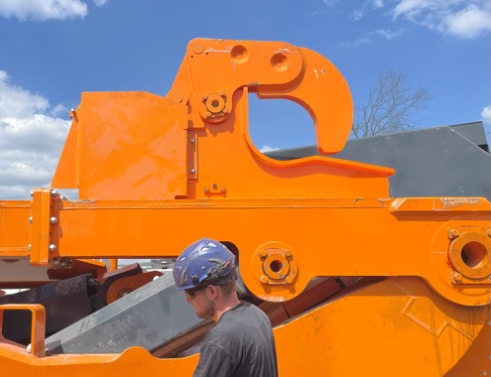
How did we overcome the challenges?

Slide 10
What made this delivery happen for the customer?

Slide 11
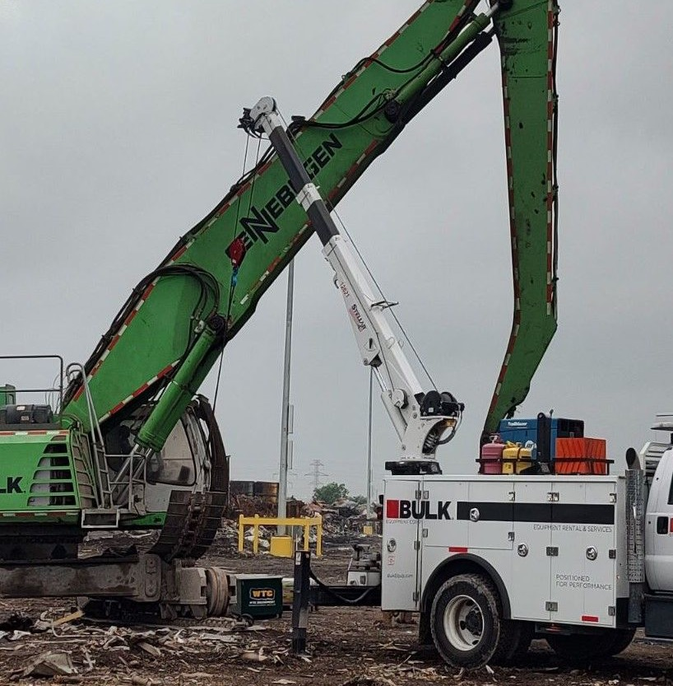
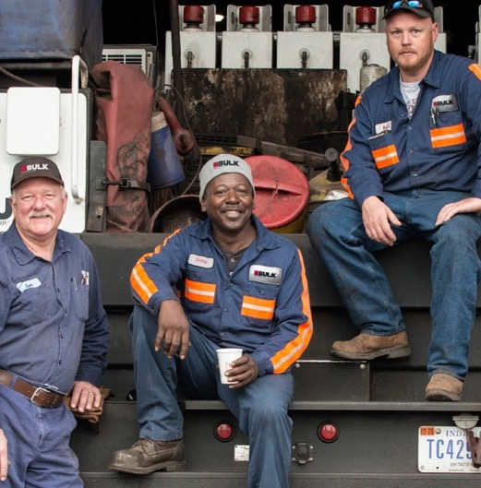
Trusted for Decades
Eliminate uncertainty
Serving since 1951
Comprehensive programs
Keeping you moving
Purpose-built equipment
Field service, maintenance, and manned or unmanned deployments
Safe & efficient operation
Equipment, maintenance, and service designed for your operation
Unrivaled support
Delivering best-in-class customer experience
One partner for supply, maintenance, and specialized services

Slide 12

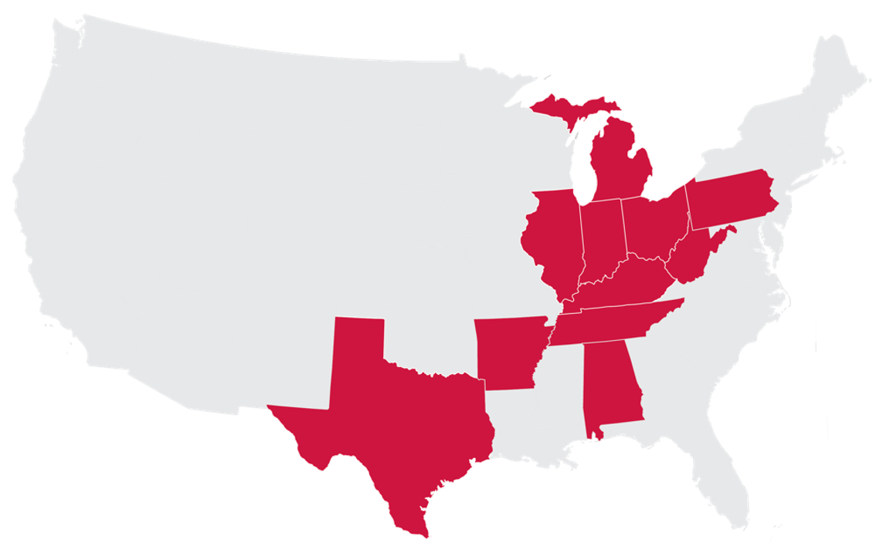






Global Brands + Local Support
180+ of the most highly-trained technicians in the country

Slide 13
Thank You
Learn more at bulkequip.com
Join the conversation on

