Slide 1

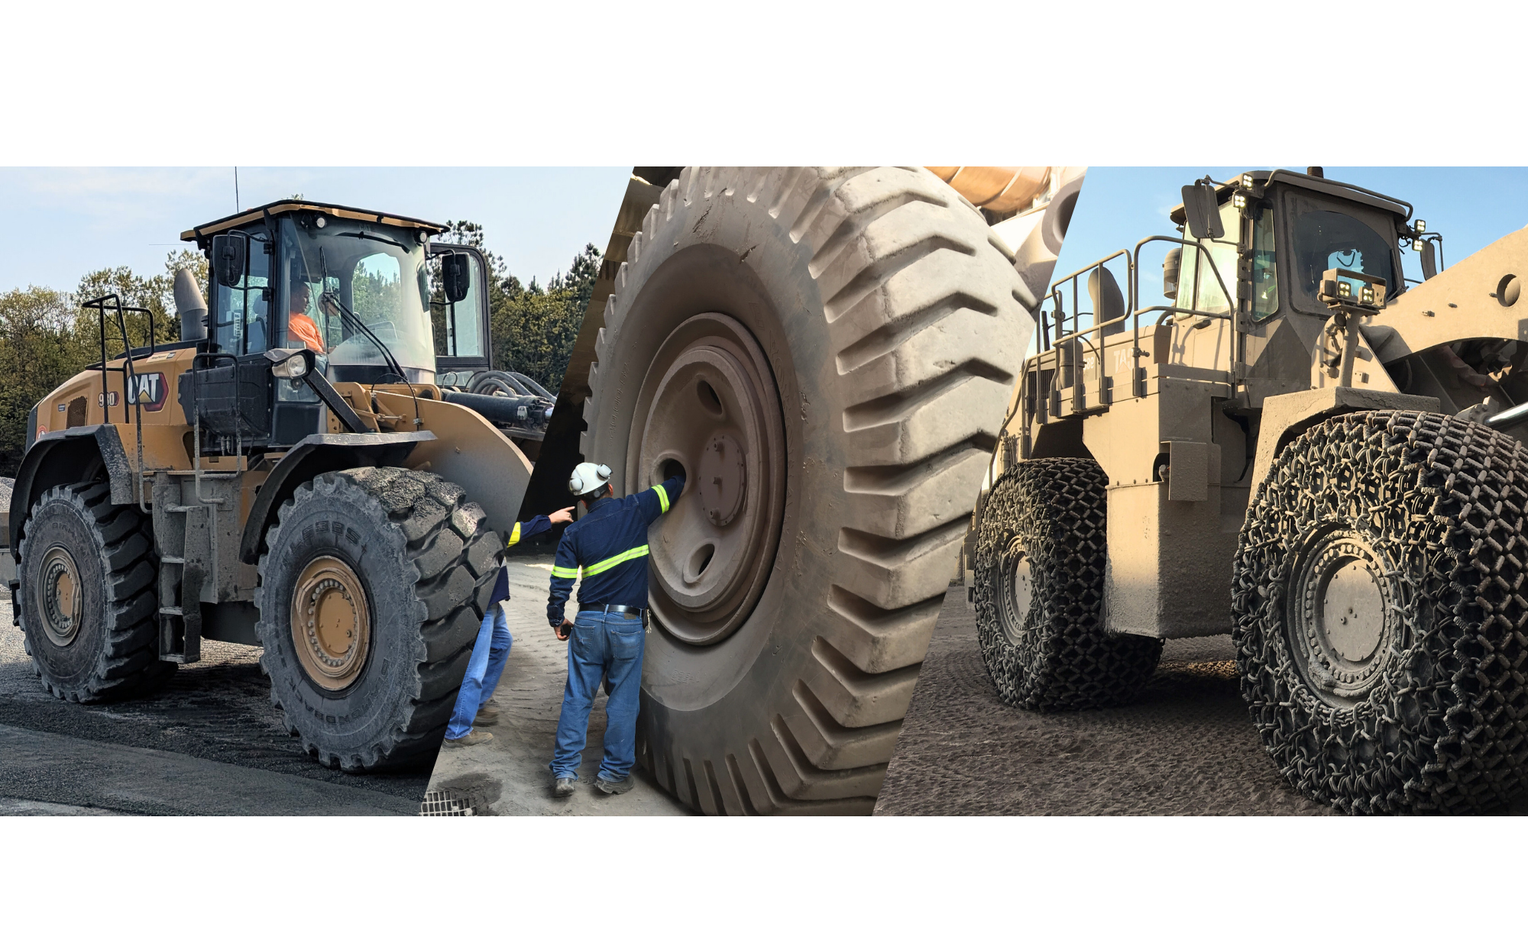
EARTHMOVER WHEELS & SAFETY
Titan® doesn’t just follow safety standards, we redefine them
This document is proprietary and confidential. No part of this document may be disclosed in any manner to a third party without the prior written consent of the Titan engineering and legal department.

Slide 2
Earthmover Wheels & Safety
Contents
Types / Construction / Manufacturing
Inspections:
How-to
Field Inspections
Best Practices
This document is proprietary and confidential. No part of this document may be disclosed in any manner to a third party without the prior written consent of the Titan engineering and legal department.

Slide 3



Titan International
Wheel Footprint / History
Europe / Russia
● | Ceprano, Italy | ● | Kidderminster, UK
● | Fanano, Italy | ● | Monreal del Campo, Spain
● | Finale Emilia, Italy | ● | Potenza, Italy
● | Flers, France | ● | St. Helens, UK
● | Gevelsberg, Germany | ● | Valsamoggia, Italy
● | Jesi, Italy | ● | Volgograd, Russia
● | Tires
● | Wheels
● | Undercarriage
● | Mining Services
● | Distribution
North America
● | Quincy, IL (International headquarters)
● | Bryan, OH
● | Des Moines, IA
● | Elkhorn, WI
● | Freeport, IL
● | Fort McMurray, AB, Canada
● | Gillette, WY
● | Holden, WV
● | Jefferson, GA
● | Querétaro, Mexico
● | Saskatoon, SK, Canada
● | Union City, TN
● | West-Chicago, IL
● | Winston-Salem, NC
Asia / Africa
● | Aydin, Turkey
● | Heidelberg, South Africa
● | Jakarta, Indonesia
● | Liuzhou, China
● | Tianjin, China
● | Visakhapatnam, Andhra Pradesh, India
Australia
● | Emerald, QLD
● | Mildura, VIC
● | Muswellbrook, NSW
/ | Perth, WA
● | Sydney, NSW
/ | Yatala, QLD
Latin / South America
● | Atibaia, Brazil
● | Buenos Aires, Argentina
● | Cali, Columbia
● | Iquique, Chile
/ | Lima, Peru
● | Parauapebas, Pará, Brazil
● | São Paulo, Brazil
/ | Santiago, Chile
[
]
=
+
+
STEEL PRODUCTS DIVISION

Slide 4
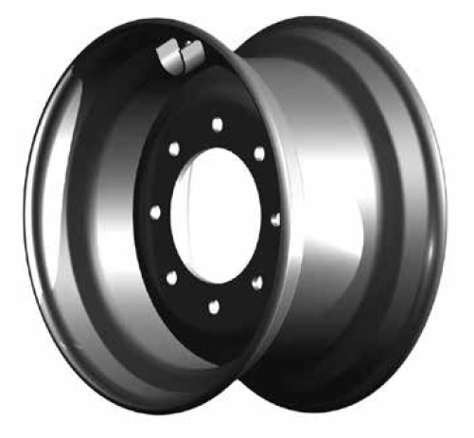
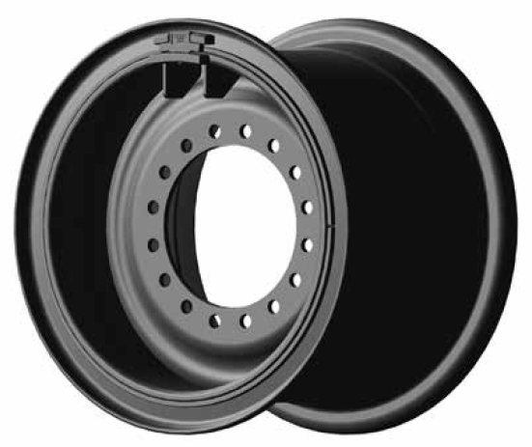
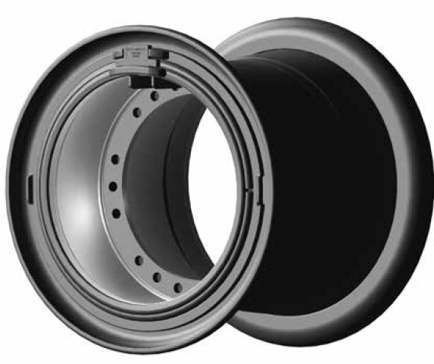
Wheel Types (Industry Common)
Single, 3-Piece & 5-Piece Wheels
Single-piece >>
Single Piece roll-formed rim contour
Formed and press-fit disc for structural integrity and minimized weight
Fully e-coated for corrosion protection and superior finish
3-piece >>
Typically for small wheel loader, grader and harvester applications
Removable side-ring and lock-ring for ease of tire mounting and servicing
Square face lock-ring to prevent incorrect installation
5-piece >>
Removable side flanges, bead-seat, and lock-ring for ease of tire servicing
Square face lock-ring to prevent incorrect installation
HSLA (High Strength Low Alloy) materials used to maximize fatigue life
Forged/Seamless flanges available (optional on some sizes)
Integral continuous pry bar slot on 33” and above for ease of component servicing
This document is proprietary and confidential. No part of this document may be disclosed in any manner to a third party without the prior written consent of the Titan engineering and legal department.

Slide 5
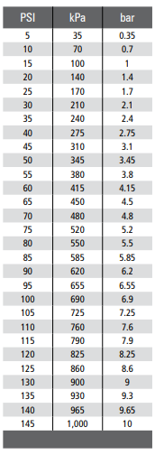
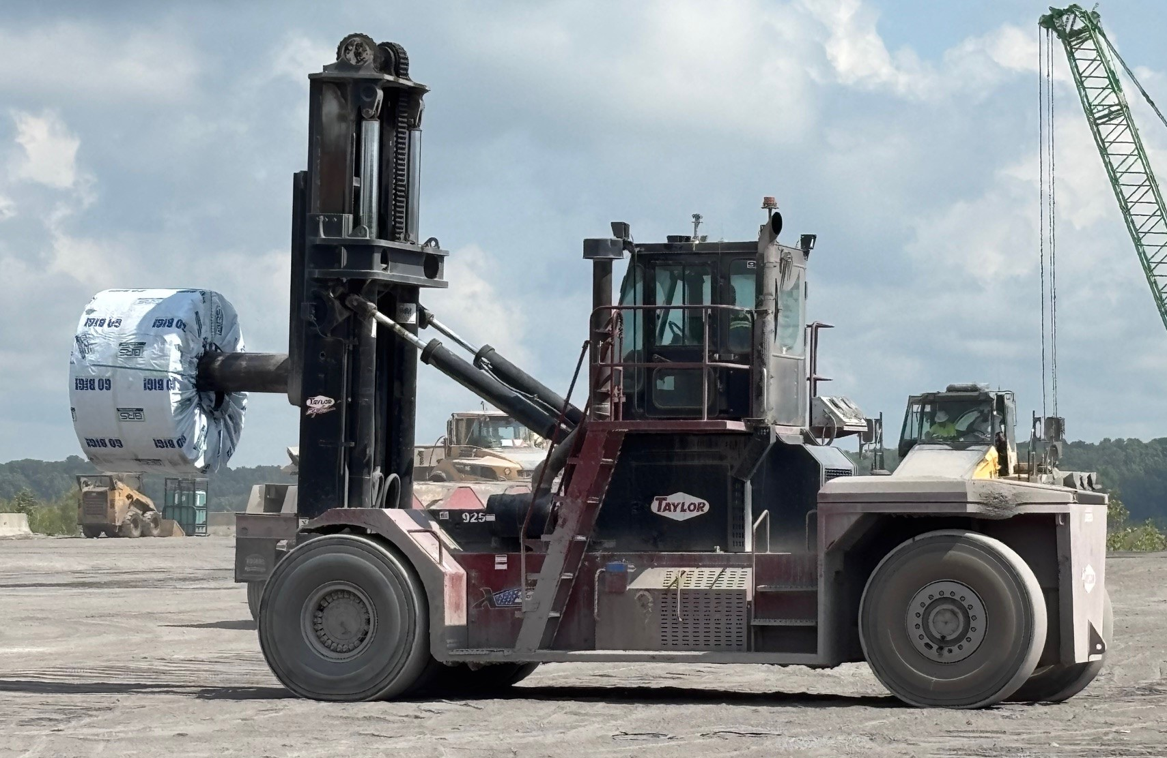
Wheel Types (Industrial 10 bar Wheels)
Standard vs. Industrial
10 bar (Industrial)
Designed for 145 psi (10 bar) cold pressures
Standard (Earthmover)
Not designed for hot pressures above 145 psi
EH rims may not be used to create 10 bar wheels
This document is proprietary and confidential. No part of this document may be disclosed in any manner to a third party without the prior written consent of the Titan engineering and legal department.

Slide 6
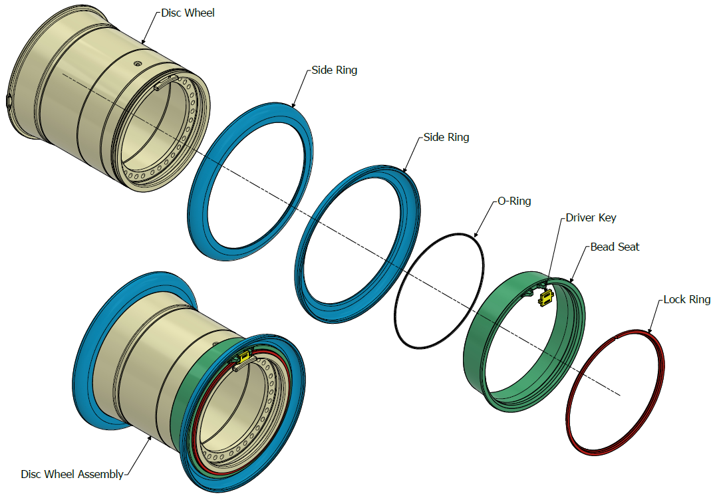
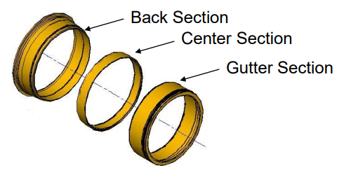
Wheel Construction (Standard)
Rim Base Components
This document is proprietary and confidential. No part of this document may be disclosed in any manner to a third party without the prior written consent of the Titan engineering and legal department.

Slide 7
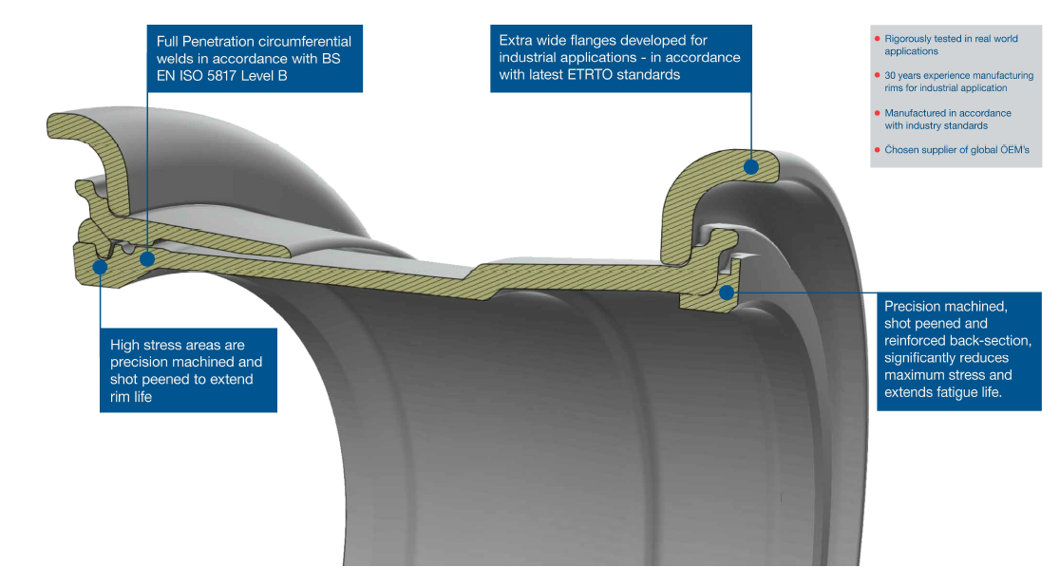
Wheel Construction (Industrial 10 bar Wheels)
This document is proprietary and confidential. No part of this document may be disclosed in any manner to a third party without the prior written consent of the Titan engineering and legal department.

Slide 8
Wheel Manufacturing
Product Quality Assurance
Each component we produce
meets the highest quality standards
possible, beginning with CNC
precision machining
Titan welds to AWS standards
and uses state-of-the-art x-ray
technology to verify 100% weld
integrity.
By using state-of-the-art welders and
camera monitoring, we get 100 percent
penetration on each weld to meet
AWS standards. All wheels are
serialized for traceability.
Critical surfaces are shot peened to
extend wheel life.
Each component is verified using
coordinate measuring machines.
Titan-manufactured loose components
are fully coated with durable powder
paint to ensure long product life.
This document is proprietary and confidential. No part of this document may be disclosed in any manner to a third party without the prior written consent of the Titan engineering and legal department.

Slide 9
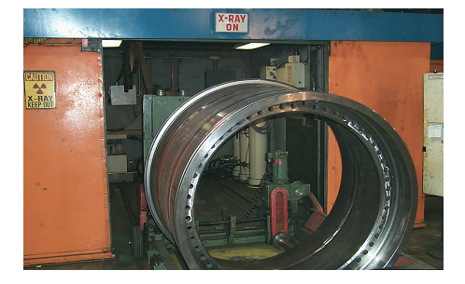
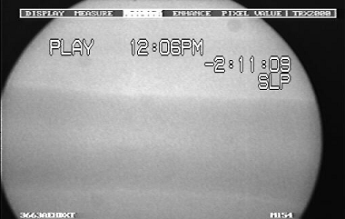
Wheel Manufacturing
Non-Destructive X-Ray Capabilities
This document is proprietary and confidential. No part of this document may be disclosed in any manner to a third party without the prior written consent of the Titan engineering and legal department.

Slide 10
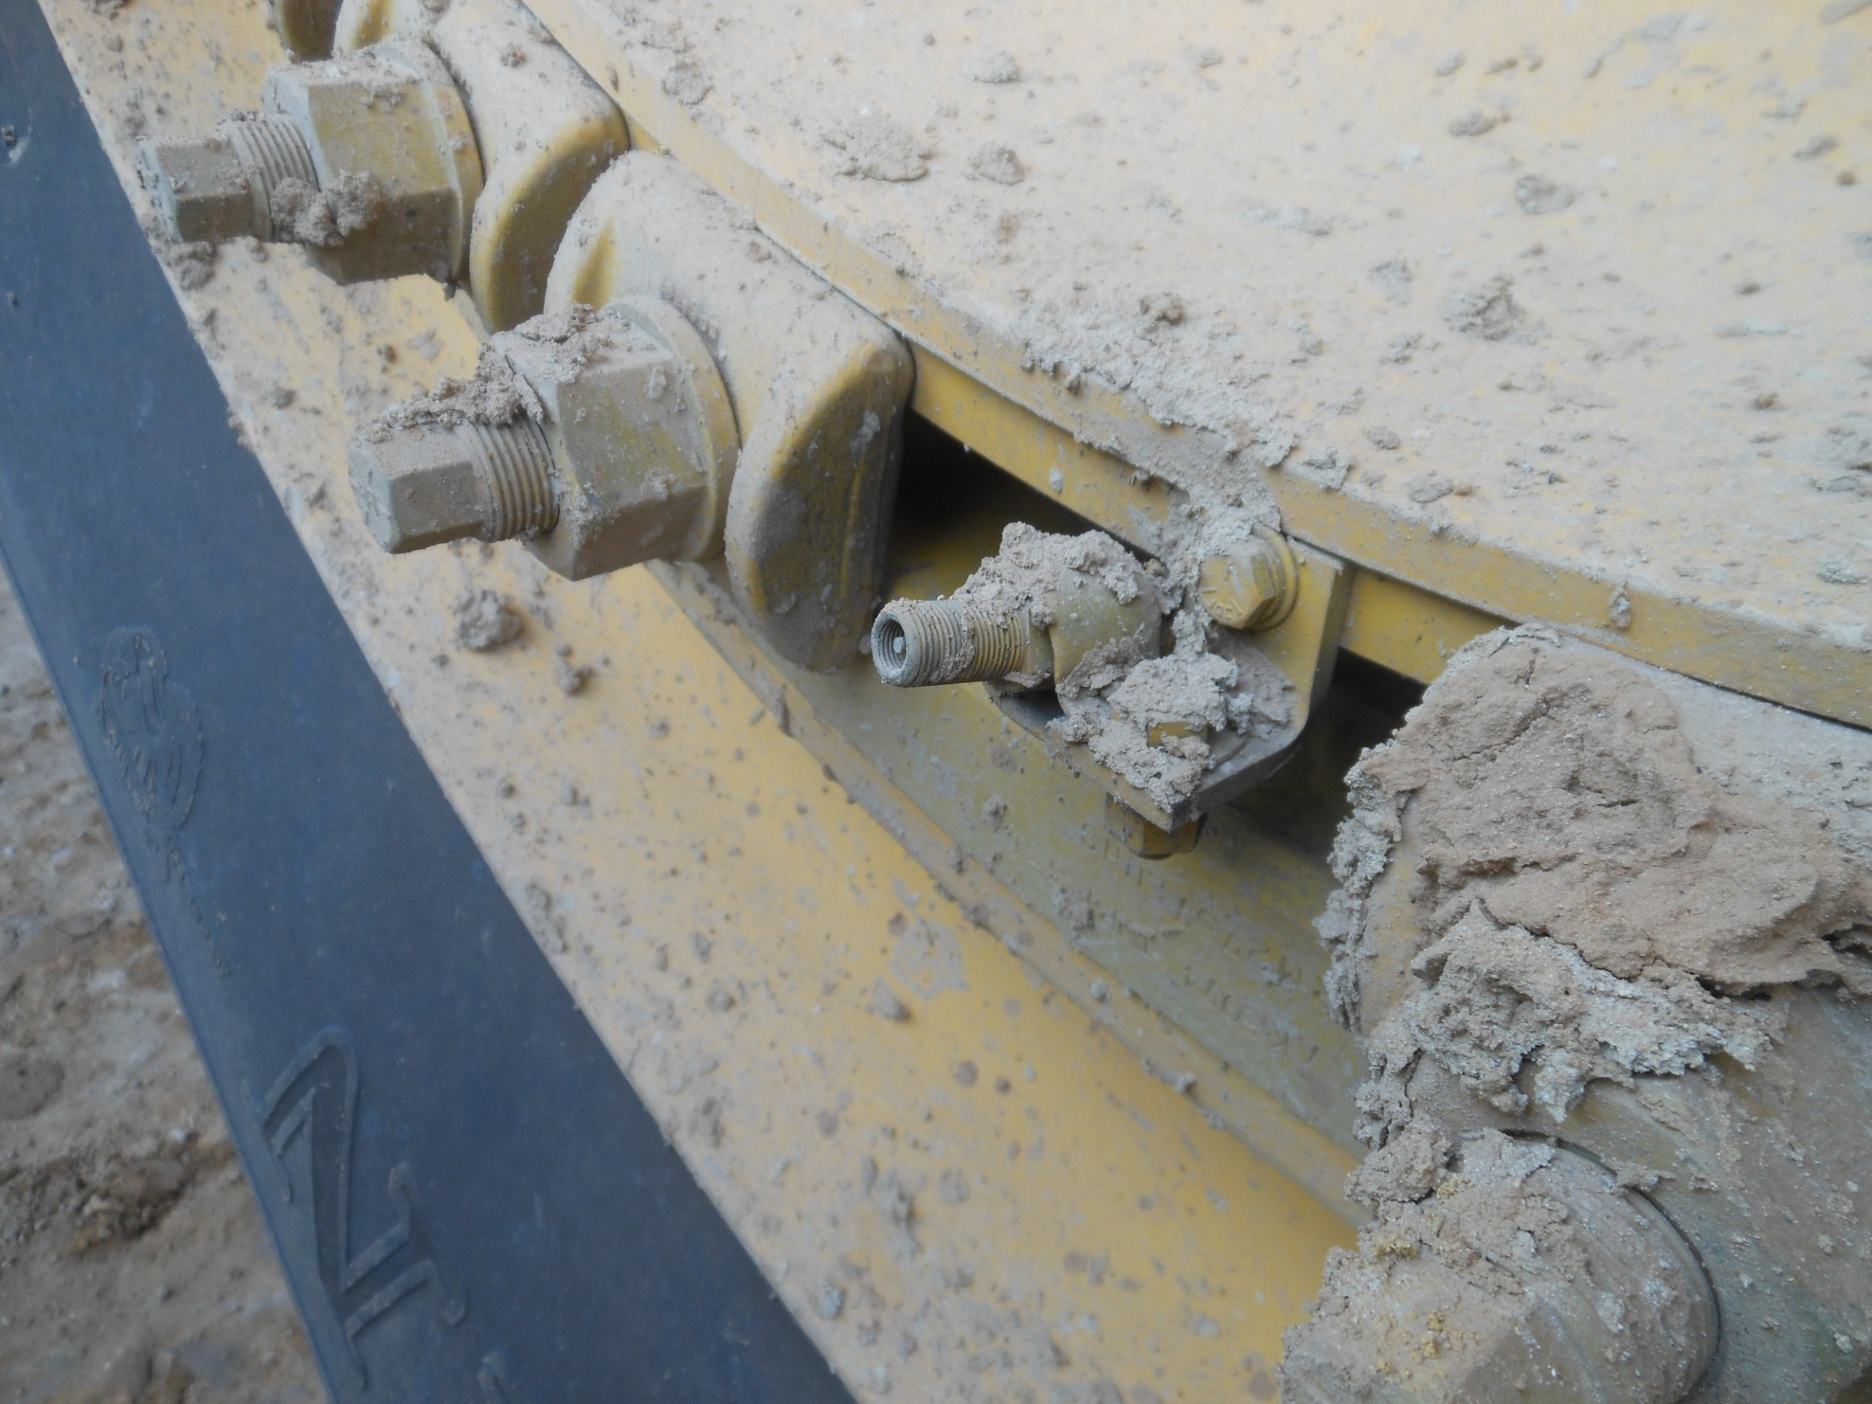
Wheel Inspections (How-to)
Common Field Issues
Causes of premature FAILURE or worse, a life-threatening accident:
Age
Overload
Poorly maintained haul roads
Poor operating conditions
Misuse of equipment
Under inflated tires
Washed out lock ring grooves stress fatigue fractures caused by:
Friction welding
Aggregate
Corrosion
Great reasons for doing a safety inspection of the rim
This document is proprietary and confidential. No part of this document may be disclosed in any manner to a third party without the prior written consent of the Titan engineering and legal department.

Slide 11
Wheel Inspections (How-to)
Components
Identification:
Part Number
Serial Number
Size
“Gutter section”
“Back section”
Stud holes
Bolting plate weld
Rim base welds
This document is proprietary and confidential. No part of this document may be disclosed in any manner to a third party without the prior written consent of the Titan engineering and legal department.

Slide 12
Wheel Inspections (How-to)
Components:
Points to Consider
Hardware is considered as consumable product.
Hardware includes:
Bead Seat Bands
Rim Flanges
Locking Rings
Hardware that is suspected of having defects or distortion, shall be discarded.
All hardware shall be inspected by Field and Tire Shop Personnel prior to it’s reuse.
OSHA 29 CFR 1910
This document is proprietary and confidential. No part of this document may be disclosed in any manner to a third party without the prior written consent of the Titan engineering and legal department.

Slide 13
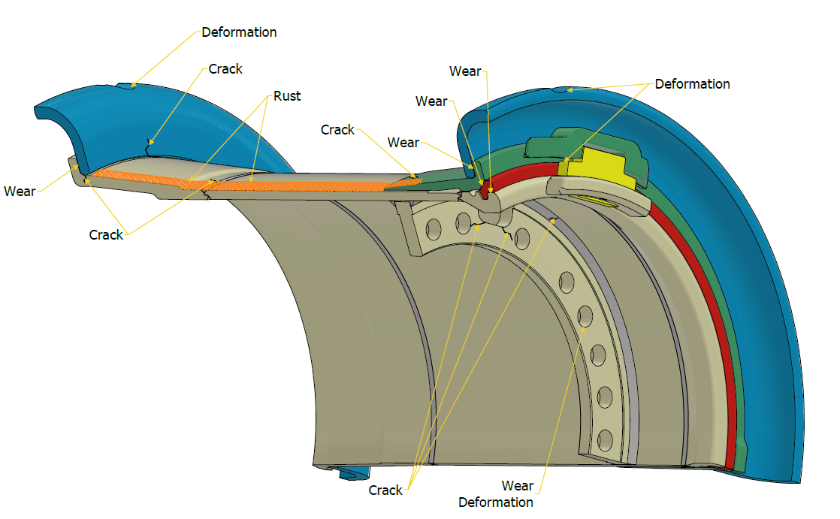
Wheel Inspections (How-to)
Components:
Common Damage Areas
This document is proprietary and confidential. No part of this document may be disclosed in any manner to a third party without the prior written consent of the Titan engineering and legal department.

Slide 14
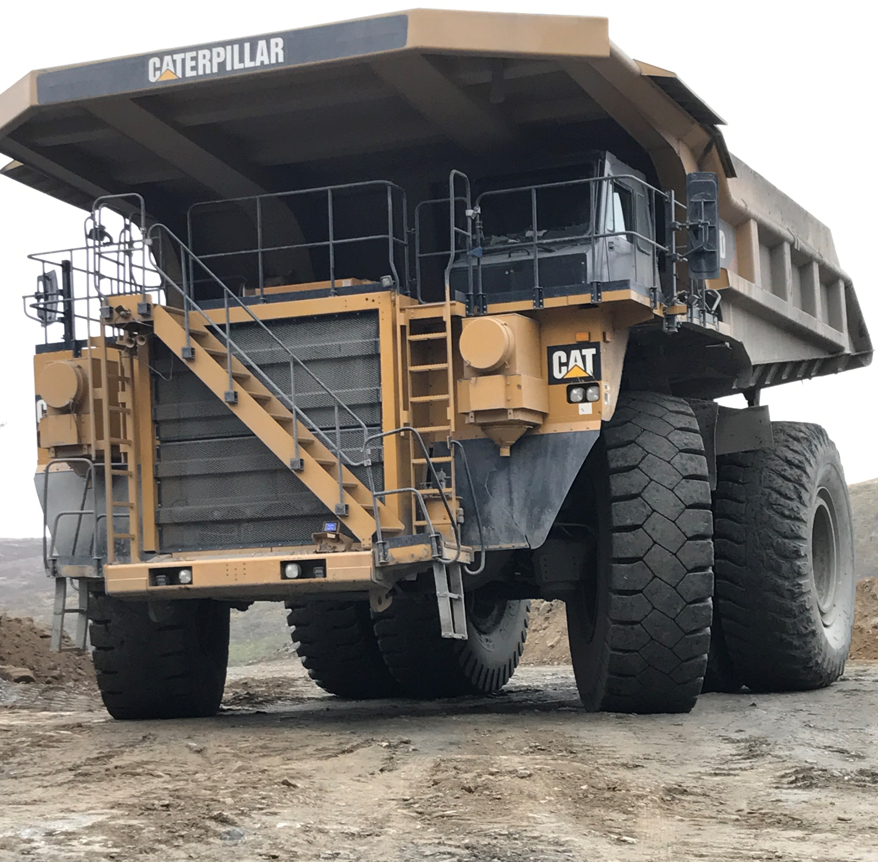
Wheel Inspections (How-to)
Fill Media Types
Standard:
Air
Nitrogen
Tire Life® (supplemental protectant)
Alternate:
Liquid Ballast (Water, Foam, Poly) – cost, maint, no checks
Foam Core (Trojan™ Liner) – cost, maint.
Non-Pneumatic, Solid Tires – ride
This document is proprietary and confidential. No part of this document may be disclosed in any manner to a third party without the prior written consent of the Titan engineering and legal department.

Slide 15
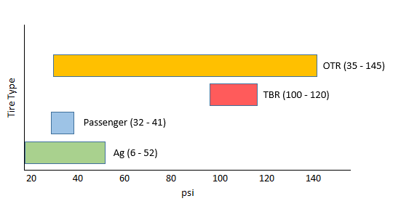
Wheel Inspections (How-to)
Fill Media Types:
Inflation Pressure Ranges
Inflation Pressure Range by tire type
This document is proprietary and confidential. No part of this document may be disclosed in any manner to a third party without the prior written consent of the Titan engineering and legal department.

Slide 16
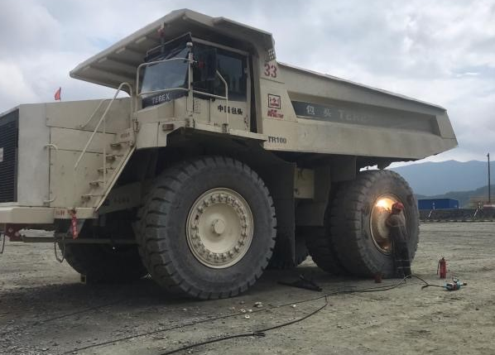
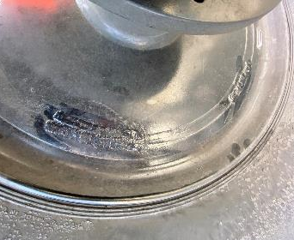
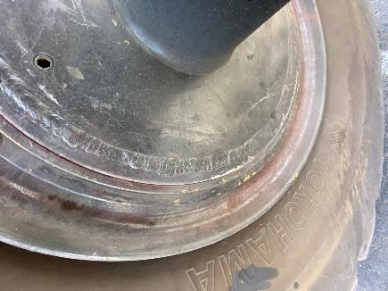

Inspections (Field)
Mounting / Inflating
Condition:
Welded Wheel / Welding on Mounted Wheel
Cause:
Gases may be present within the tire cavity and heat form welding will cause a drastic rise in pressure, this can result in a rapid air loss
Best Practice:
Never attempt to weld on a deflated tire and rim assembly
Never attempt to weld on an inflated tire and rim assembly
This document is proprietary and confidential. No part of this document may be disclosed in any manner to a third party without the prior written consent of the Titan engineering and legal department.

Slide 17
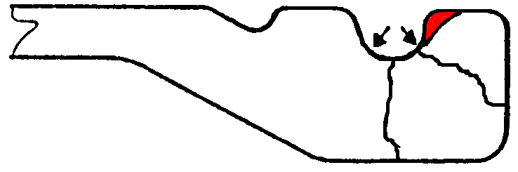
Inspections (Field)
Rim Base / Gutter
Danger Zone:
Pressure
Zone
Non-Pressure
Zone!!
This document is proprietary and confidential. No part of this document may be disclosed in any manner to a third party without the prior written consent of the Titan engineering and legal department.

Slide 18
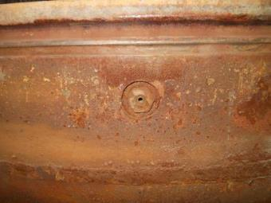
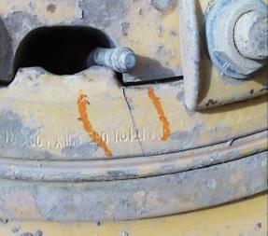
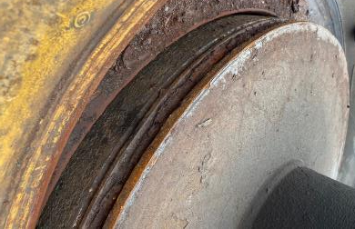
Inspections (Field)
Rim Base / Gutter
Condition:
Cracking
Corrosion
Cause:
Overload / Under-Inflation
Age
Best Practice Action:
Recommended service life is 10,000 operating hours
Wheels should be sand blasted and inspected for fatigue and hairline cracks
At minimum, rim base, spud, and valve hardware should be changed every other tire change
Use Tire Life®
This document is proprietary and confidential. No part of this document may be disclosed in any manner to a third party without the prior written consent of the Titan engineering and legal department.

Slide 19
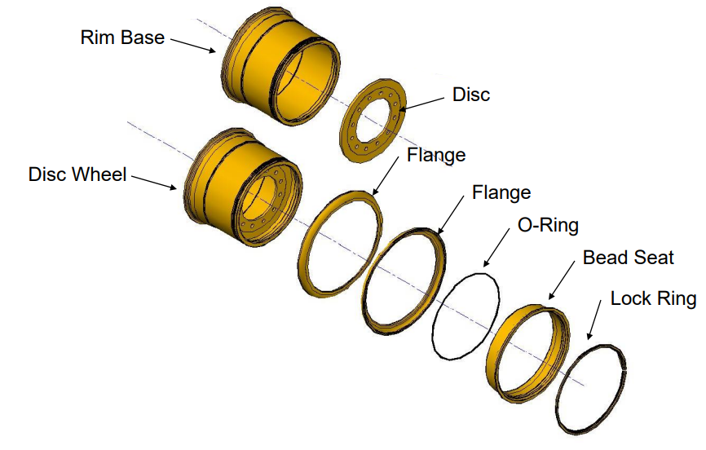
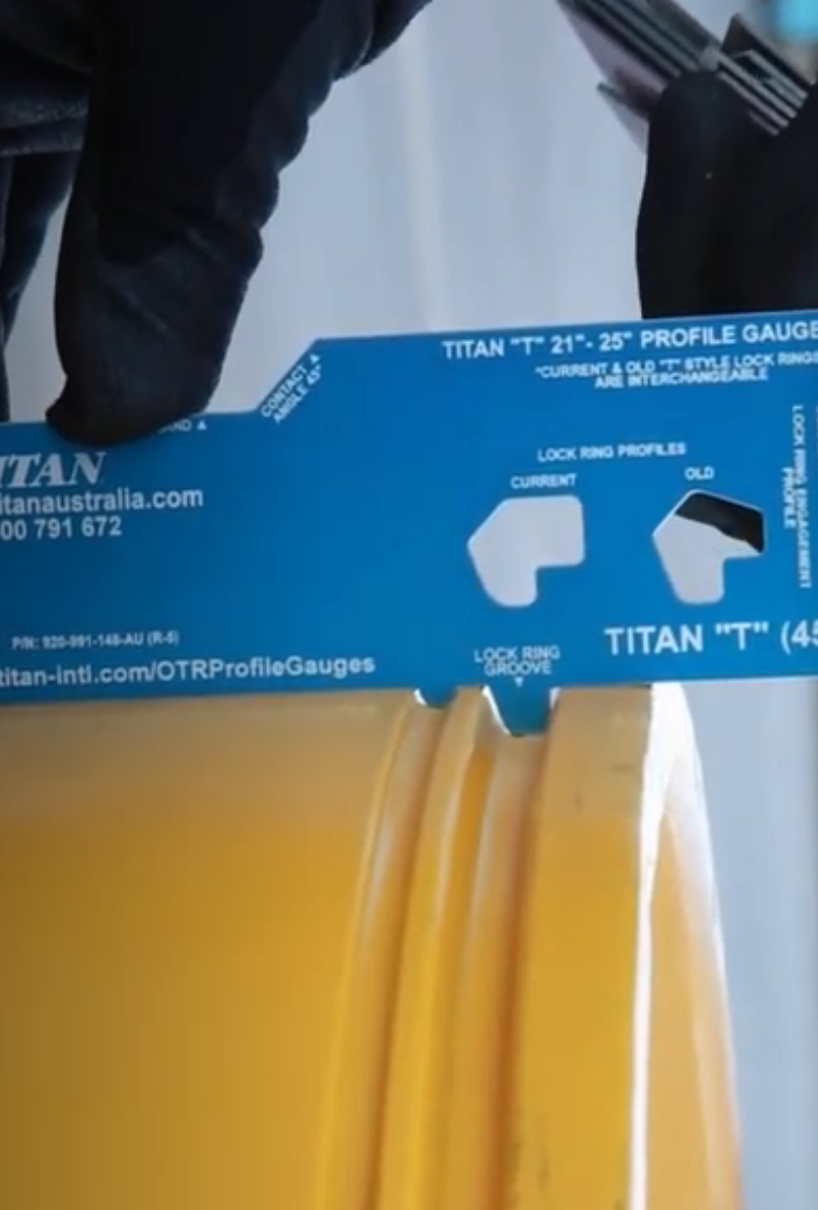
Inspections (Field)
Rim Base / Gutter
O-Ring / Wheel Interface
ID of Rim, houses the Disc, and seats the components
Lock ring grooves are inspected using a gauge for wear & damage
Profile Gauge
(“Go, No-Go” Gauge)
O-Ring Groove
Lock Ring Groove
This document is proprietary and confidential. No part of this document may be disclosed in any manner to a third party without the prior written consent of the Titan engineering and legal department.

Slide 20
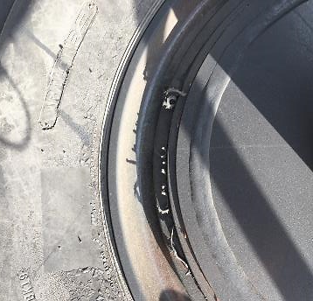
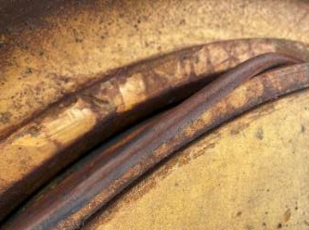
Inspections (Field)
O-Rings
Condition:
Air Loss / Exposed O-Ring
Cause:
Flattened O-Ring (age, under-inflation: shifting components)
Rolled O-Ring (misalignment during mounting)
Best Practice Action:
De-mount, check for burrs, replace O-Ring, re-mount with proper inflation pressure, check in 24 hours
Replace at every tire change
Rolled O-Ring
Flattened O-Ring
This document is proprietary and confidential. No part of this document may be disclosed in any manner to a third party without the prior written consent of the Titan engineering and legal department.

Slide 21
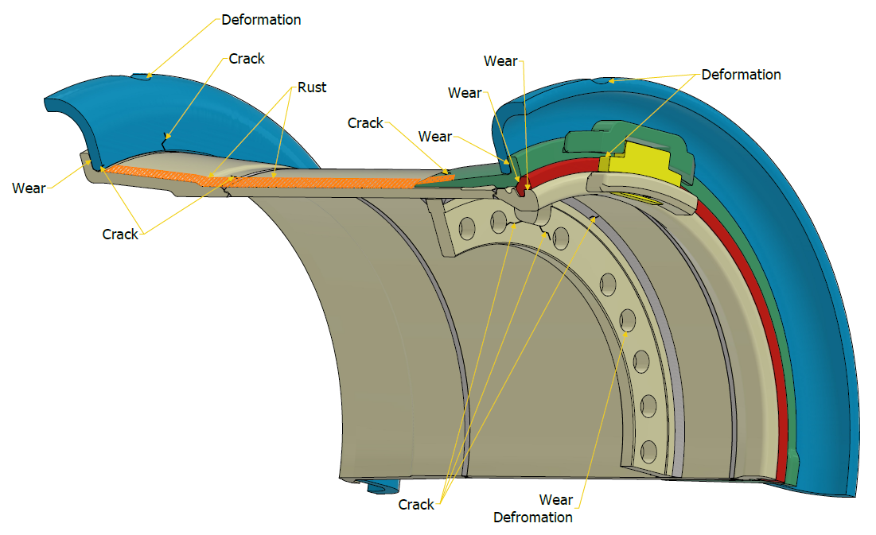
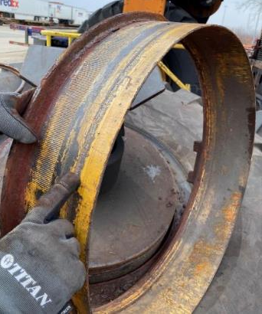
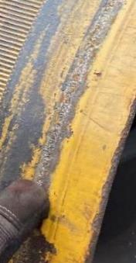
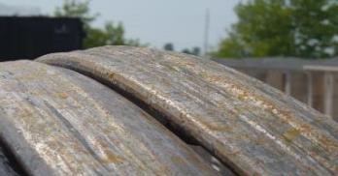
Inspections (Field)
Bead Seat Band
Condition:
Wear
Corrosion
Cause:
Under-inflated tire rocking on the wheel
Age and/or storage
Best Practice Action:
Replace
Sprung Lock-Ring
This document is proprietary and confidential. No part of this document may be disclosed in any manner to a third party without the prior written consent of the Titan engineering and legal department.

Slide 22
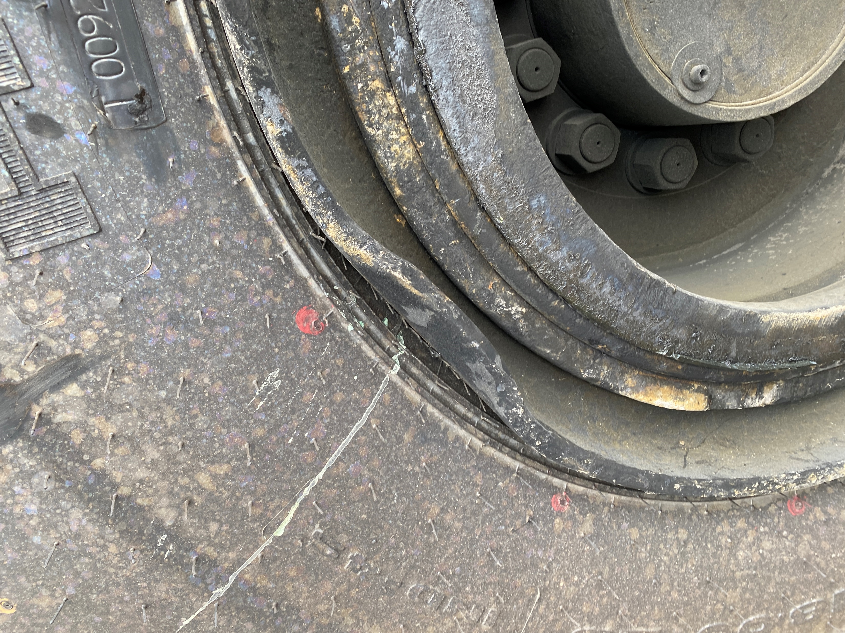
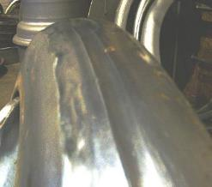
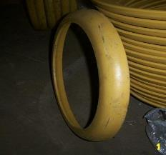
Inspections (Field)
Flange
Condition:
Bent / Deformed
Extreme Wear
Cause:
Mounting Damage
Old stock, over-deflection of tire
Best Practice Action:
Replace
This document is proprietary and confidential. No part of this document may be disclosed in any manner to a third party without the prior written consent of the Titan engineering and legal department.

Slide 23
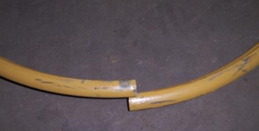
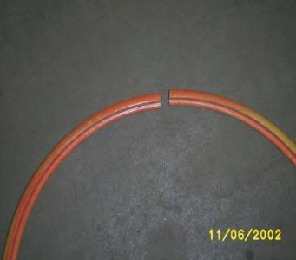
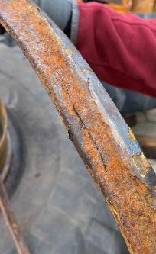
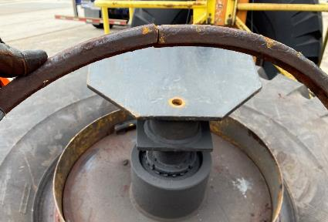
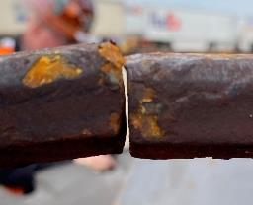
Inspections (Field)
GOOD
Lock Rings
(Main Retainer for the rim components)
Condition:
Stretched / Worn / Sprung
Cracked
Corrosion
Cause:
Age and/or storage
Best Practice Action:
Visually inspect for wear, “sprung”, stretched, corrosion, cracks, flat spots, misalignment and warping
The Lock Ring needs to be replaced when the two ends no longer touch when loose
BAD (sprung)
This document is proprietary and confidential. No part of this document may be disclosed in any manner to a third party without the prior written consent of the Titan engineering and legal department.
CRACKED
BAD (sprung, rusted)

Slide 24
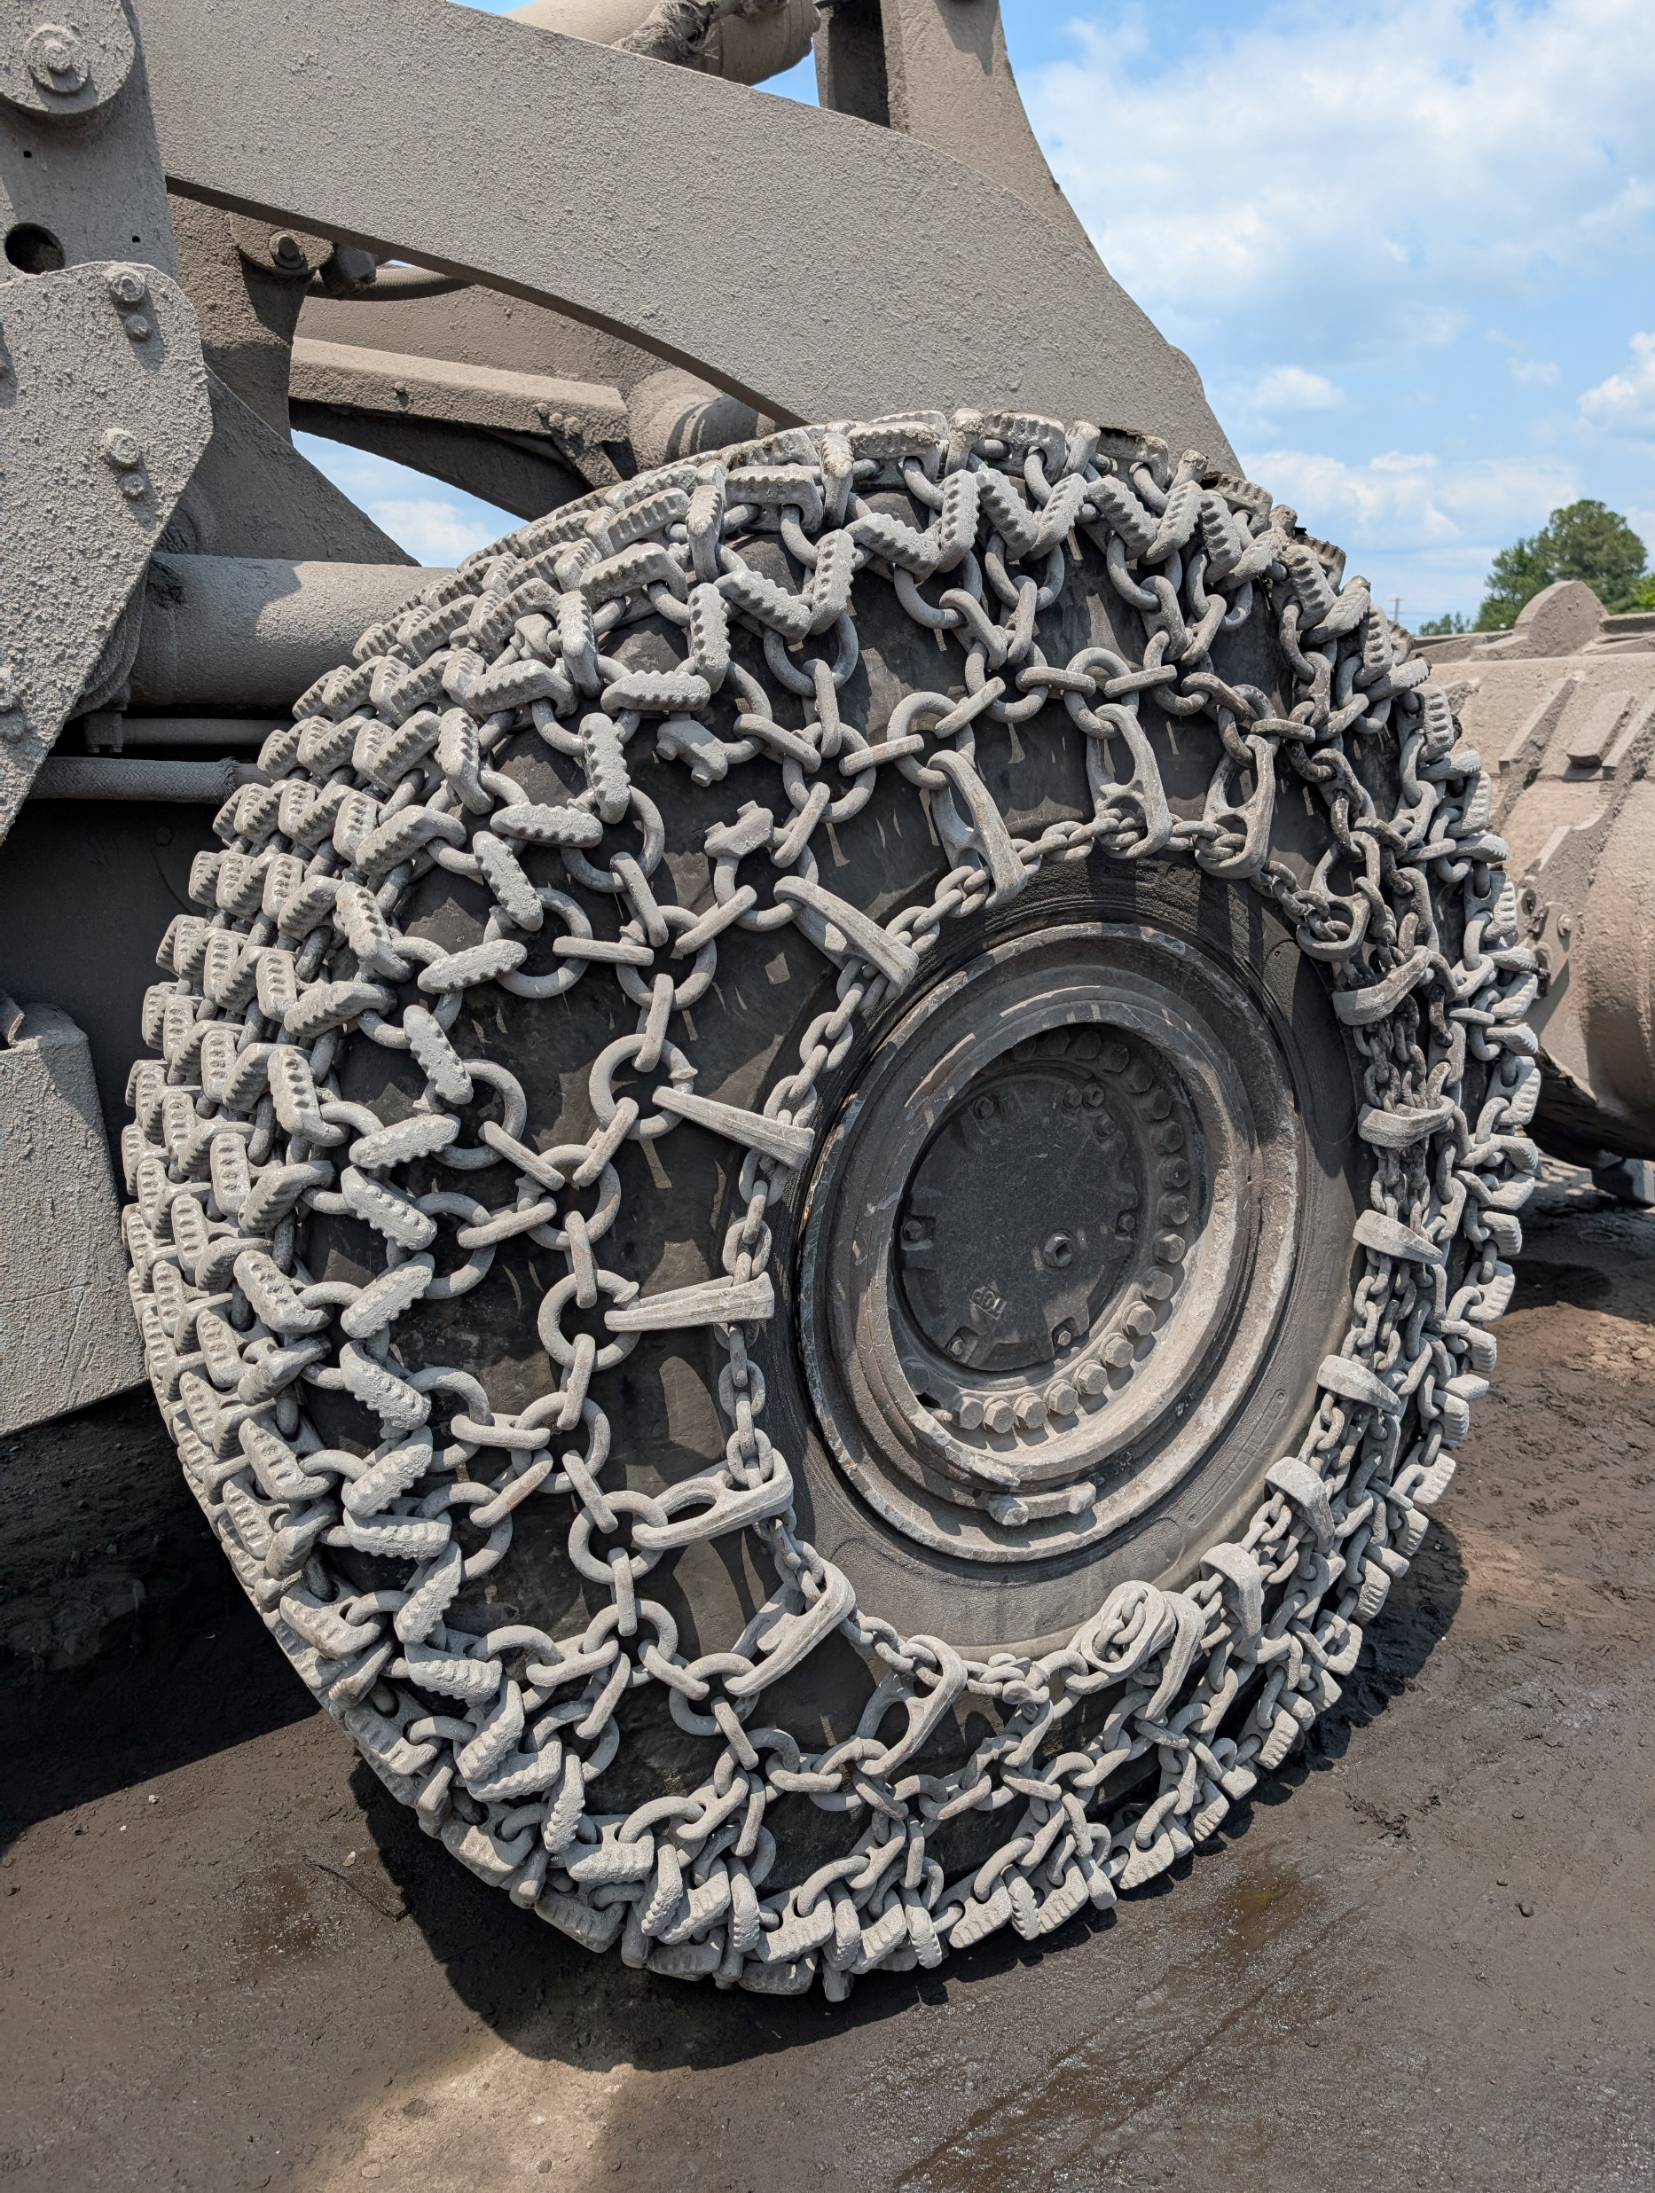
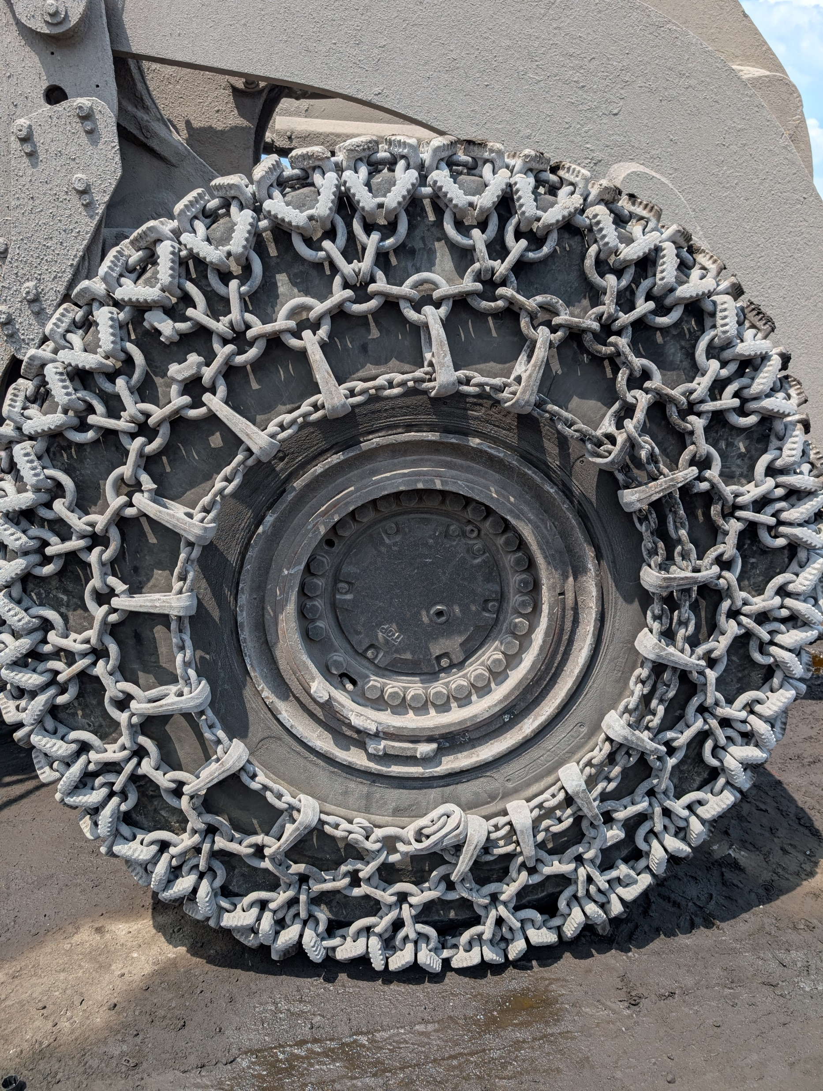
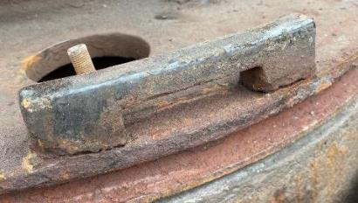
Inspections (Field)
Driver Key / Pocket
(Driver keys help to prevent premature metal to metal wear by keeping rim components in place and keeps debris out (more pressure on O-ring in high torque / static turning scenarios))
Condition:
Missing Key
Cracked Pocket
Misaligned/Indexed Components
Cause:
Damage, Age, Missed
Best Practice Action:
Install new Driver Key
Wheel needs replaced (pocket)
OSHA 29 CFR 1910
Missing Driver Key; Indexed components
OSHA 29 CFR 1910 Violation
Cracked Driver Pocket
This document is proprietary and confidential. No part of this document may be disclosed in any manner to a third party without the prior written consent of the Titan engineering and legal department.

Slide 25
Thank you!
What questions do you have?
Pete Kearney
Global Director of Mining Tires & Wheels
(515) 710-7724
Willie Yeber
OTR Tire & Wheel Specialist & Territory Sales Manager (305) 496-2516
Matt Miller
Director of Engineering, R&D (OTR)
Matt Werstein
Engineering Manager R&D / Product Manager (OTR)
This document is proprietary and confidential. No part of this document may be disclosed in any manner to a third party without the prior written consent of the Titan engineering and legal department.

