Slide 1

The Slow Death of Heavy Equipment: How to Make it Happen Faster!
Sennebogen LLC
Constantino Lannes
President & CEO

Slide 2
Why Maintenance ???
Lower owning and operating costs
  Extended component and machine life
  Less down time, higher availability
  Lower fuel consumption
  Higher resell value
Higher Safety
  Lower risk of accidents

Slide 3
Maintenance Intervals
Daily checks
Preventive Maintenance
Repairs
Structural inspections
Third party inspections
What is your strategy in maintenance?
What is your strategy costing you?

Slide 4

Are you preforming daily maintenance checks?

Slide 5
Daily Inspection
excessive wear, damage or leaks on boom / stick cylinders and safety check valves
excessive wear, damage or leaks on outrigger cylinders
excessive wear, damage or leaks on cab elevating cylinder
excessive wear, damage or leaks on hydraulic hoses
damage or leaks on grapple cylinders
excessive wear, damage on magnet cable
damage or leaks on transmission / travel motor / axle hubs
damages on boom / stick
damages on under carriage
fluid level, leakage engine oil
fluid level, leakage engine coolant
fluid level, leakage swing gear oil
fluid level, damage hydraulic tank
fluid level, damage diesel fuel tank

Slide 6
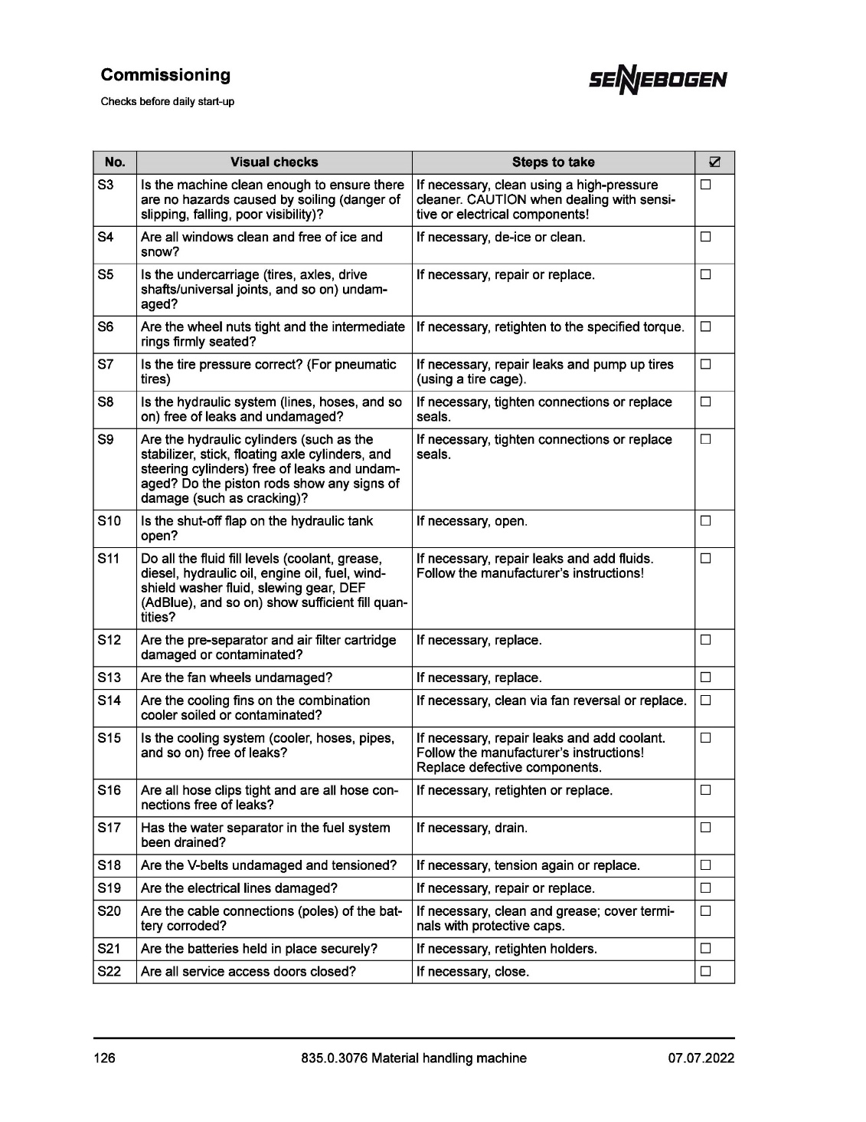

Slide 7
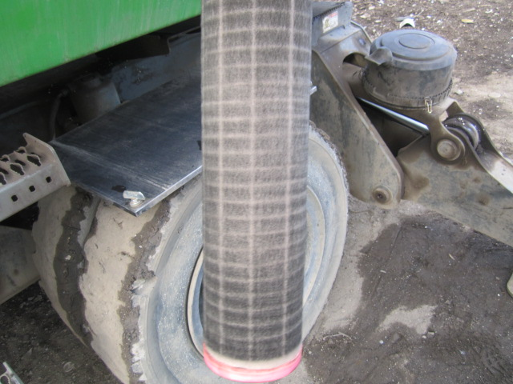
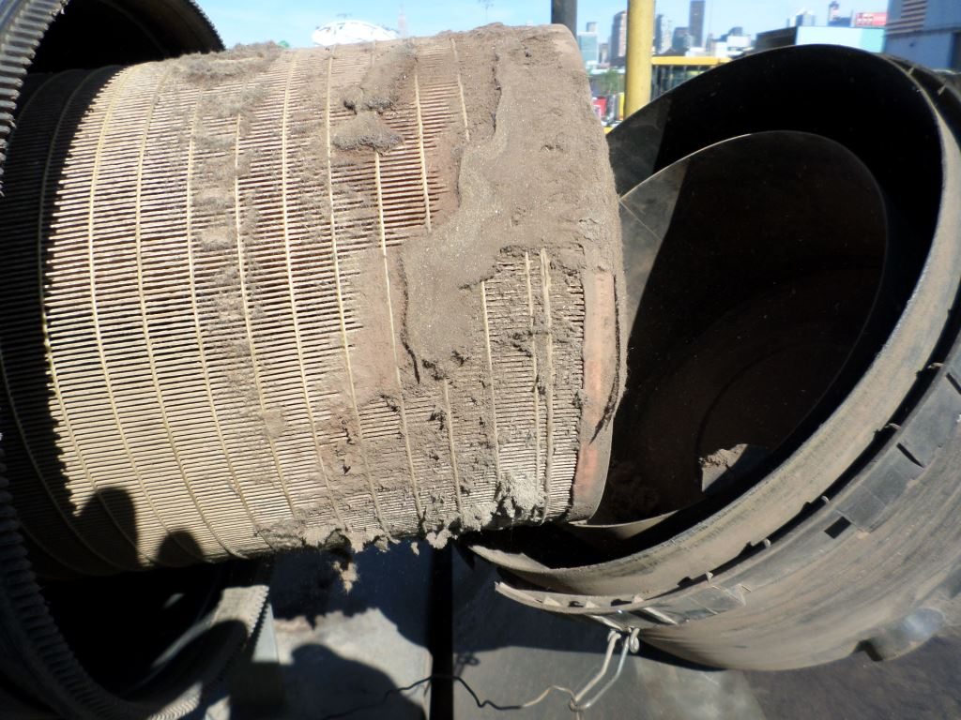
No Maintenance Results
Cause
Dirty air filter
Result
Engine replacement

Slide 8
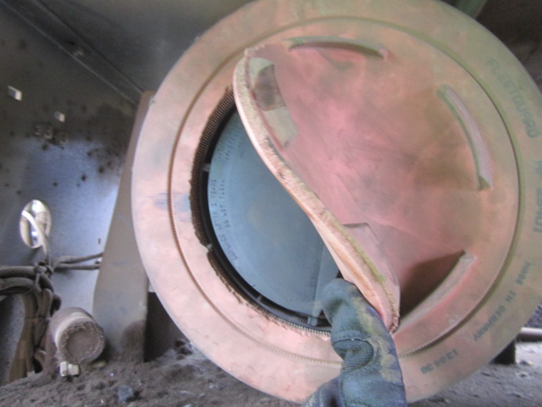
No Maintenance Results
Cause
Air filter damaged
Result
Engine replacement

Slide 9
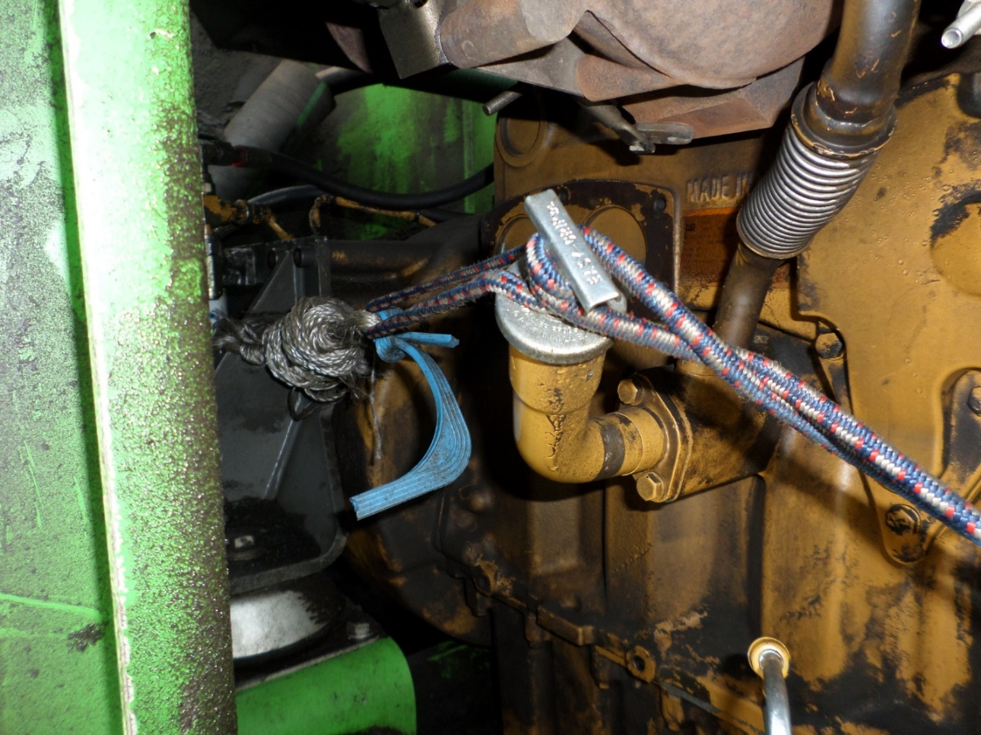
No Maintenance Results
Cause
Engine eating dust
Result
Blowby pressure is so high its shooting dipstick out of engine

Slide 10
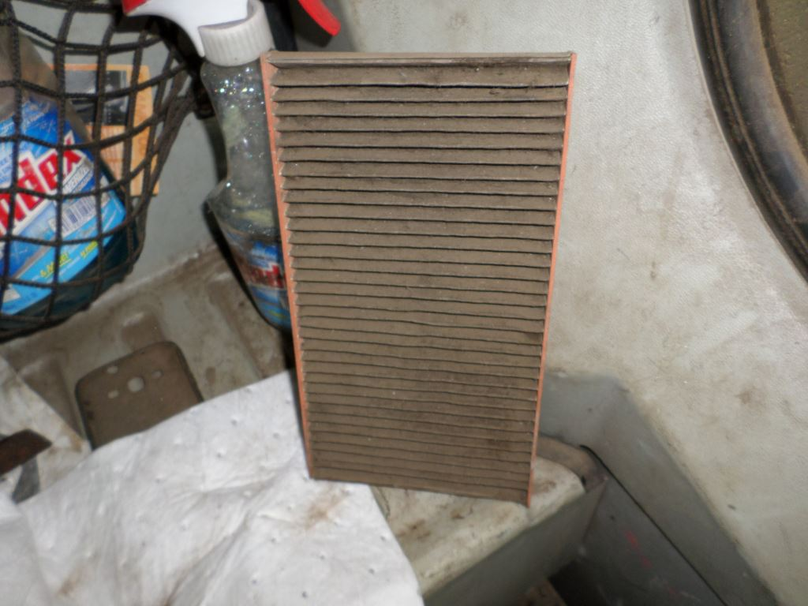
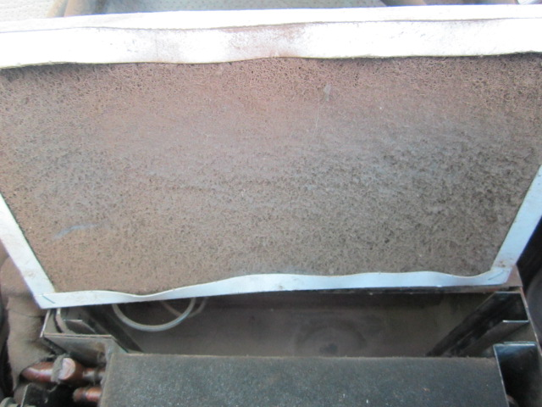
No Maintenance Results
Cause
Dirty cab filter
Result
A/C compressor failure

Slide 11
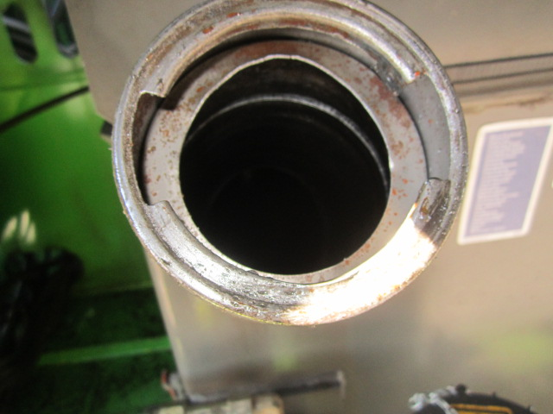
No Maintenance Results
Cause
Missing fuel screen
Missing fuel cap
Result
Exchange of all injectors & fuel pump
1-2 day down time
Expensive repair costs

Slide 12
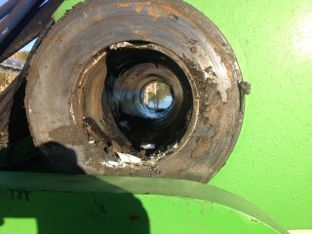
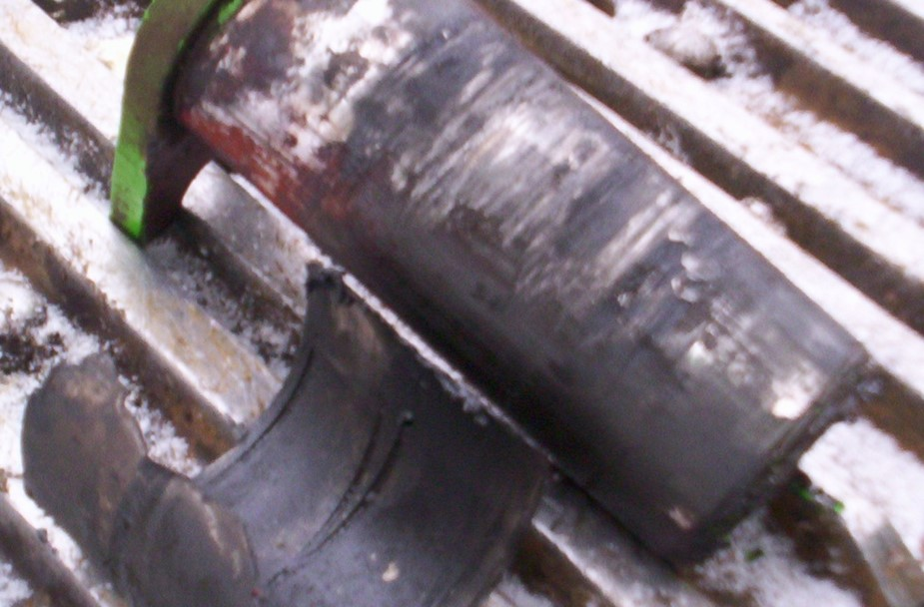
No Maintenance Results
Cause
No grease
Result
New bushings, line boring, …
5-10 days machine down time
Expensive repair costs

Slide 13
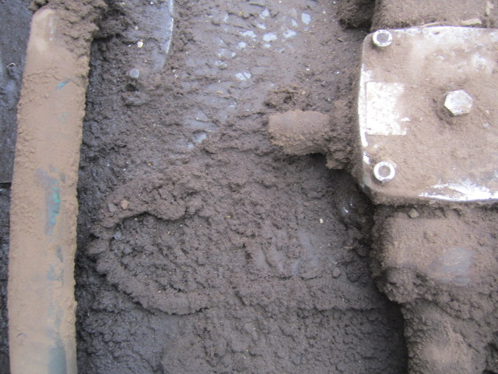
No Maintenance Results
Cause
Hydraulic tank dirty around return filter
Result
Hydraulic oil contamination
Drain tank & flush system
Hydraulic component failures

Slide 14
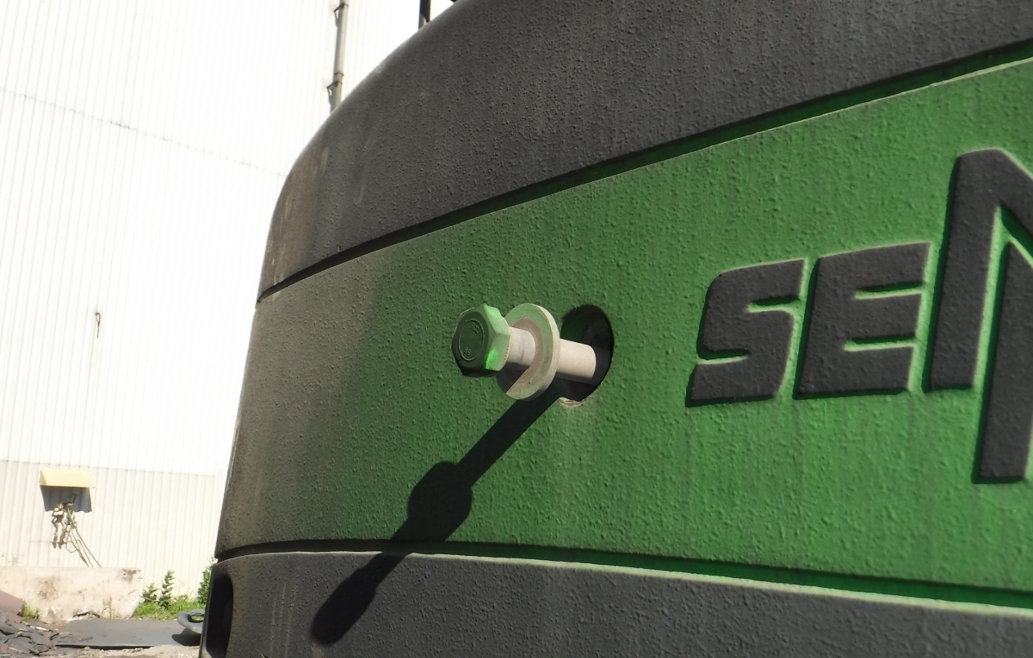
No Maintenance Results
Cause
Loose counterweight holding bolts
Result
Safety hazard

Slide 15
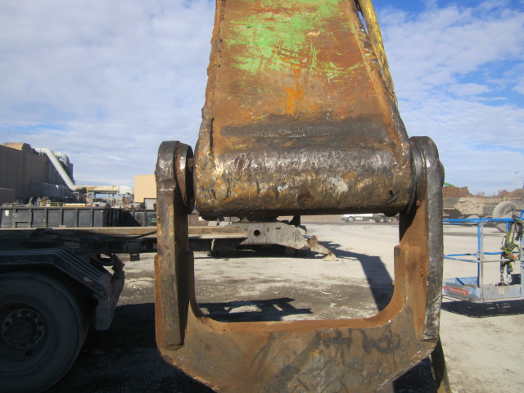
No Maintenance Results
Cause
Yoke not shimmed properly
Result
Wear and tear on pins and Bushings & damage to Structural components

Slide 16
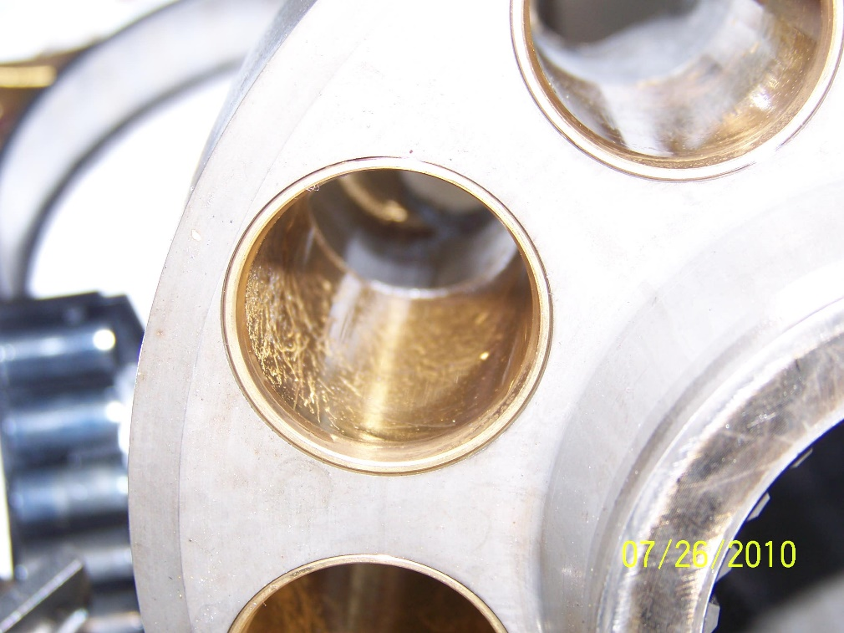
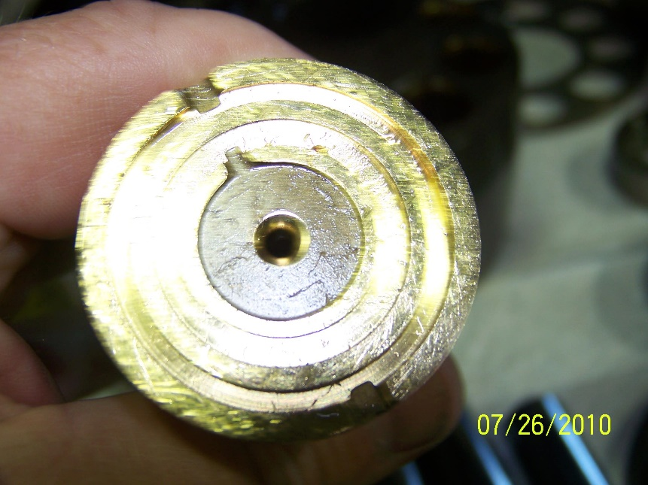
No Maintenance Results
Cause
Contamination hydraulic oil
Result
Hydraulic component failures

Slide 17
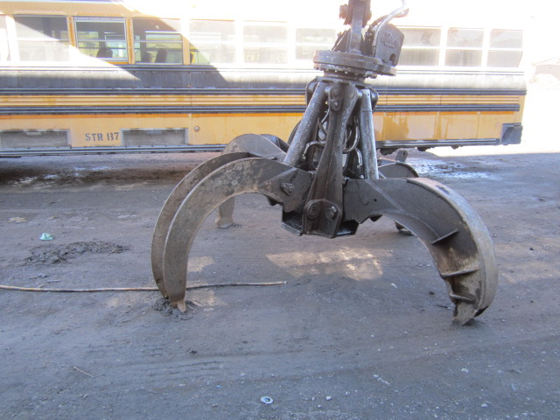
No Maintenance Results
Cause
Damaged grapple cylinders
Result
Hydraulic oil contamination
Drain tank & flush system
Hydraulic component failures

Slide 18
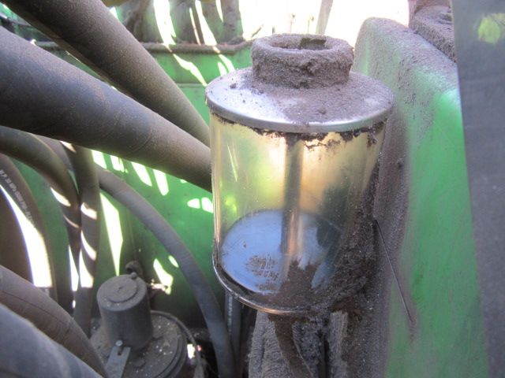
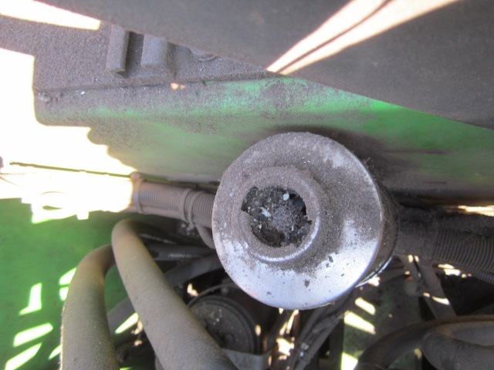
No Maintenance Results
Cause
Low oil level swing gear lubrication
Dirt in the reservoir
Result
Swing gear failure

Slide 19
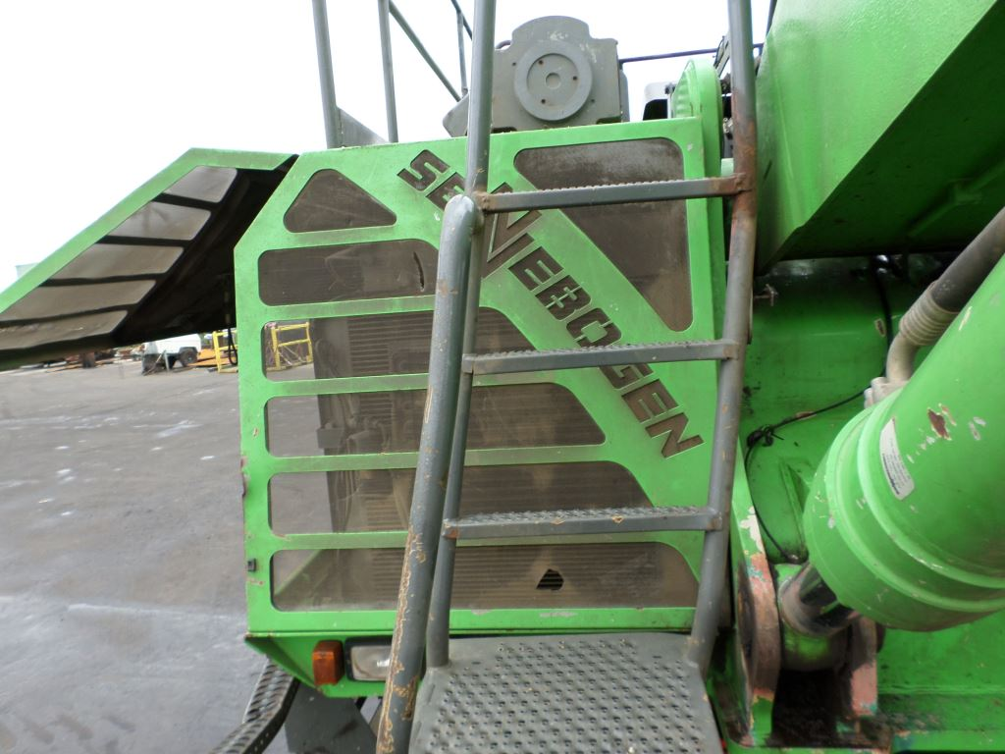
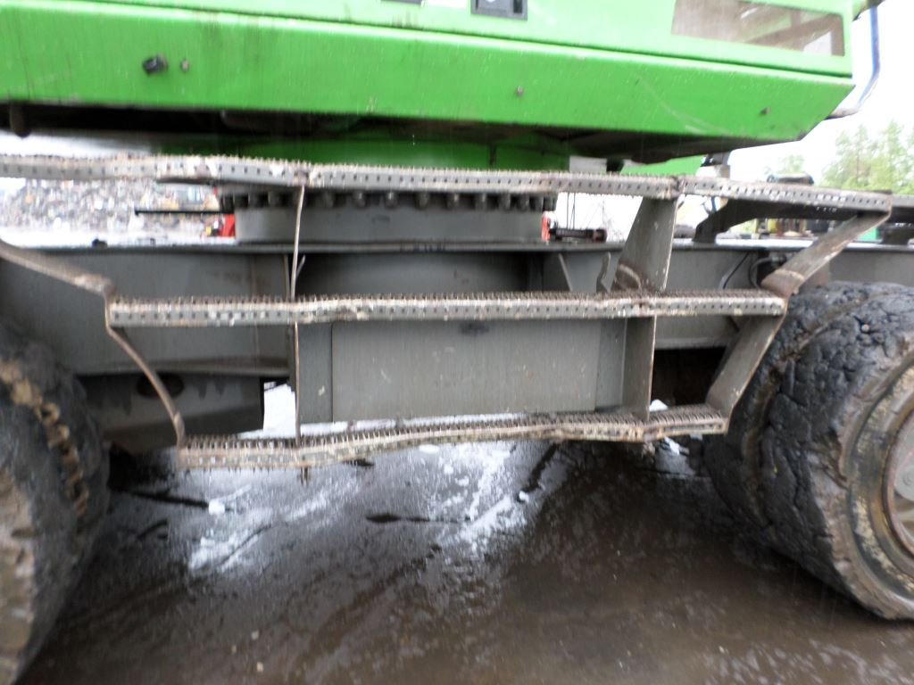
No Maintenance Results
Cause
Bent steps
Result
Safety hazard

Slide 20
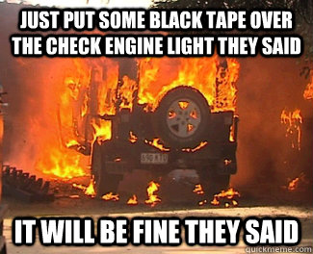
What’s the worst that can happen?

Slide 21
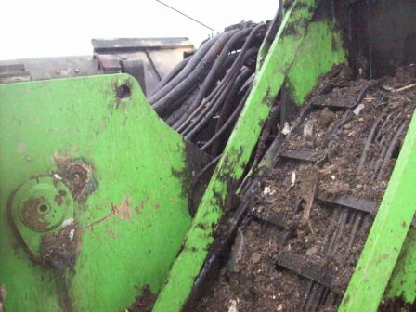
No Maintenance Results
Cause
Dirt
Result
Hose failures & fire

Slide 22
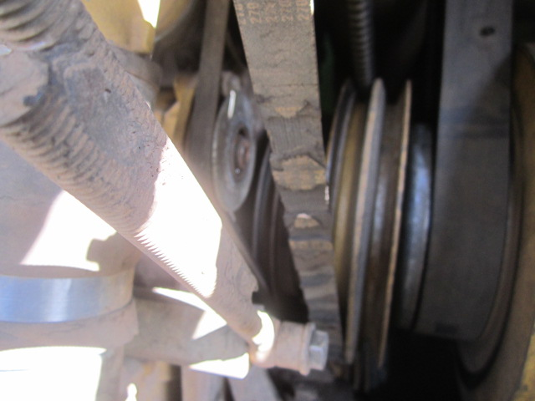
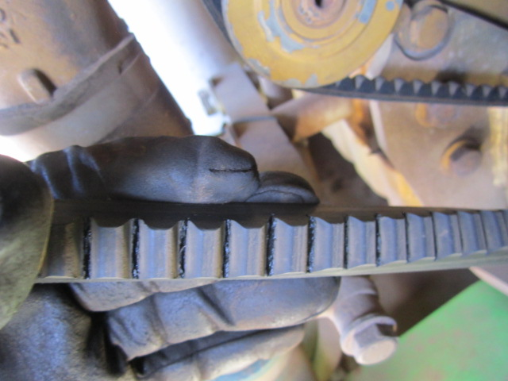
No Maintenance Results
Cause
Belts damaged
Result
Engine overheating
Engine premature failure

Slide 23
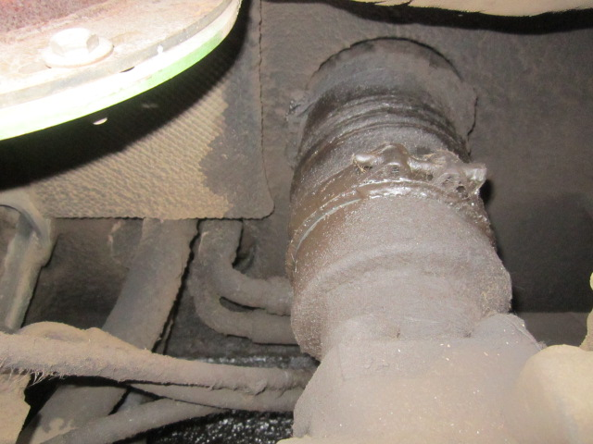
No Maintenance Results
Cause
Leaking engine air suction line
Result
Loss of engine performance
Engine contamination
Engine premature failures

Slide 24
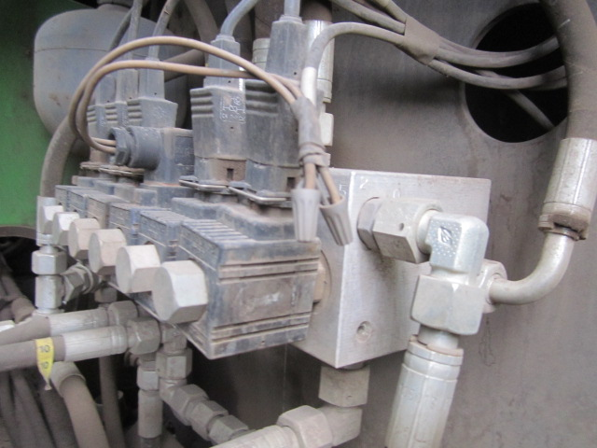
No Maintenance Results
Cause
Poor repairs to wiring harness
Result
Constant coil failure
Low machine availability
Difficult trouble shooting
Can cause equipment fire

Slide 25
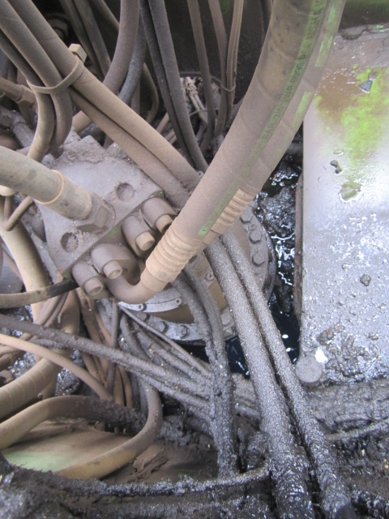
No Maintenance Results
Cause
Leaking hydraulic hoses
Result
Safety hazard
Loosing machine performance
Can cause equipment fire

Slide 26
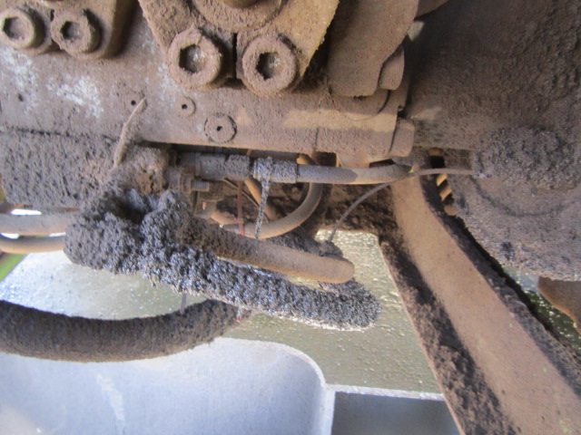
No Maintenance Results
Cause
Leaking fuel lines
Result
Safety hazard
System contamination
Can cause equipment fire

Slide 27
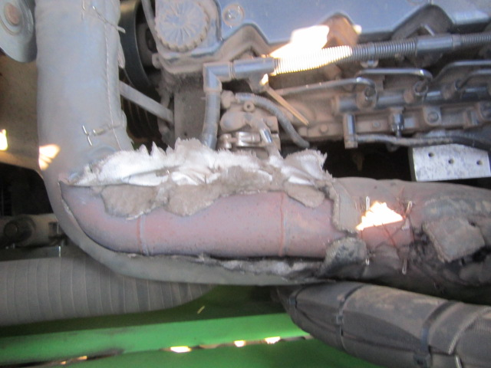
No Maintenance Results
Cause
Exhaust pipes insulation damaged
Result
Excessive heat in the engine compartment
Damage to fuel and hydraulic lines
Safety hazard
Can cause equipment fire

Slide 28
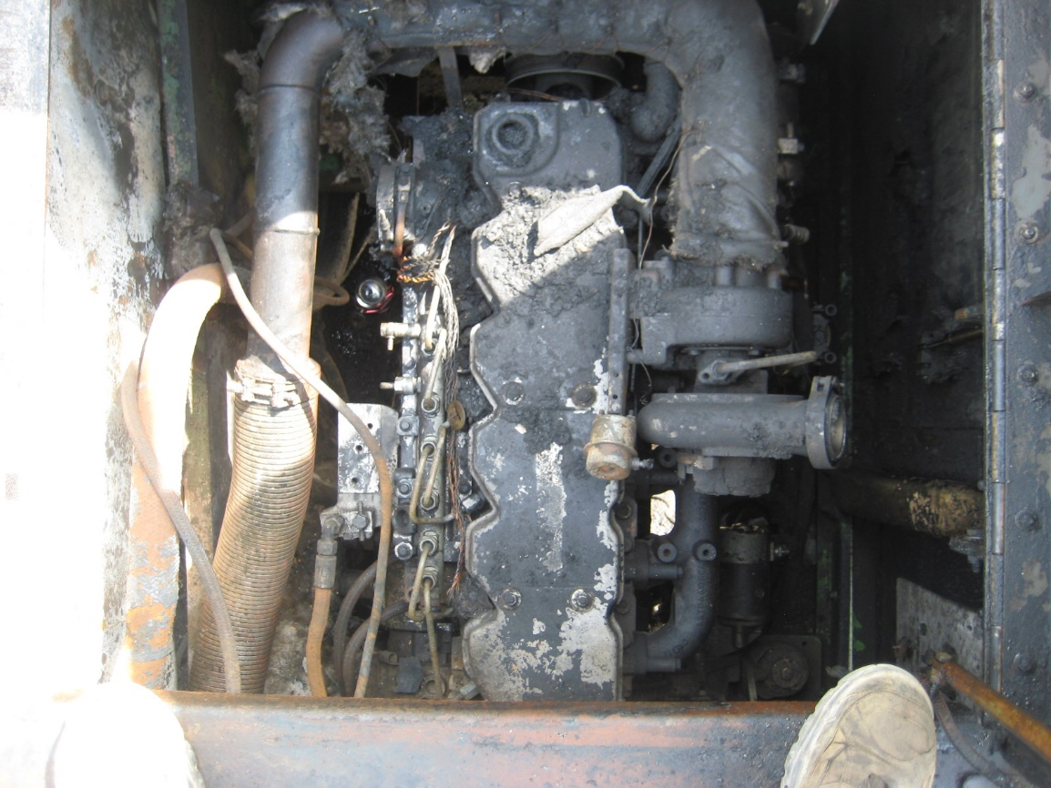
No Maintenance Results
Cause
Dirt in the engine compartment
Result
Safety hazard
Fire

Slide 29
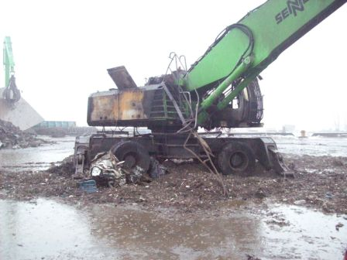
No Maintenance Results
Do you want to go there???

Slide 30
Improper maintenance increases your owning costs, decreases your uptime and creates a safety hazard to the operation and its environment.

Slide 31
Questions???
Constantino Lannes
704-340-8232
clannes@sennebogenllc.com

