Slide 1
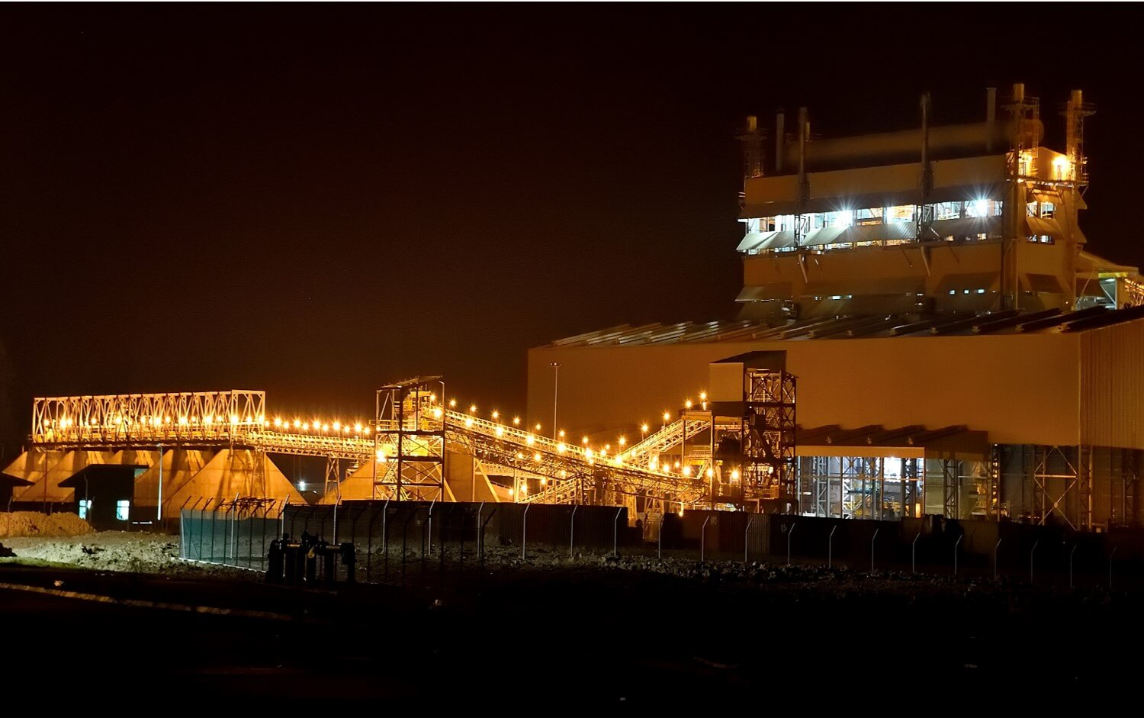

Business case for including a pyrometallurgical Slag Valorisation Furnace (SVF) into a new or existing steelmaking operation
Presented at 2025 National Slag Association Annual Meeting by:
- Zak van der Westhuizen (Sales Manager): zak.vanderwesthuizen@sms-group.com
Metix – SMS group in South Africa
Confidential

Slide 2
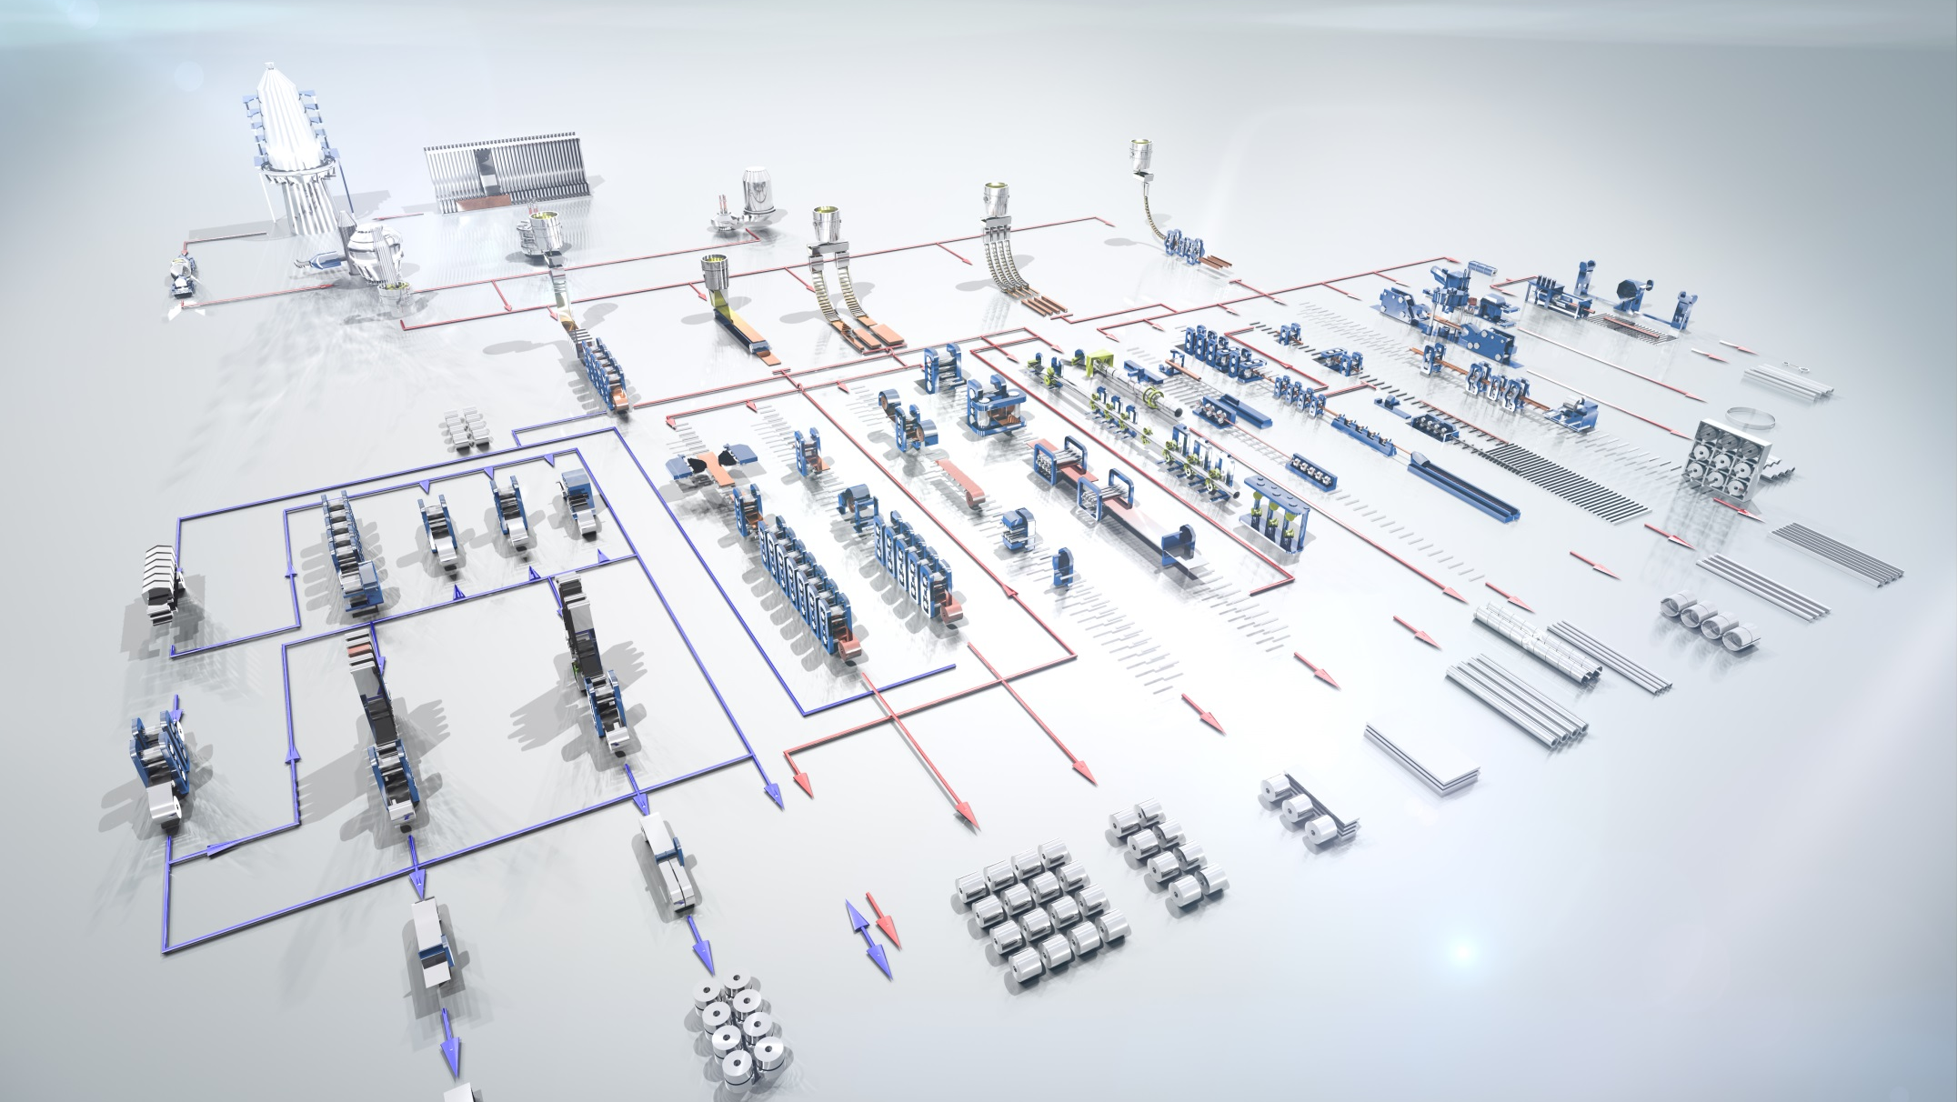





SMS group: Your full liner project partner for all reduction furnace applications
Contains Trade Secrets, Confidential, Proprietary, or Privileged Information Exempt from Public Disclosure

Slide 3

Your full liner project partner for all reduction furnace applications within SMS group
  PAUL WURTH - LEADING PARTNER IN THE IRON & STEEL INDUSTRY:
  Thanks to many generations of passionate and committed people and to a continuous urge for innovation, Paul Wurth, part of SMS group, made ground-breaking contributions to the advancement of these industries and can claim today to be a leading partner in the world of metals. Hot metal and pig iron produced by blast furnaces accounts for ≈60% of all steel products which the world’s population consumes. Almost every medium to large-size blast furnace operating in the world today incorporates Paul Wurth technology. Many smaller-size blast furnaces benefit from these technologies, too! Paul Wurth has developed the INBA® slag granulation process, with >300 references, it is the most popular and effective route of processing BF slag in the world today. The INBA system with steam condensation is officially recognised as a Best Available Technology (BAT).
  https://www.paulwurth.com
  SMS GROUP - LEADING PARTNER IN THE WORLD OF METALS:
  SMS group is renowned worldwide for its forward-thinking technologies and outstanding services in the metals industry. We apply our 150 years of experience and digital know-how to continuously innovate products and processes inside and outside our industry. As a partner for the most demanding projects, SMS group accompanies its customers throughout the entire lifecycle of their plants, thus enabling profitable and resource-saving value chains. Our mission is to turn metals green and to advance climate-neutral and sustainable metals production!
  https://www.sms-group.com
  METIX - LEADING PARTNER IN THE PYROMETALLURGY INDUSTRY:
  Metix, part of SMS group, is a market leader for providing process plants solutions and engineering services to the pyrometallurgical industry spanning both the ferrous, non-ferrous, waste recycling, slag conditioning, and green iron & steel sectors. Metix’ team of passionate and skilled engineers developed specialized and patented OEM equipment and refined its turnkey abilities for various smelter applications. Metix combines in-depth design and operational experience with the know-how of >750 SMS group smelter projects worldwide through its heritage brands. These tools are continuously stress tested against the market and best practices (Building Information Modelling “BIM”, Design for Construction “D4C”, and Best in Class Technology) for improving both product and customer service. Civil-, Structural-, Process-, Mechanical-, Electrical-, Instrumentation and Control Engineering form part of Metix’ core competence supported by a full-time BIM design office!
  https://www.metix.co.za
  TMT - LEADING PARTNER FOR ALL TAPPING & MEASUREMENT TECHNOLOGIES:
  TMT, part of SMS group, is the leading solution provider of tapping and measurement solutions for blast furnaces, ferroalloys-, and non-ferrous smelters. While a wide range of casthouse machines ensures that the furnaces can be tapped in a reliable and safe manner, multiple different probes deliver measurement data to make the reduction and smelting process more transparent and cost efficient. Today, TMT dedicates 100% of its efforts to provide its customers the most appropriate solutions for their individual situation. Personnel safety, process safety and reduction of production costs are taken into consideration in the same way as the environmental impact of the smelting process. TMT is proud to have supplied >2,400 tapping machines worldwide!
  https://tmt.com
Contains Trade Secrets, Confidential, Proprietary, or Privileged Information Exempt from Public Disclosure

Slide 4
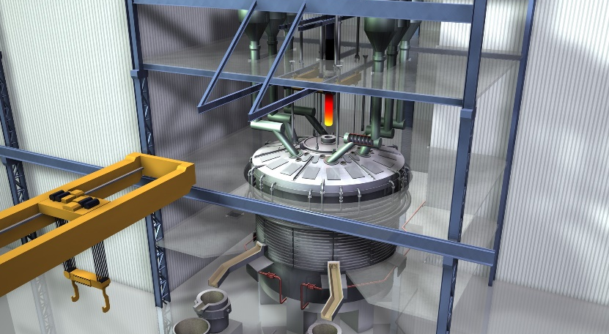
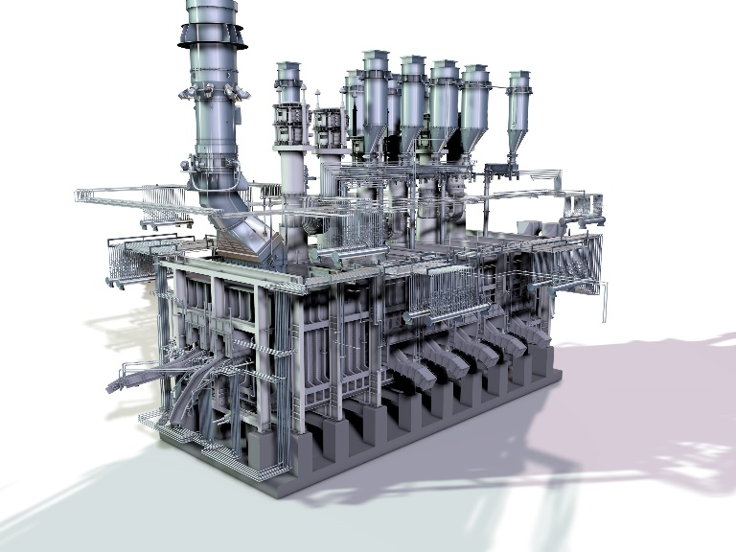

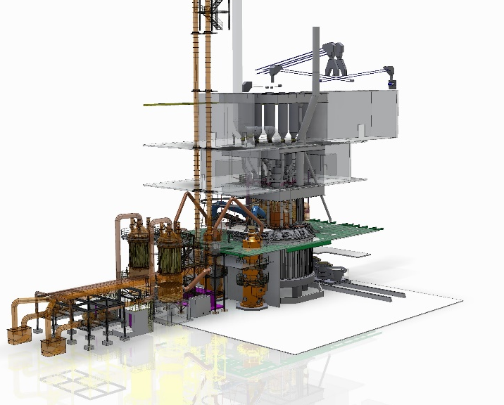
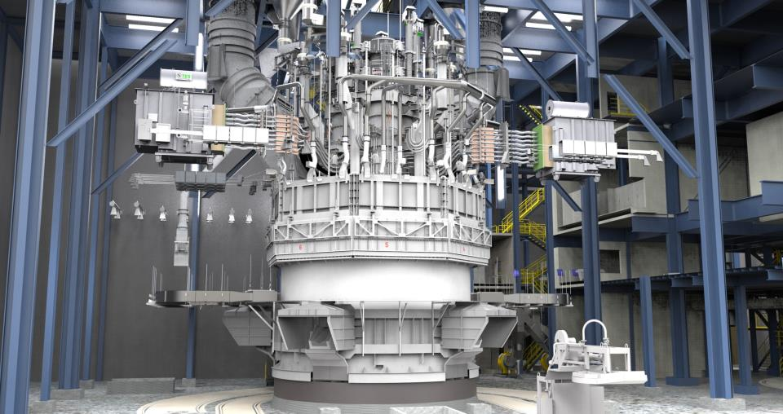
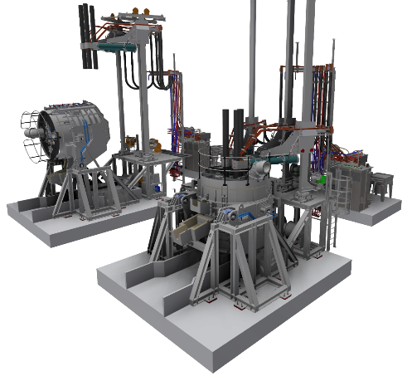
Metix‘ core competence & capabilities
Single electrode DC-arc
3- & 6-electrode rectangular
Metix (JHB, South Africa)
Team members: ~125
Tailored process solutions for (but not limited to):
FERROUS Ferrochrome Ferromanganese Silicomanganese Ferrosilicon Ferrovanadium Ferroniobium Ferronickel Pig iron | NON-FERROUS Platinum Group Metals Base Metals (Cu, Co, Pb, Zn, Ni, Sn) Calcium Carbide Ilmenite (TiO₂ slag) Metallurgical Silicon Fused Magnesia | GREEN TECHNOLOGIES Iron & Steel making Waste recycling Slag conditioning
Large capacity closed circular
Semi-closed & rotating shell
CORE TECHNOLOGIES
AC & DC Furnaces (circular / rectangular)
Submerged-, Brush-, Shielded- and Open arc
Matte Settling & Slag Cleaning
Slag Valorisation
CORE CAPABILITIES
All project formats (EP / -S / -C / -CM)
Feasibility studies (FEL, PFS, DFS, FEED, BE, etc.)
Building Information Modelling (BIM)
Metallurgical and process design
Pilot furnaces & test work assistance
After sales service & support
Bespoke & tailored pilot plants
Contains Trade Secrets, Confidential, Proprietary, or Privileged Information Exempt from Public Disclosure

Slide 5
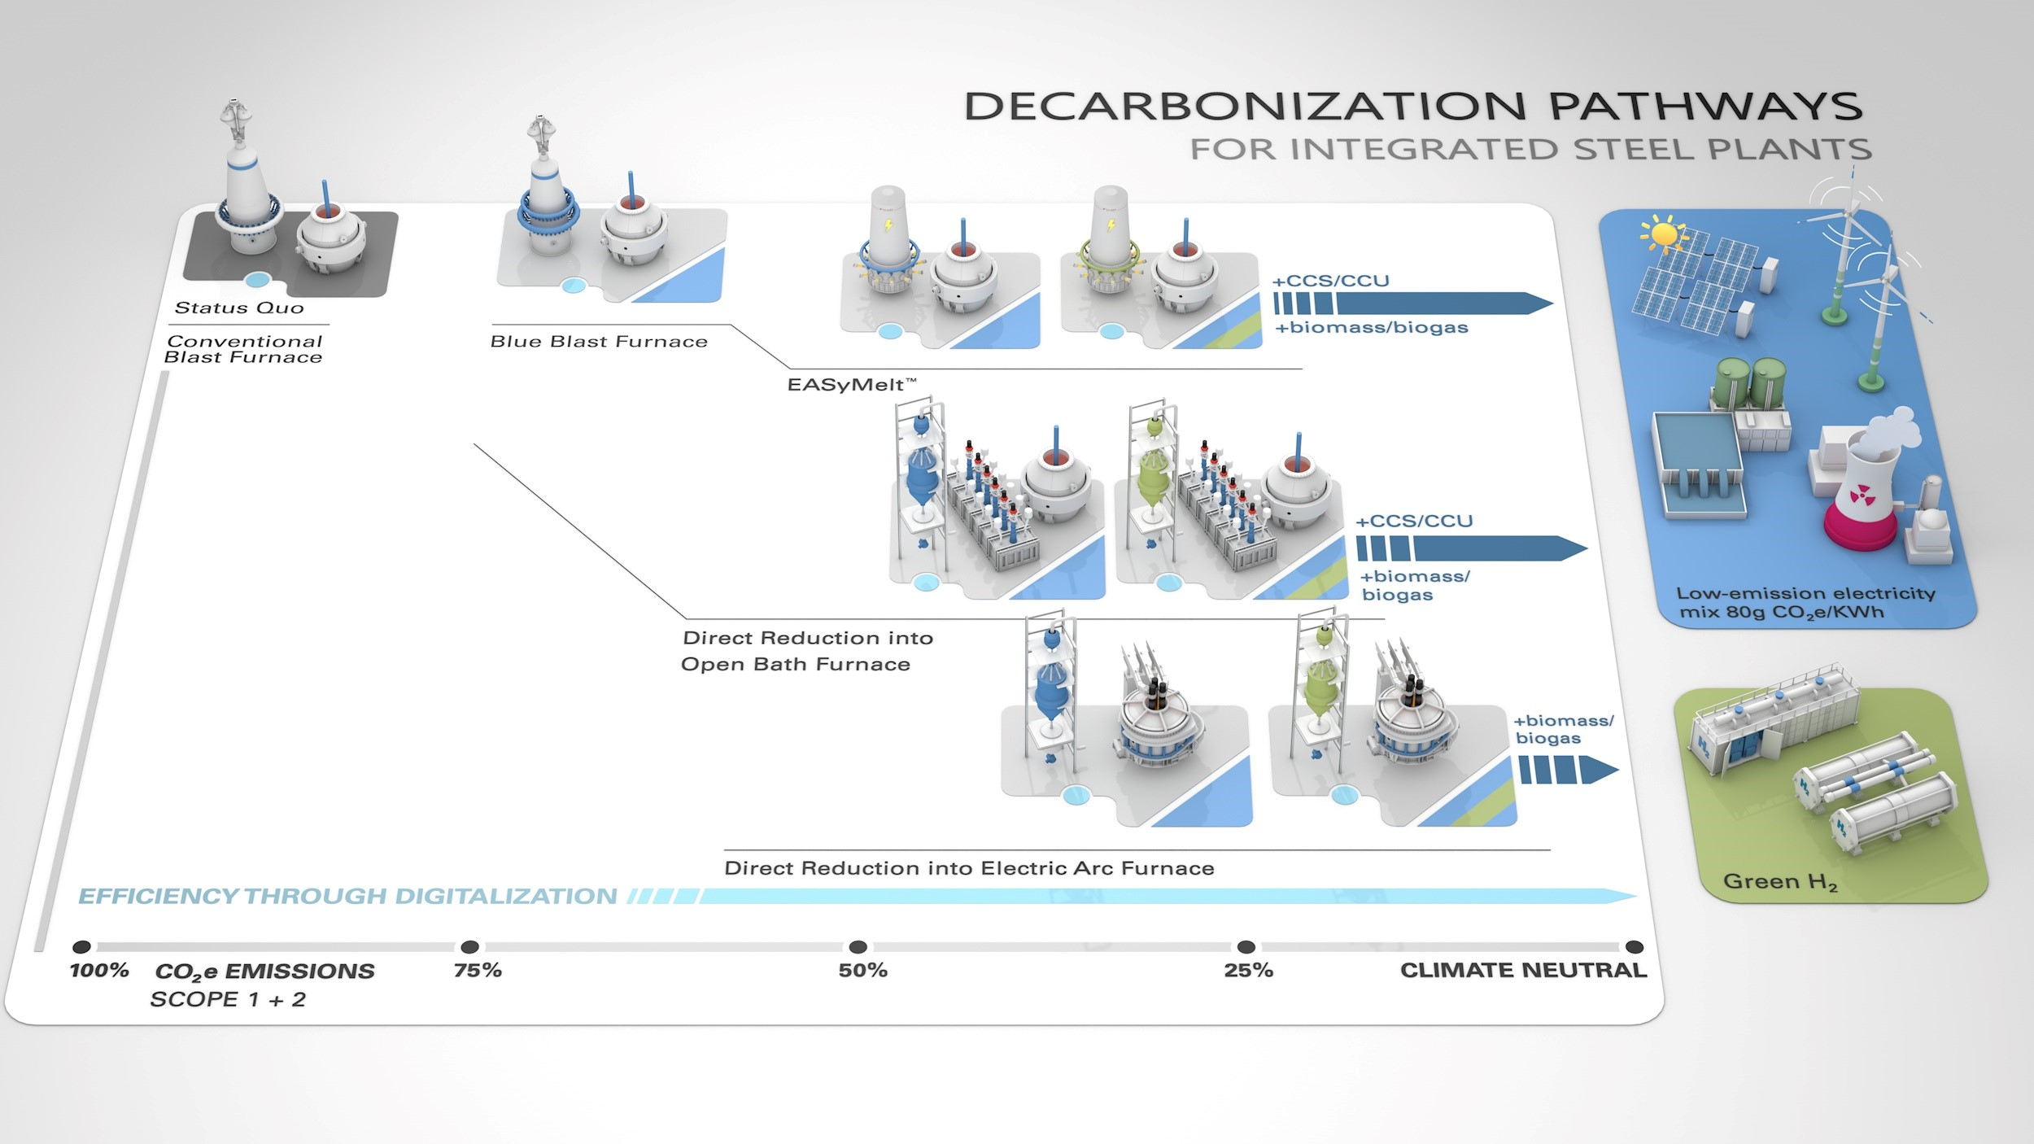

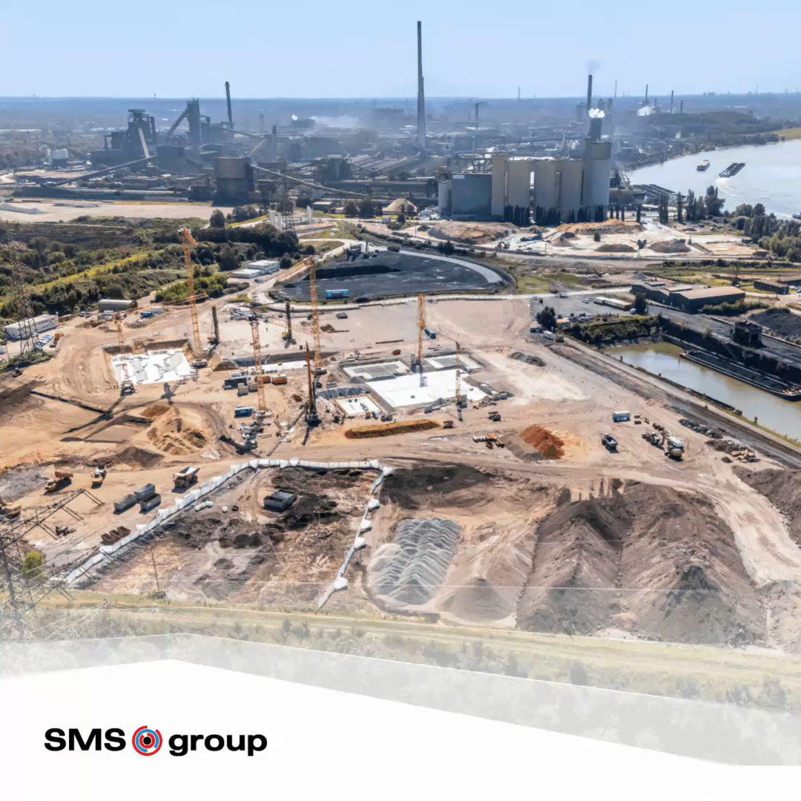



Contains Trade Secrets, Confidential, Proprietary, or Privileged Information Exempt from Public Disclosure

Slide 6
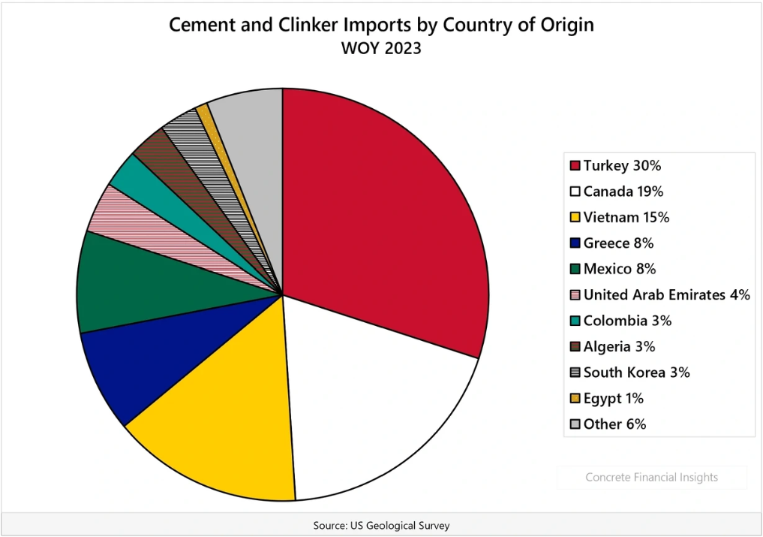
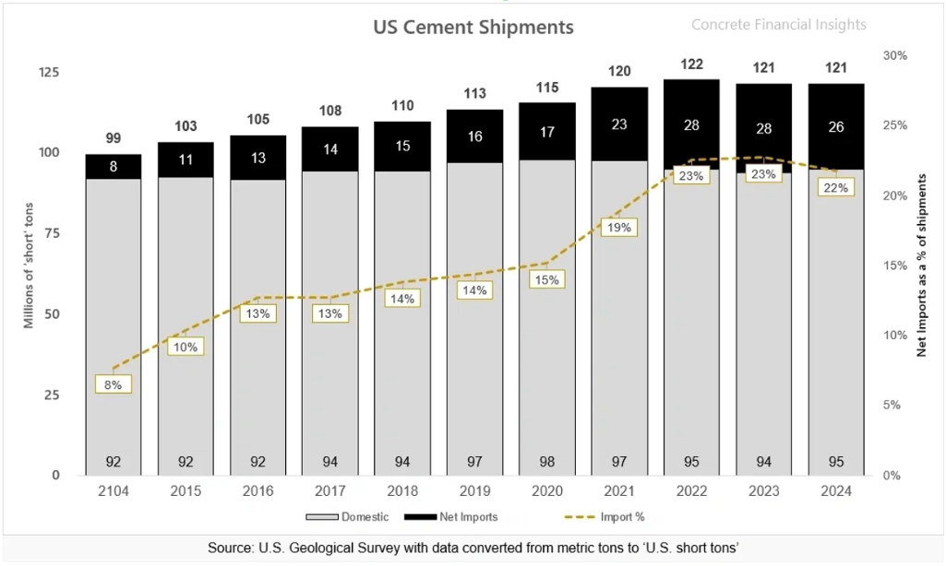
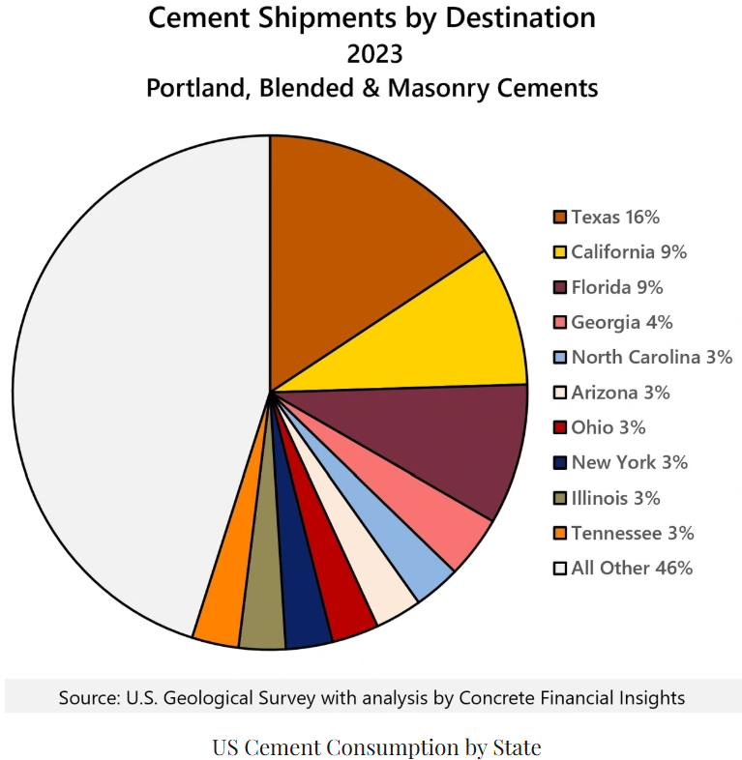
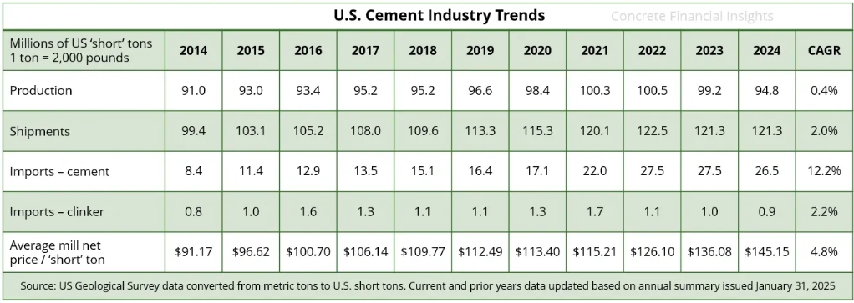
US cement industry trade statistics
INCREASED IMPORTS
Contains Trade Secrets, Confidential, Proprietary, or Privileged Information Exempt from Public Disclosure

Slide 7
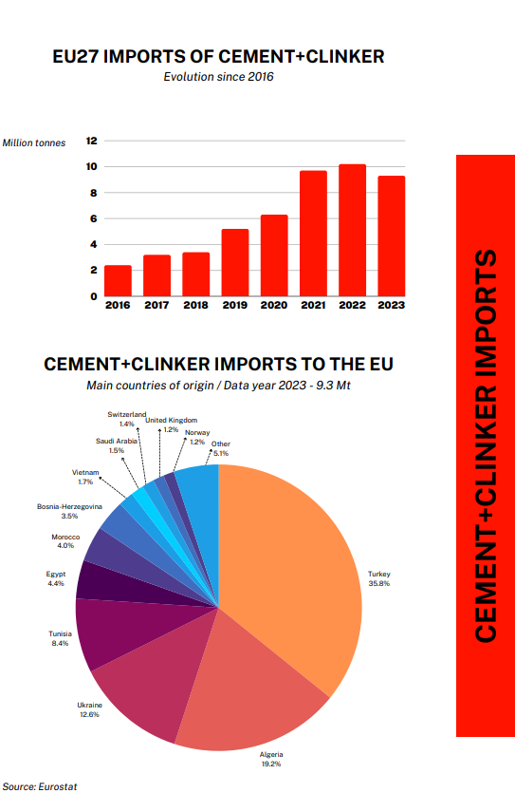
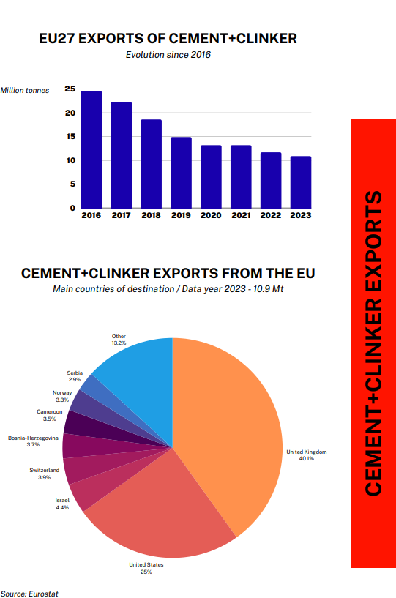
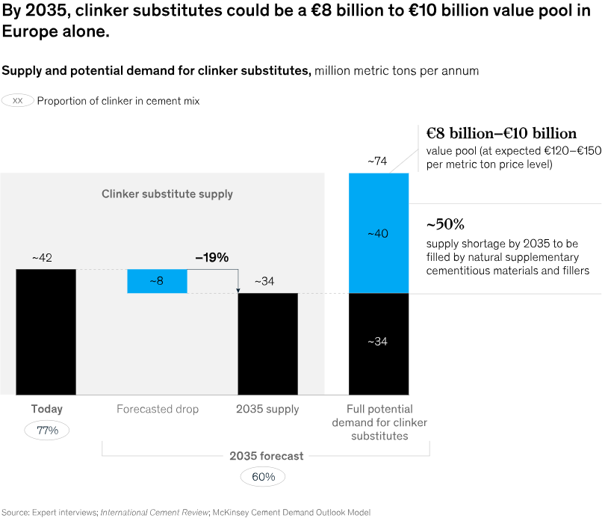
EU cement industry trade statistics
INCREASED IMPORTS
https://cembureau.eu/media/1ibpjhpn/eu-cement-industry-trade-statistics-full-year-2023.pdf
https://www.mckinsey.com/industries/engineering-construction-and-building-materials/our-insights/the-future-cement-industry-a-cementitious-golden-age
Contains Trade Secrets, Confidential, Proprietary, or Privileged Information Exempt from Public Disclosure

Slide 8
Existing steelmaking flowsheet
Contains Trade Secrets, Confidential, Proprietary, or Privileged Information Exempt from Public Disclosure

Slide 9

Improved steelmaking flowsheet
Contains Trade Secrets, Confidential, Proprietary, or Privileged Information Exempt from Public Disclosure

Slide 10
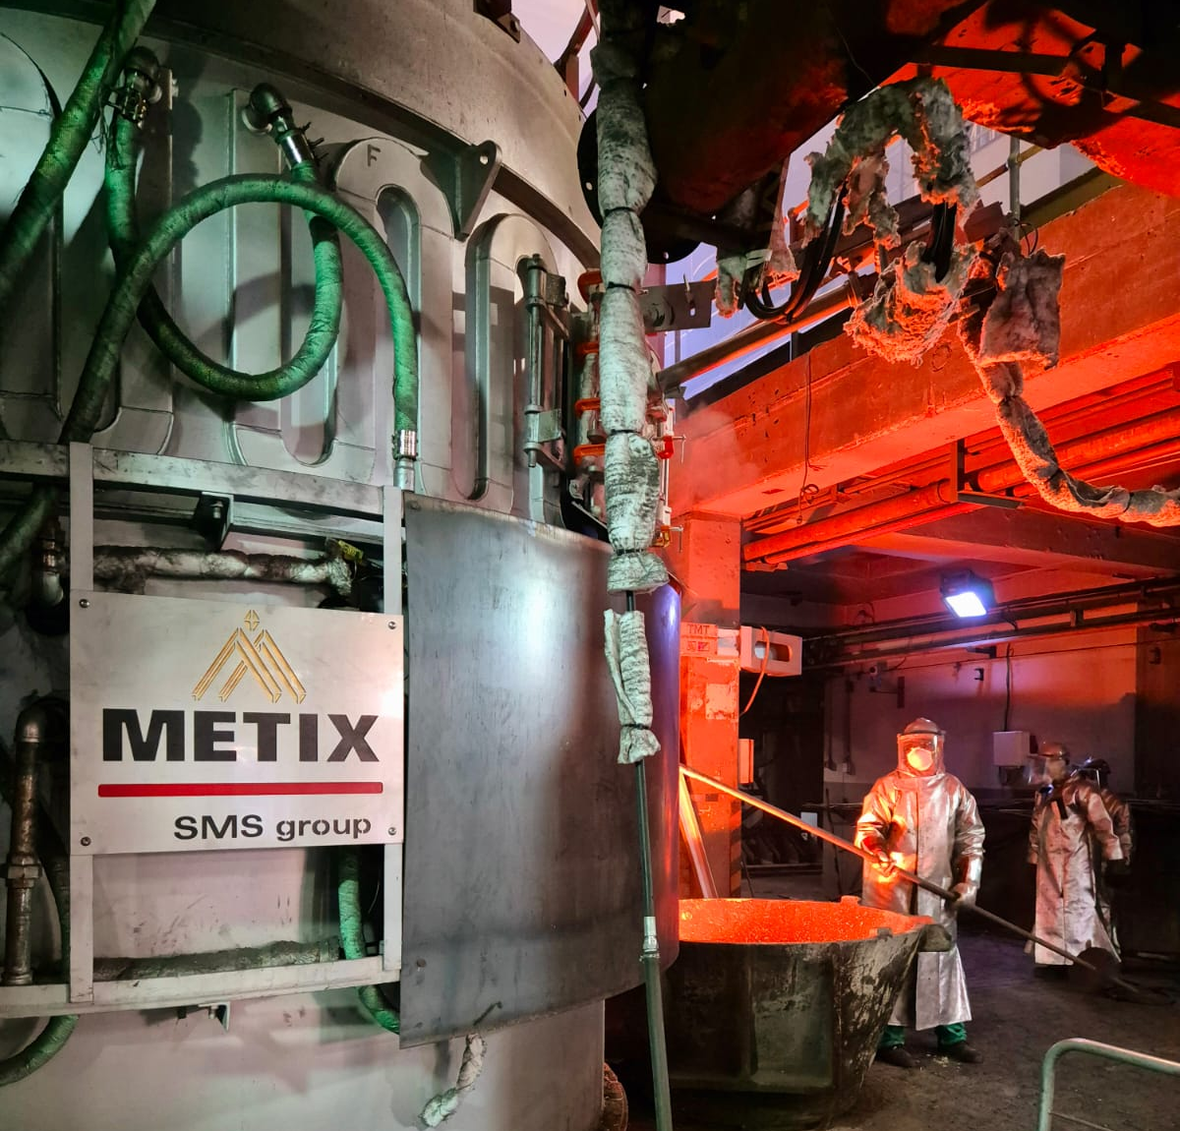
SVF: Integrated EAF flowsheet improvement & opportunities
Potential end-users:
    Integrated iron & steel facilities.
    Cement producers utilising clinker replacement from iron & steel facilities.
    3rd party slag conditioning & valorisation entities.
Core benefits:
    Introduce circular economy by recycling slag, reclaiming of iron units, and zero slag stockpiled.
    Decouples slag modification for valorisation purposes from iron/steel production.
    Wide targeted valorisation product range capabilities, i.e. Supplementary Cementitious Materials (SCM), Ground Granulated Blast Furnace Slag (GGBFS), alumina cement ,etc.
    Recovering of metallic oxides and free metal droplets as an alloy byproduct.
    Process versatility by combining rectangular or DC plasma arc electrical SVF with post furnace slag modification or/in conjunction with granulation (wet/dry) and slag clinkering.
    Capability of receiving a wide range of feed material.
    Processing capability of a wide range of wastes, i.e. fine dusts and mill scale.
    Option to combine a heat recovery system to recover energy.
    Save on slag stockpiling costs and area.
    Decreasing the carbon footprint with possibility of claiming carbon credits (depending on the specific region).
Contains Trade Secrets, Confidential, Proprietary, or Privileged Information Exempt from Public Disclosure

Slide 11
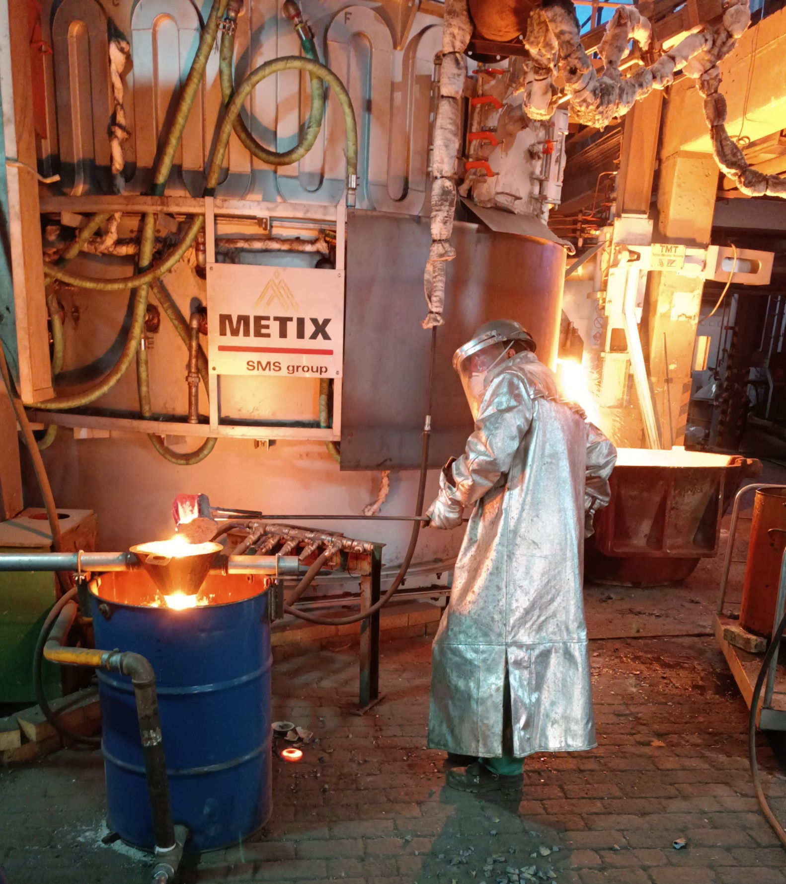
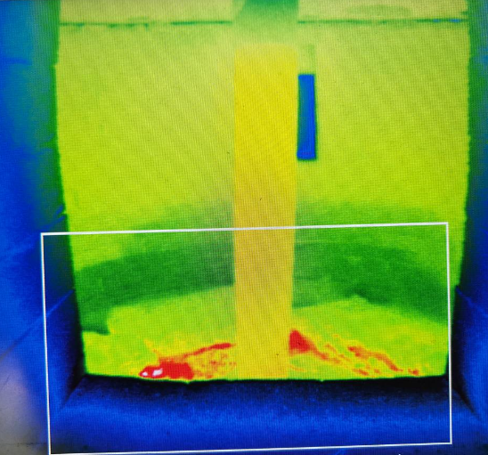
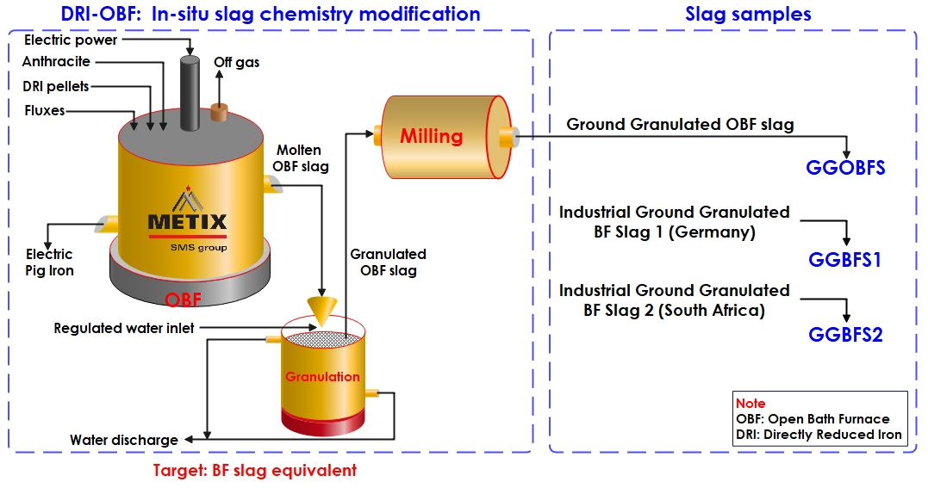
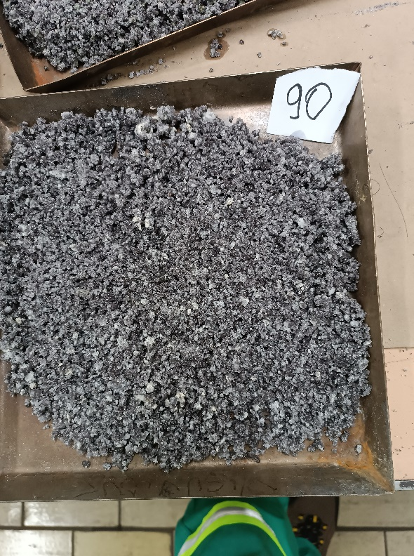
SVF: Dedicated test work completed
GGBFS produced as part of a DRI test campaign utilising Metix’ custom-built Open Bath Furnaces (OBFs) at the Mintek test Facility in Johannesburg, South Africa.
Continuous operation over >30-days (smelting ≈400 tons cold NGDRI with >100 taps completed).
Wide temperature range and varying compositions tested.
Adjusting slag properties to enhance metal collection and reduction processes.
Slag properties compared and confirmed with Industrial GGBFS.
Contains Trade Secrets, Confidential, Proprietary, or Privileged Information Exempt from Public Disclosure

Slide 12
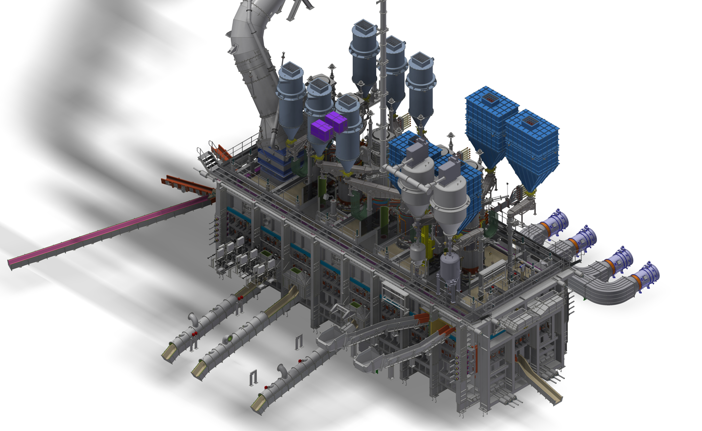
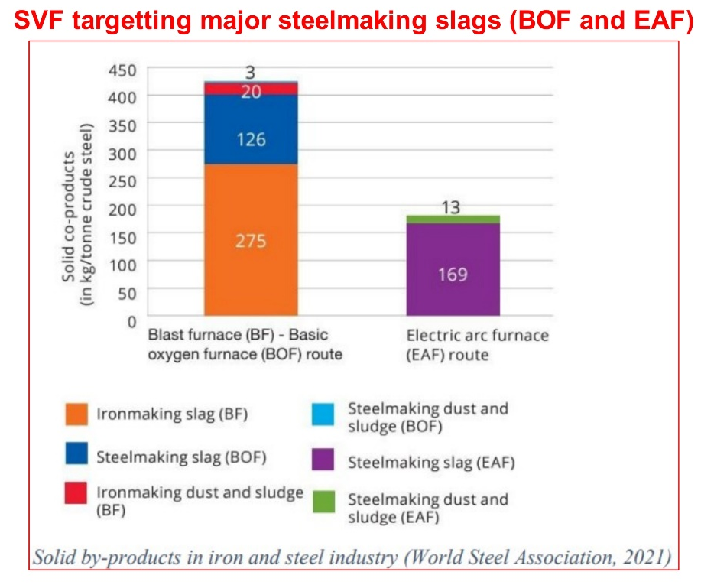
SVF: Integrated EAF flowsheet improvement & opportunities
Off-gas energy
recovery
REDUCTANTS
& FLUXES
COLD FEED
(ie; historic slags)
Valorised
SCM slag
FINE FEED
(ie; manufacturing wastes)
Recovery of
Fe-units
HOT FEED
(ie; molten EAF slag)
Contains Trade Secrets, Confidential, Proprietary, or Privileged Information Exempt from Public Disclosure

Slide 13
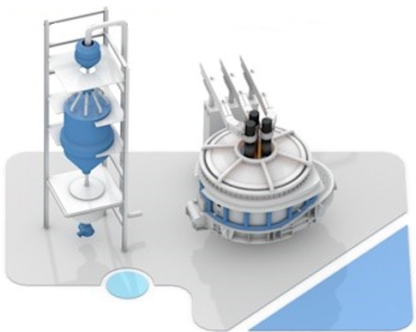
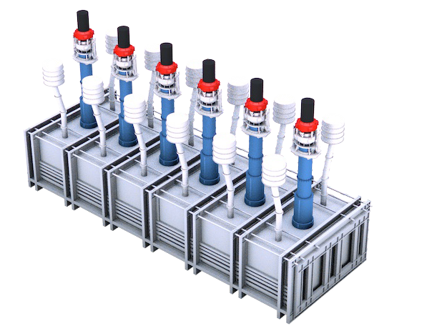
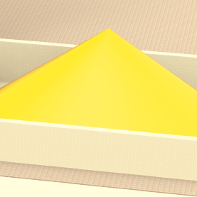

SVF: Integrated EAF flowsheet improvement & opportunities
(based on several case studies)
Fe ore
DRP > EAF + SVF
DRP > EAF (+SVF):
Introduction of a Slag Valorization Furnace (SVF)
Recovery of Fe-units from discard EAF slag = Improved ROI!
Adjust discard EAF slag composition to a saleable Supplementary Cementitious Materials (SCM) type = Improved ROI!
Off-gas thermal energy post combustion = Improved ROI!
No slag crushing and metal recovery operations required = Reduced OPEX!
Zero slag stockpile costs = Reduced OPEX!
Crude steel
Fe recovery
EAF slag
Energy recovery
Other
(ie; pig iron)
SCM
Contains Trade Secrets, Confidential, Proprietary, or Privileged Information Exempt from Public Disclosure

Slide 14
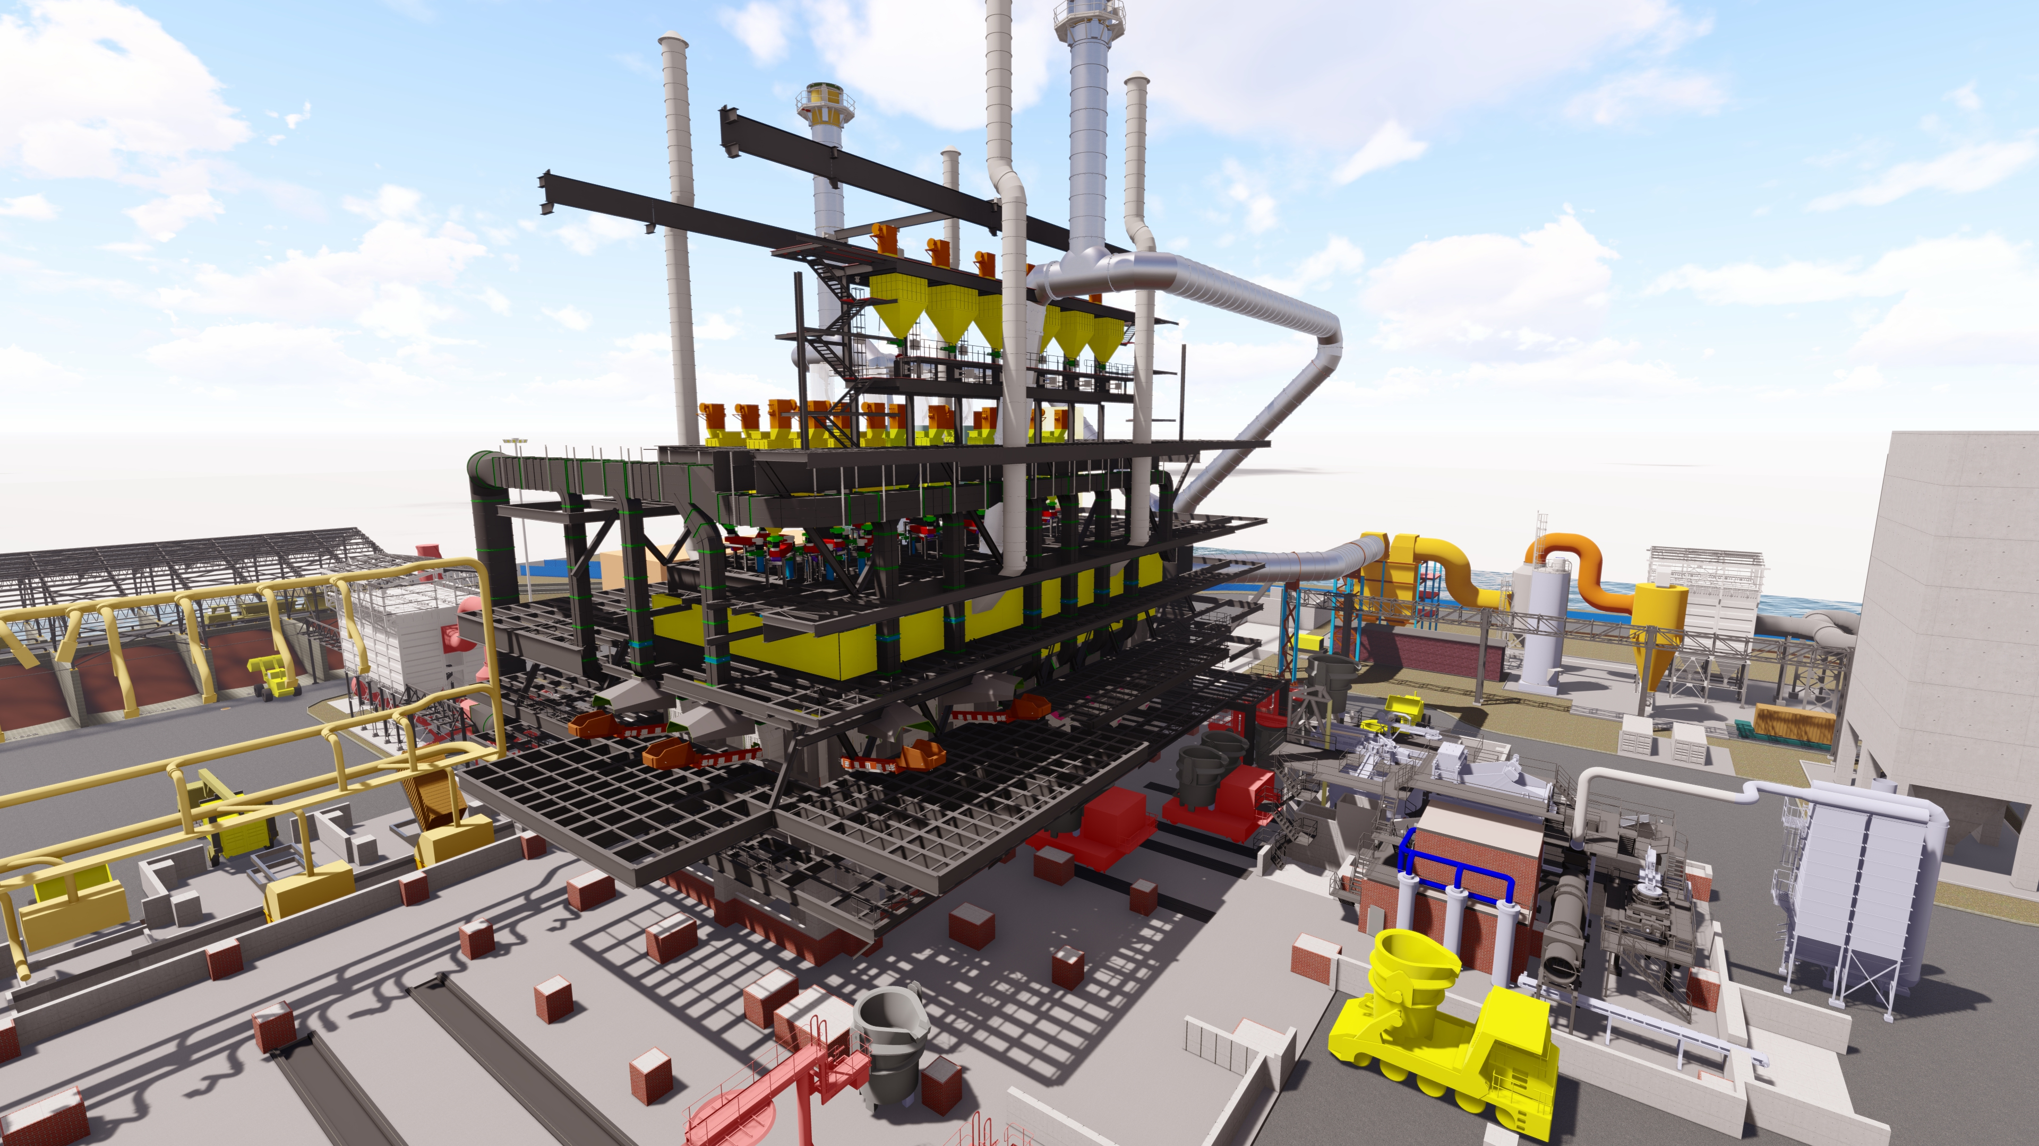
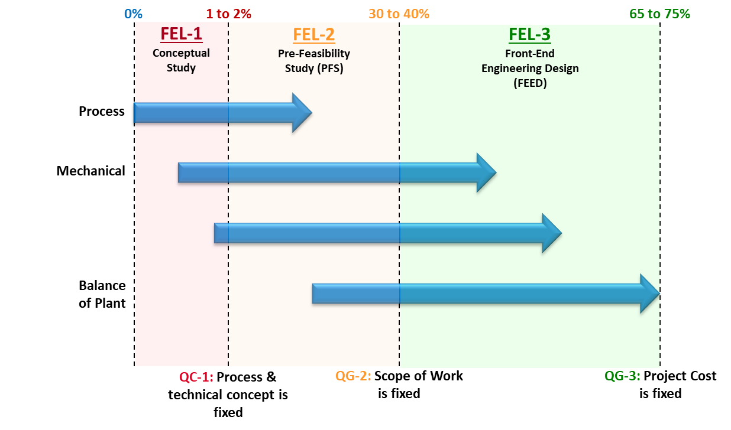
SVF: Tailoring a bespoke solution
Client specific scenario will impact furnace technology selection and hence will be tailored to suit!
    Based on SMS & Metix rectangular furnace references: Mostly non-ferrous matte settling-, and slag cleaning furnaces (MSEF & SCF)
    Based on SMS & Metix circular furnace references: Mostly ferroalloy and ilmenite furnaces
Contains Trade Secrets, Confidential, Proprietary, or Privileged Information Exempt from Public Disclosure

Slide 15
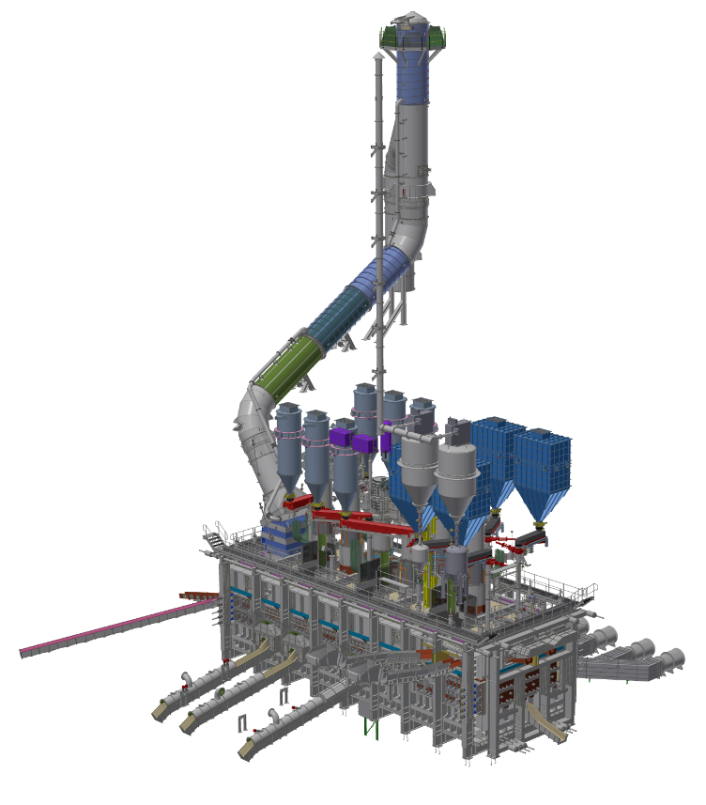
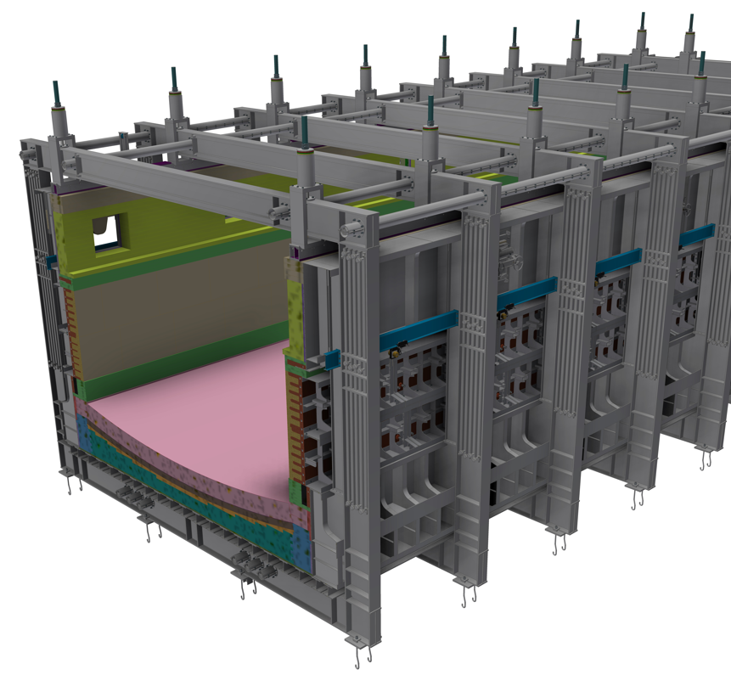
SVF: Conclusion
Turning a “waste” into a “product”!
Improving the EAF steelmaking process efficiency!
Strong potential for SVF application to produce SCM slag!
Lucrative project payback (~3-years on average)!
SVF efficiency increase proportionally to higher throughput (ie; operating MW)!
Tailored solution and integration to existing facilities!
Derisking done through extensive investigation, modelling, and physical test campaigns!
Furnace fundamental design industrialised utilising proven and robust equipment from other industries and commodity application!
Contains Trade Secrets, Confidential, Proprietary, or Privileged Information Exempt from Public Disclosure

Slide 16
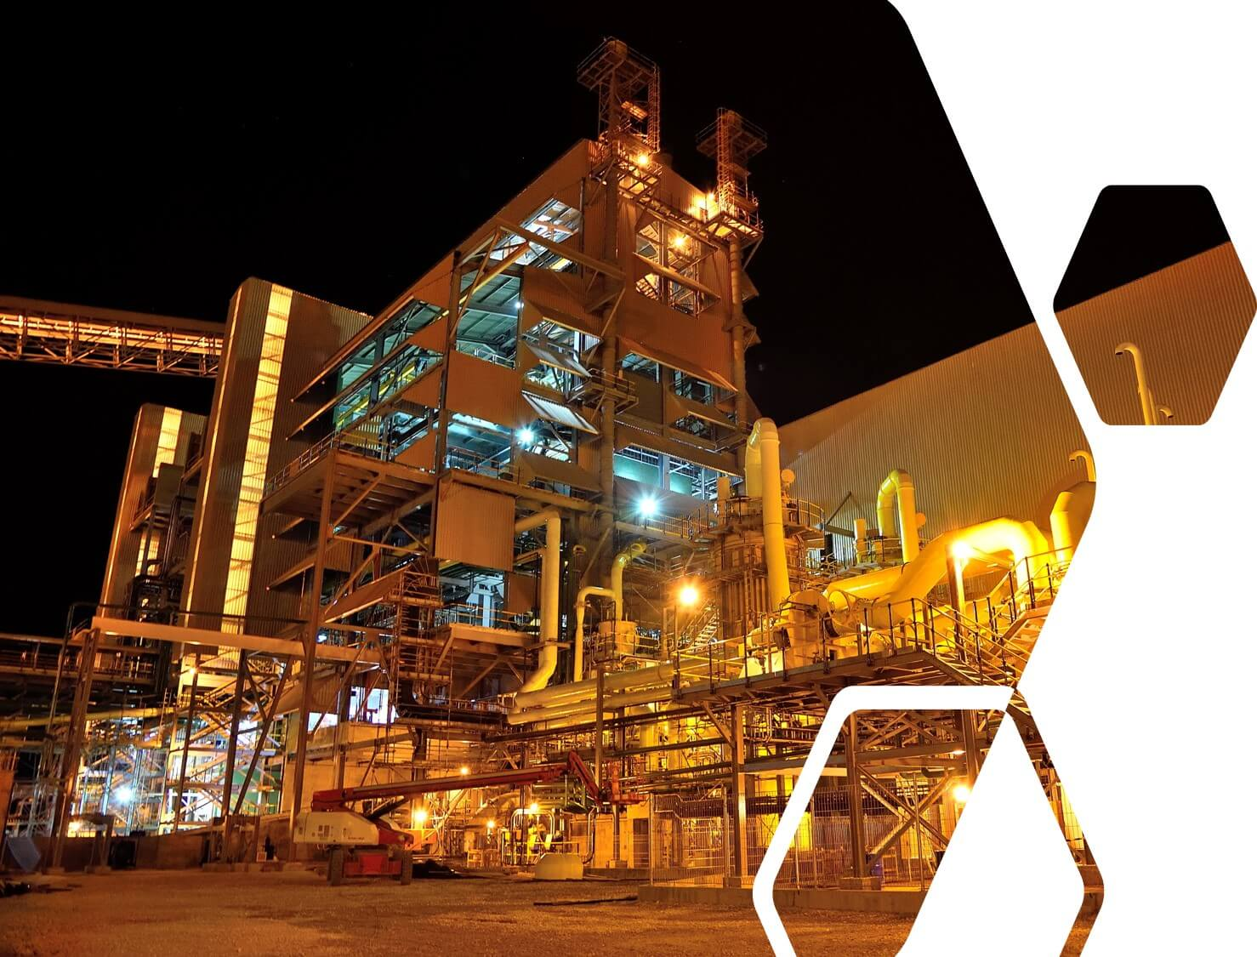
METIX (PTY) LIMITED
Zak van der Westhuizen
Sales Manager – Metix (SMS group)
Mobile: +27-72-180-2719| Office: +27-11-676-2300
Email: zak@metix.co.za | Website: www.metix.co.za
204 Rivonia Road, Morningside, 2196
Sandton, Gauteng, South Africa
P.O. Box 3293, Cramerview, 2060, South Africa
Contains Trade Secrets, Confidential, Proprietary, or Privileged Information Exempt from Public Disclosure

