Slide 1
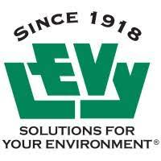


EAF Slag Grade Stabilization Structures (Check dams) for Stormwater Management
Timothy J. Schauwecker
Dept of Landscape Architecture and Environmental Design
Funding for this project:
This material is based upon work supported by the Natural Resources Conservation Service, U.S. Department of Agriculture, under award number NR213A750013G019. Any opinions, findings, conclusions, or recommendations expressed in this publication are those of the author(s) and do not necessarily reflect the views of the U.S. Department of Agriculture."

Slide 2
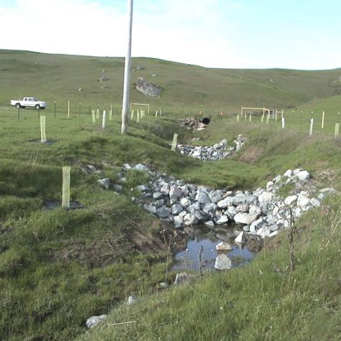
Grade Stabilization Structures: USDA-NRCS Conservation Practice Standard 410 (2020)
DEFINITION
A structure used to control the grade in natural or constructed channels.
PURPOSE
This practice is used to accomplish one or more of the following purposes:
Reduce erosion
Improve water quality
CONDITIONS WHERE PRACTICE APPLIES
This practice applies where channels require a structure to stabilize the grade or to control gully erosion.
USDA-NRCS 2020

Slide 3
Research Objectives
Determine the total cost and efficacy of the production of large quantities of engineered biochar designed for the removal of dissolved phosphorus from stormwater runoff.
Install check dams and bioreactors and track all processes and costs.
Quantify the impact of bioreactor installation on instream and downstream processes
Transfer the design, installation, cost, and monitoring data to EQIP-eligible producers in the Redbud-Catalpa watershed, the state of Mississippi, and the southeastern US via field days, information sheets, conference presentations, and outreach events.

Slide 4
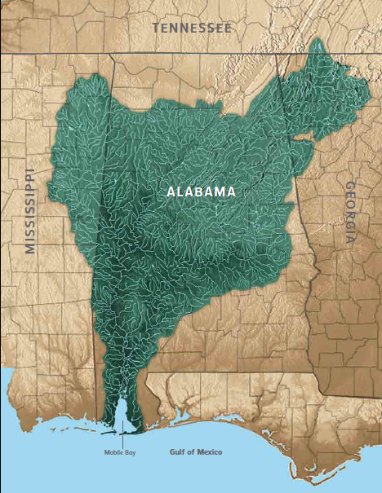
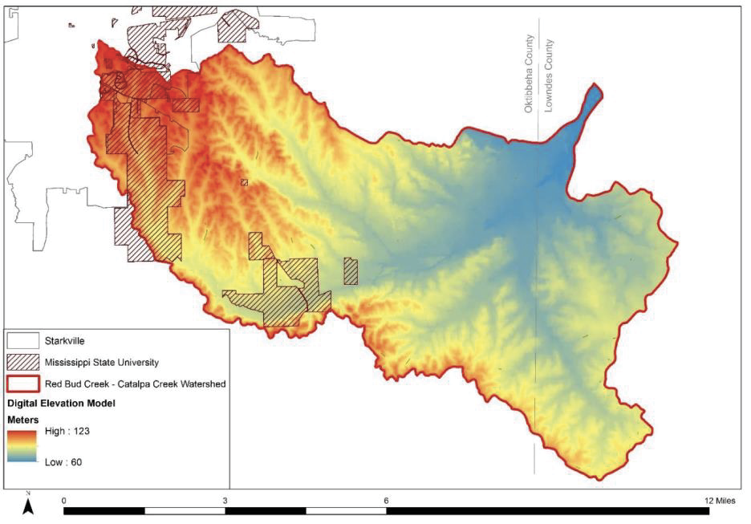
Redbud-Catalpa Creek Watershed > Tibbee Creek > Tenn-Tombigbee Waterway > Mobile Bay

Slide 5
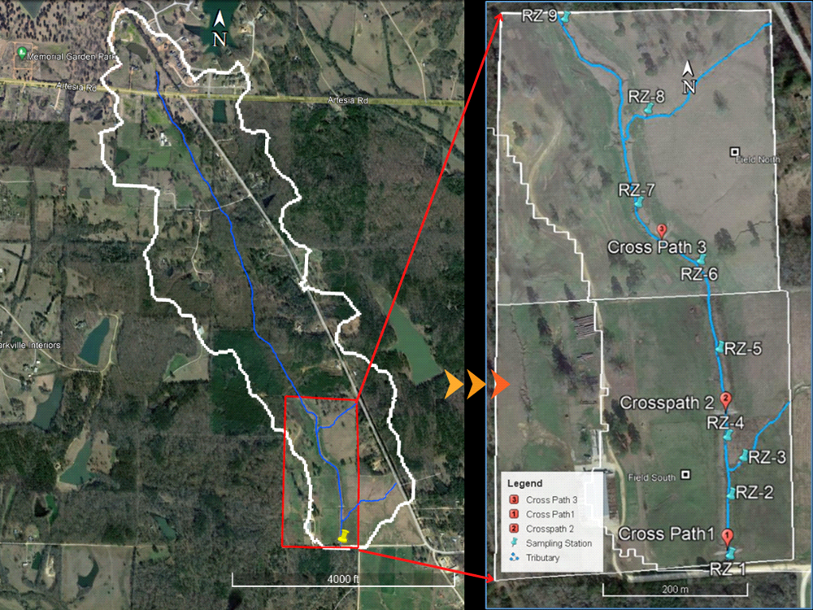
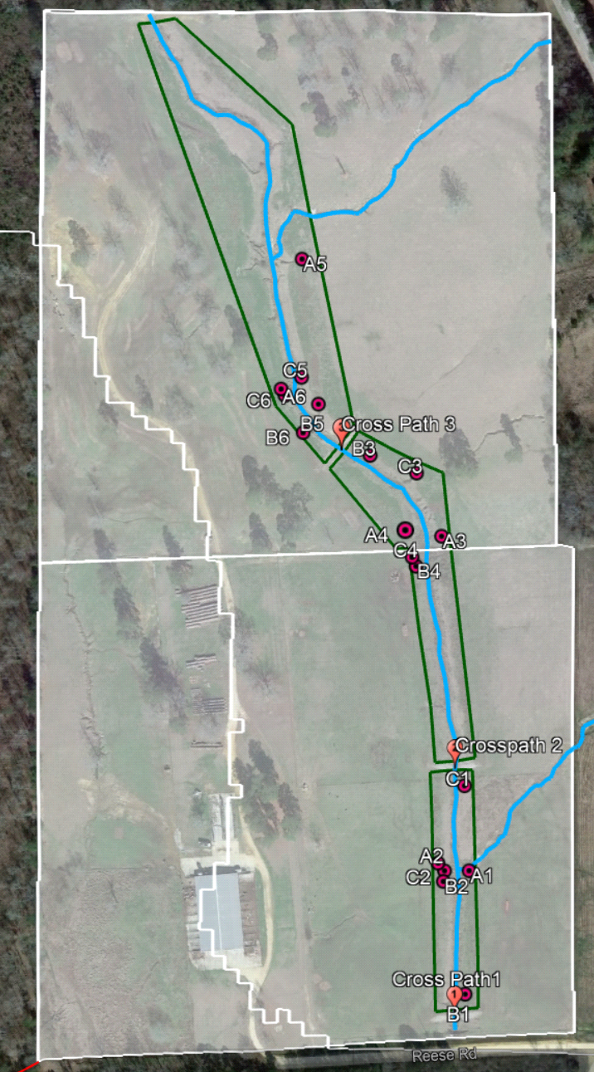
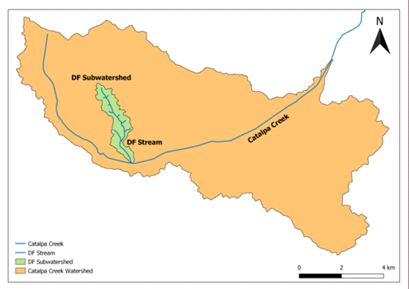
LOCATION, WATERSHED, AND SUB-BASIN
Research subwatershed location within the Redbud-Catalpa Creek watershed
Reach of the subwatershed that contains our experimental units
Layout of main channel baseline data sampling locations (RZ 1-8). Sampling of baseflow only.
Layout of 6 treatment locations. Each locations has 1 Slag+biochar bioreactor, 1 Slag-only bioreactor, and 1 control gully randomly assigned to each of 3 existing gullies.

Slide 6
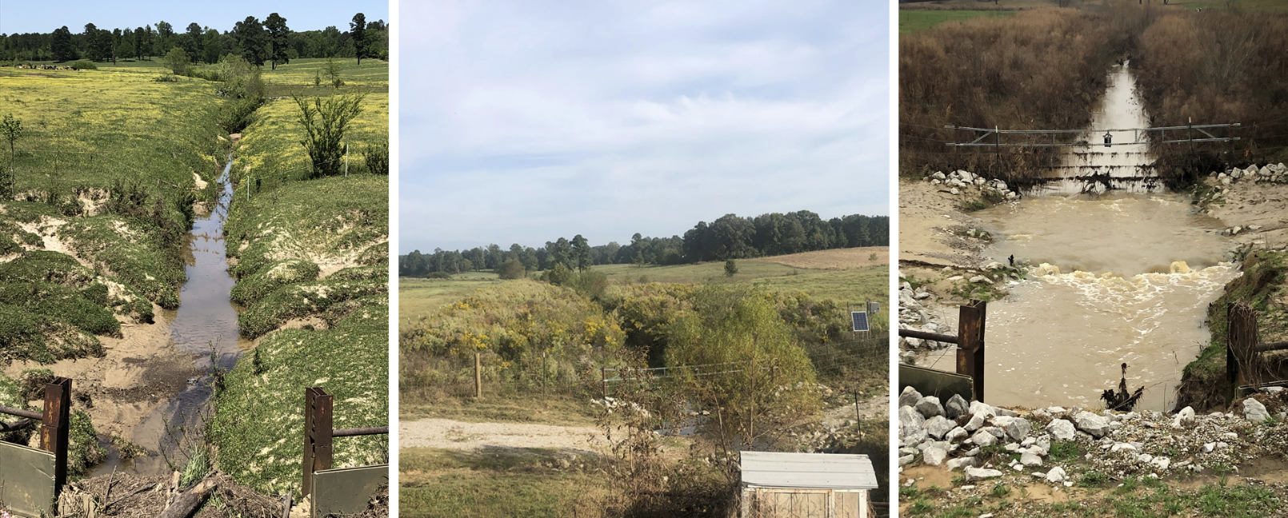
Study Site: Tributary stream, Dairy pasture, gullies within a new stream buffer

Slide 7
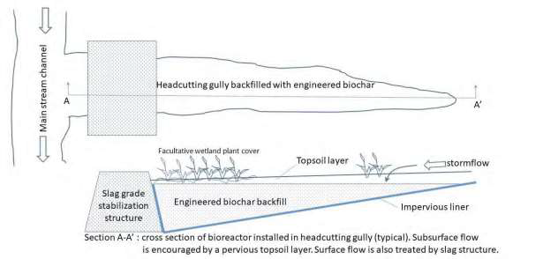
Bioreactor Design

Slide 8
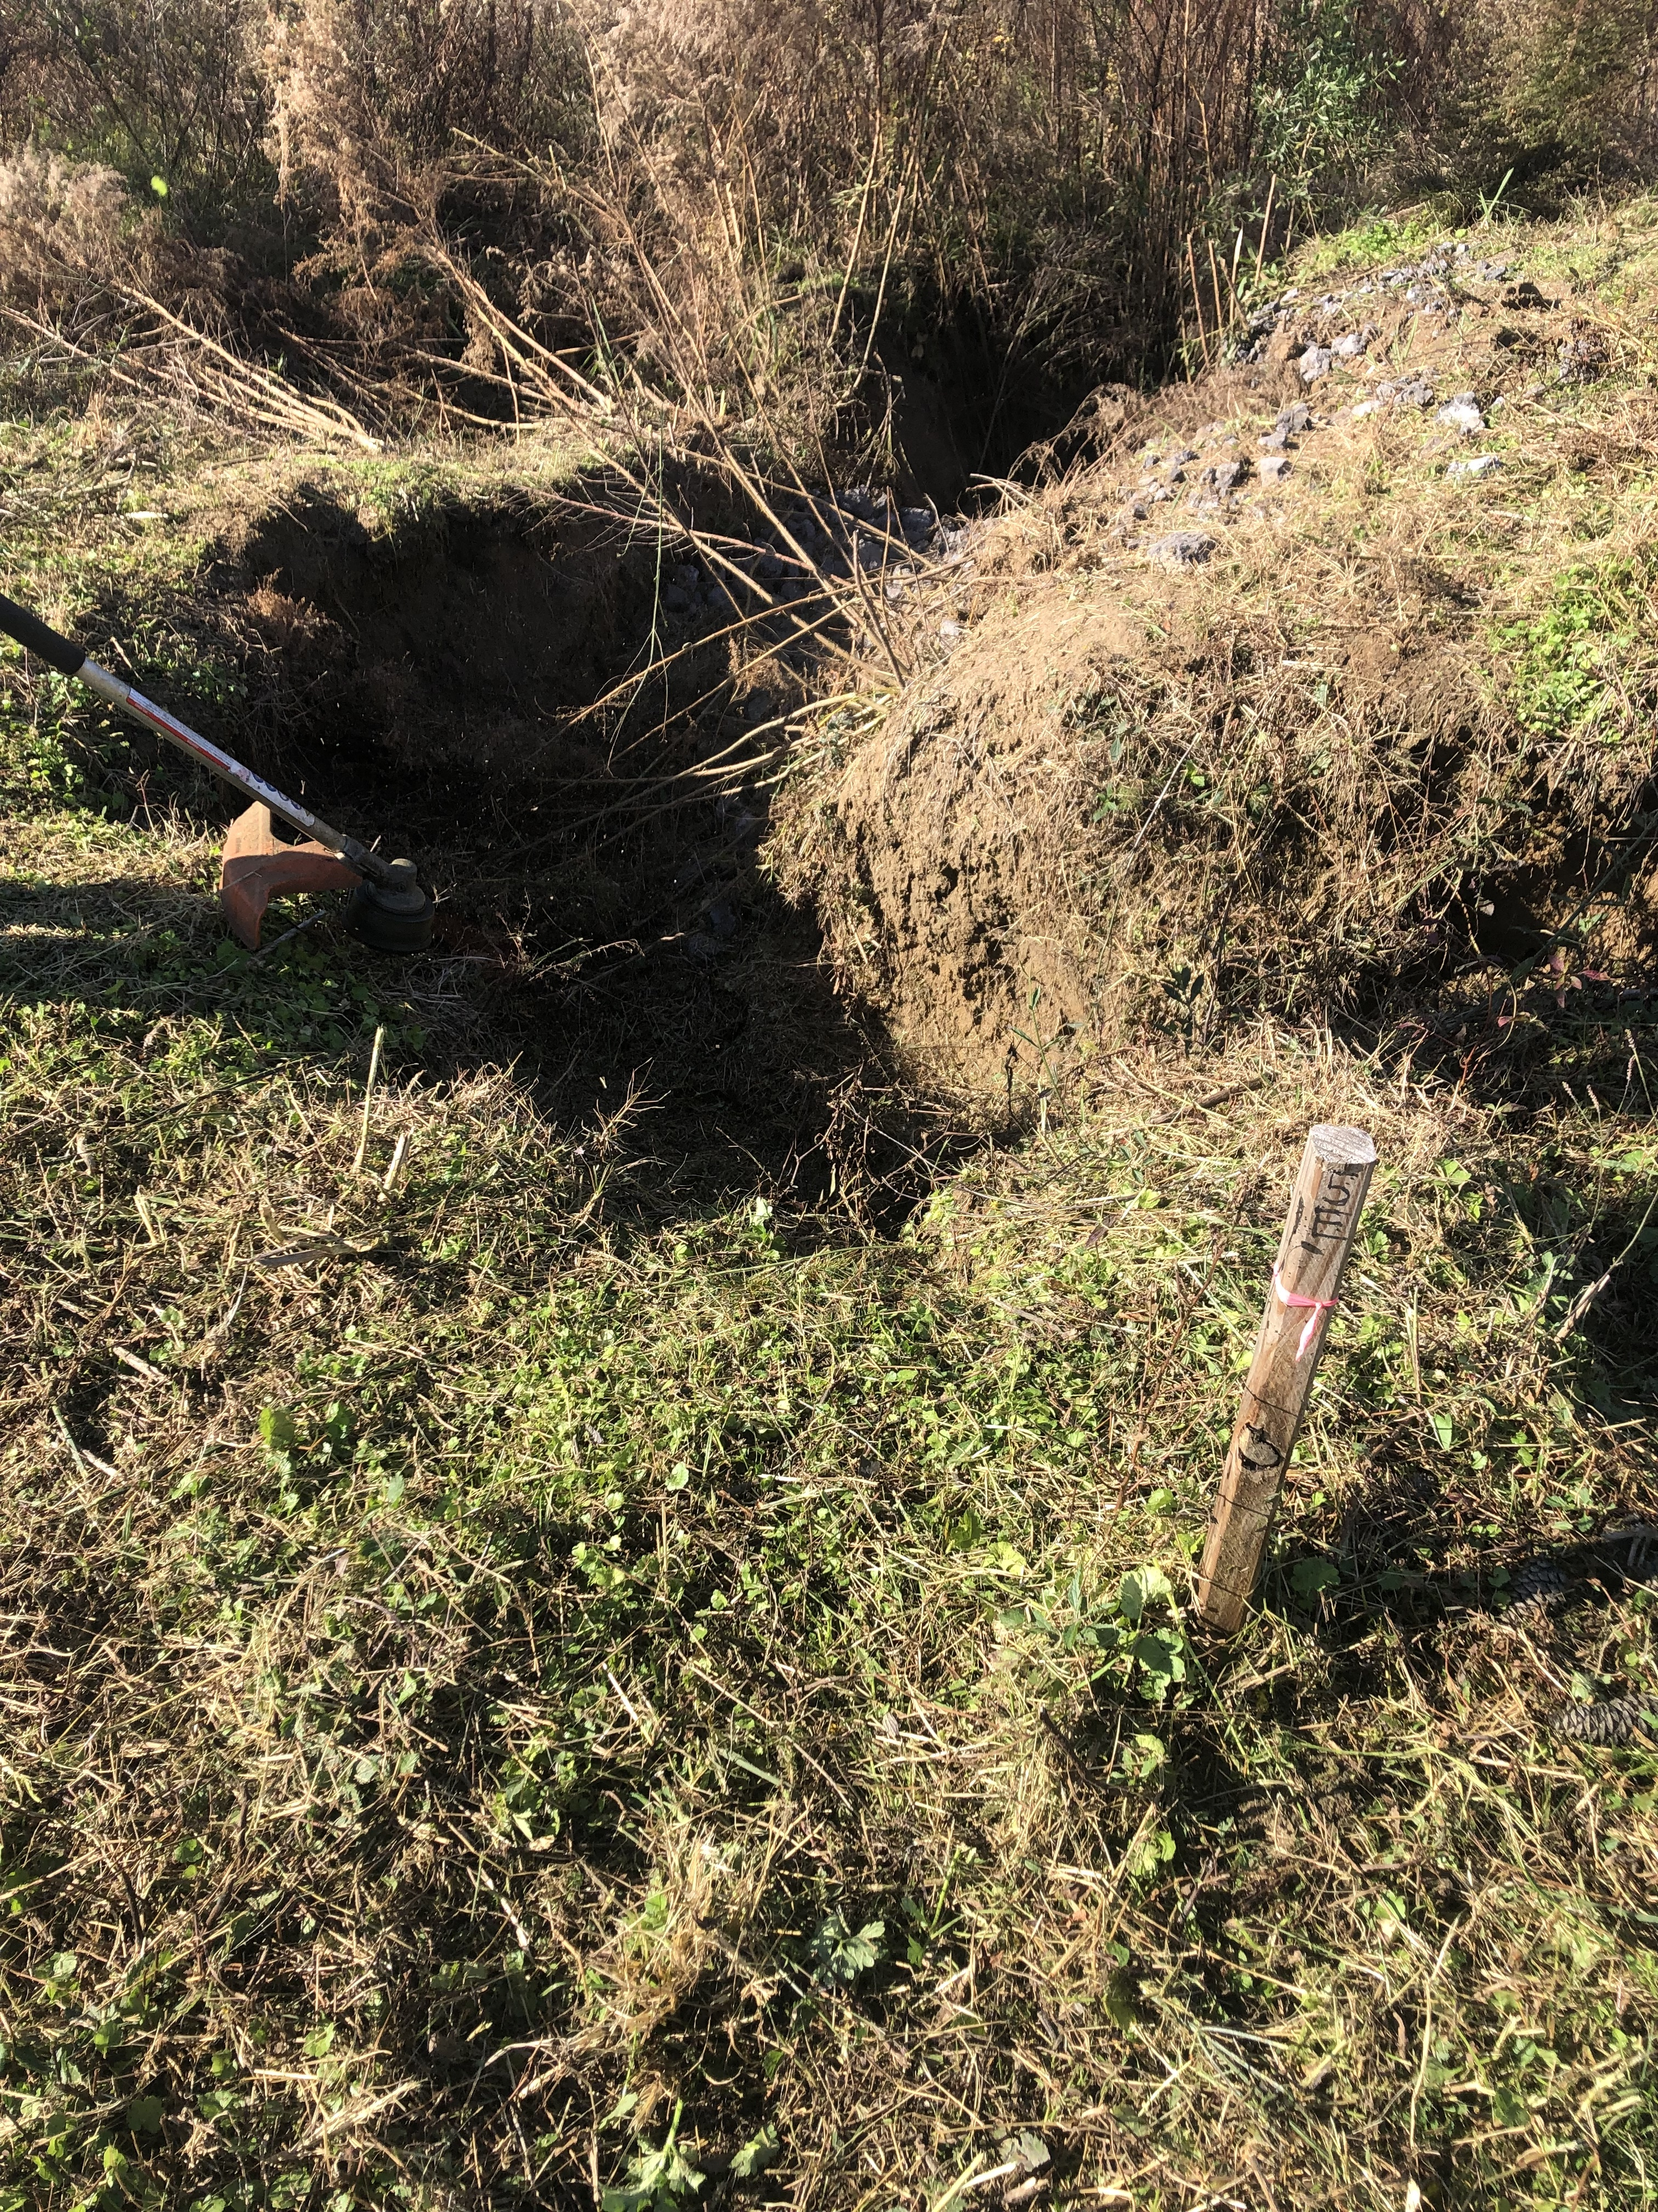
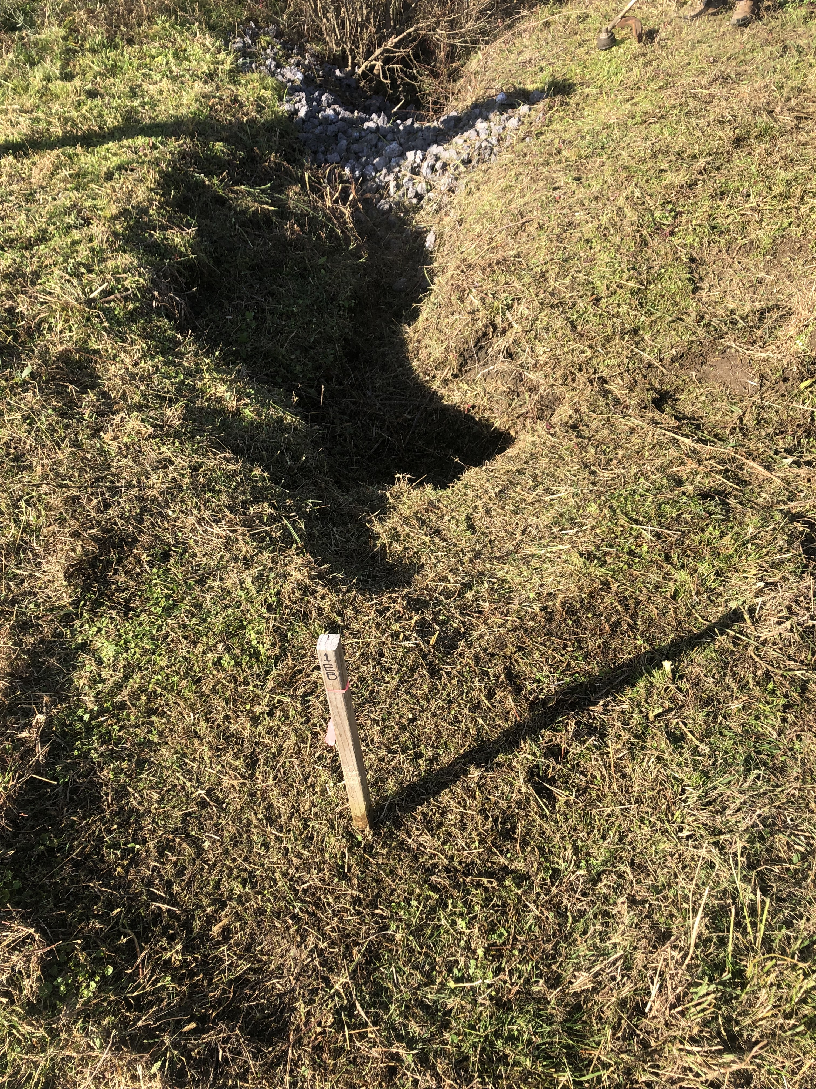
Gully preparation for bioreactor installation

Slide 9
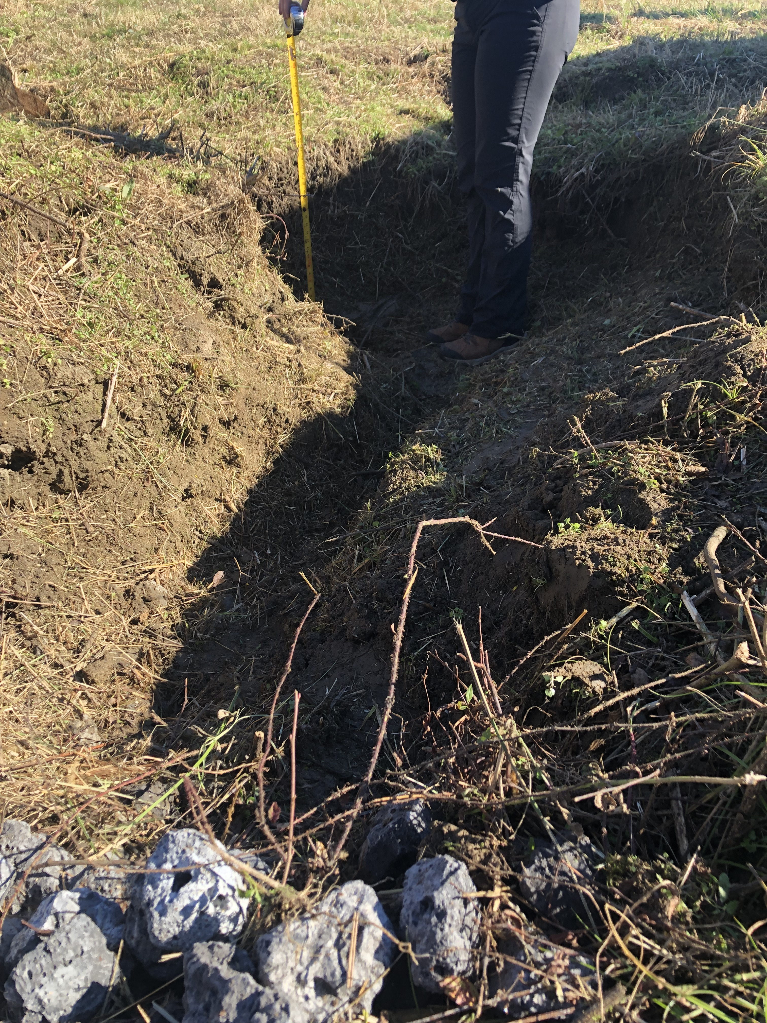
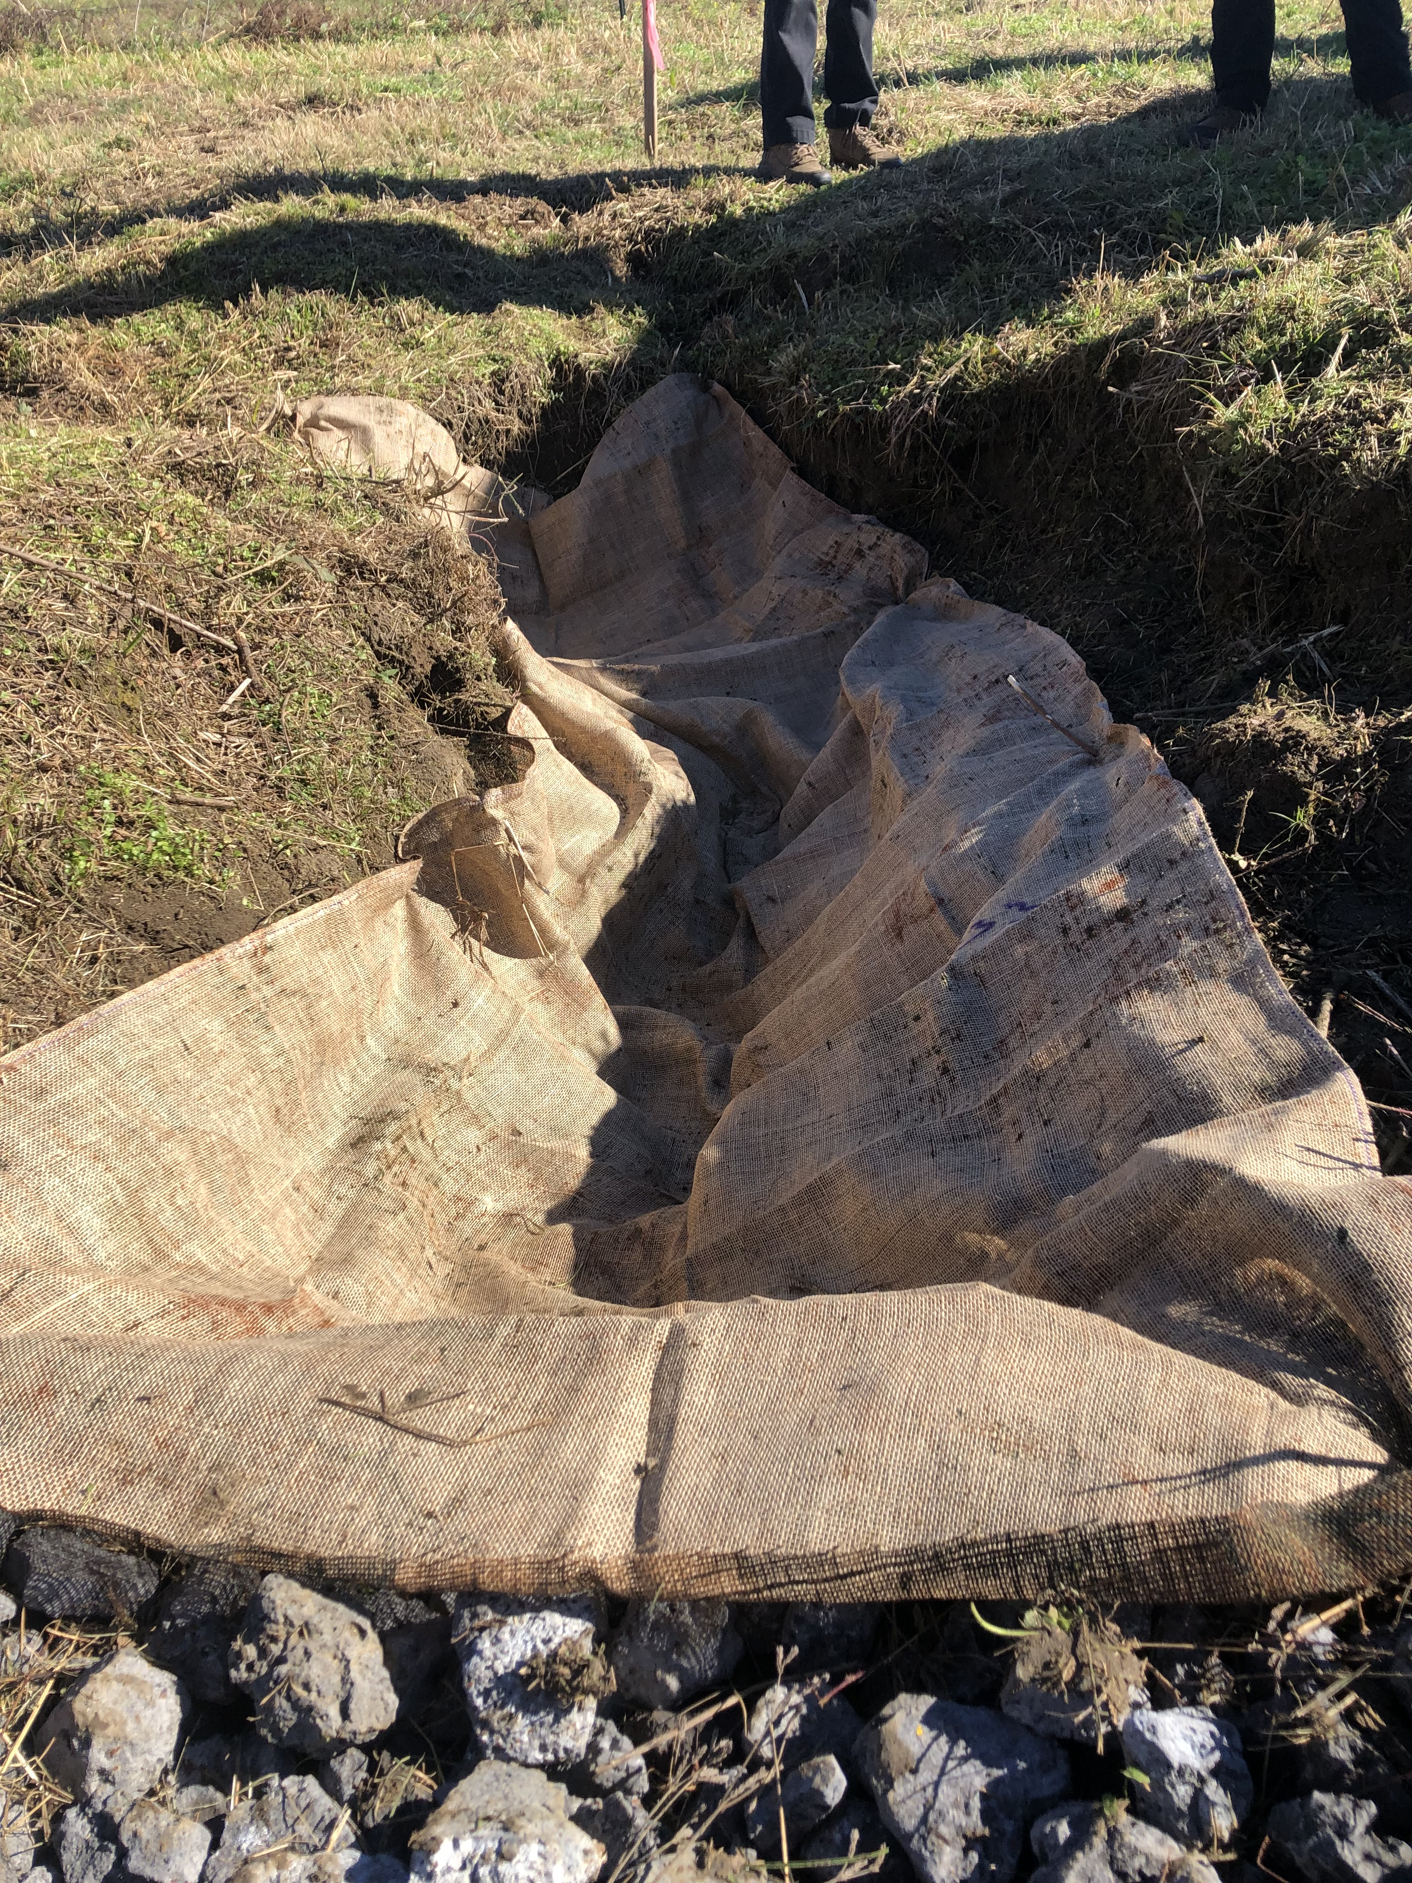
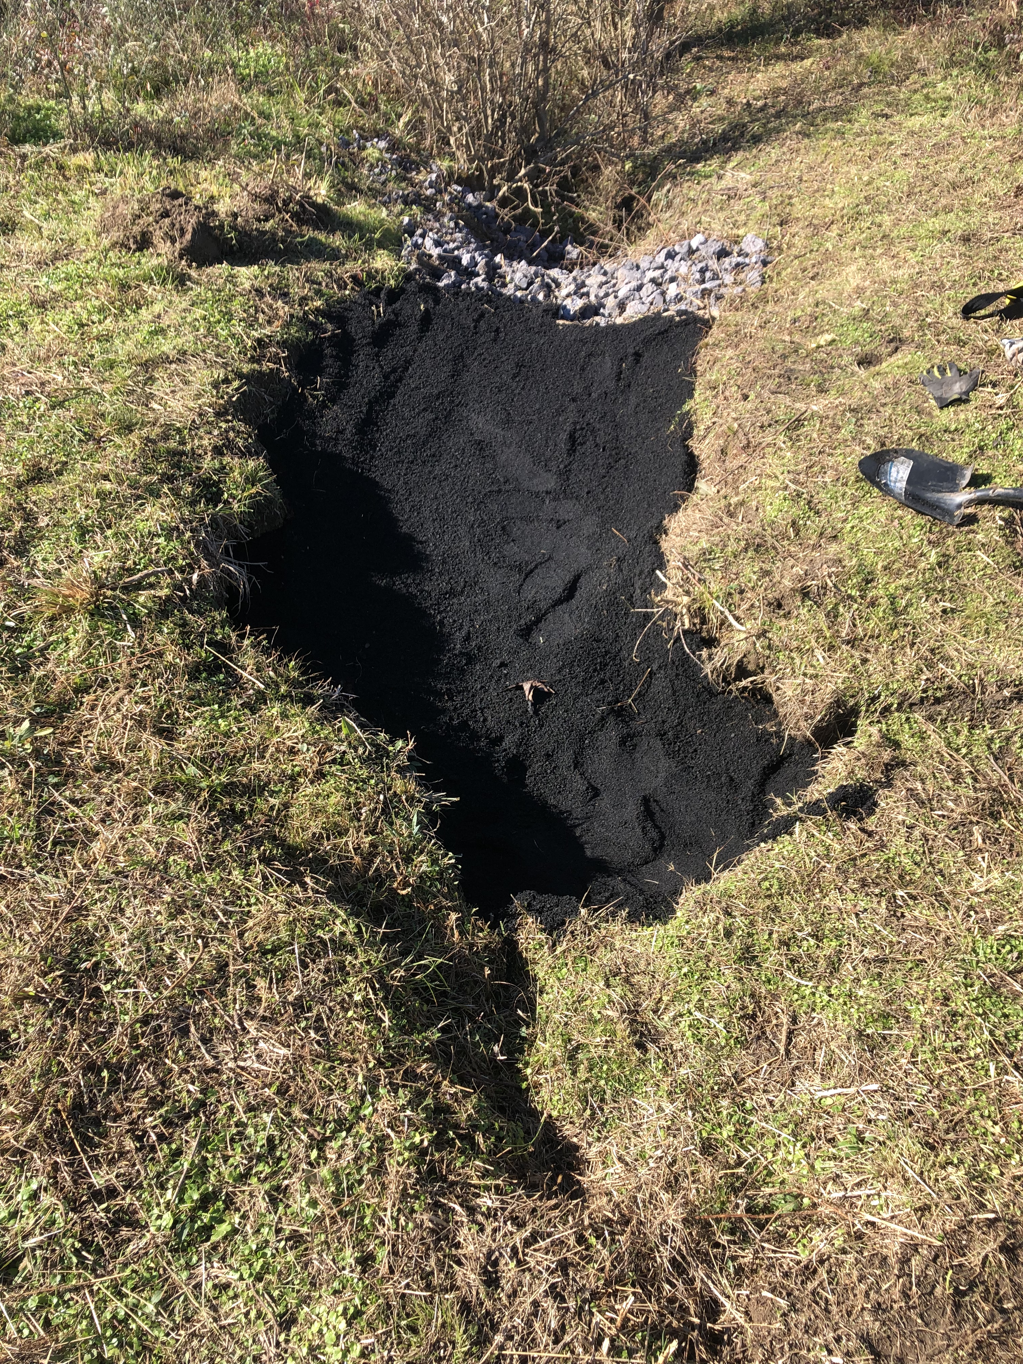
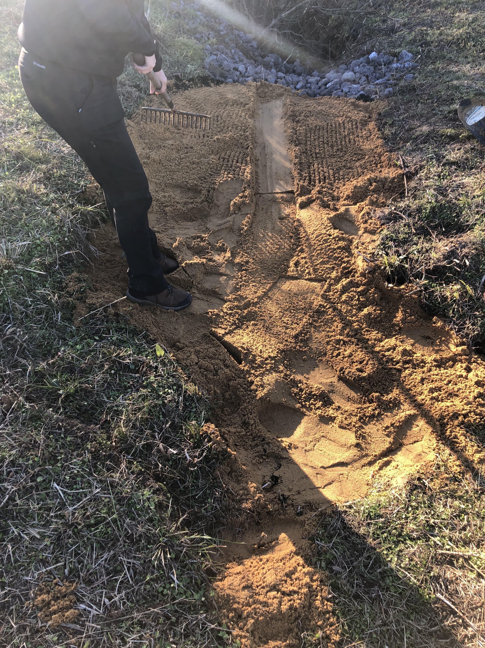
Bioreactor: 4” Slag Check Dam holding engineered biochar in place

Slide 10
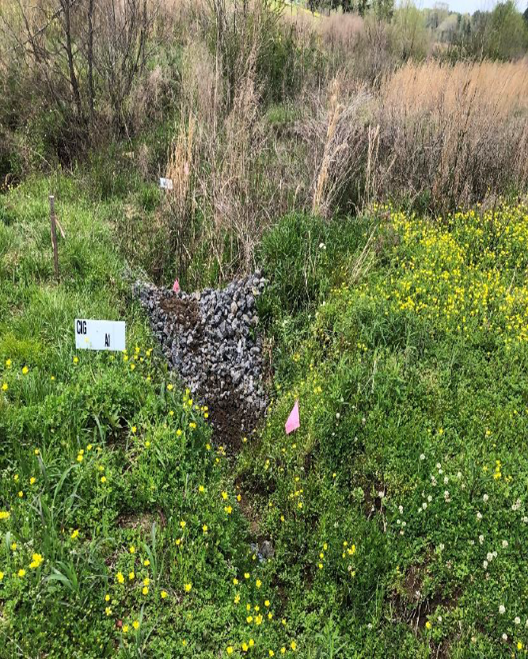
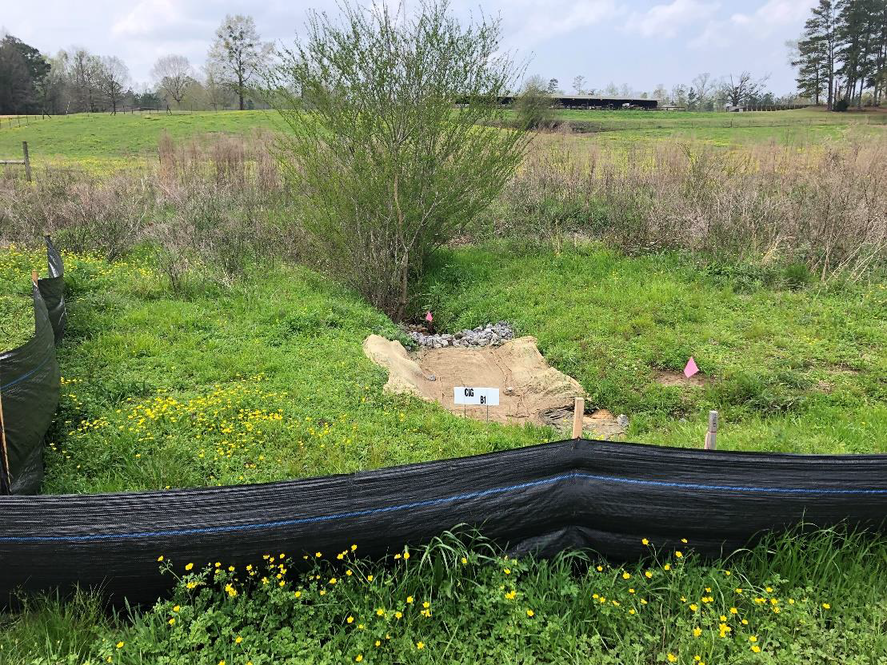
2 Treatments: Check Dam only and Check Dam + Engineered Biochar

Slide 11
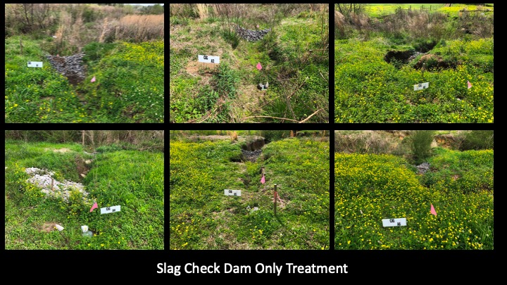

Slide 12
Results: Efficacy and Cost of Slag Check Dams
Check dams installed using loader/backhoe and mini-excavator
Final placement by hand to “shape” the final installation
All 12 4” EAF Slag Grade Stabilization Structures (check dams) remained stable throughout the project
Check dams worked well to hold in the biochar materials and set up plant growth
Deposition occurred upstream of every check dam-only treatment (final measurements in progress)
Contractor cost per check dam around $150

Slide 13
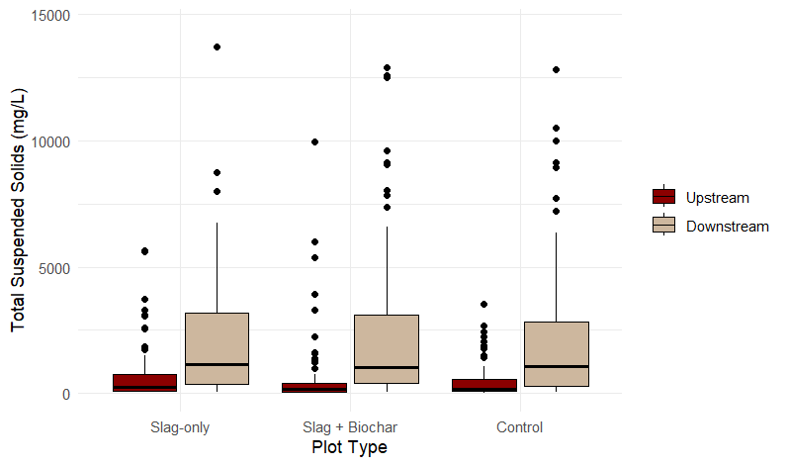
Results: Total Suspended Solids

Slide 14
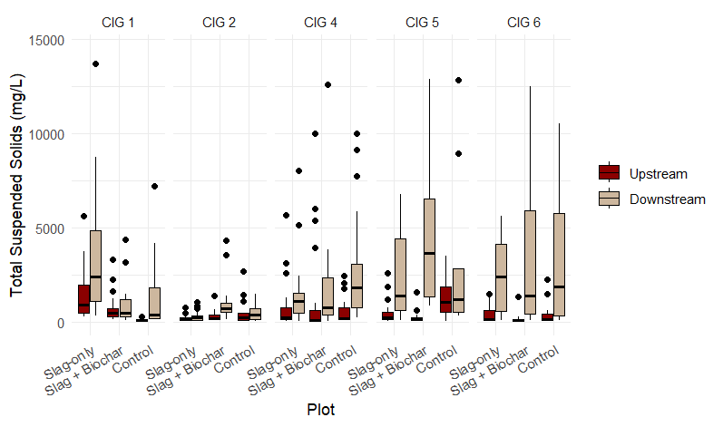
Results: Total Suspended Solids

Slide 15
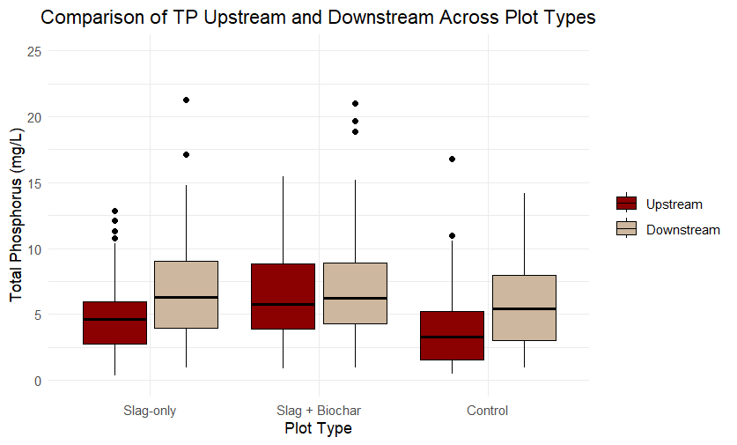
Results: Total Phosphorus

Slide 16
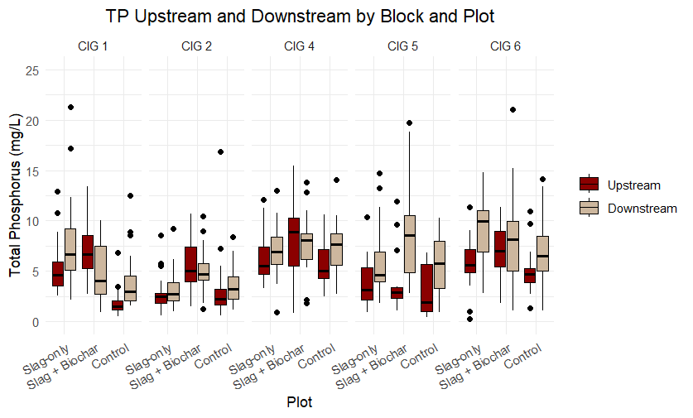
Results: Total Phosphorus

Slide 17
Transfer of Information
From a former student worker:
“I took a… course of yours in Fall 2020 and also briefly worked as a student worker of yours that December. I spent that time planting about ~100 or so trees along a stream buffer in one of the school’s cattle pastures southeast of the campus.
I’ve since moved on to working for the USDA, Natural Resource Conservation Service in Virginia but my student work with you instilled in me an interest in riparian buffers. My supervisor has graciously recognized my interest and has made me the field office’s point person for a buffer program my agency offers. I really appreciate your course and for offering that student job. ”

Slide 18
Conclusions and Considerations
Slag check dams (4” material) performed similarly to what would be expected of rip-rap
Stable in gullies for all rainfall events
Held backfill materials in place
Monitoring of runoff events (for this type of research) is critical
Future studies will incorporate continuous event sampling
First-flush sampling left us with doubts about whether our monitoring protocol addressed our research questions
Future studies will test smaller grades of slag in combination with the 4” material

