Slide 1
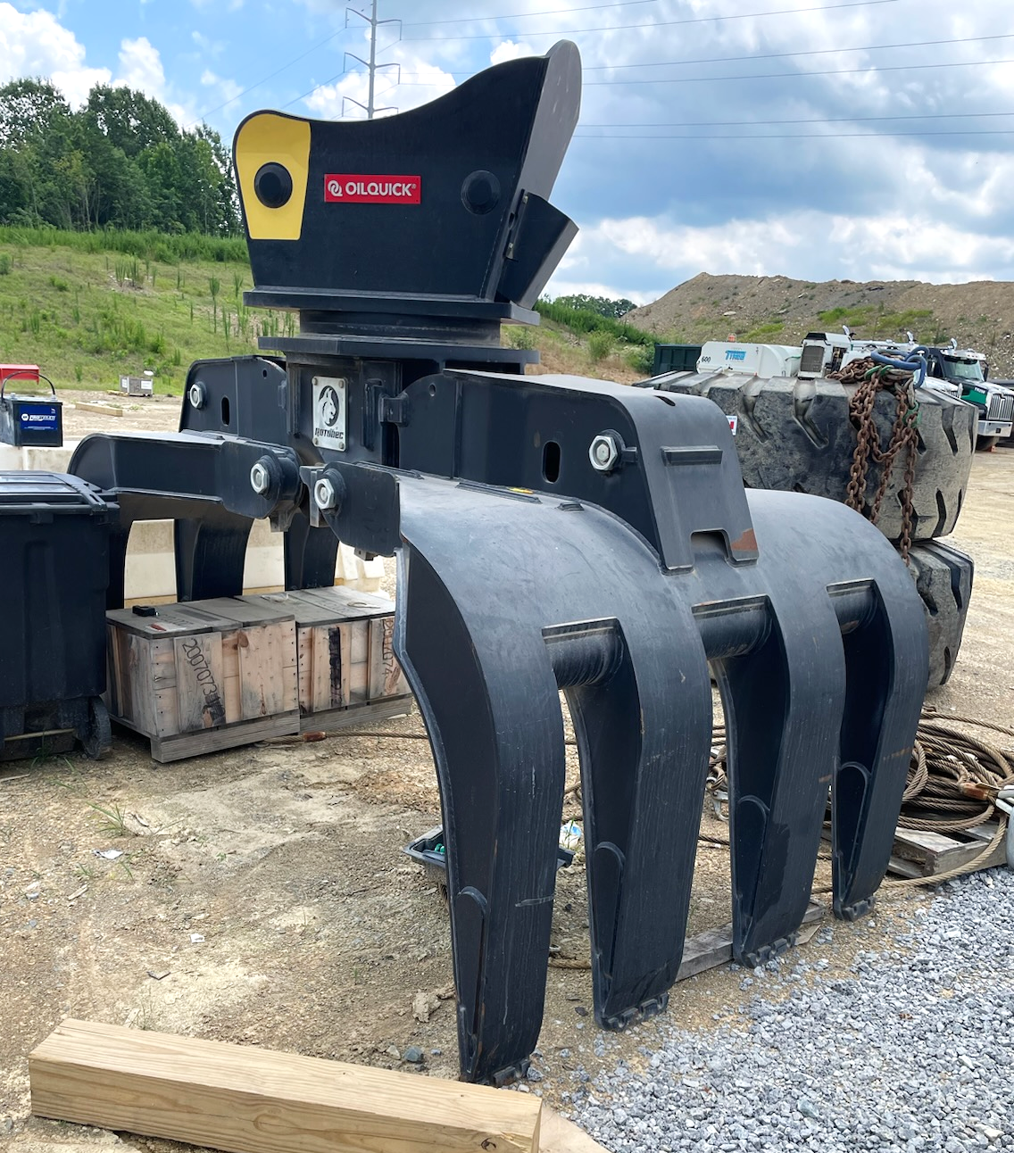
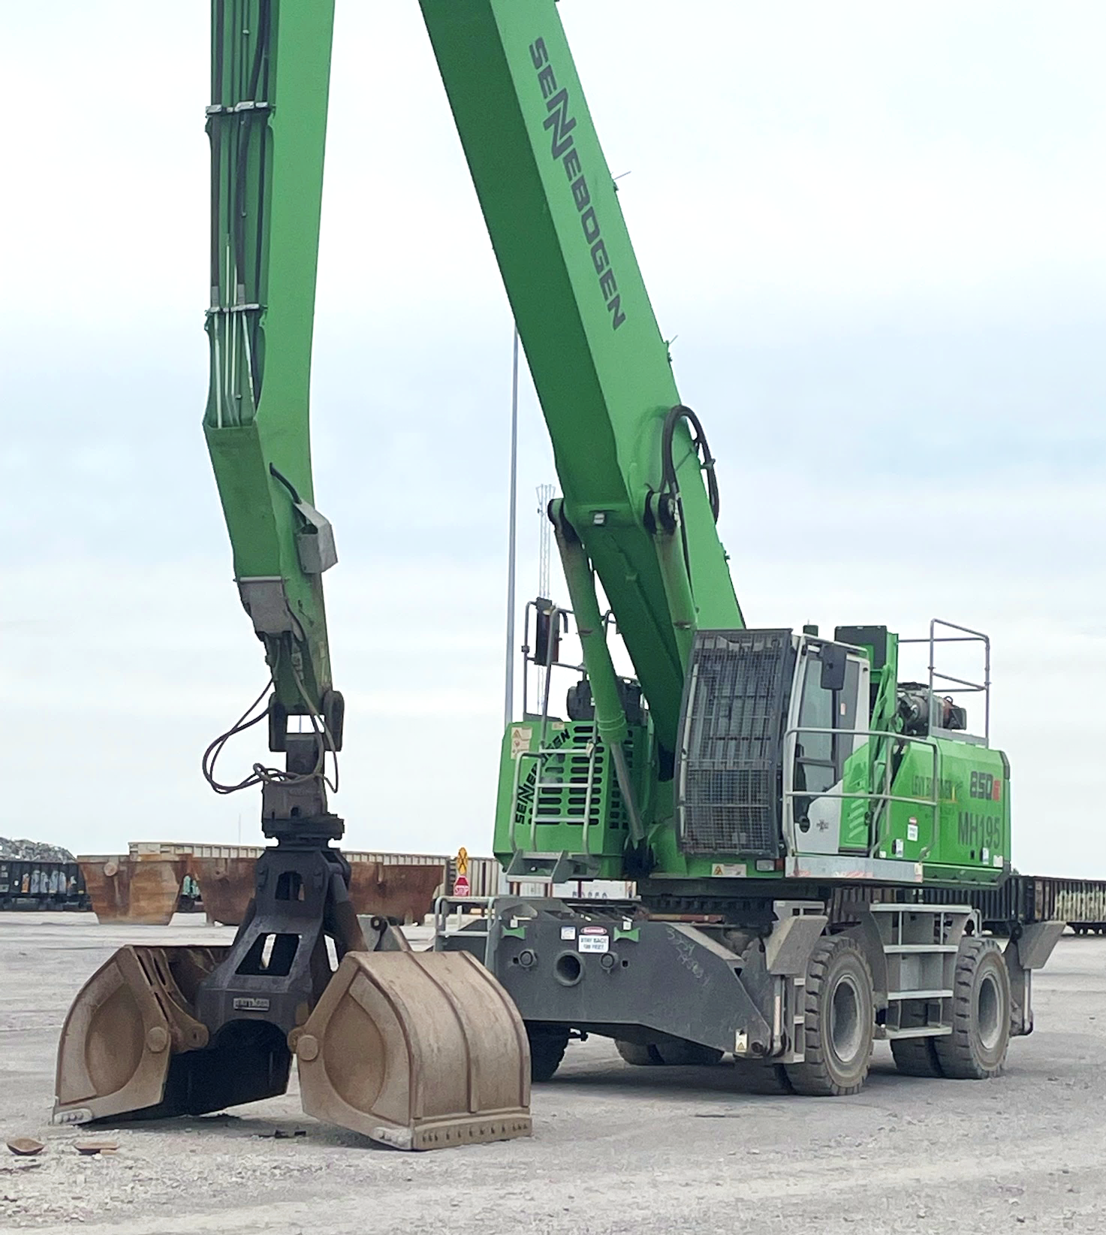
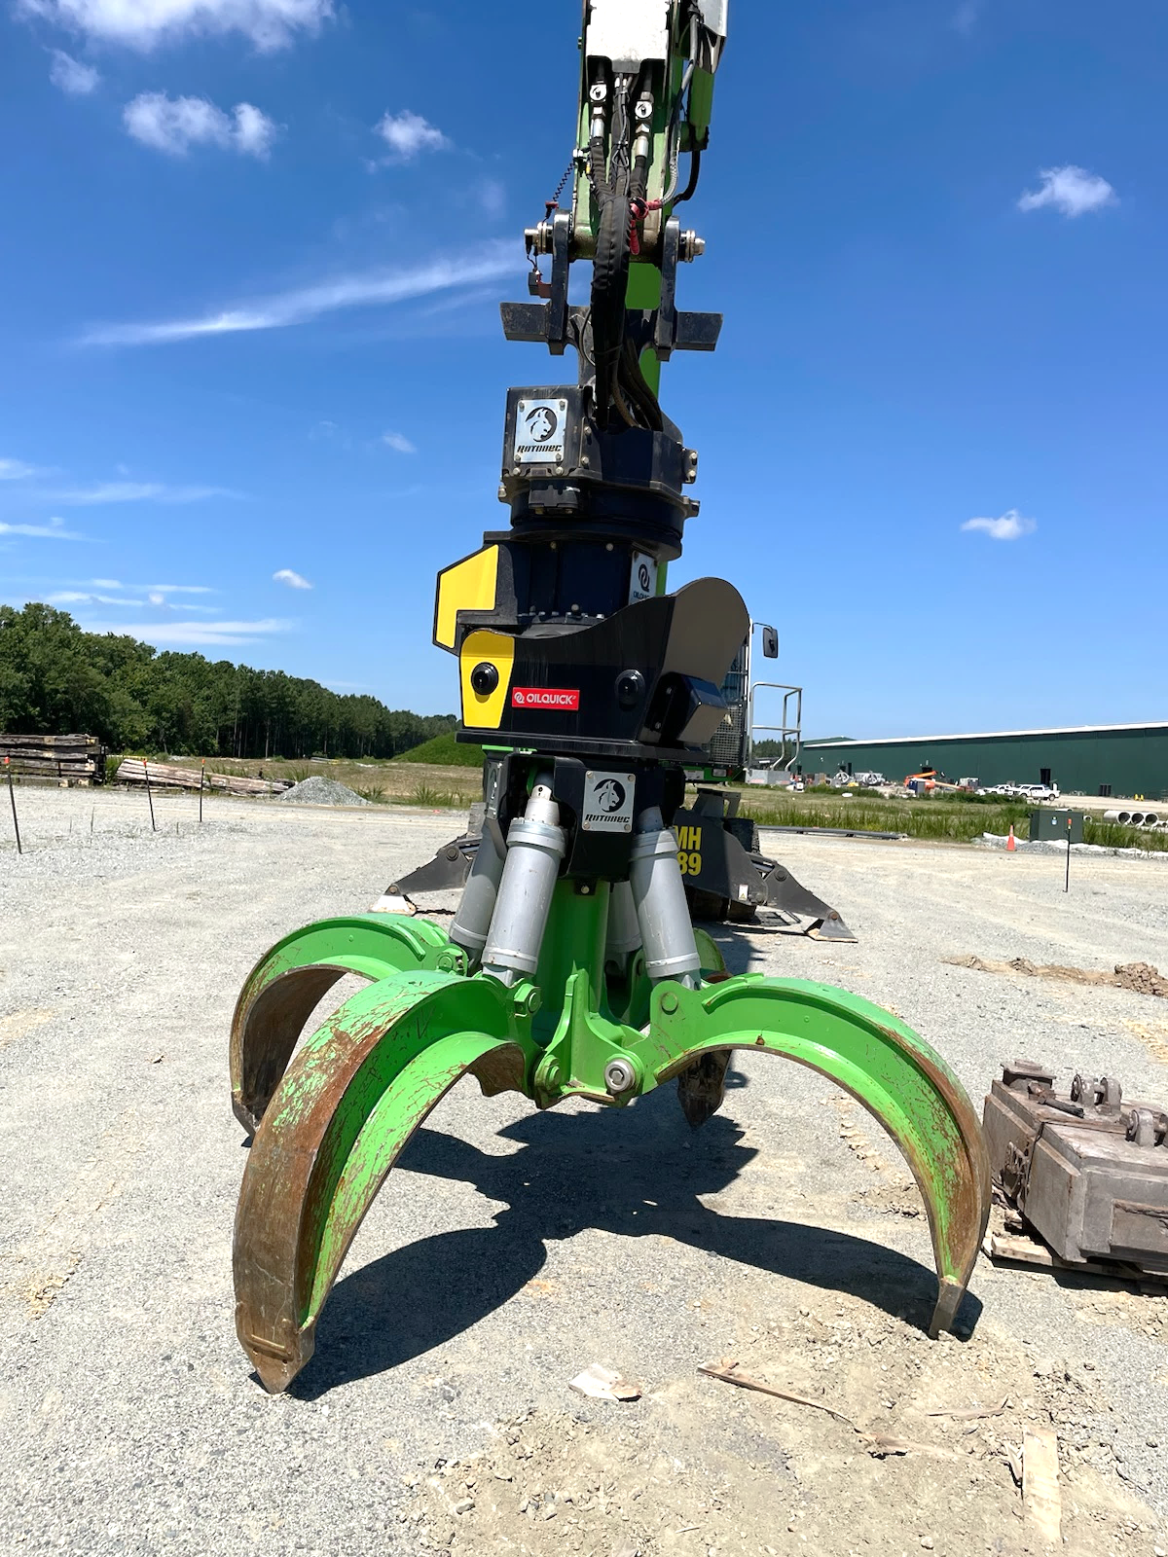
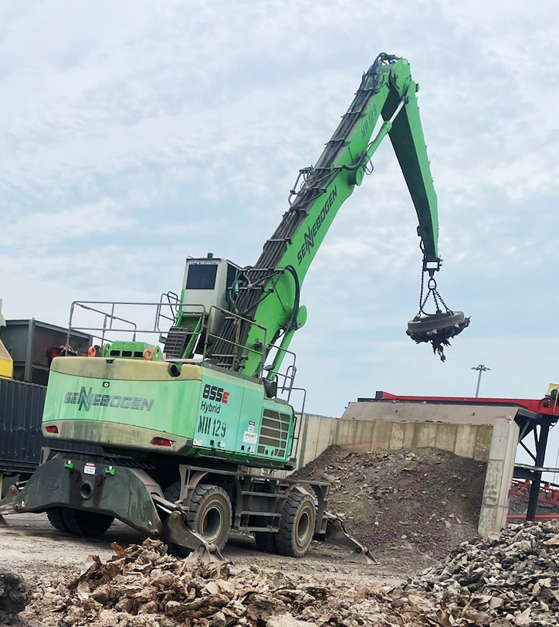
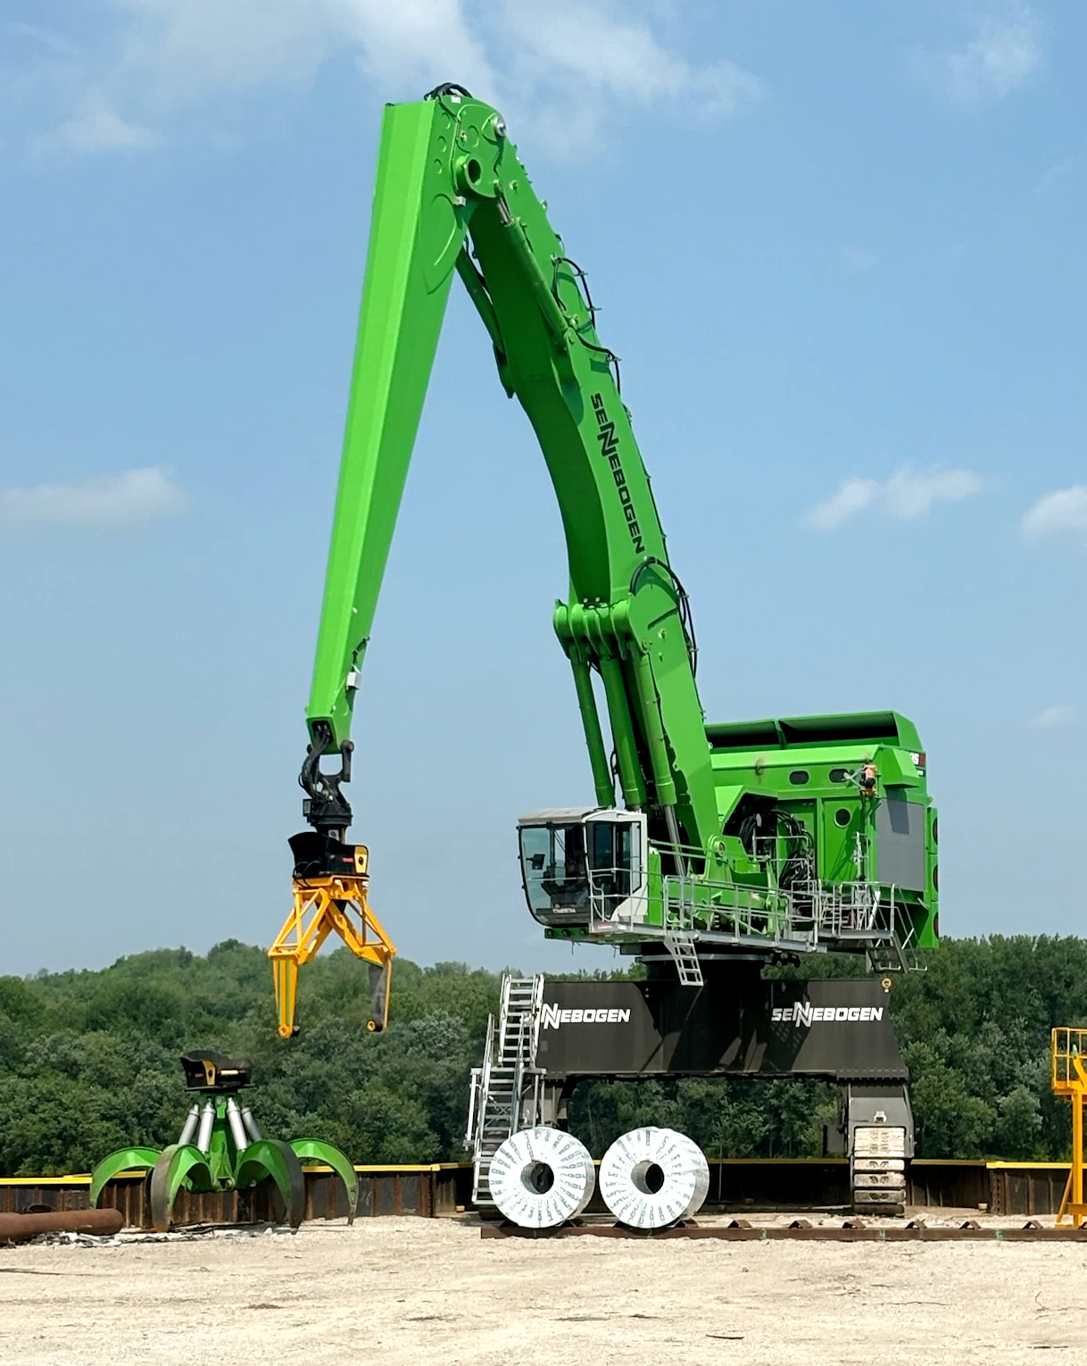

LOADER CRANE PRODUCTION ENHANCED WITH A STICK PIN SCALE
One Pin Size Fits All Attachments and All Hanger Assemblies
Easily Used with Multiple Attachments
Tong Grapple
Clam Shell
Grapple
Magnet
Oil Quick Coupler
Loadman of Tx

Slide 2
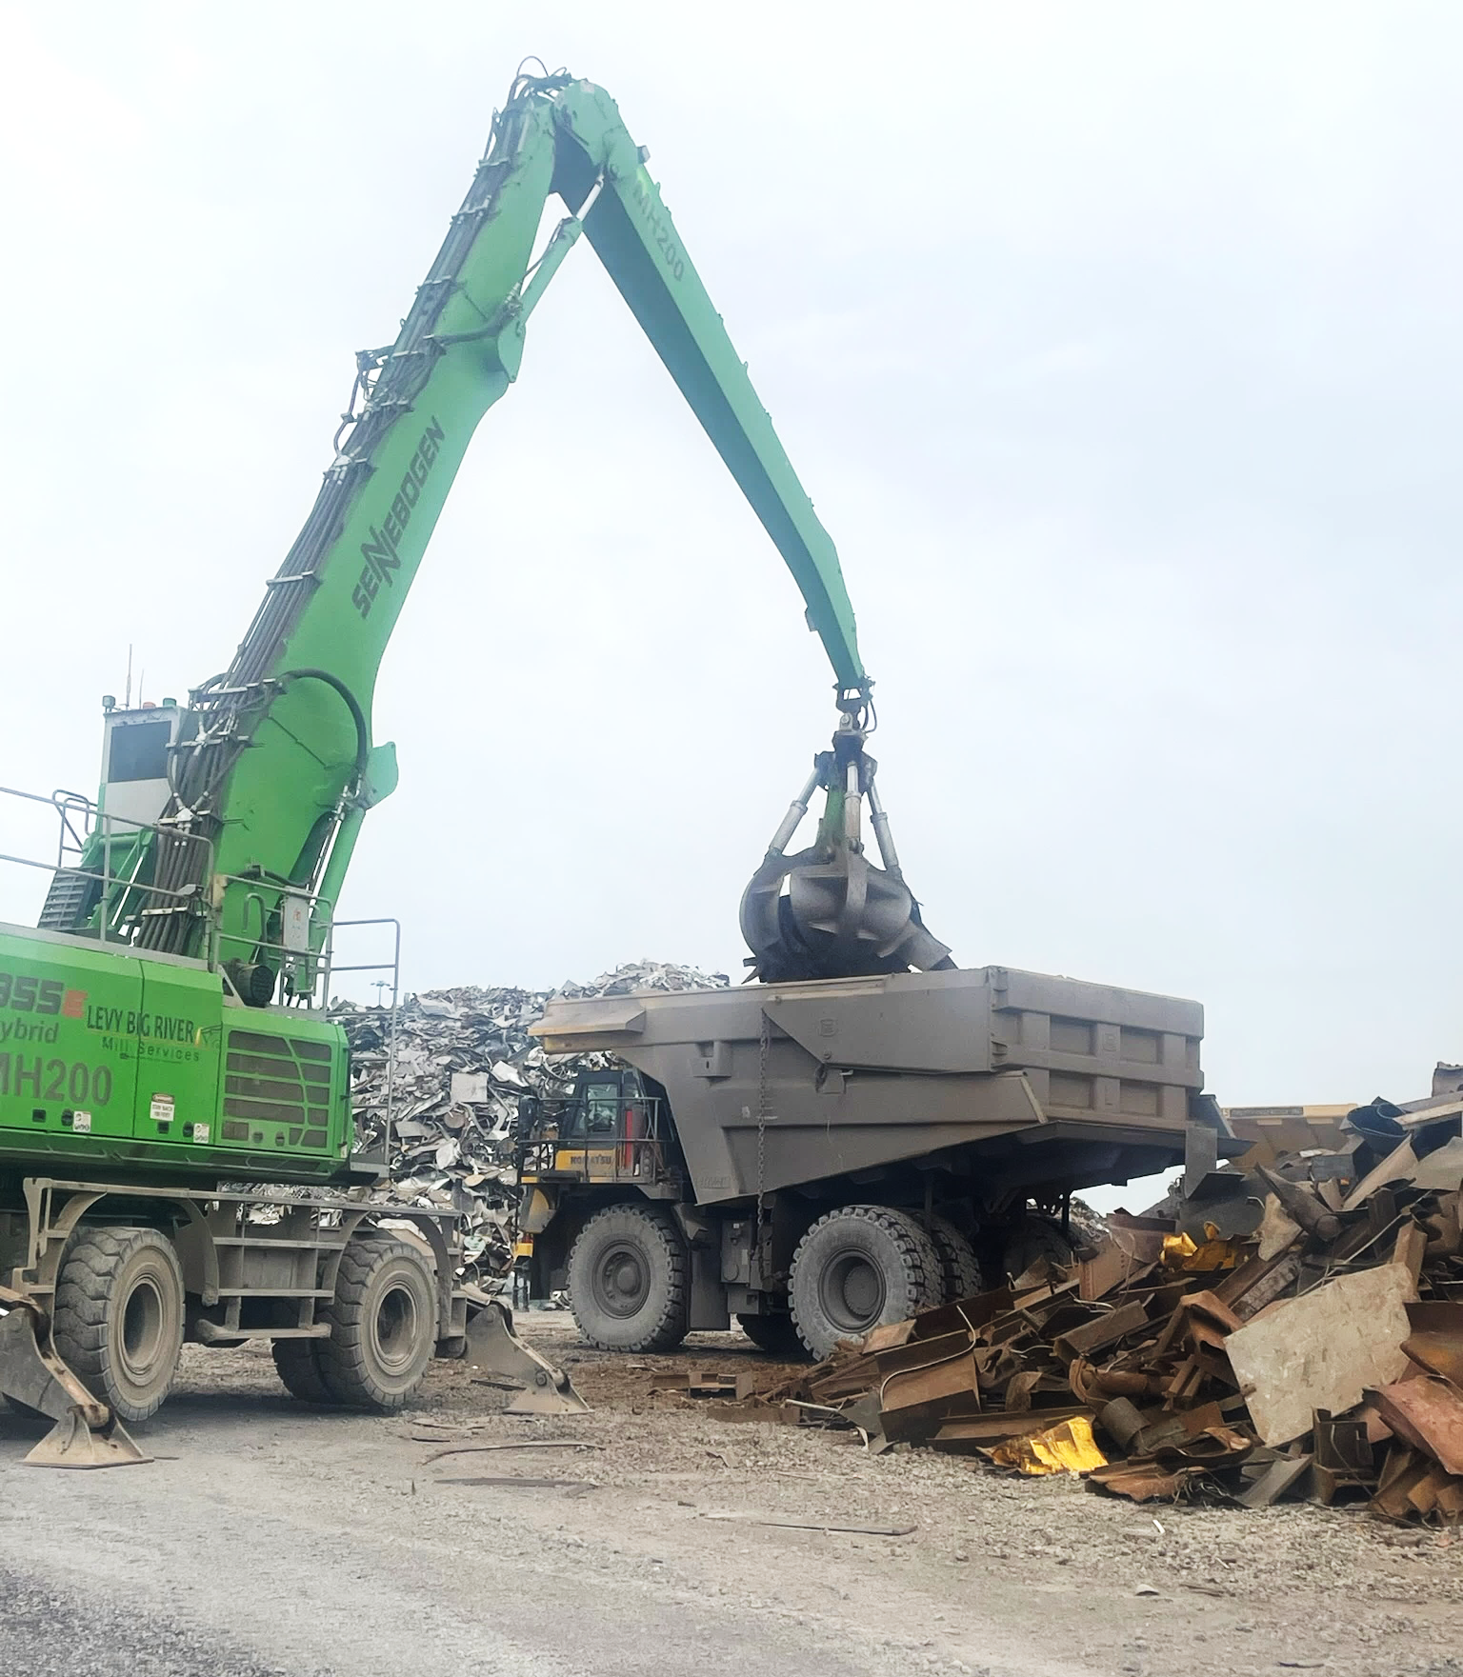
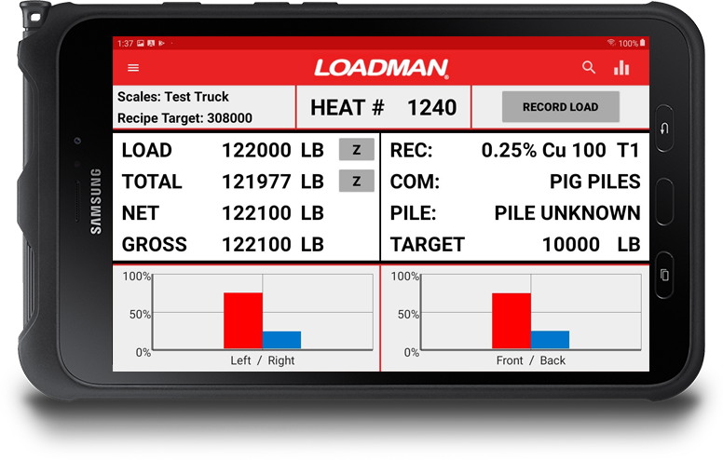
LOADER CRANE PRODUCTION ENHANCED WITH A STICK PIN SCALE
Processes / Applications
Building Recipes for Level 2
Loadman of Tx

Slide 3
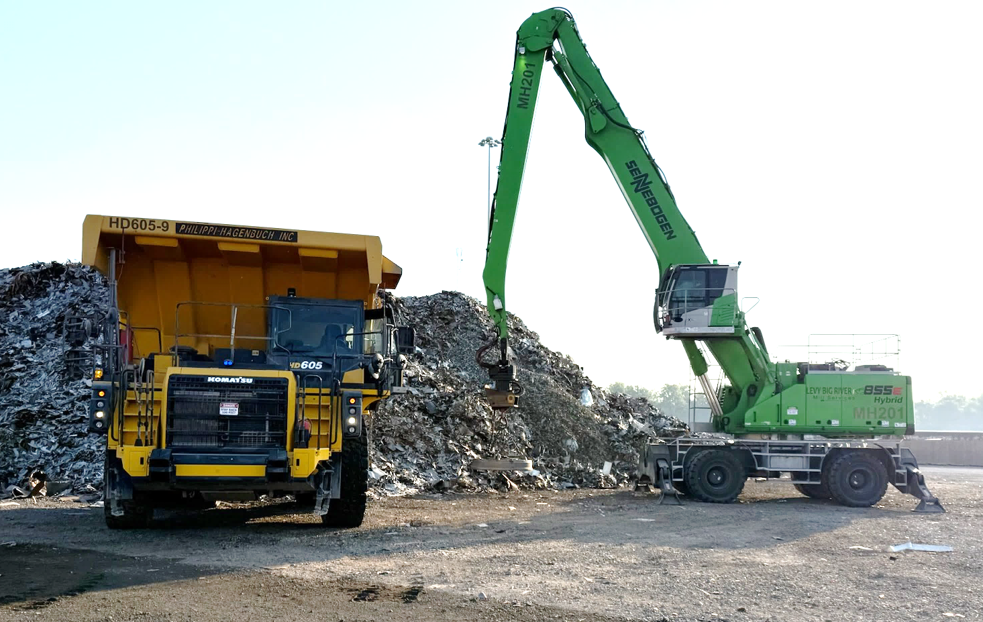
LOADER CRANE PRODUCTION ENHANCED WITH A STICK PIN SCALE
Processes / Applications
Cut Yard Production
Loadman of Tx

Slide 4
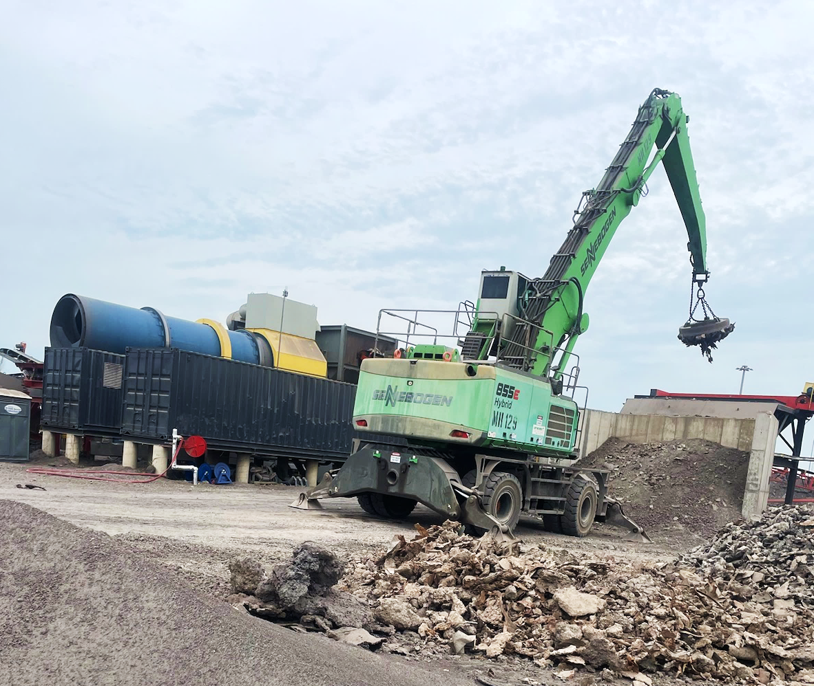
LOADER CRANE PRODUCTION ENHANCED WITH A STICK PIN SCALE
Processes / Applications
Controlled Feed to
Batch Plant
Loadman of Tx

Slide 5

LOADER CRANE PRODUCTION ENHANCED WITH A STICK PIN SCALE
Processes / Applications
Clam Shell for Dipping Mill Scale
Loadman of Tx

Slide 6
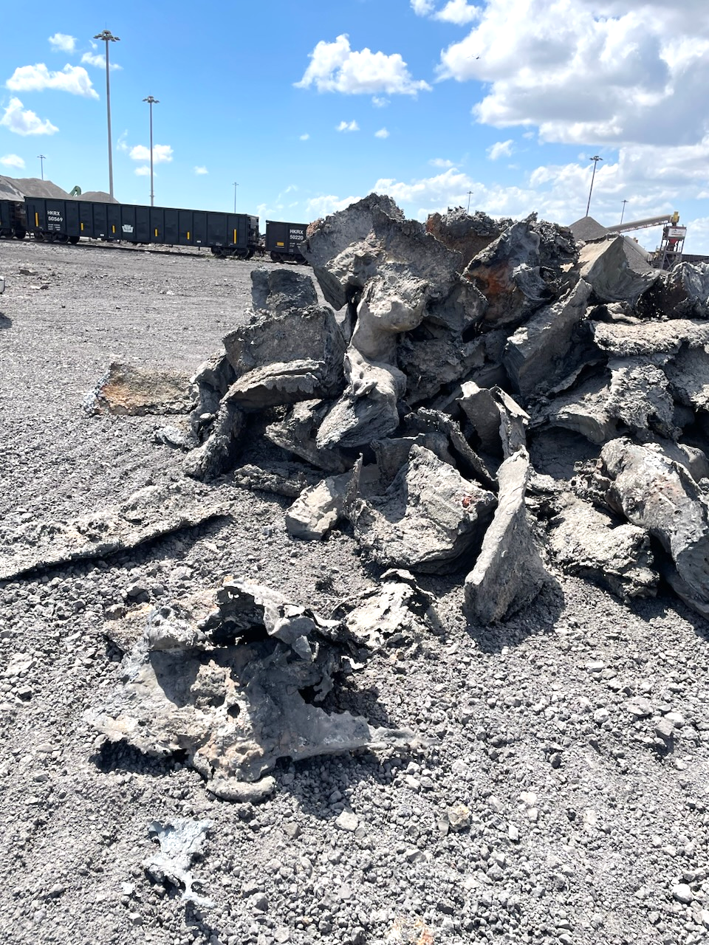
LOADER CRANE PRODUCTION ENHANCED WITH A STICK PIN SCALE
Processes / Applications
Outbound Slag Rings
Loadman of Tx

Slide 7

LOADER CRANE PRODUCTION ENHANCED WITH A STICK PIN SCALE
Processes / Applications
Coil Handler
Loadman of Tx

Slide 8
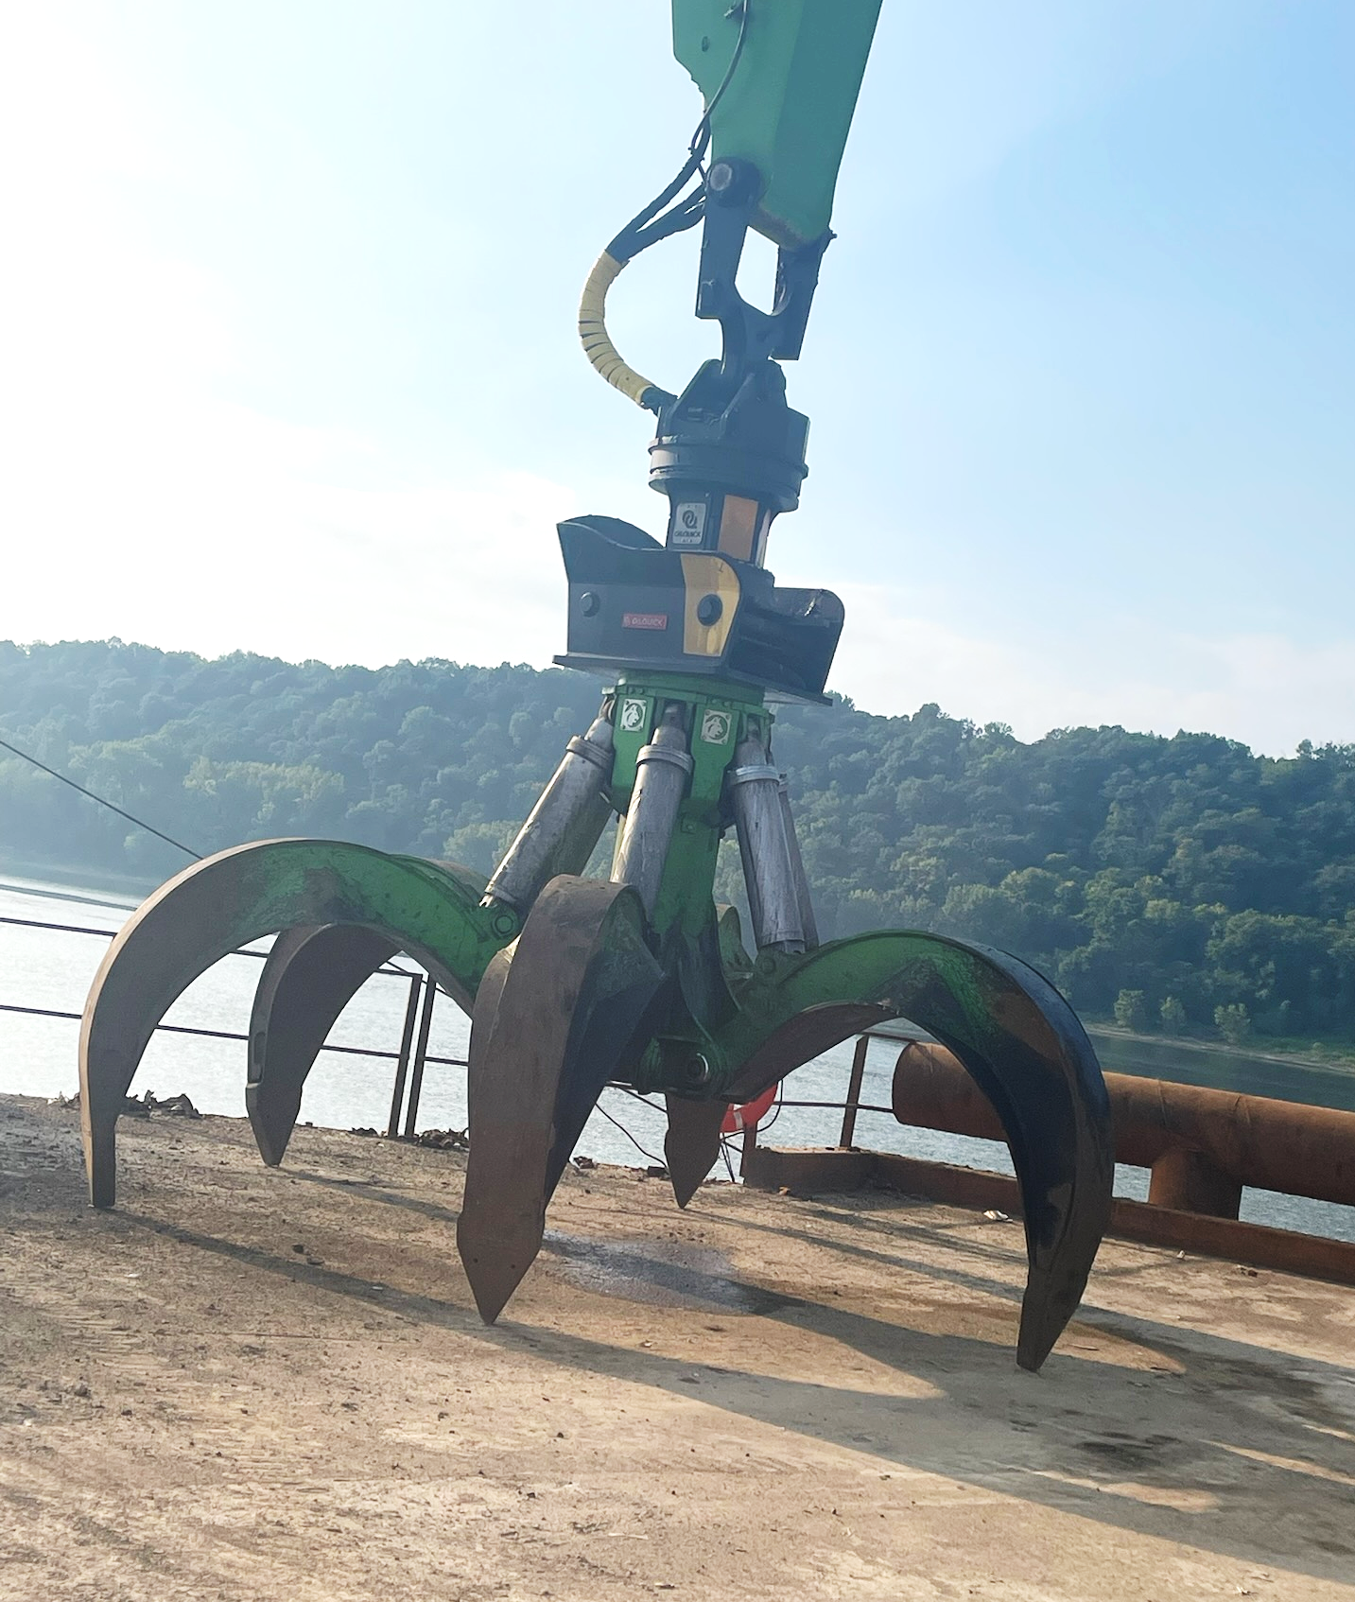
LOADER CRANE PRODUCTION ENHANCED WITH A STICK PIN SCALE
Processes / Applications
Barge Loading and Unloading
Loadman of Tx

Slide 9
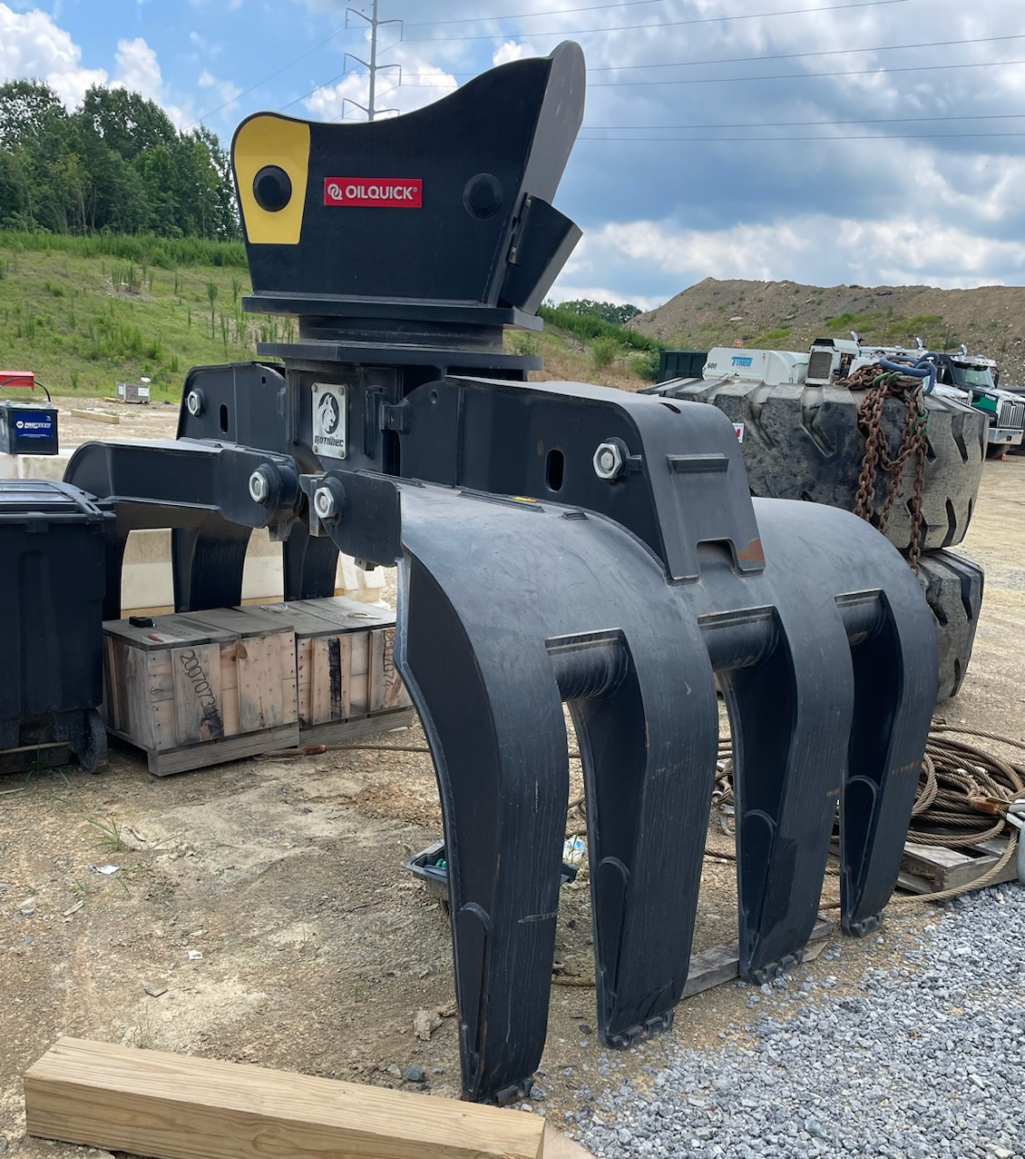
LOADER CRANE PRODUCTION ENHANCED WITH A STICK PIN SCALE
Processes / Applications
Load Out of Finished Product
Loadman of Tx

Slide 10
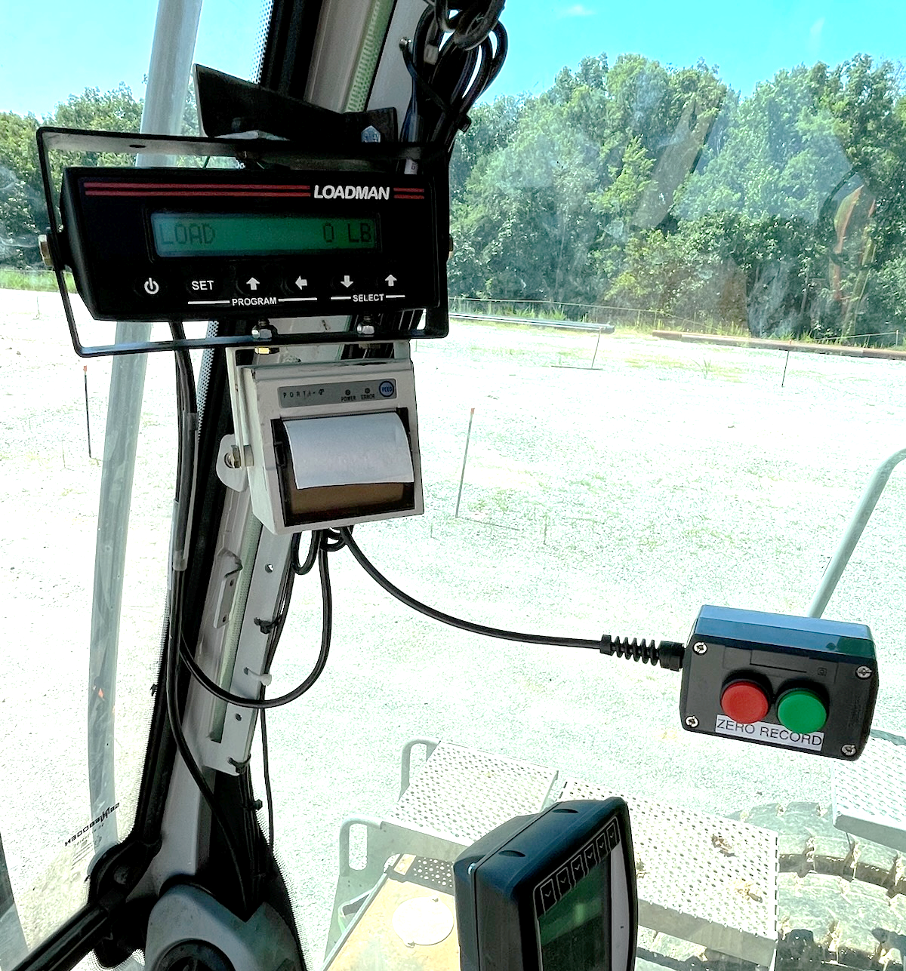
LOADER CRANE PRODUCTION ENHANCED WITH A STICK PIN SCALE
Calibration / Communication
Extremely simple to calibrate
Wireless from scale to cab is optional
Scale is compatible with most all tablets
Tablet with load data sent to the cloud is an option
Loadman of Tx

Slide 11
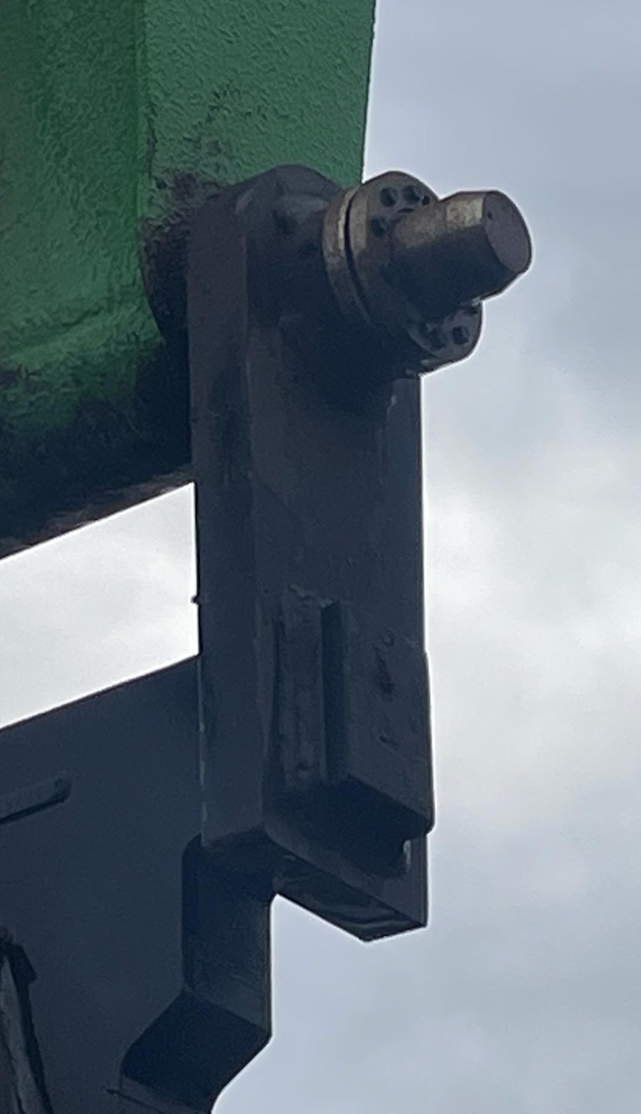
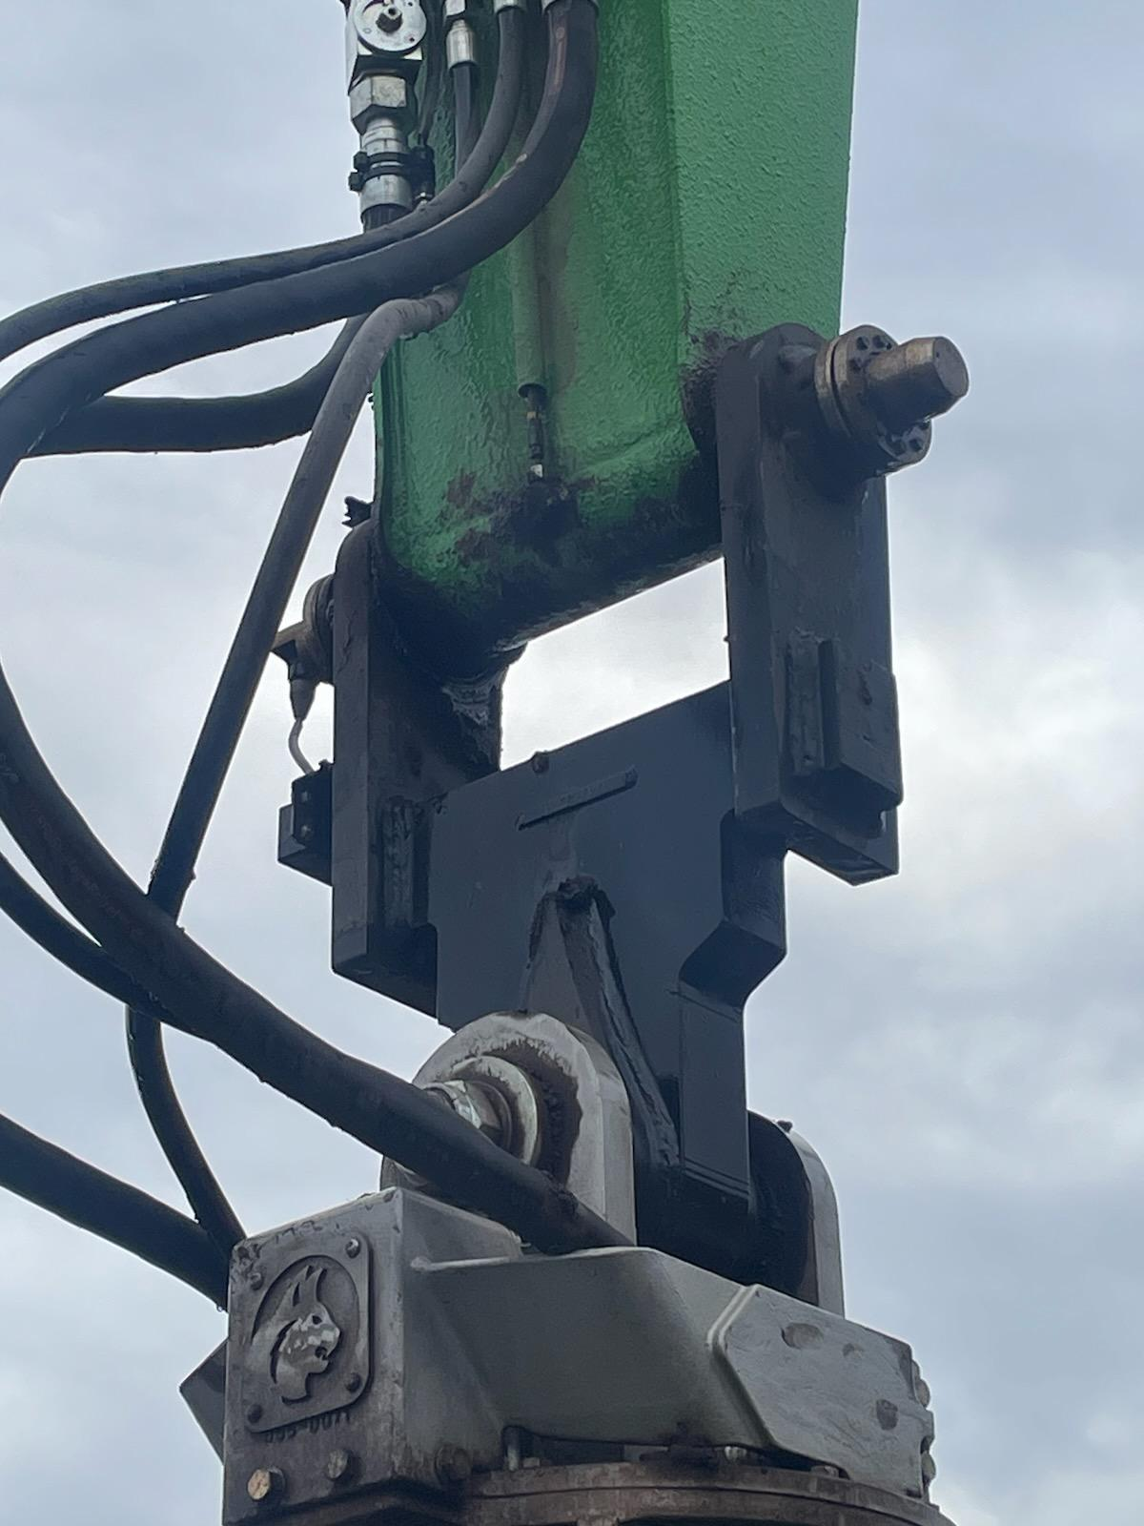
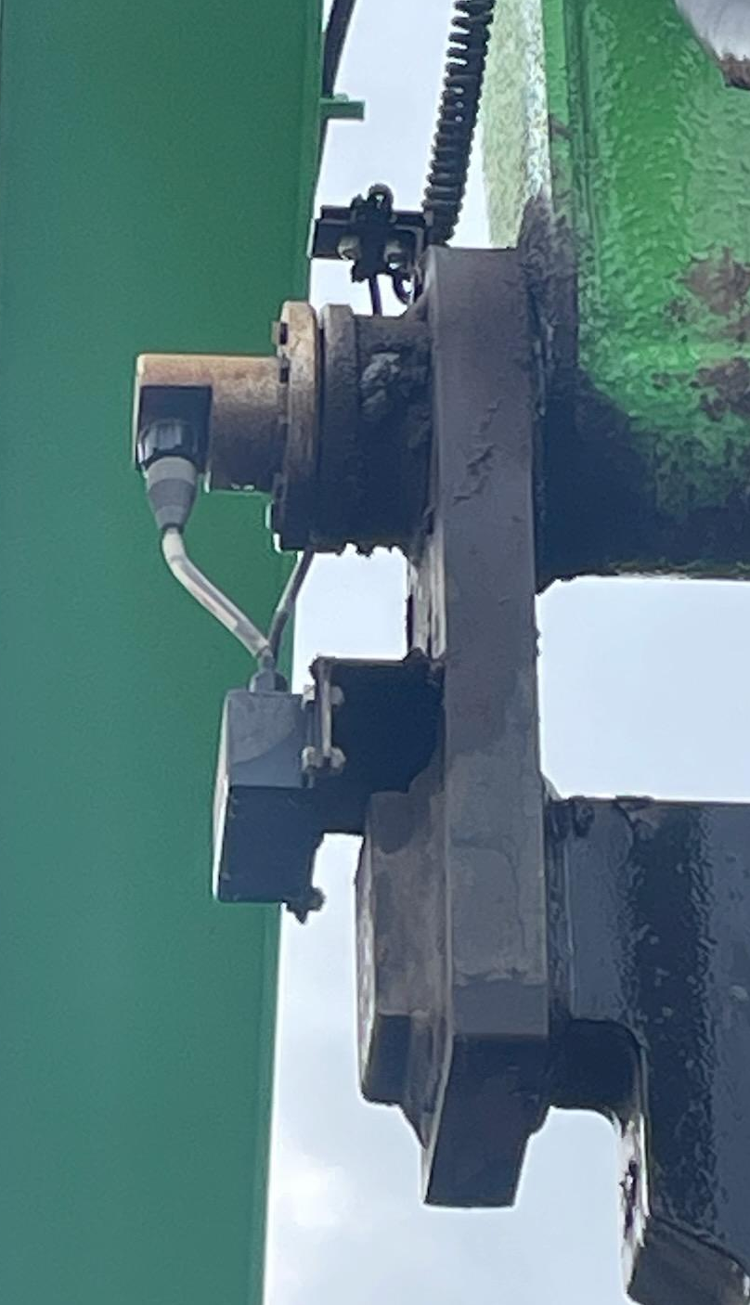
LOADER CRANE PRODUCTION ENHANCED WITH A STICK PIN SCALE
Basic pin sized for stick width and pin diameter
Hanger assembly dimensions vary
Couplings eliminate radial and axial motions
Crane’s stick pin has auto greaser
Loadman of Tx

Slide 12
LOADER CRANE PRODUCTION ENHANCED WITH A STICK PIN SCALE
Why Consider Scaling your Loaders?
Eliminate overloads
Increase efficiency
Create consistent batches
Reduce load out times
Improve accountability
Loadman of Tx

Slide 13


LOADER CRANE PRODUCTION ENHANCED WITH A STICK PIN SCALE
Thank You for your time and attention!
Loadman of Tx

Slide 14
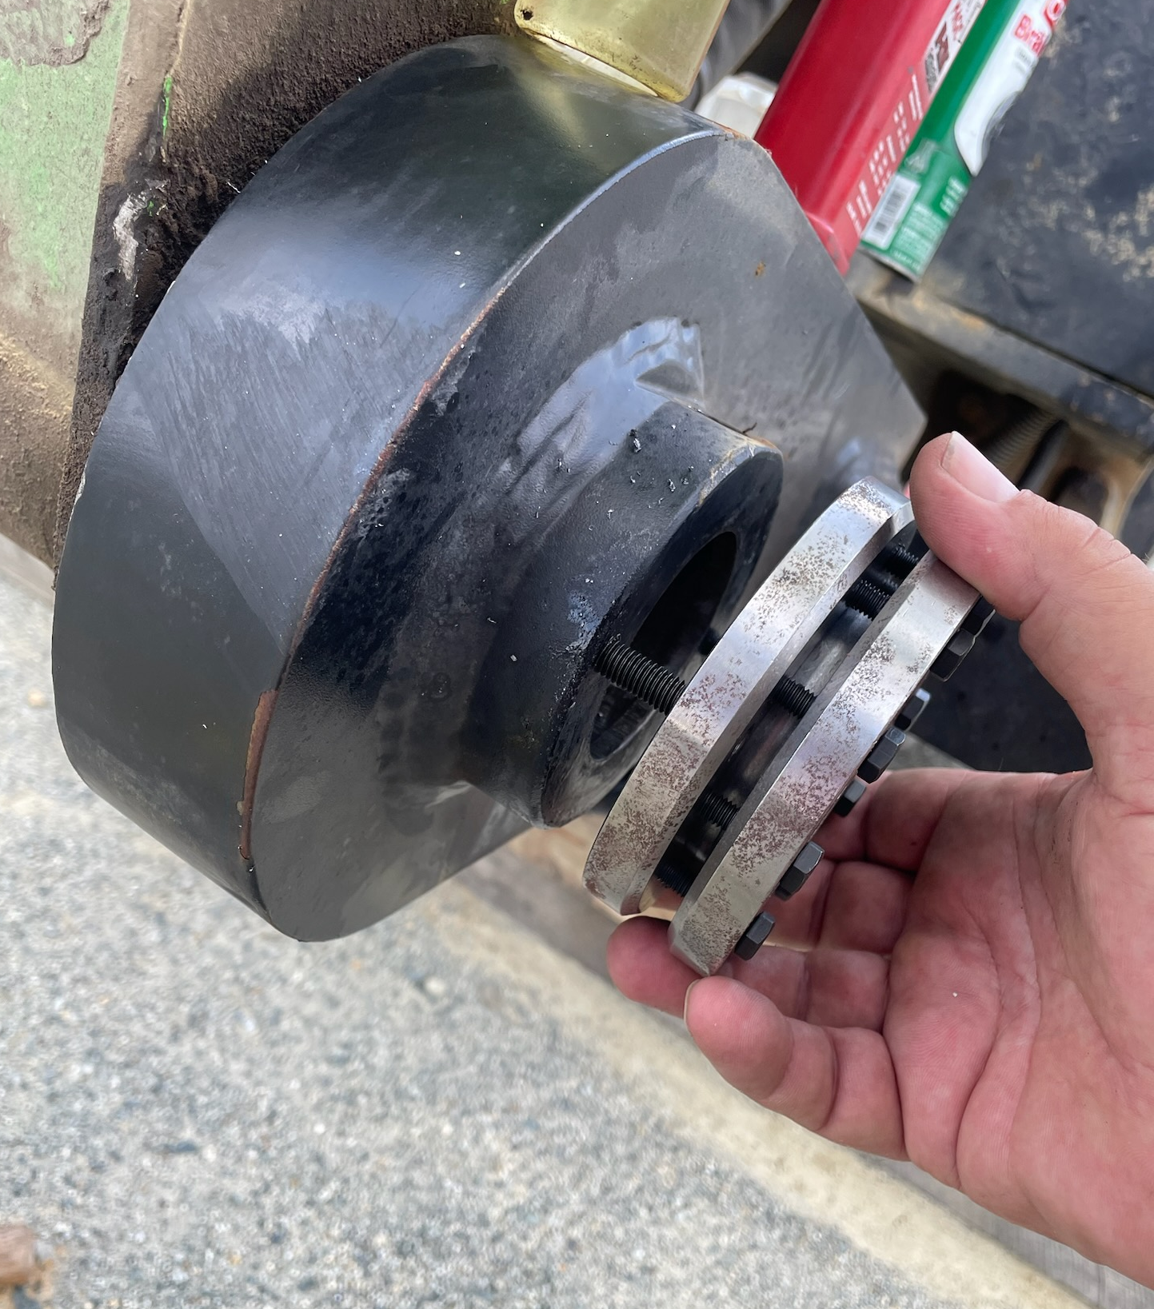
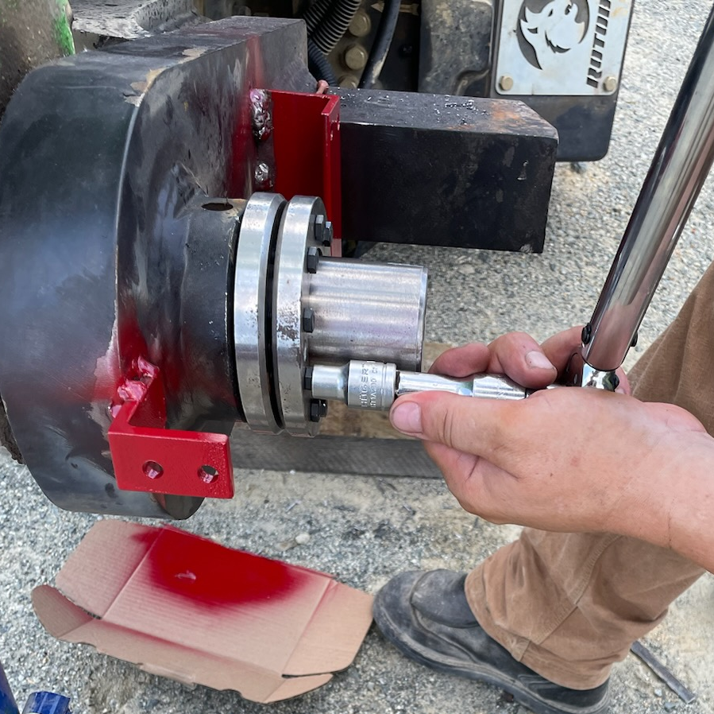
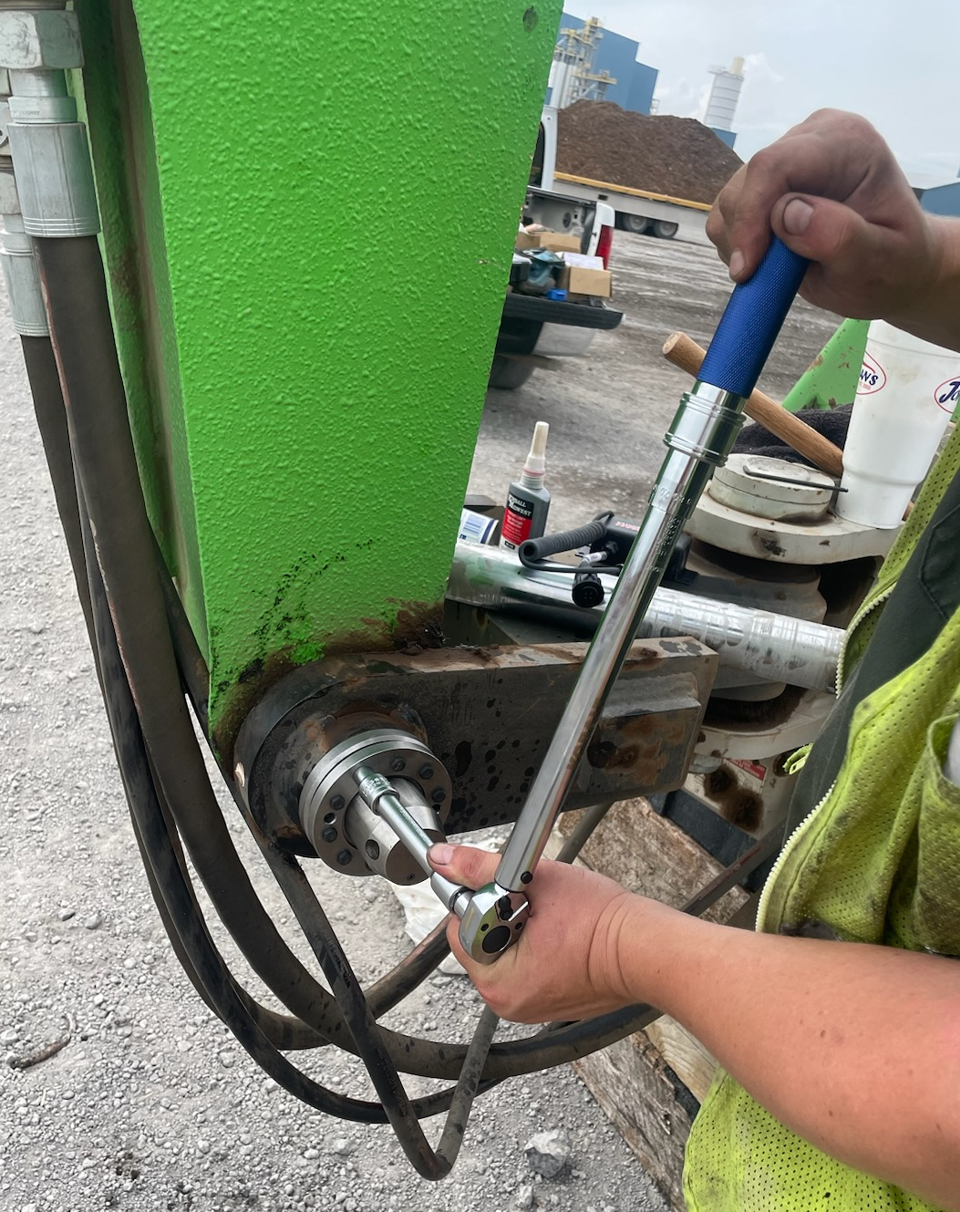
LOADER CRANE PRODUCTION ENHANCED WITH A STICK PIN SCALE
Shrink coupling eliminates all axial and radial motions of the load cell pin
One of two shrink disc couplings fully adjustable for any hanger
Shrink couplings require only 9 ft/lbs of torque
Loadman of Tx

