Slide 1


The Shift from Total Recordables (TRIR) to Serious Injury Fatality (SIF) Prevention
Samantha O’Saben, CSP
Director – EHS
Edw. C. Levy Co.

Slide 2
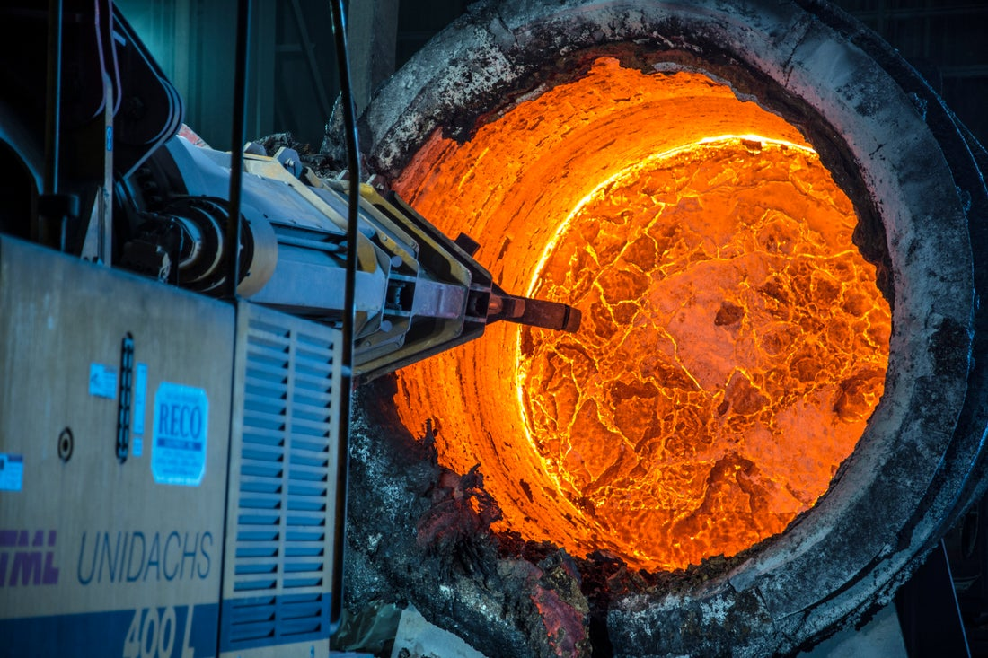

AGENDA
The Purpose Behind the Journey
Recognizing & Classifying PSIFs
Strengthening Risk Controls
Measuring Success & Learnings
Implementation Roadmap

Slide 3
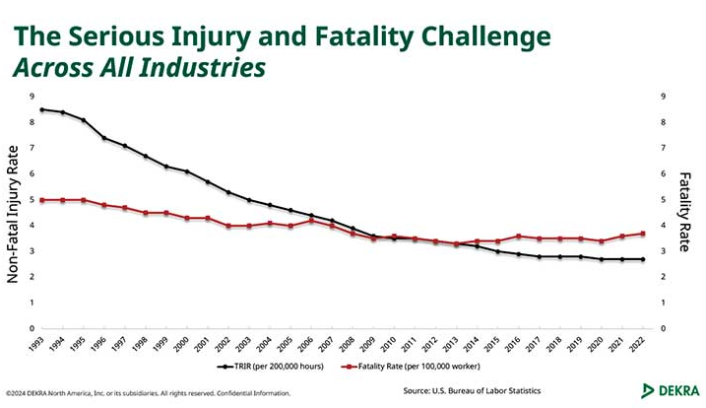
THE PURPOSE BEHIND THE JOURNEY

Slide 4

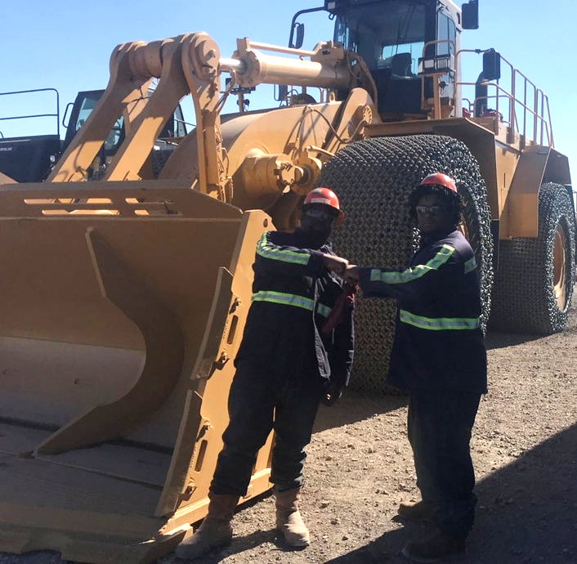
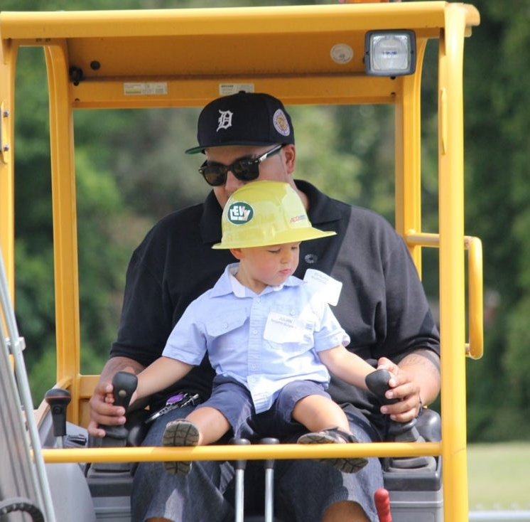
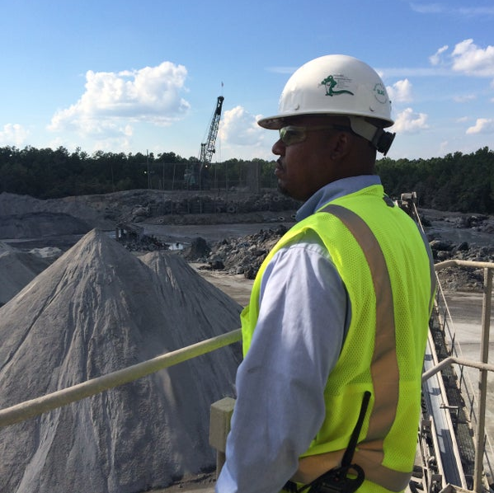
THE PURPOSE BEHIND THE JOURNEY
Traditional metrics (TRIR, LTIR) don’t always reflect true risk
Many incidents with no injury could have resulted in life-altering harm
PSIF (Potential Serious Injury or Fatality): captures incidents with serious potential
Shifting from counting recordables to preventing what matters most
Notes:
For years, our industry has measured safety performance through traditional lagging indicators like Total Recordable Incident Rate (TRIR) and Lost Time Incident Rate (LTIR). While these metrics provide valuable information, they often fail to capture what matters most—preventing life-altering injuries and fatalities.
That’s why today, we are shifting the conversation from numbers on a report to the real potential of incidents. We are focusing on Potential Serious Injury and Fatality (PSIF) events—incidents that may not have resulted in a serious injury this time, but easily could have under slightly different circumstances. By recognizing and classifying PSIFs, we can sharpen our focus on risk, strengthen our controls, and most importantly—save lives.
This presentation will walk through the evolution from recordable injury metrics toward a PSIF-centered approach, highlight how we classify PSIFs, and demonstrate how this shift empowers us to prevent what matters most: serious injuries and fatalities.
Focuses on
: 1.) Recognizing and classifying PSIFs 2.) Strengthening risk controls 3.) Eliminating serious injuries and fatalities

Slide 5
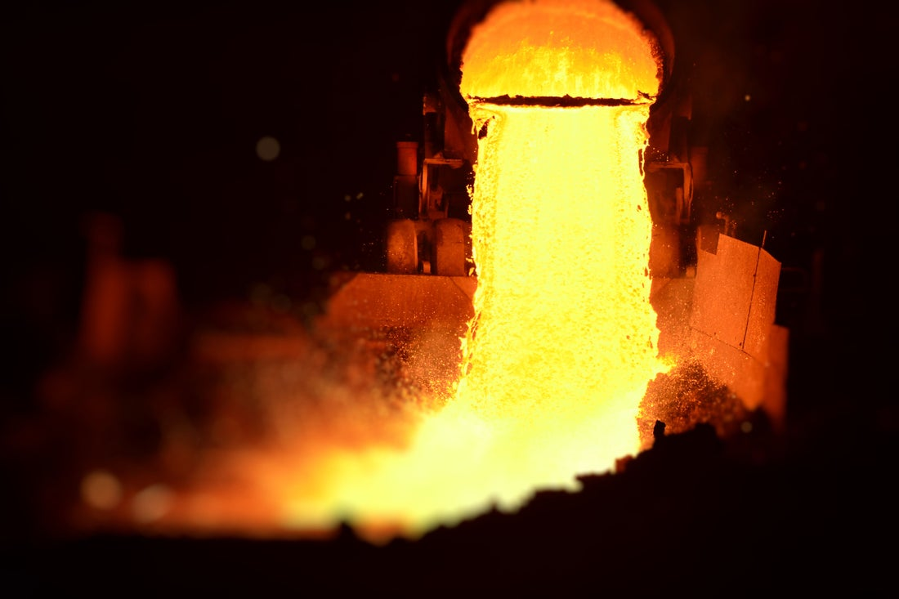
THE EVOLUTION OF THE LEVY SAFETY PROGRAM
2000
OSHA Compliance
2023
Low Recordables
High PSIFs
Fatality
2005
Safety Program in Place + Cardinal Safety Rules
2014
Employee Engagement
2018
Human Factors
2020
COVID
2019
Intro. of SIF Prevention Program & Life Saving Rules
2024
SIF Prevention, Life Saving Rules
2016
Risk Assessment
PSIF
LTIR
DART
TRIR

Slide 6
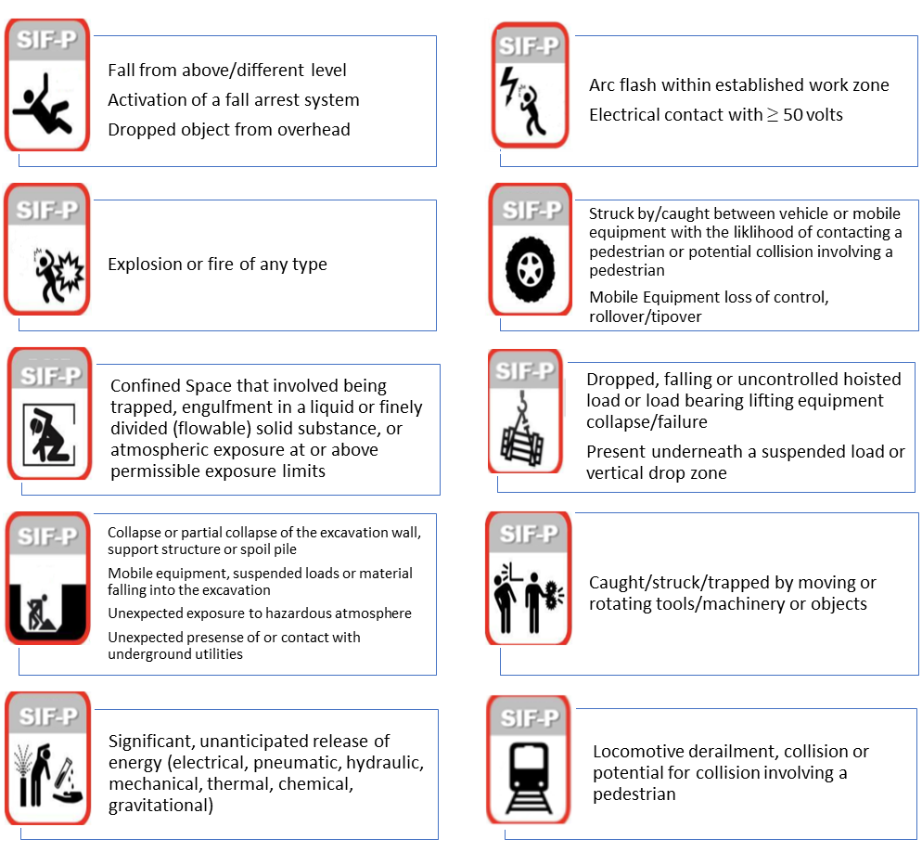
Serious Injury or Fatal Potential (PSIF)
An occupational incident that did not result in a serious or fatal injury but had the potential if any of the circumstances, factors, or protective measures changed.
Explosion or fire beyond the incipient stage

Slide 7

PSIF CLASSIFICATIONS
Violation
Controls in place were willfully disregarded and due to luck, a SIF did not occur
Accountability, evaluate culture
Uncontrolled PSIF
There was an absence or lack of controls in place, but a SIF did not occur due to luck.
Improve systems with strong controls for risk mitigation
Controlled PSIF
Controls in place prevented the SIF outcome.
Positive recognition

Slide 8
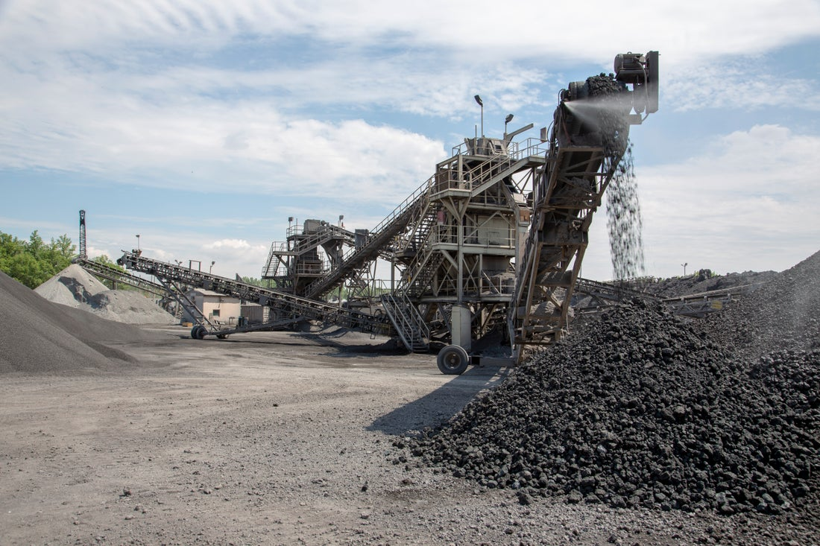
Uncontrolled PSIF
Violation
controls in place prevented the SIF outcome
there was an absence or lack of controls in place but a SIF did not occur due to luck
Controls in place were willfully disregarded and due to luck a SIF did not occur
Controlled PSIF
Violation, 20%
Uncontrolled, 50%

Slide 9



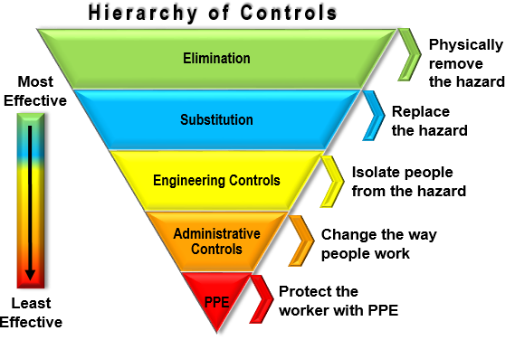
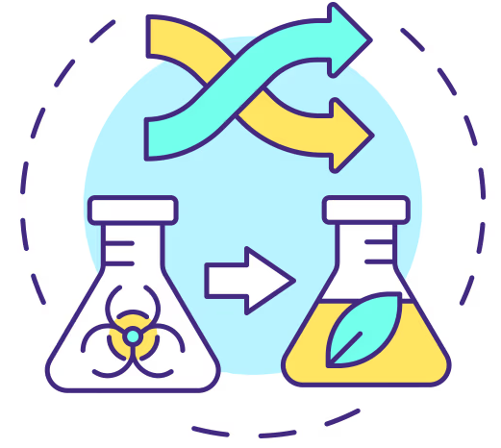
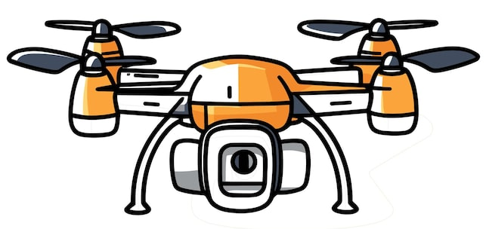
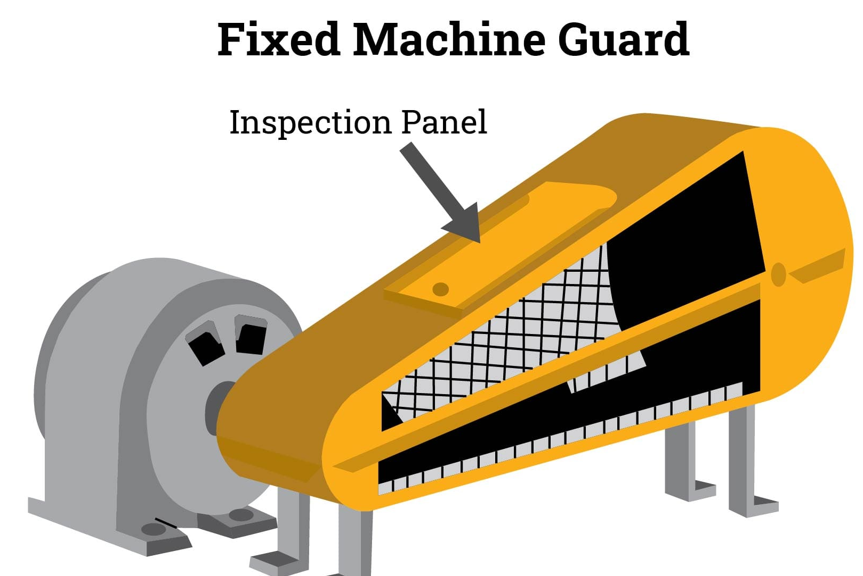
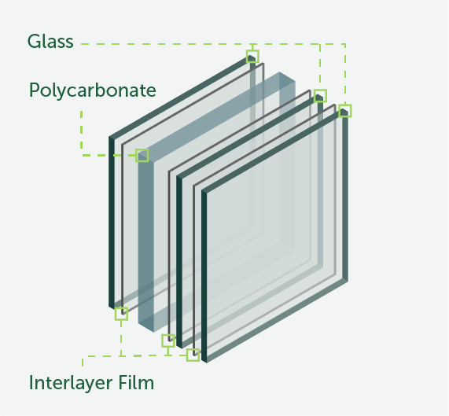

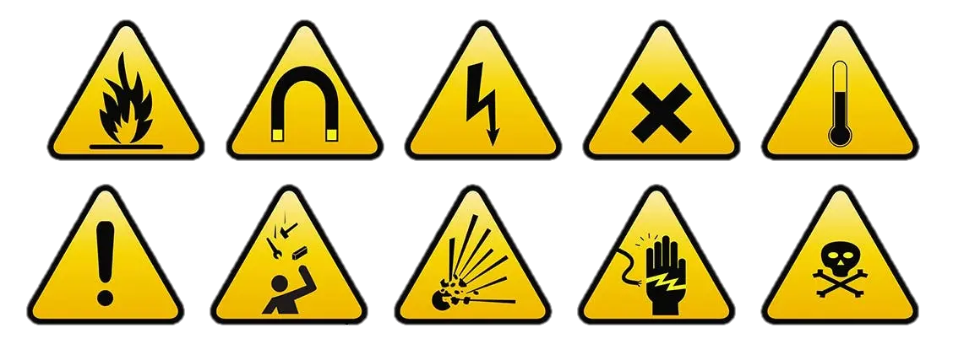

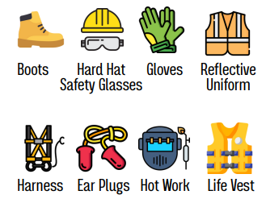
STRENGTHENING RISK CONTROLS

Slide 10
STRENGTHENING RISK CONTROLS
Goal – build strong systems for imperfect people
Elimination/Substitution, 15%
Engineering, 30%
Administrative, 52%
PPE, 3%

Slide 11
MEASURING SUCCESS AND LEARNINGS
the highest-level action includes elimination, substitution or engineering from the hierarchy of controls.
the highest-level action includes elimination, substitution or engineering from the hierarchy of controls.
% of uncontrolled incidents with an ESE control in place following the incident
% of uncontrolled incidents with an ESE control in place following the incident
Controlled PSIF % from all PSIF incidents
Controlled PSIF % from all PSIF incidents
Violation PSIF % from all PSIF incidents
Violation PSIF % from all PSIF incidents
Uncontrolled PSIF % from all PSIF incidents
Uncontrolled PSIF % from all PSIF incidents
Total PSIF Quantity
Total PSIF Quantity
PSIF % from total incident count
PSIF % from total incident count
Total Controlled PSIF Quantity
Total Controlled PSIF Quantity
Total Violation PSIF Quantity
Total Violation PSIF Quantity
Total Uncontrolled PSIF Quantity
Total Uncontrolled PSIF Quantity
1. Avoid the focus on driving down the number of PSIFs
Use PSIF % and quantities as a leading indicator for insight but be mindful of driving reporting underground
2. Not all PSIFs are the same
There are different PSIF scenarios. Classifications help prioritize investigation response and resources.
3. The power and value is in the controls
Strong controls build strong systems

Slide 12
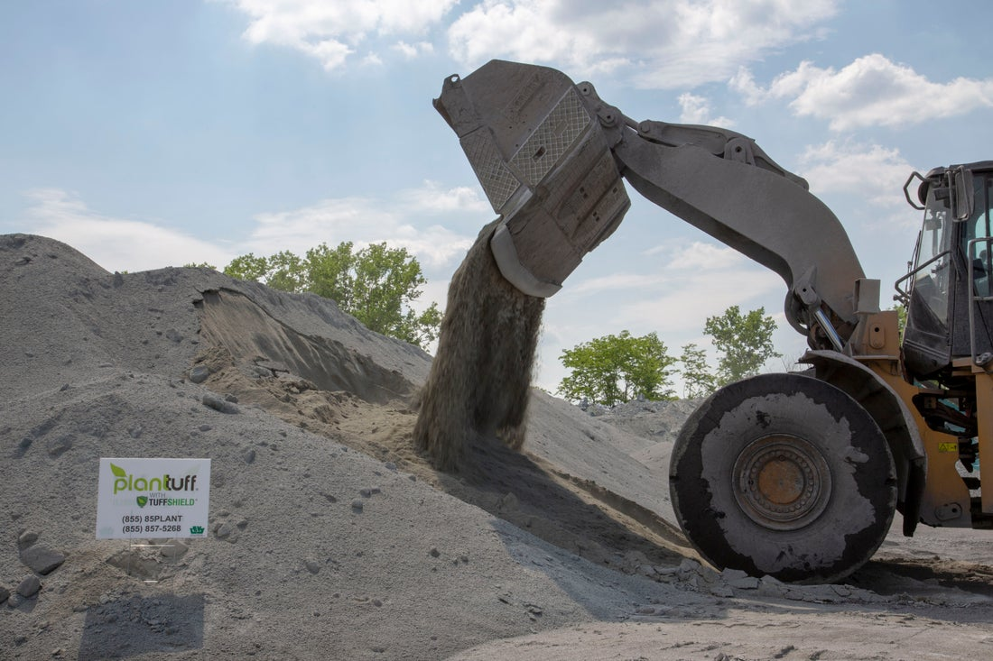
PSIF PROGRAM IMPLEMENTATION
Establish Program with Definitions, Criteria, Responsibilities, Response Expectations
Train Leadership & Employees
Identify PSIF Incidents
Implement Investigation, RCA & Review Process
Track & Measure Success (Scorecard Implementation)
Measure Corrective Action Quality & Controls Strength
Share & Implement Actions Across Different Sites
Audit & Verify PSIF Controls

Slide 13

Samantha O’Saben, CSP
Director – EHS
Edw. C. Levy Co.

