Slide 1


Experimental and Numerical Analyses of Leachate from Air Cooled Blast Furnace Slag Materials
Ali Arda CAKALOGLU – Graduate Research Assistant
Dr. Angela FARINA - Postdoctoral Research Associate
Dr. Bora CETIN - Principal investigator
2025 National Slag Association Annual Meeting
Ritz-Carlton Naples, Tiburon, Florida
September 15-18, 2025

Slide 2
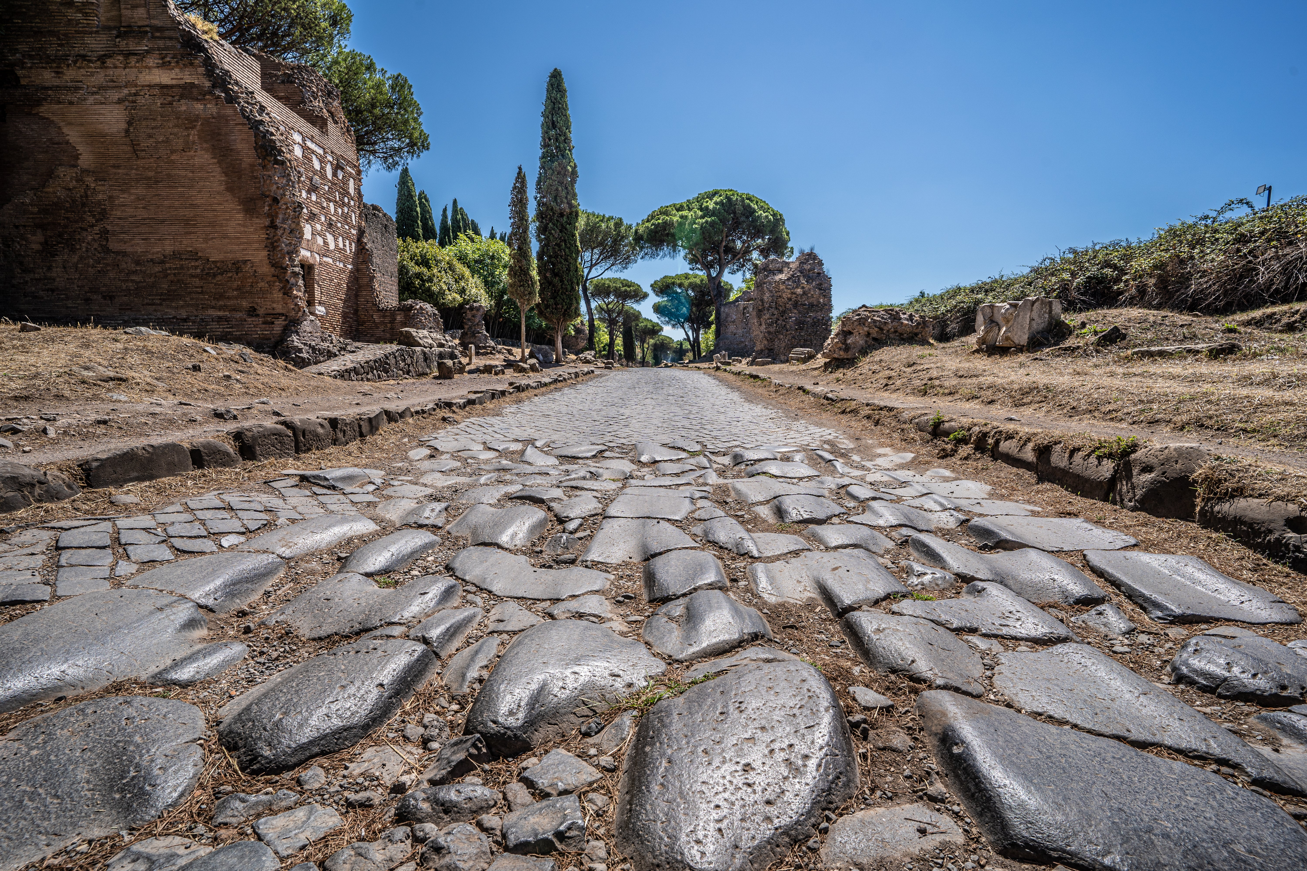

INTRODUCTION
SLAG AS A CONSTRUCTION MATERIAL
‘Appian Way’ in Italy (312 BC)
Modern Road Application

Slide 3
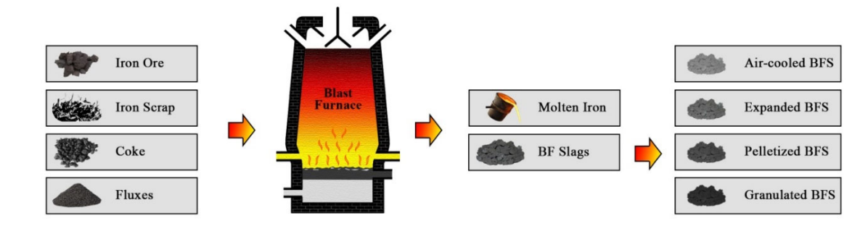
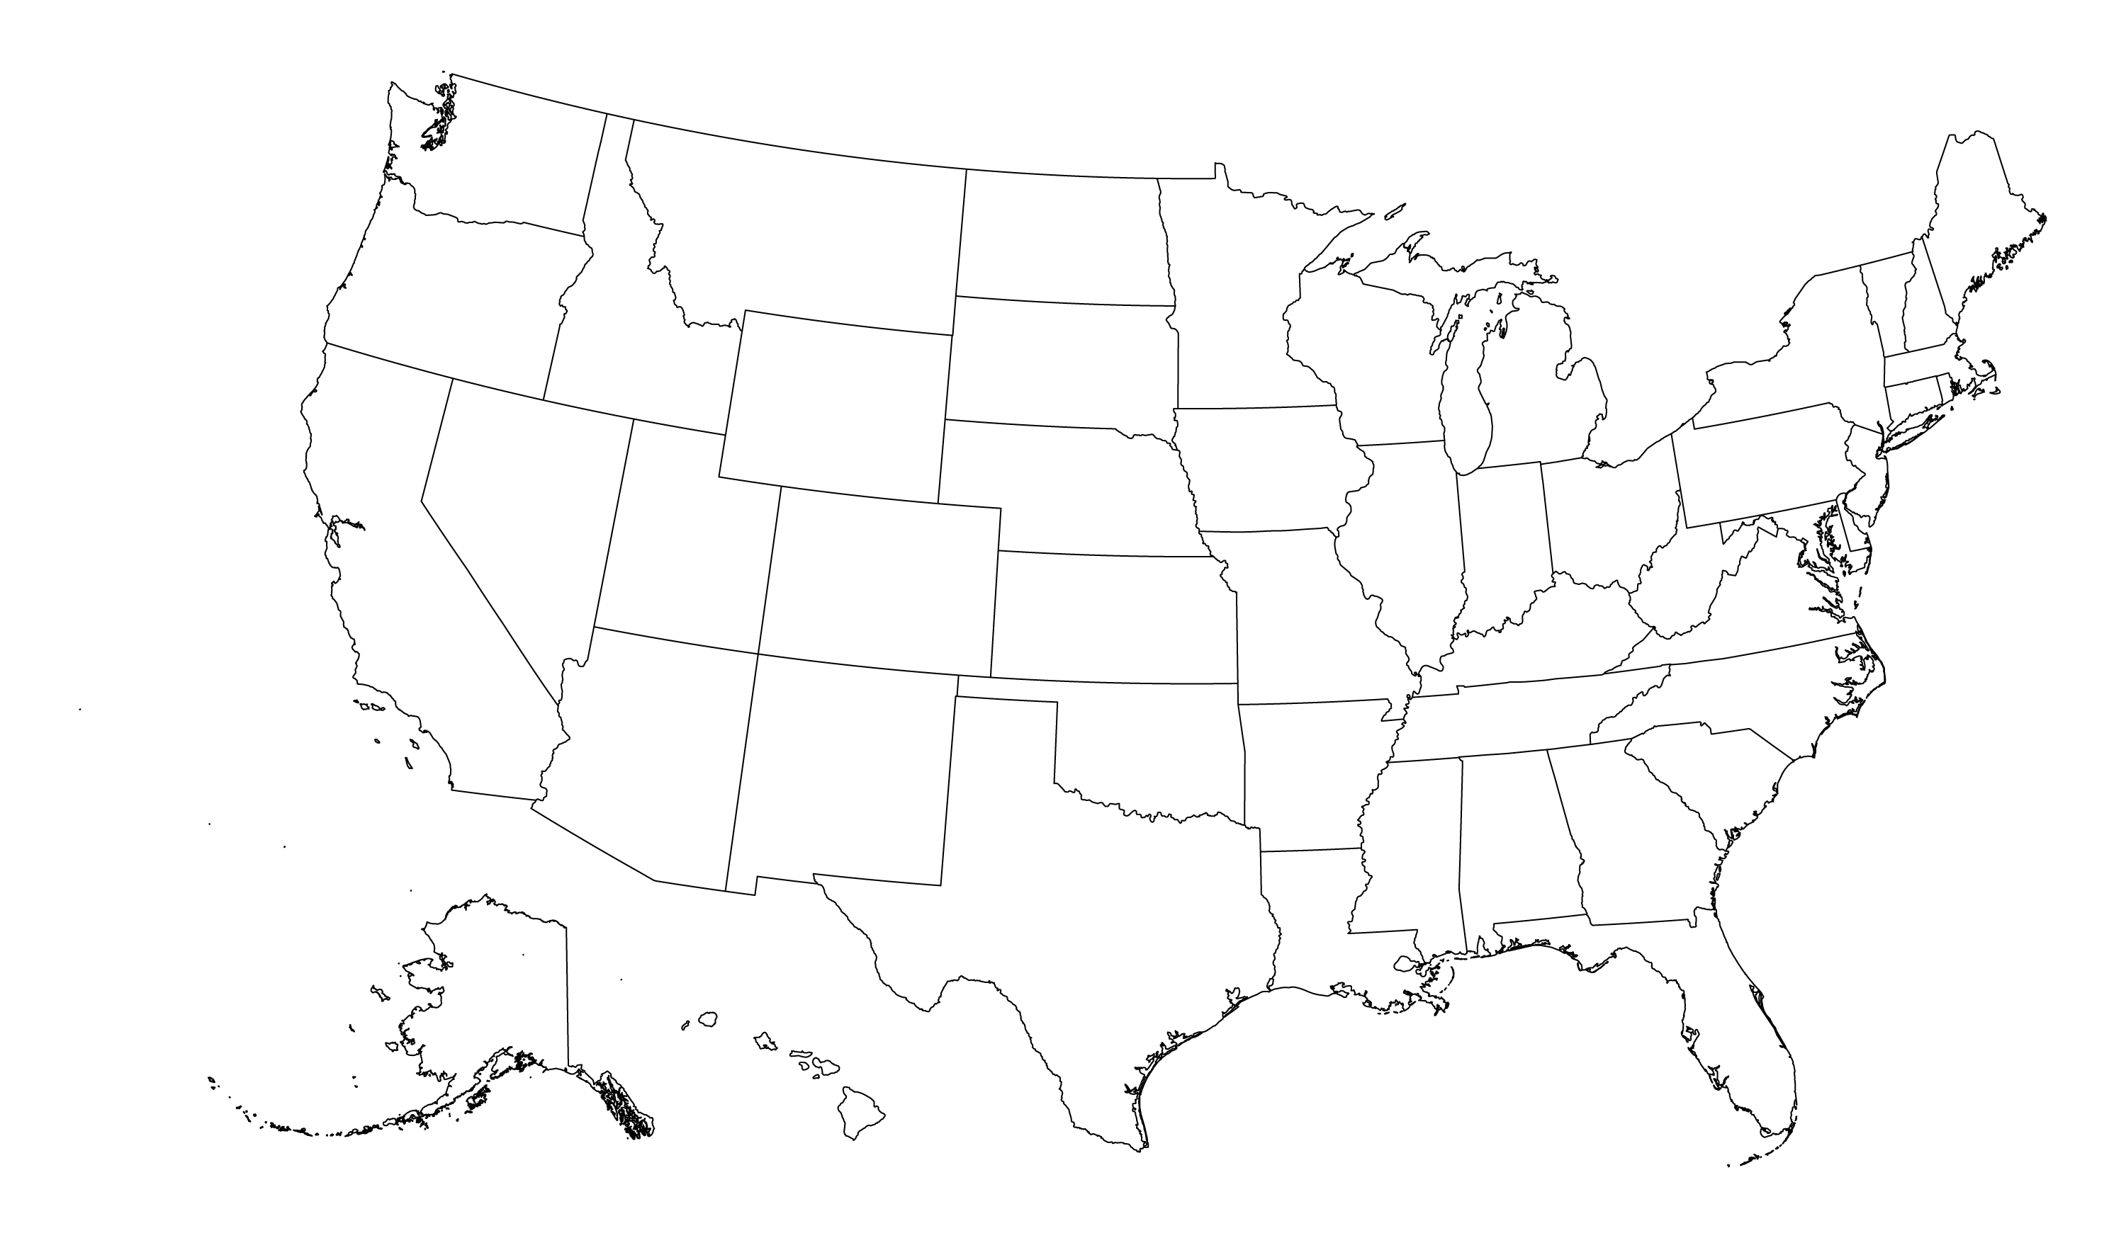
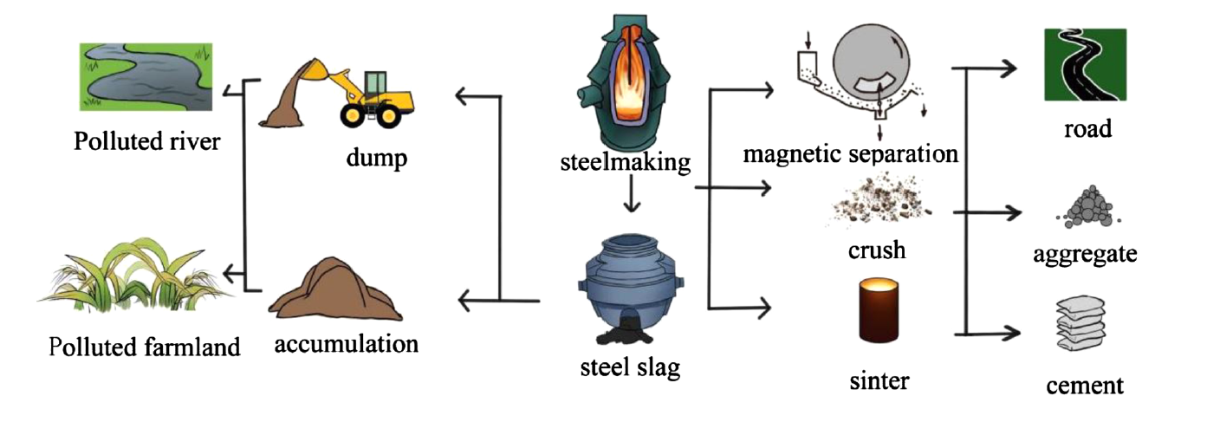
INTRODUCTION
SLAG PRODUCTION
Blast furnace slag production process.(Pasetto et al., 2023)
16 million tons produced annually
54% Blast furnace slag
(USGS, 2023)
Steel slag production and disposal routes (Song et al., 2021)

Slide 4
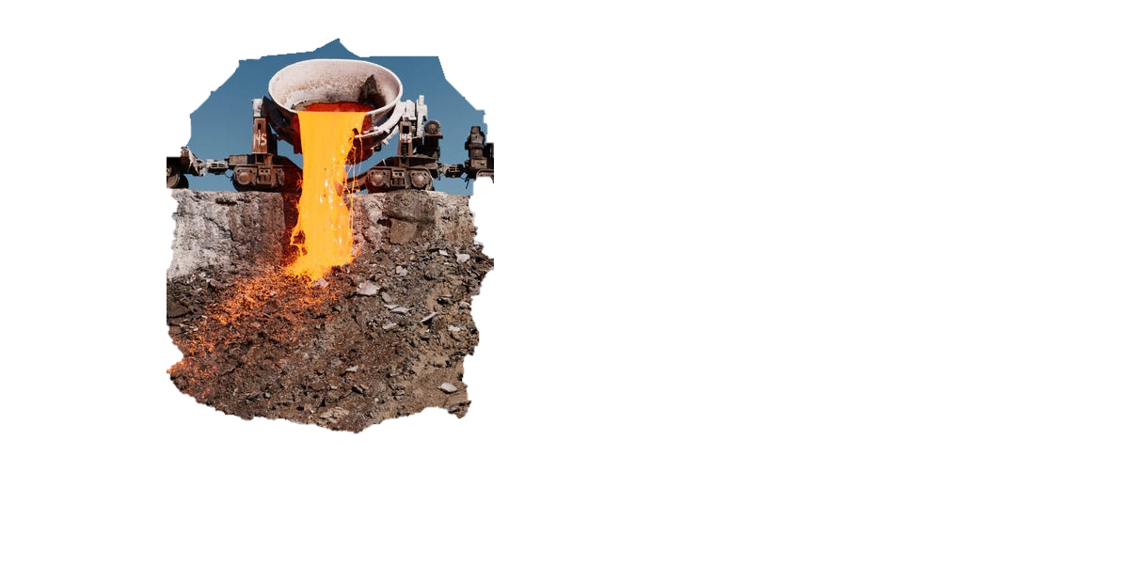
GOAL OF THE PROJECT
AIR-COOLED BLAST FURNACE SLAGS (ACBFS)
Industrial co-product of the iron & steel industry
Behavior varies by slag type & test method
MAIN GOAL
Develop a new test method to evaluate whether ACBFS are properly tested from the environmental perspective before their use in construction applications
Comparing different leaching tests
Determine the behavior of leaching
Evaluate potential remediation

Slide 5
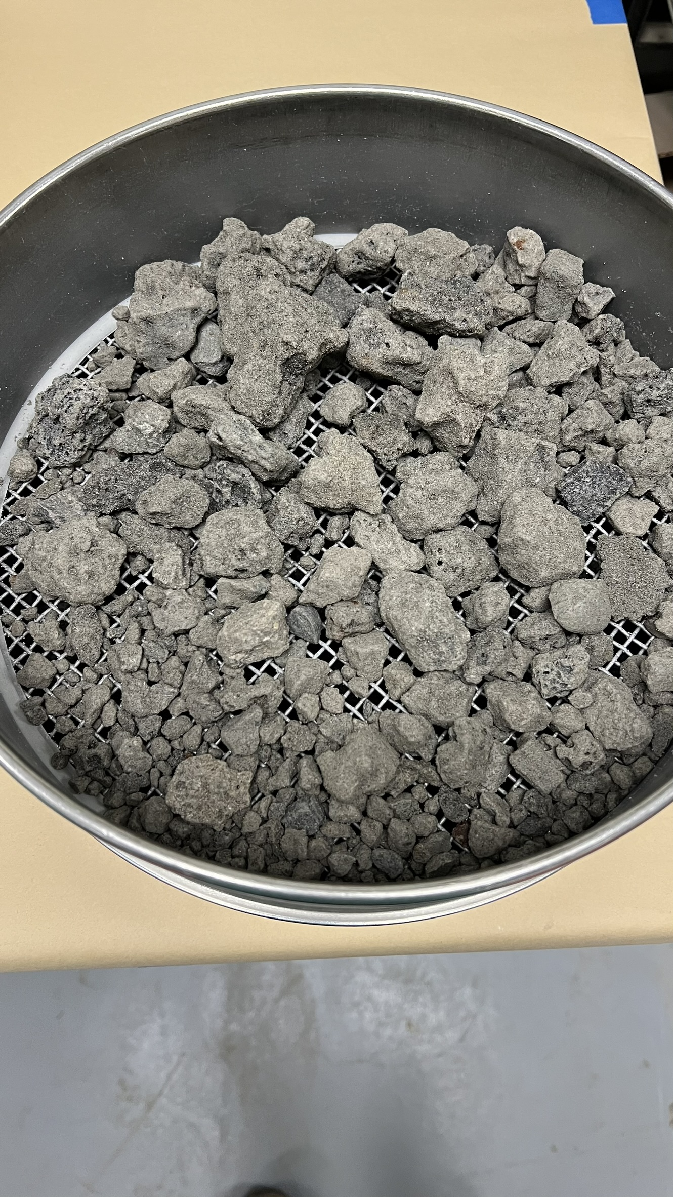
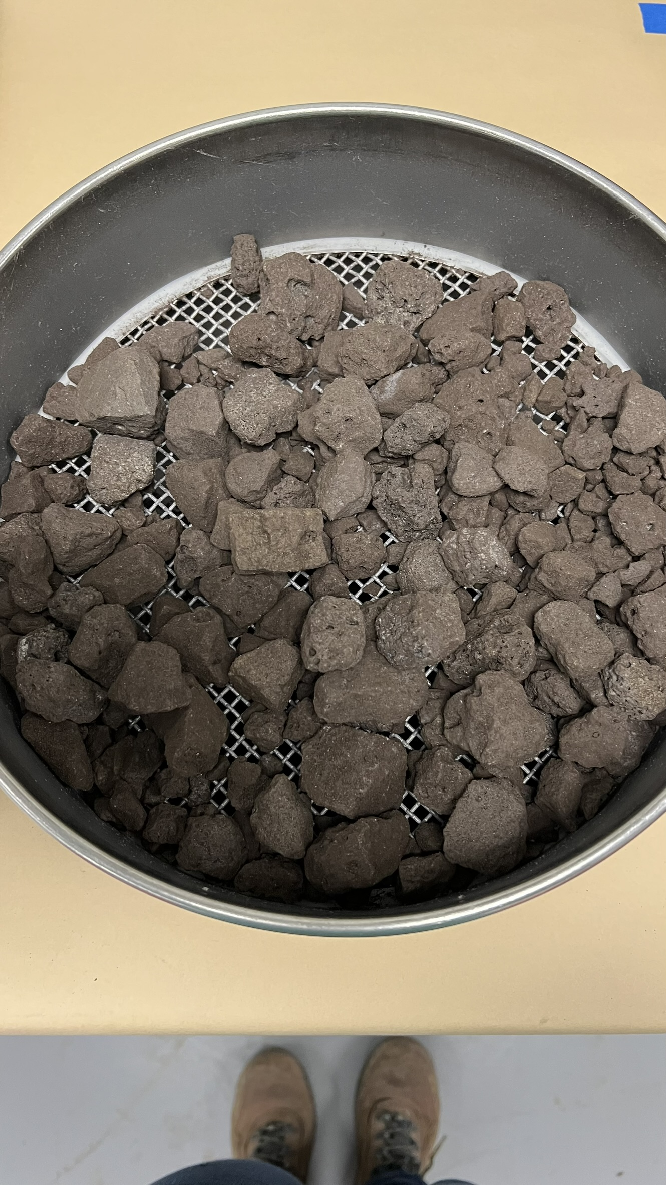
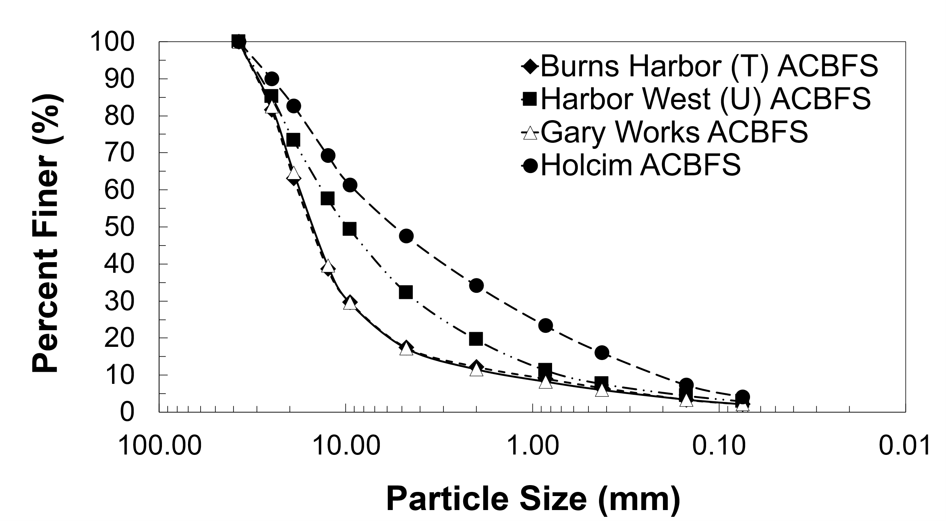
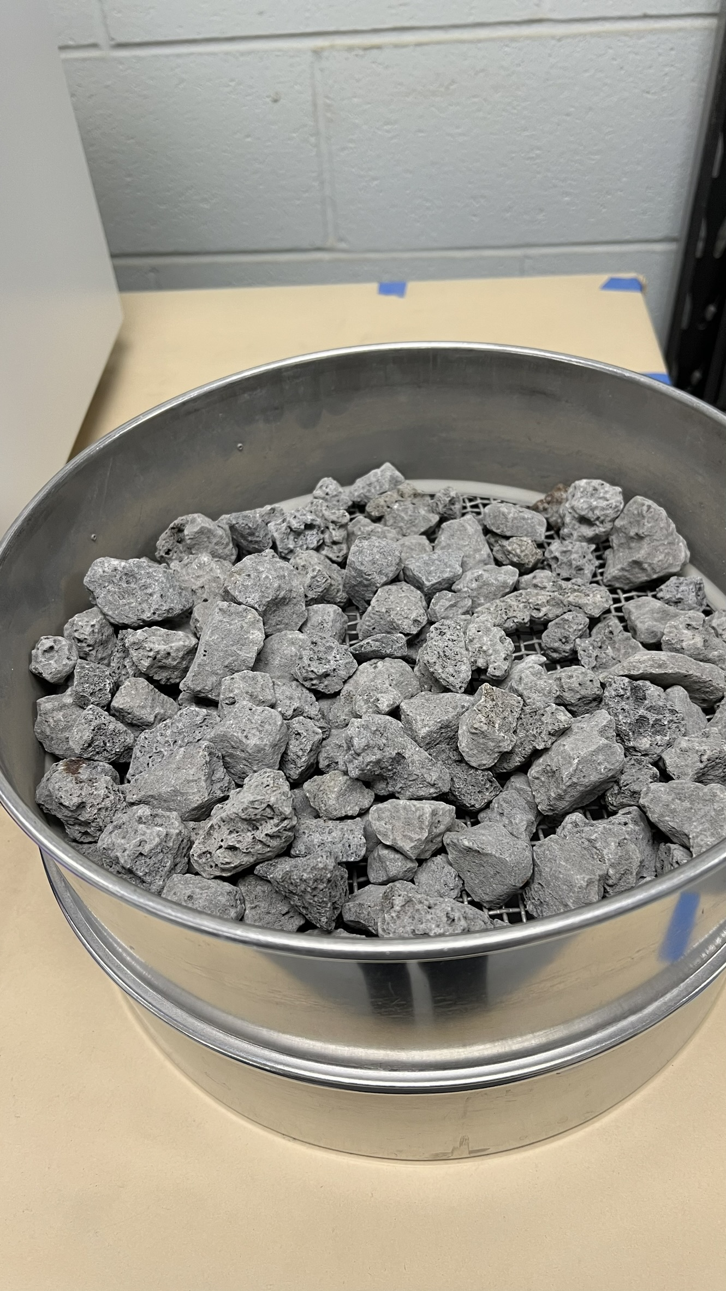
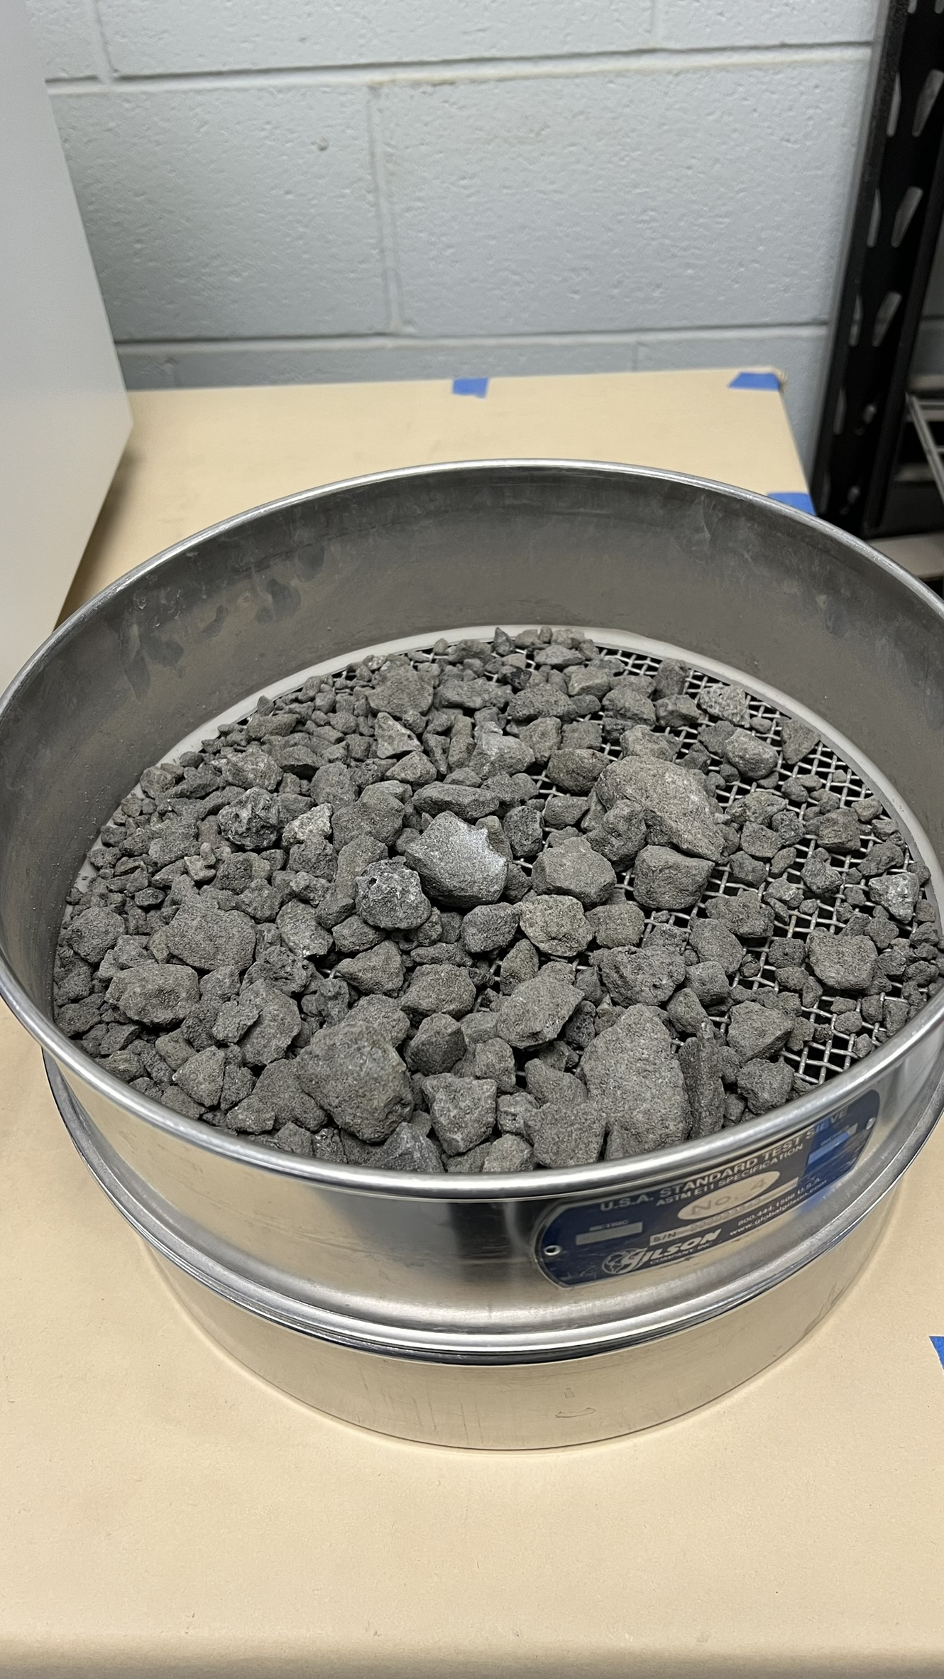
MATERIALS
ACBFS
Index and Compaction Properties of ACBFS:
Gradation Distribution of ACBFS Materials
Harbor West
Indiana
(Untreated)
Burns Harbor Indiana
(Treated)
Gary Works Indiana
Holcim
Pennsylvania
( U : Untreated, T : Treated )

Slide 6
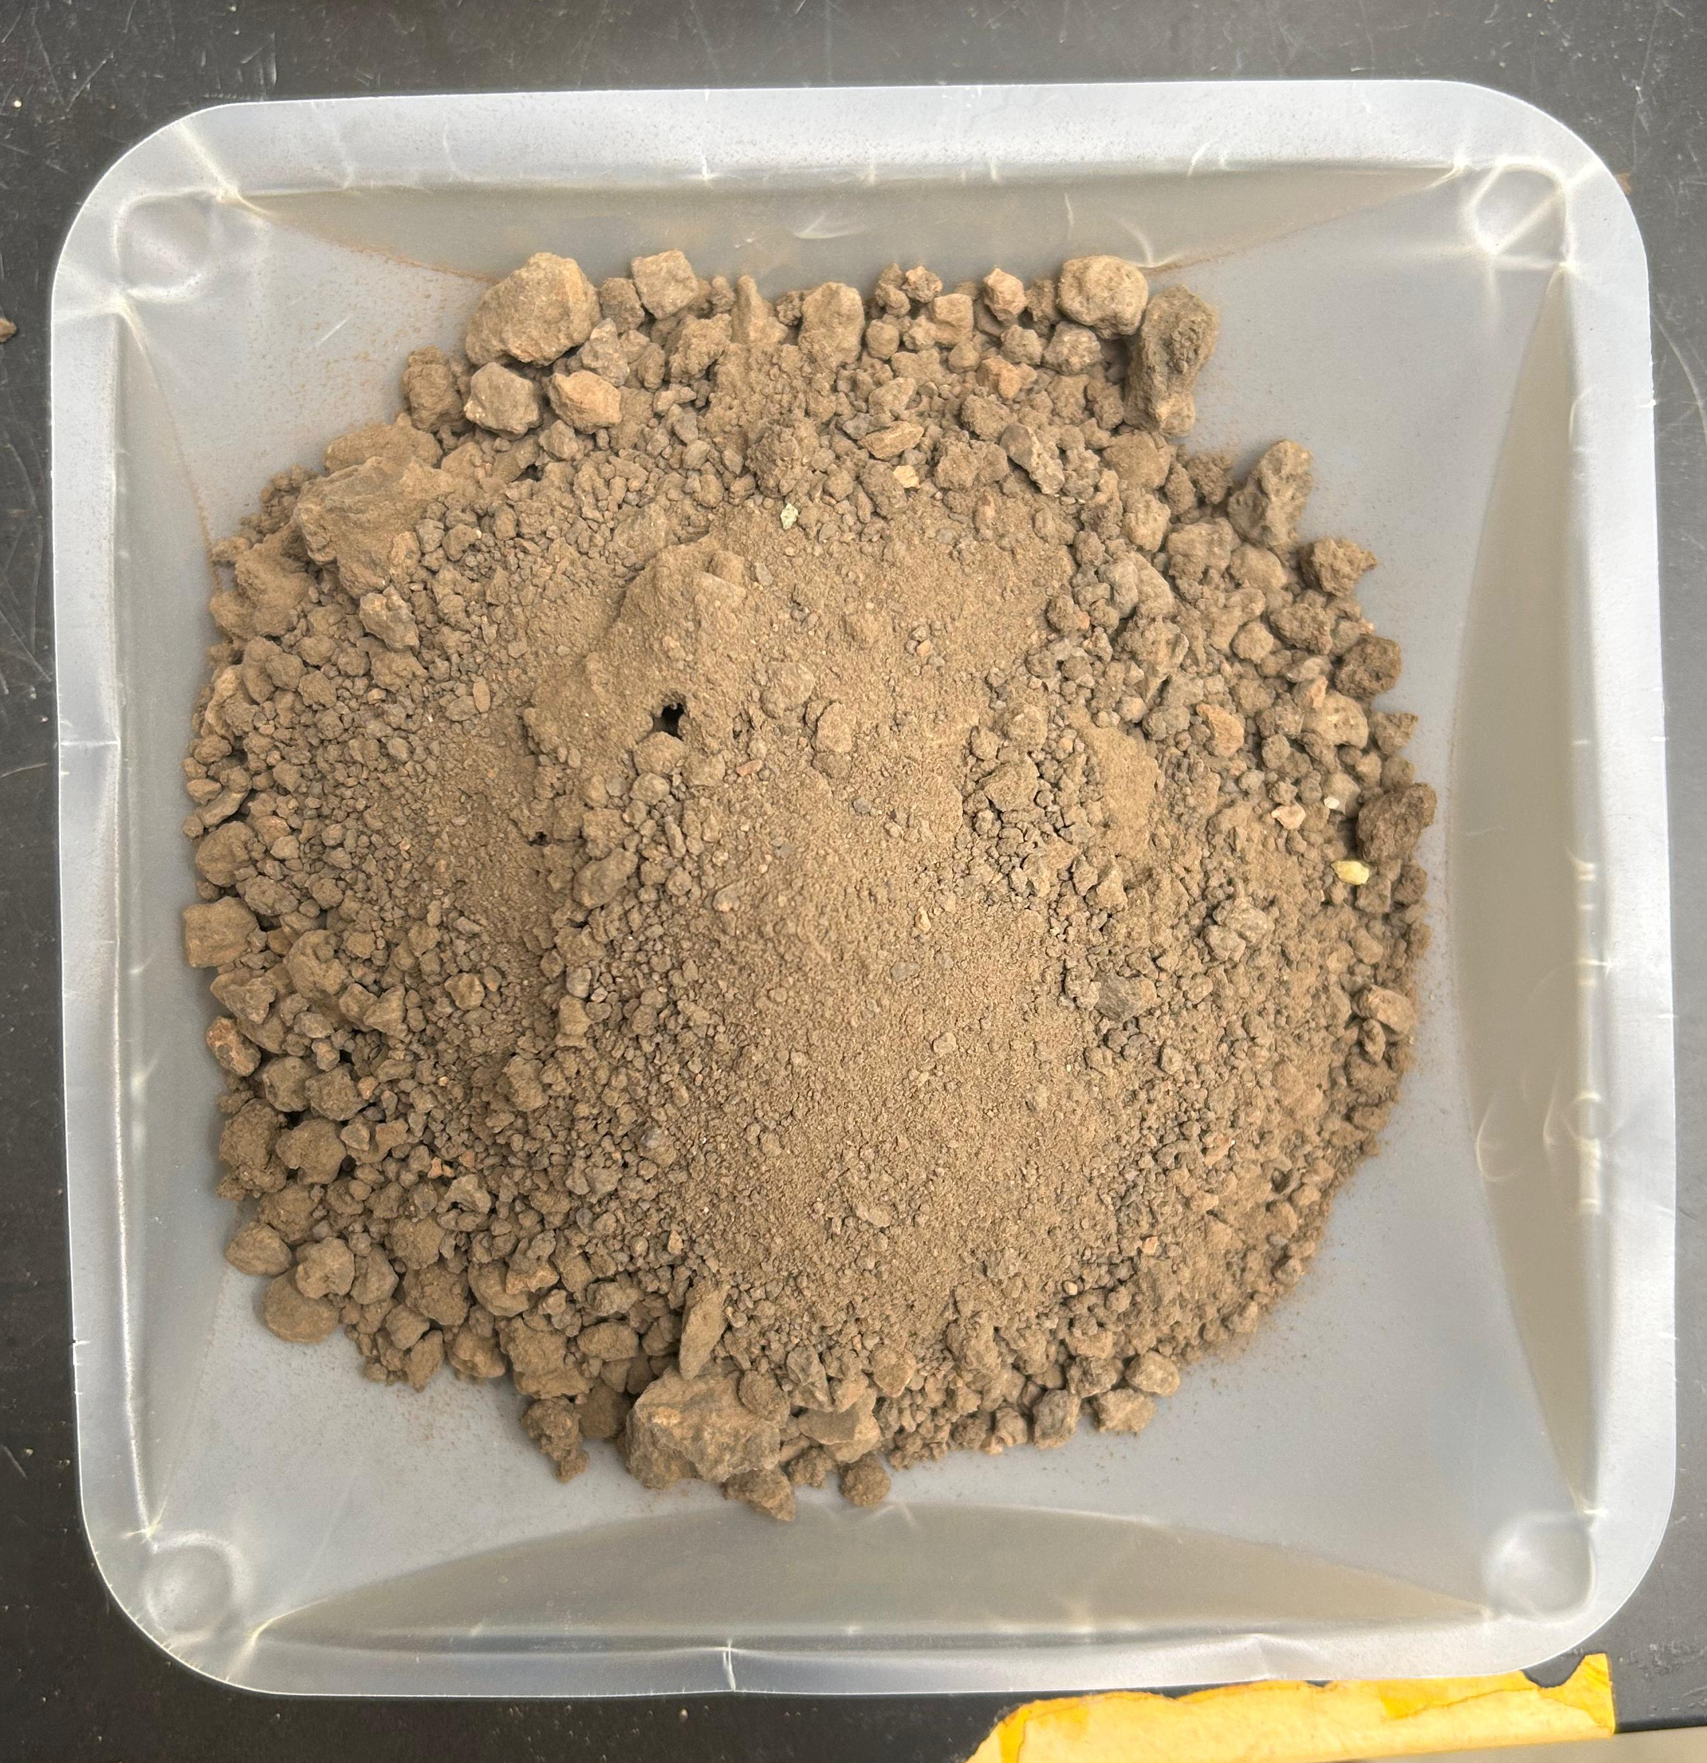
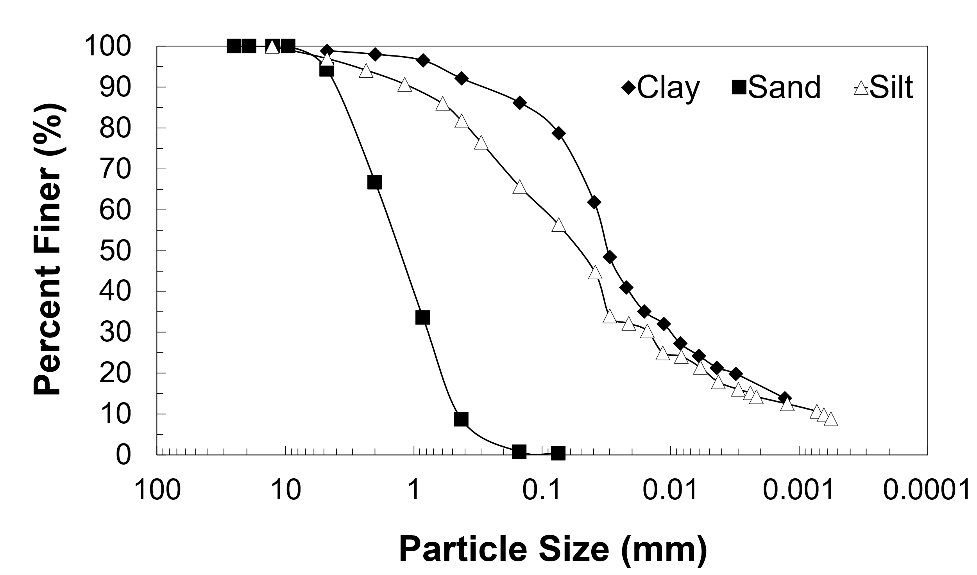
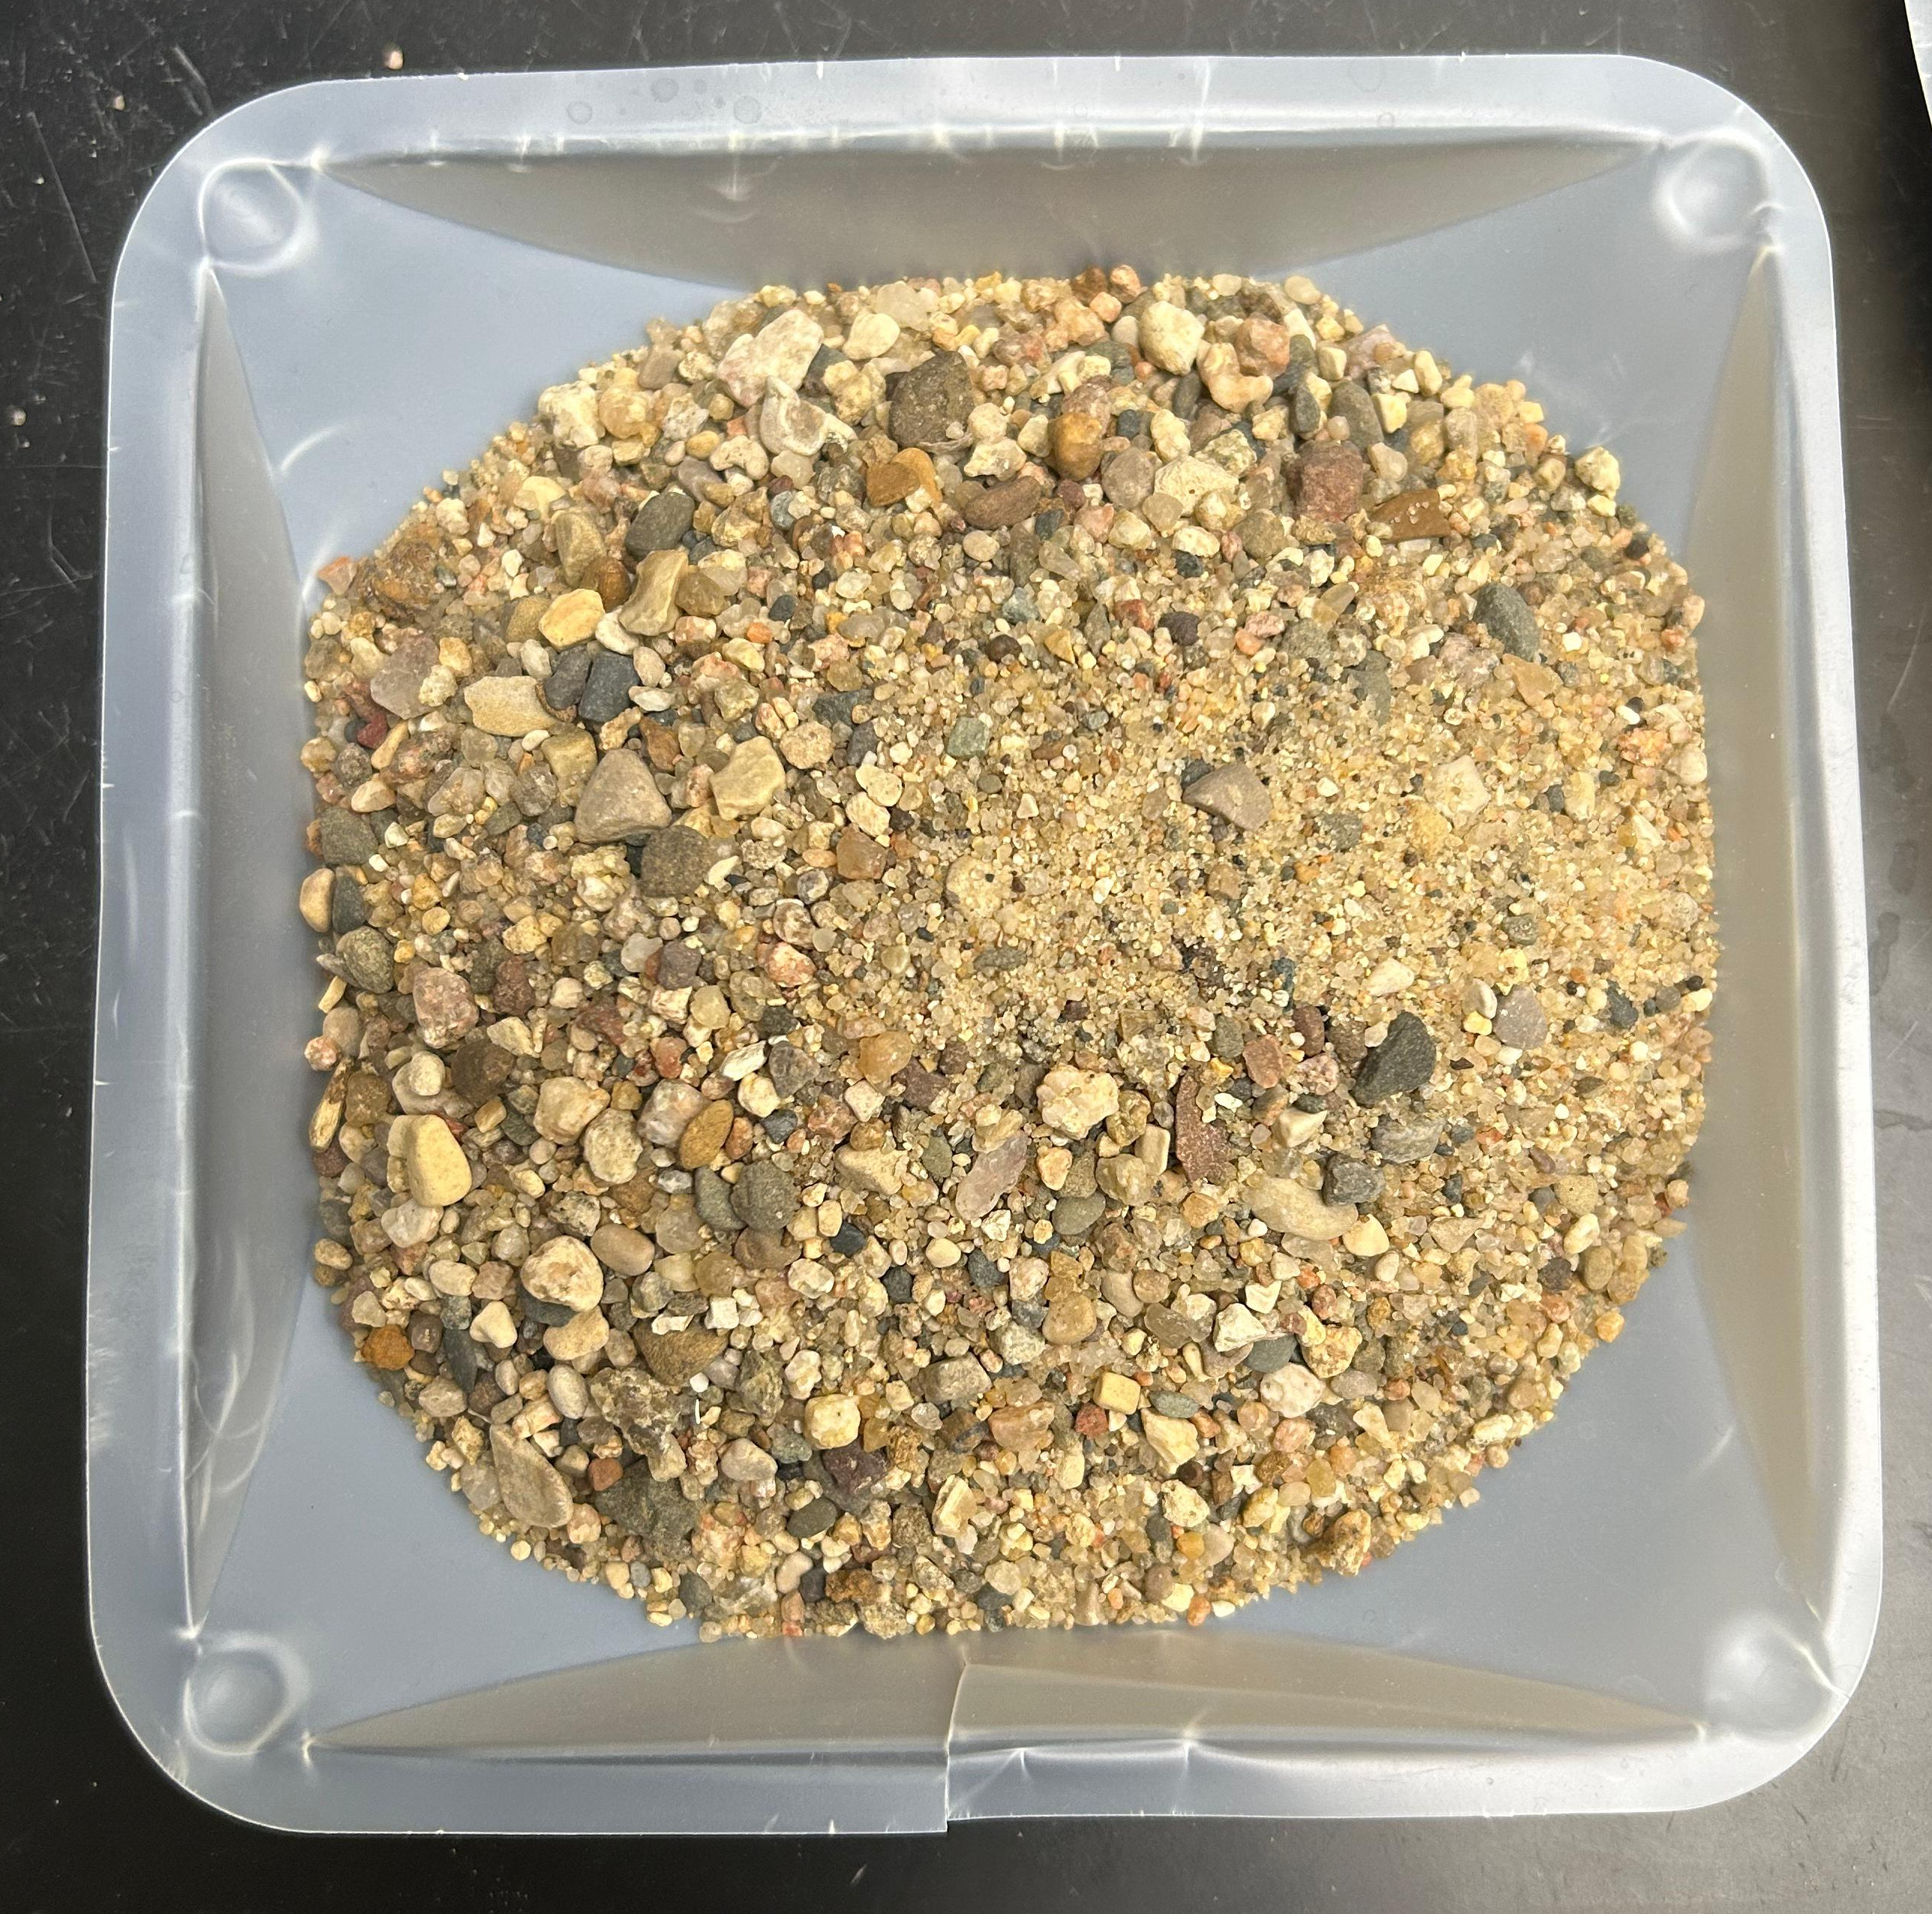
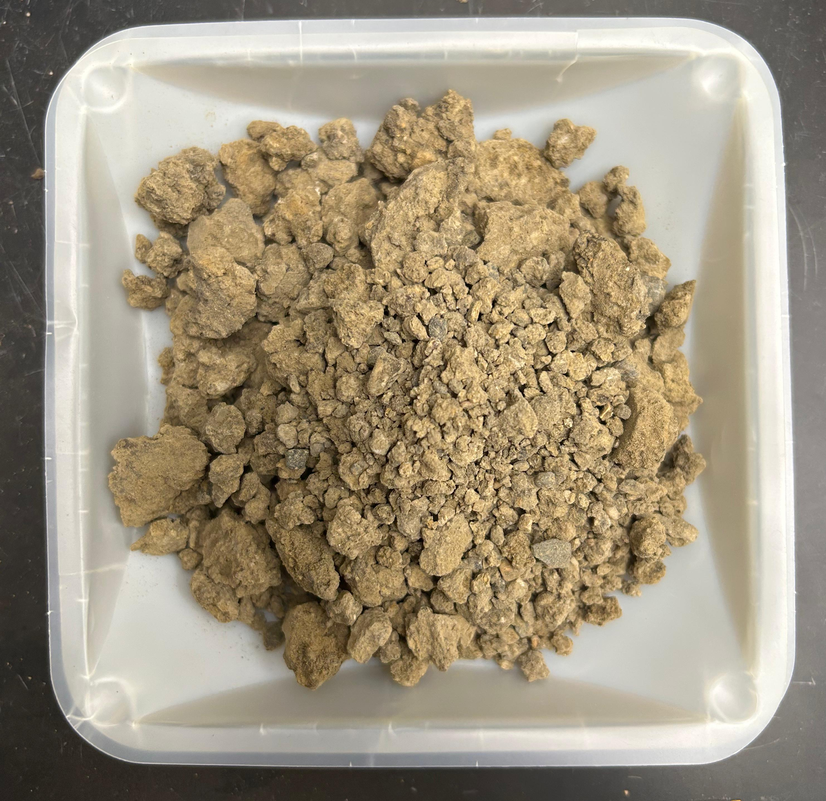
MATERIALS
SUBGRADE SOILS
Index and Compaction Properties of Soils:
Gradation Distribution of Soil Materials
Clay
Sand
Silt

Slide 7


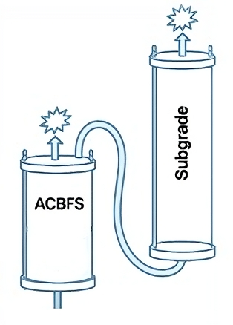

METHODS
LEACHING TESTING
ITM-212 Protocol
(ACBFS only - 1, 3, 7, 15 days)
Stagnant Sequential Batch
(ACBFS and subgrade soil - 1, 7, 30, 90, 180 days)
Sequential Column Test
(ACBFS and subgrade soil)
Stockpile Large Boxes
pH, Electrical conductivity, Oxidation reduction potential, Alkalinity, Sulfate and Sulfur content, Color, Odor (H₂S), Metals concentration

Slide 8
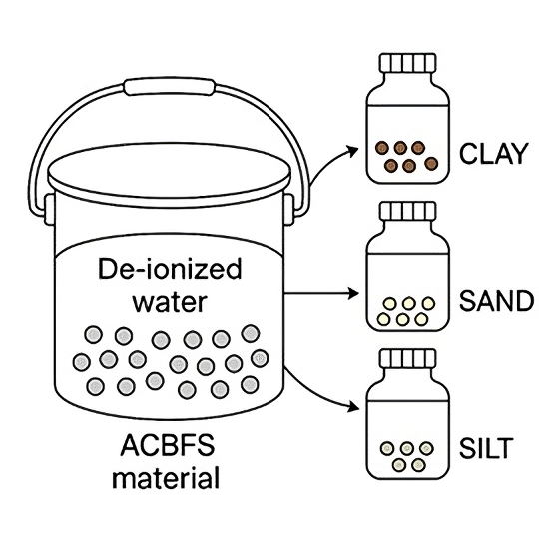
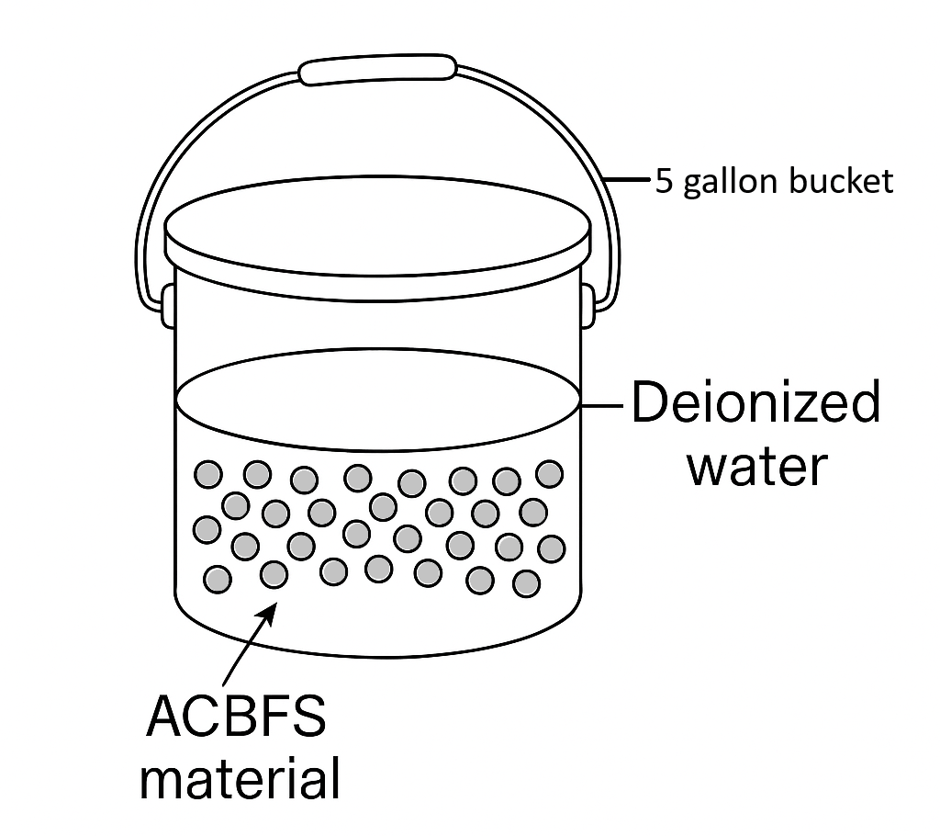
METHODS
ITM-212 Protocol
SEQUENTIAL BATCH TEST
Deionized water
L/S of 0.4 mL/g-dry
1, 3, 7, and 15 days
L/S of 10 mL/g-dry
1, 7, 30, 90, 180 days

Slide 9
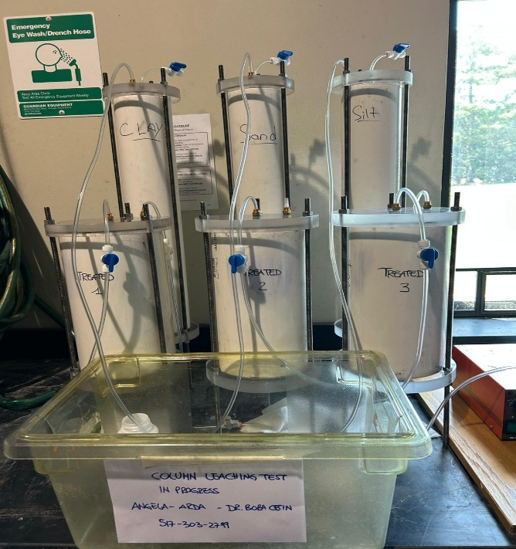
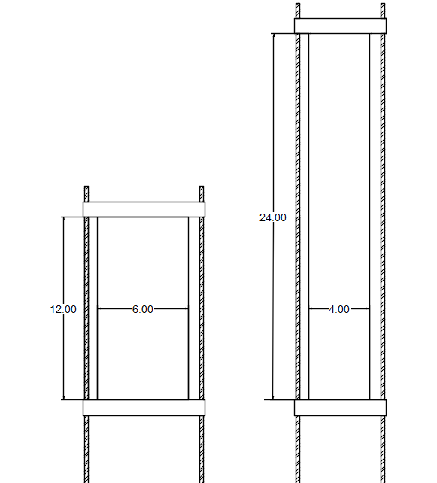
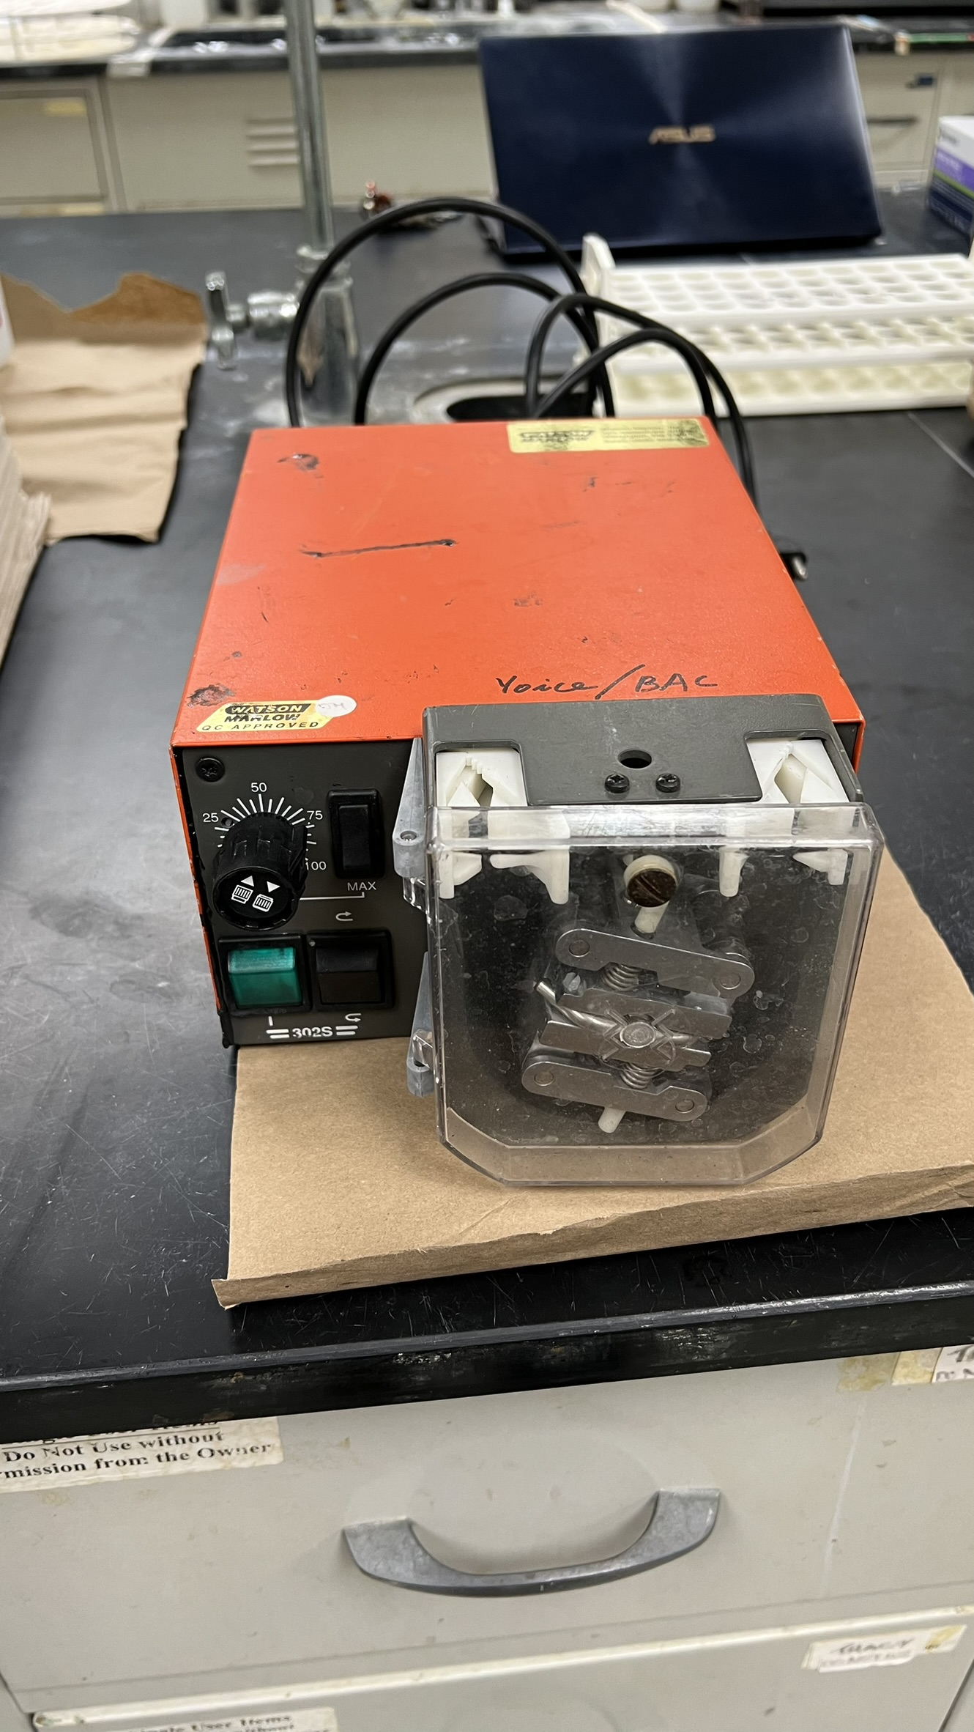
METHODS
SEQUENTIAL COLUMN LEACHING TEST
Peristaltic Pump (30 ml/h)
Subgrade
ACBFS

Slide 10
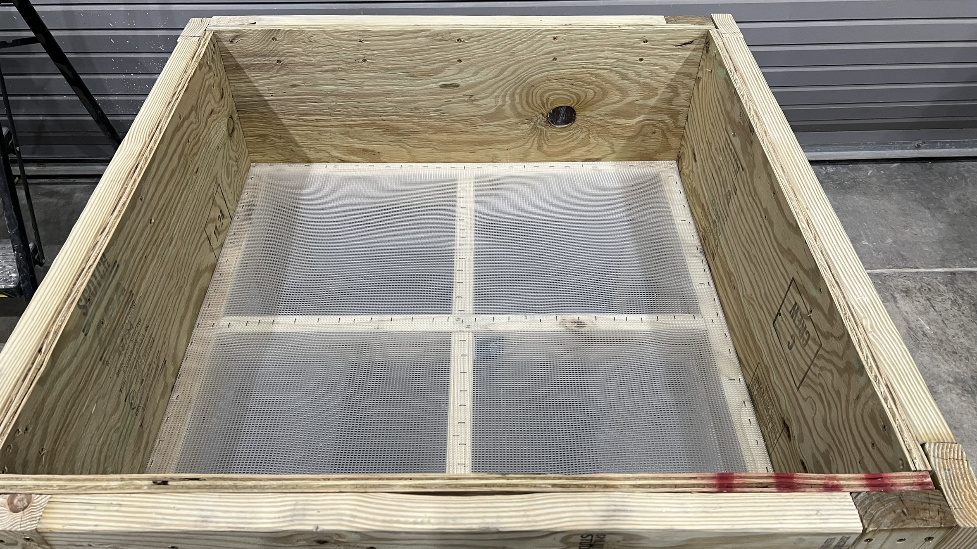
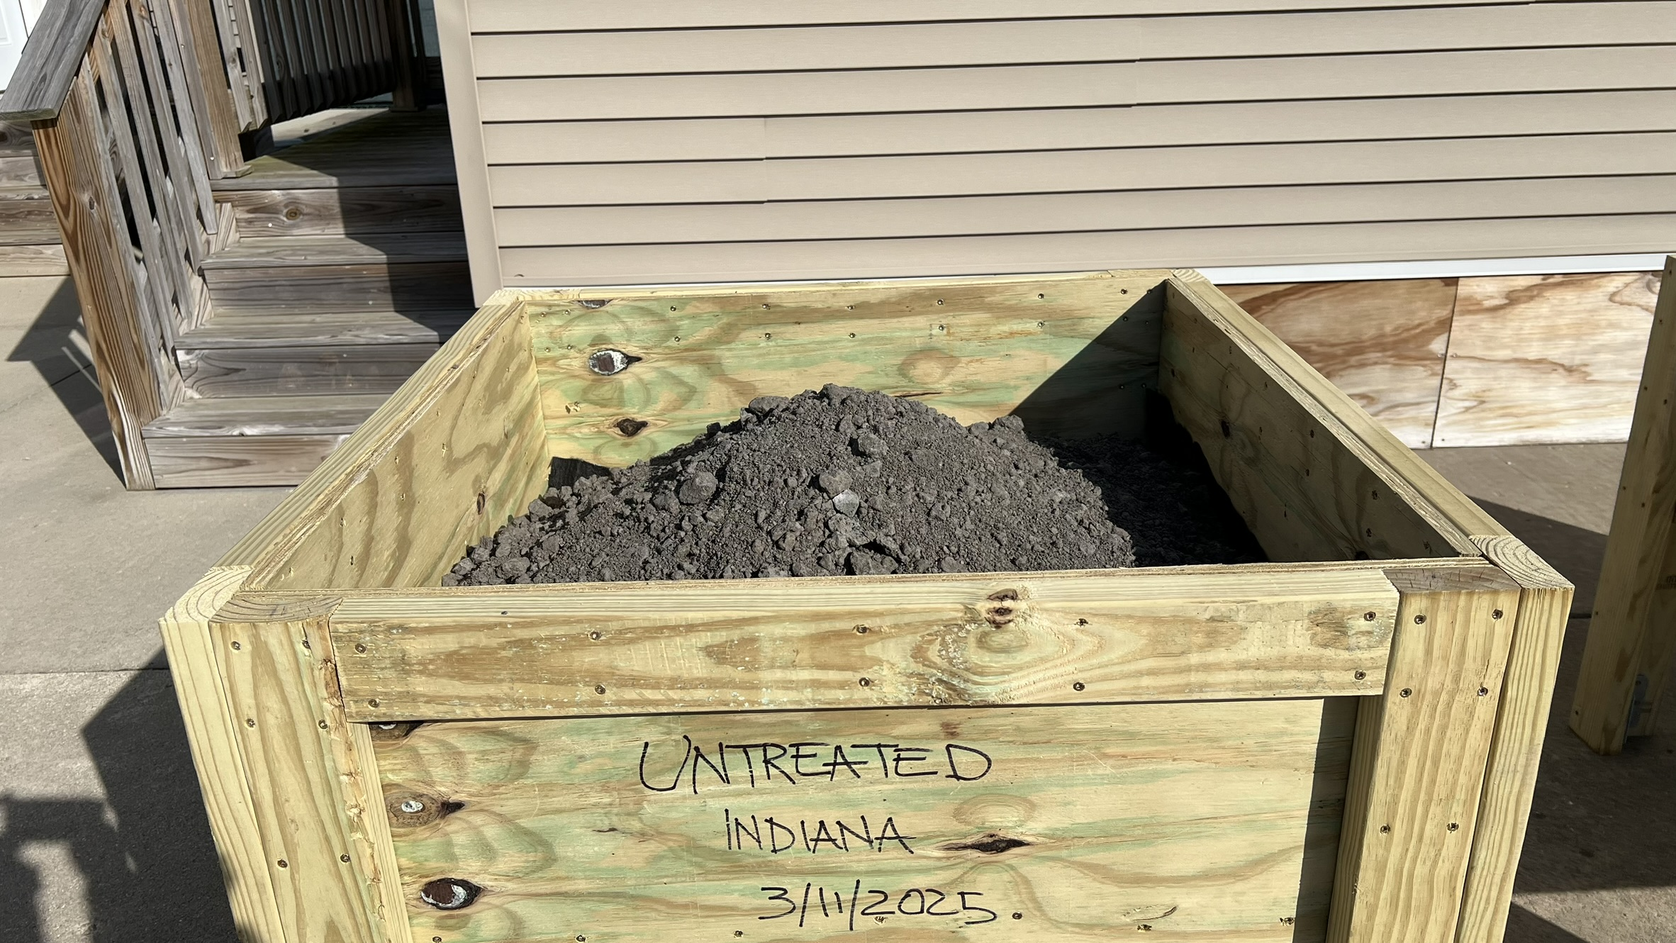
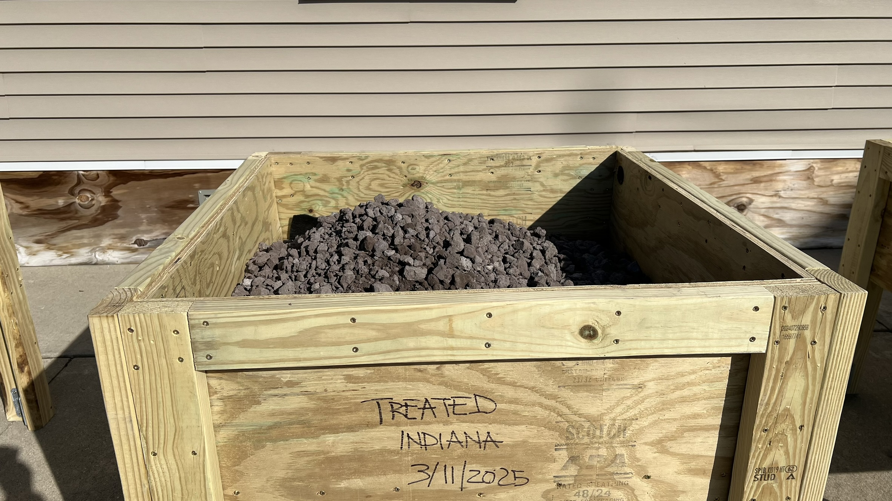
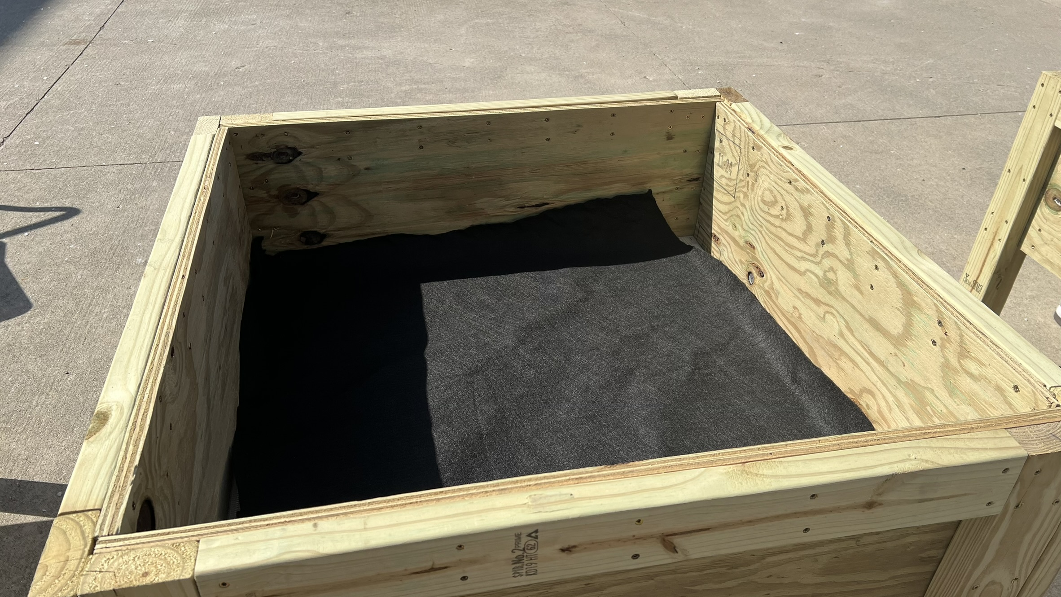
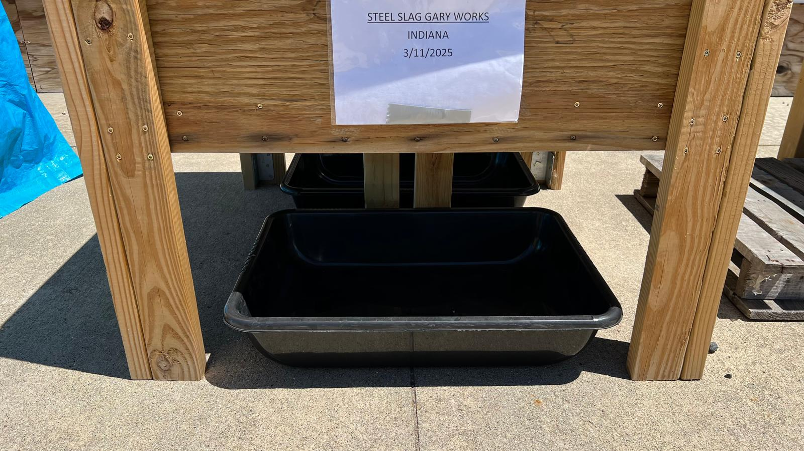
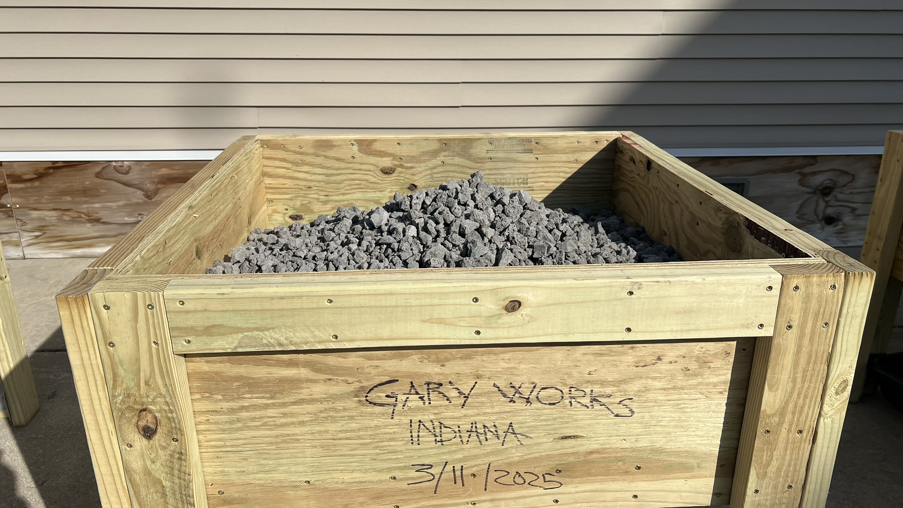
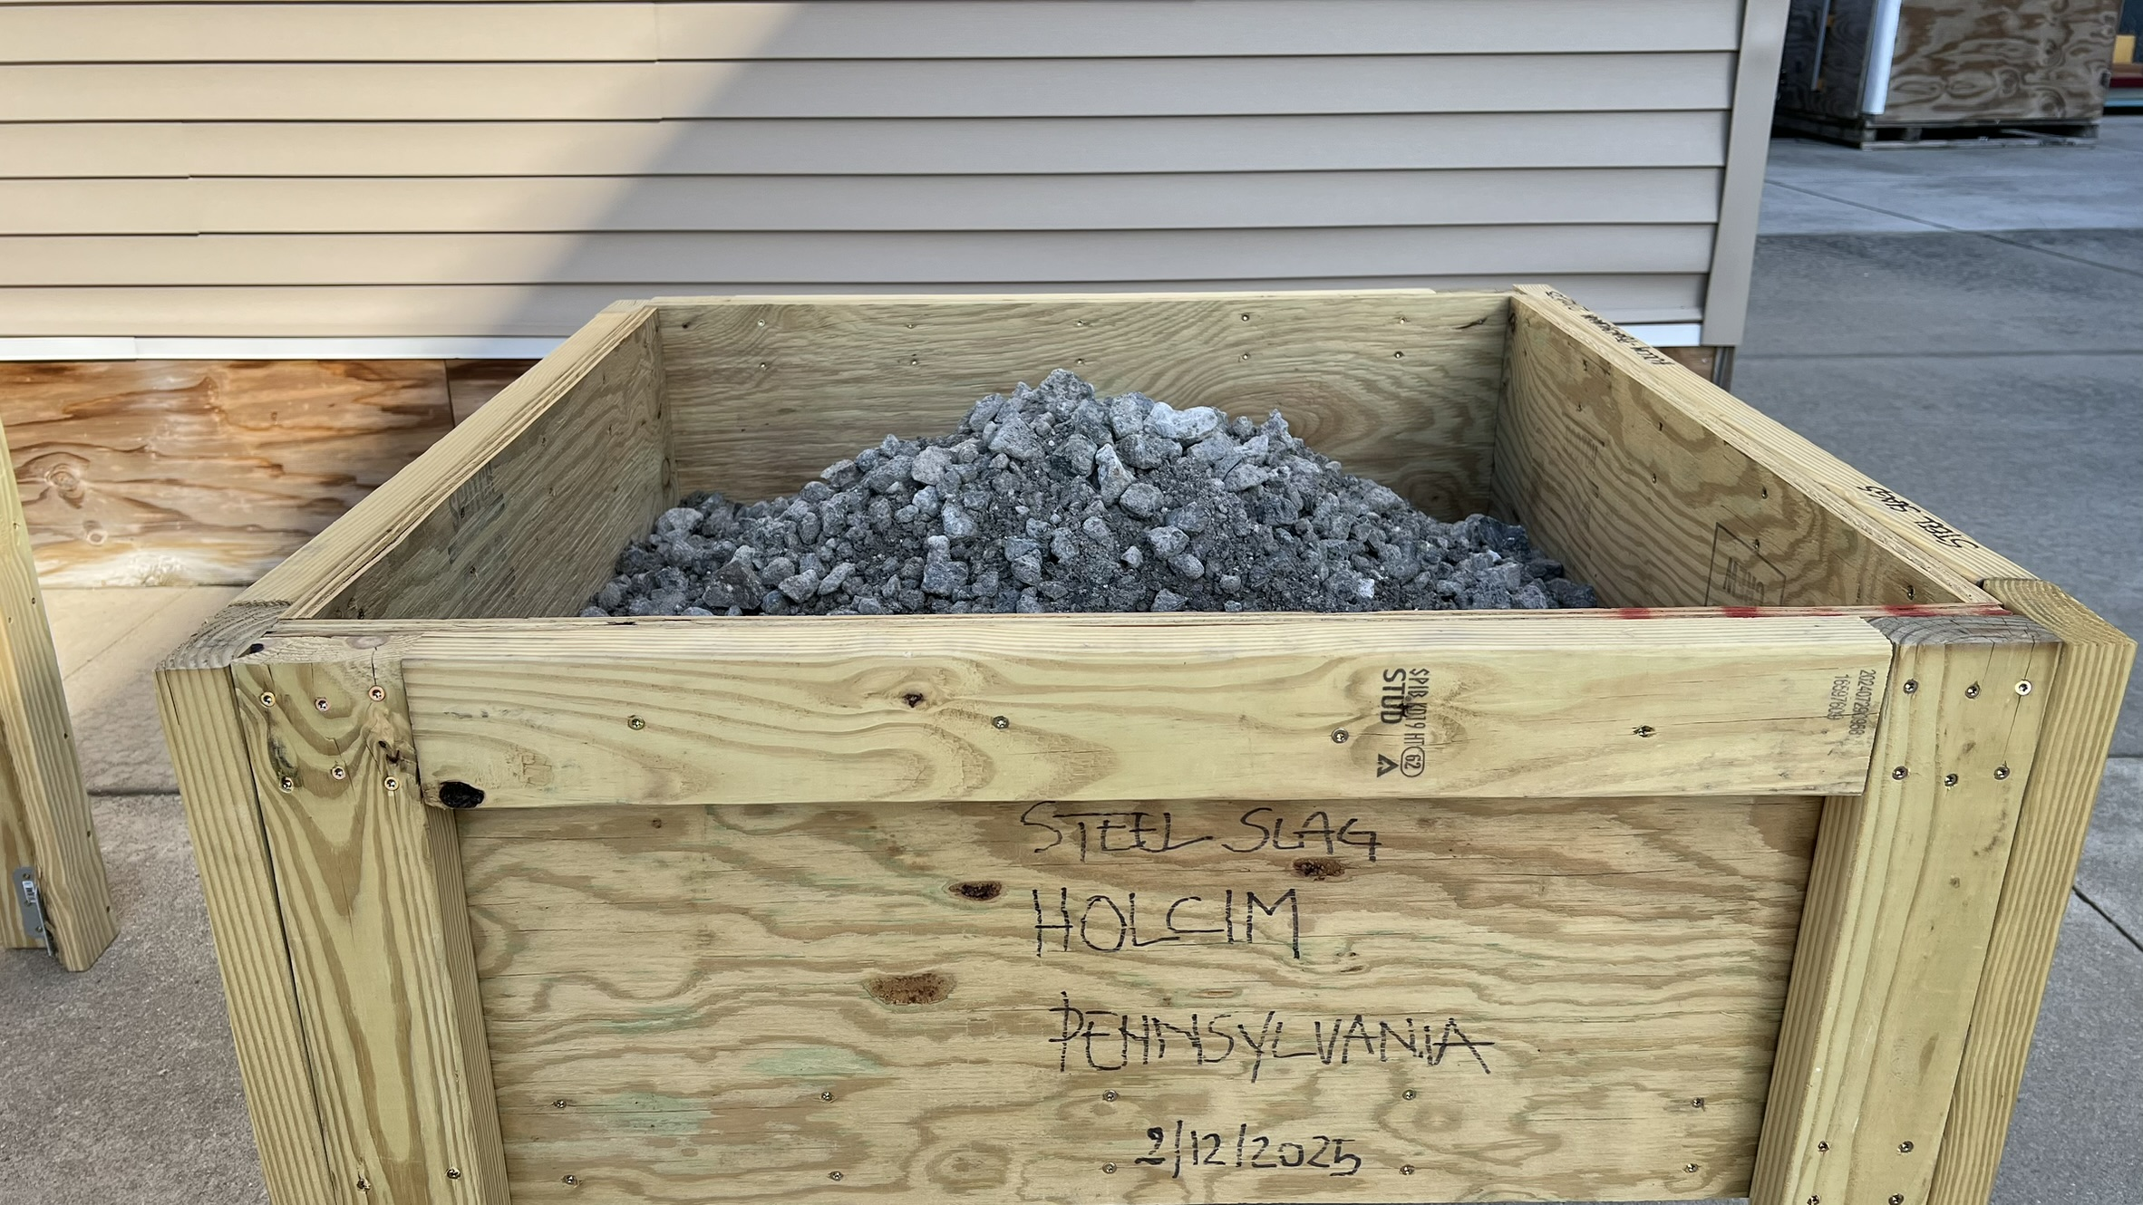
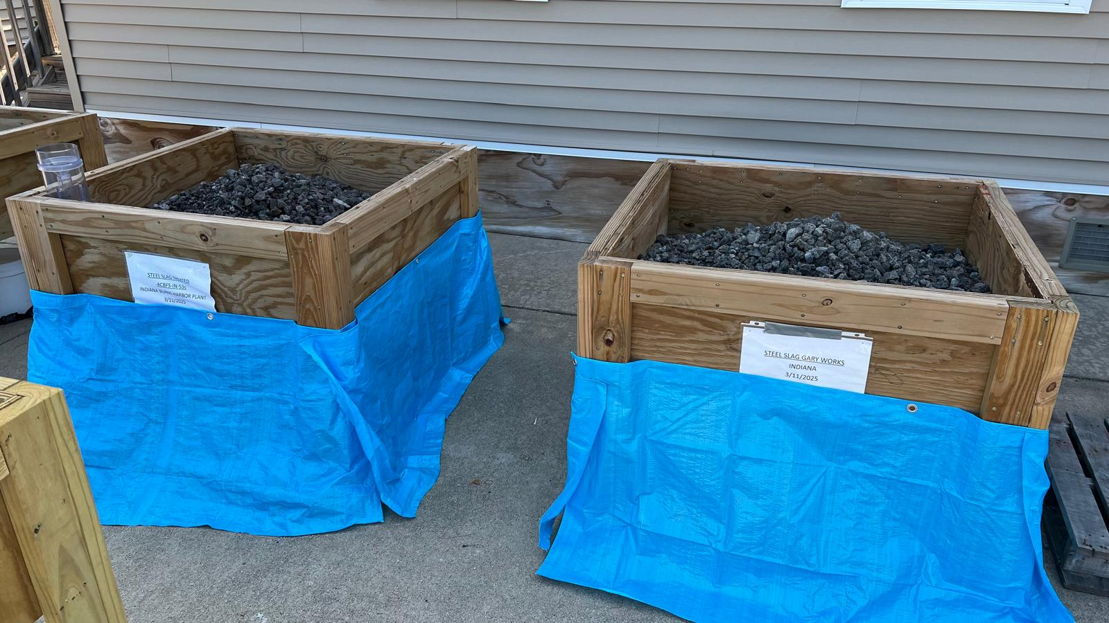
METHODS
STOCKPILES
Harbor West (U) ACBFS
Burns Harbor (T) ACBFS
Geotextile
Gary Works ACBFS
Holcim ACBFS
( U : Untreated, T : Treated )

Slide 11
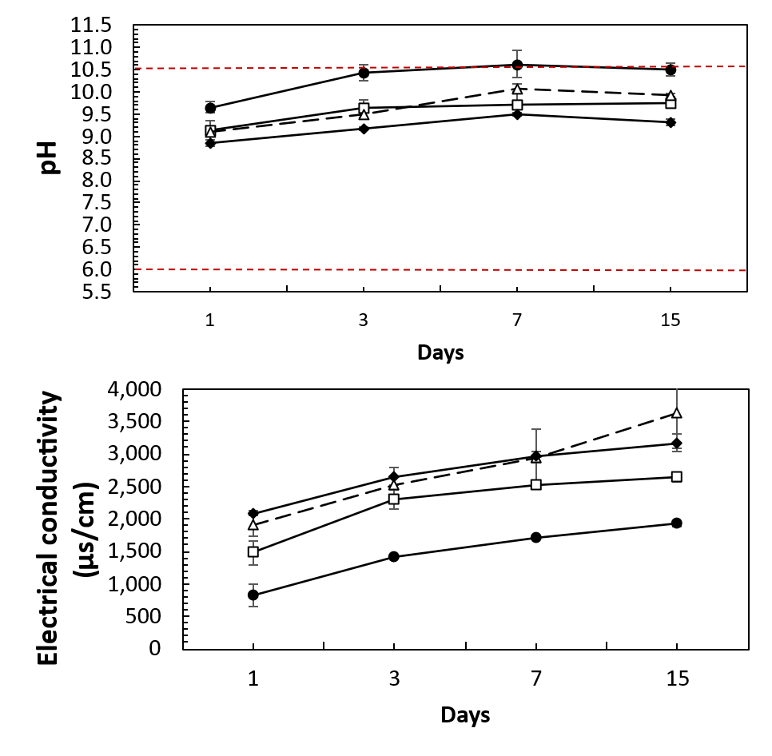
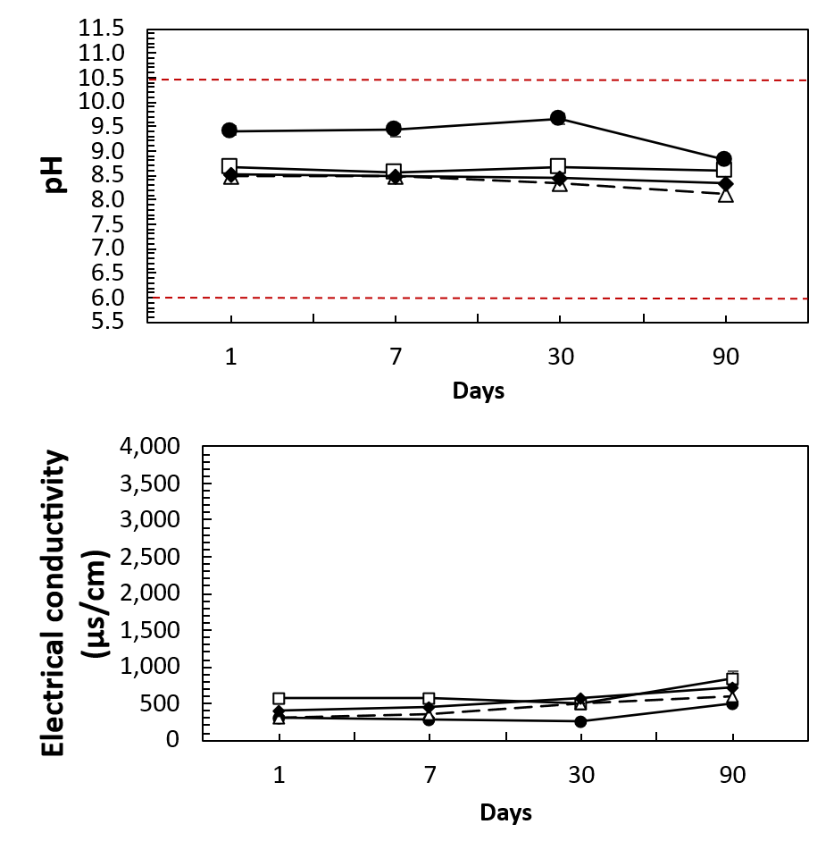
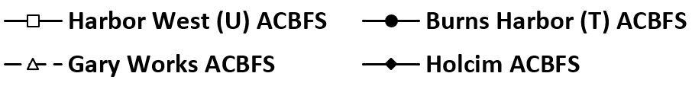
RESULTS
ITM-212
Stagnant Batch Test
Upper limit
Upper limit
The Upper and lower limits are imposed by ITM 212 protocol
Lower limit
Lower limit
( U : Untreated, T : Treated )

Slide 12
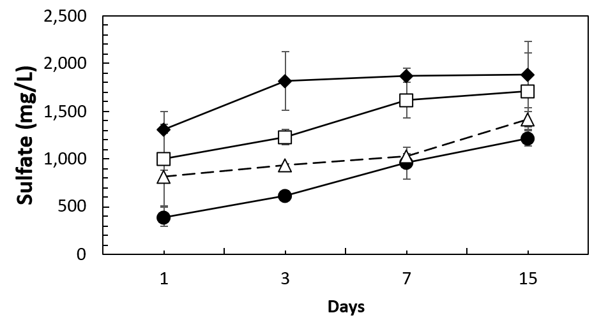
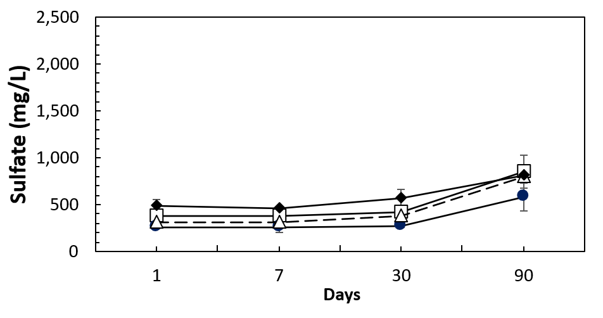
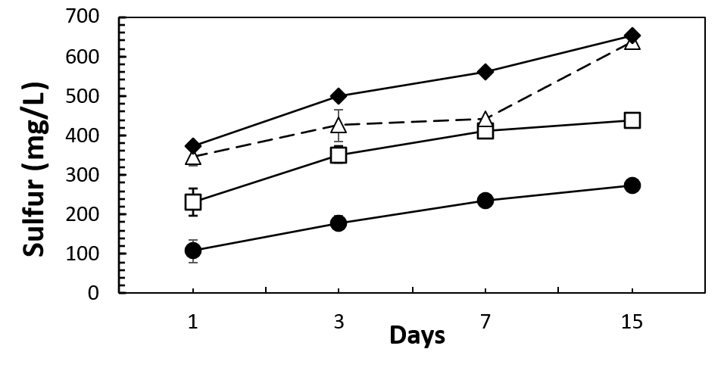
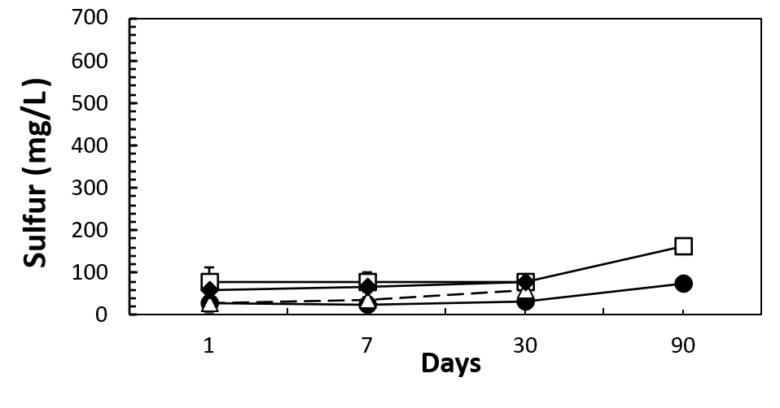
RESULTS
ITM-212
Stagnant Batch Test
The 250 mg/L EPA thresholds are secondary drinking water regulations. They are not mandatory
EPA limit
EPA limit
EPA limit
EPA limit
( U : Untreated, T : Treated )

Slide 13
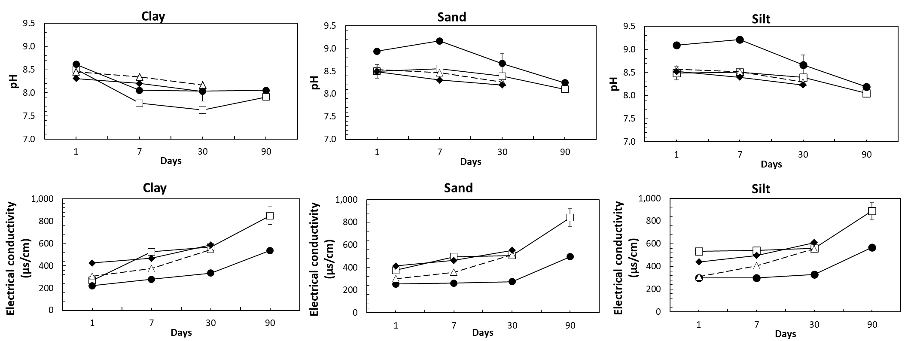
RESULTS
SEQUENTIAL STAGNANT BATCH TEST
( U : Untreated, T : Treated )

Slide 14
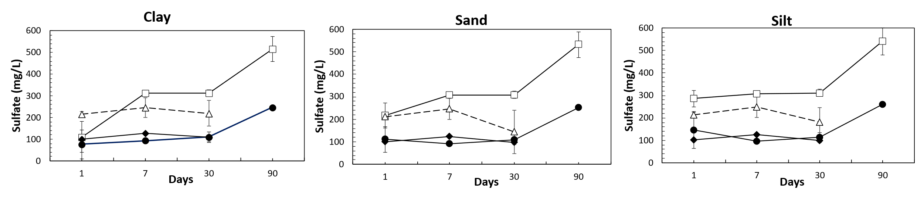
RESULTS
SEQUENTIAL STAGNANT BATCH TEST
EPA limit
EPA limit
EPA limit
When used together with soils, ACBFS shows significantly reduced leachate sulfate concentrations due to soil buffering.
( U : Untreated, T : Treated )

Slide 15
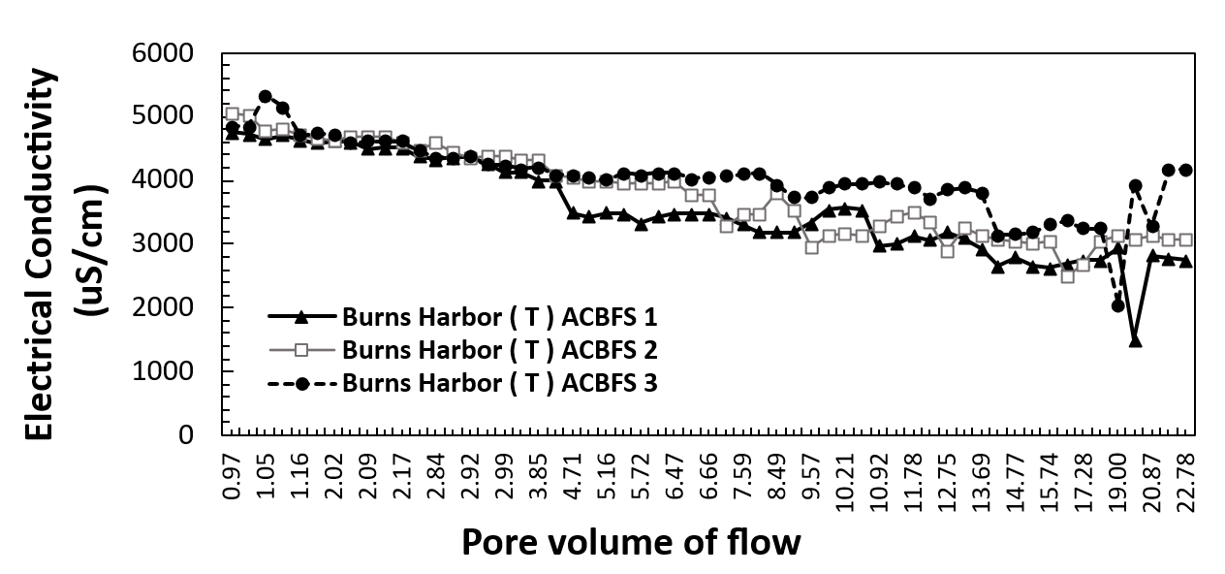
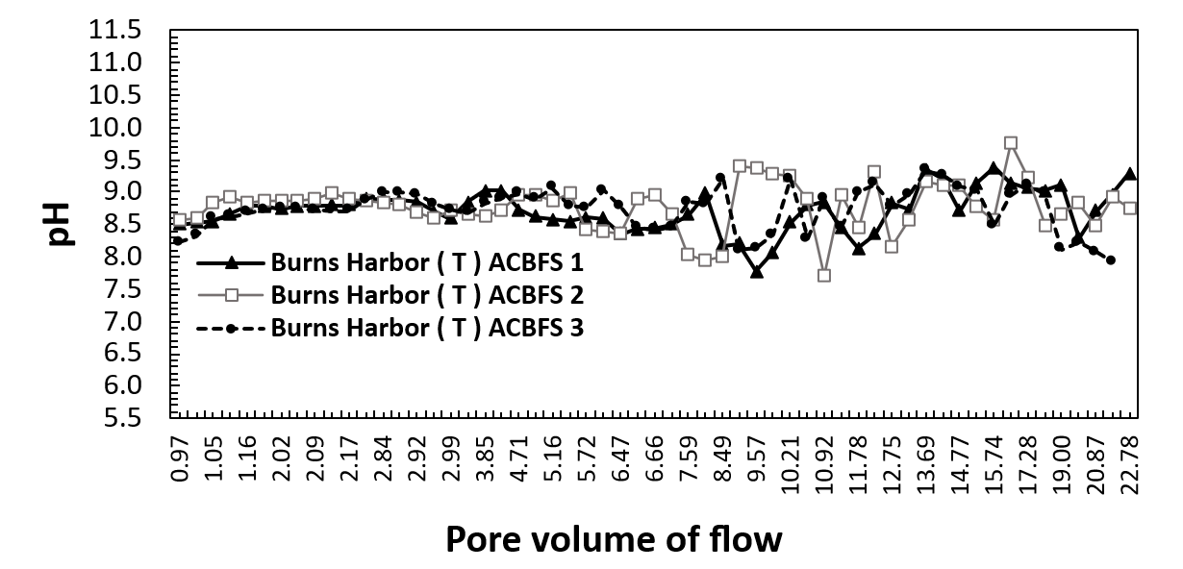
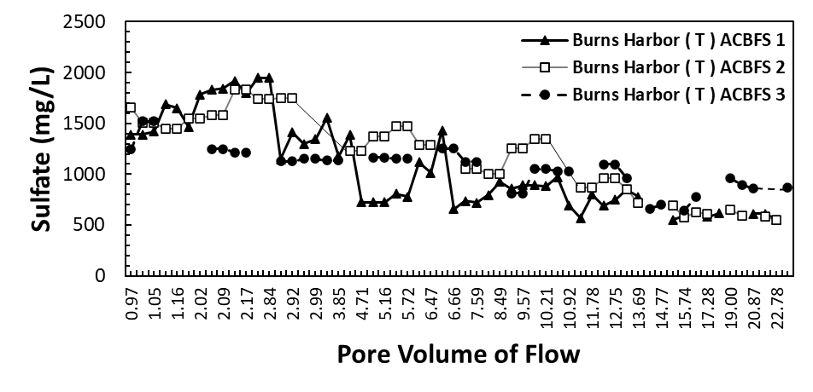
RESULTS
SEQUENTIAL COLUMN LEACHING TEST
Upper limit
Lower limit
EPA limit
( U : Untreated, T : Treated )

Slide 16
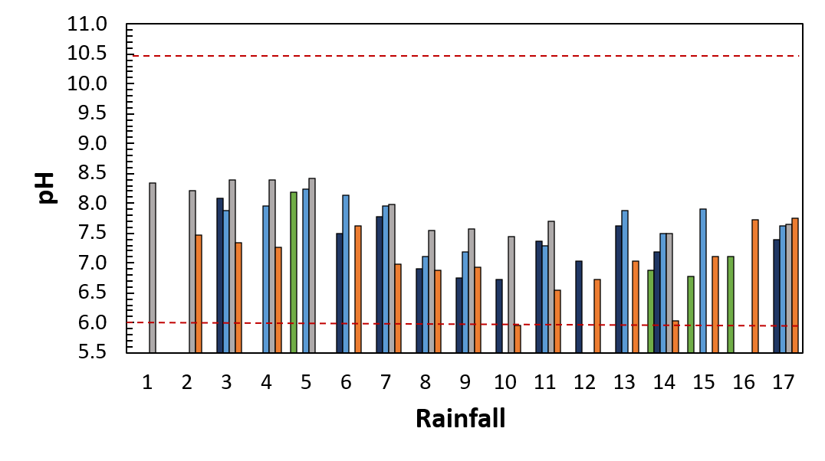
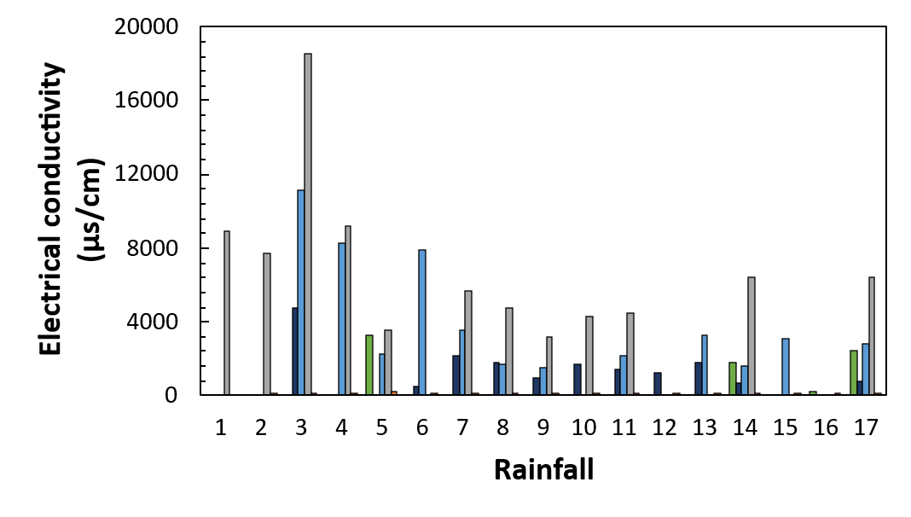
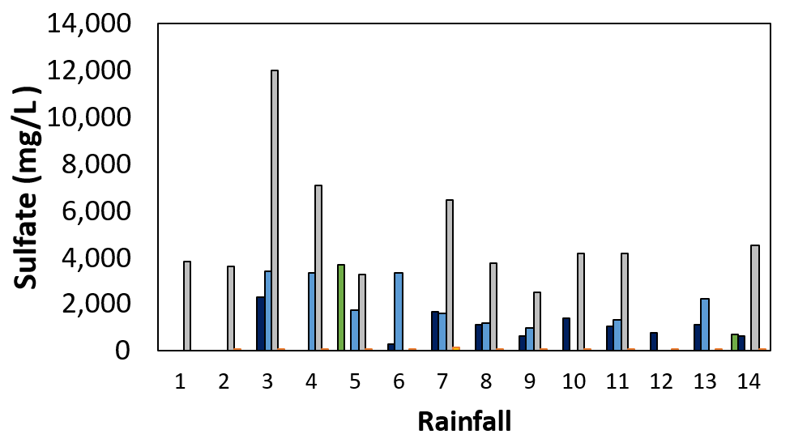
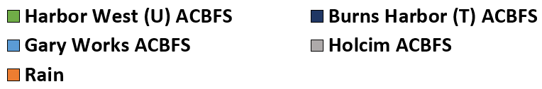
RESULTS
STOCKPILES
Upper limit
Lower limit
The test started in February, and the results cover the period from February to September.
EPA limit
( U : Untreated, T : Treated )

Slide 17
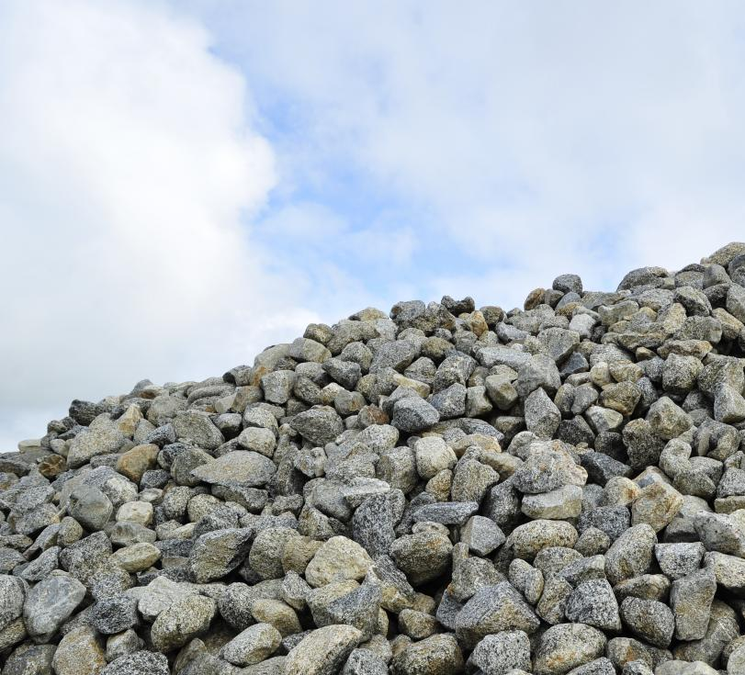
CONCLUSIONS
Results vary depending on the applied methodology
Interaction with different soils can mitigate potential environmental impacts
The treatment method provides less electrical conductivity, lower sulfate and sulfur concentrations
These observations highlight the potential value of developing a more representative testing approach rather than relying on a single standardized protocol.

Slide 18

FUTURE WORKS
FATE AND TRANSPORT MODELLING
Numerical modeling is needed to serve as a bridge between laboratory experiments and real field conditions to achieve a better understanding of leachate behavior of the material.
HYDRUS1D
PHREEQC
HP1

Slide 19
Acknowledgements
Dr. Bora Cetin – Michigan State University
Dr. Angela Farina - Michigan State University
Charles Ochola – National Slag Association
Kelly Cook - National Slag Association
Shawn Hahney - Phoenix Global
Paul Thomas – Holcim
Sean Marshall- Holcim
Francis Mark - Unites States Steel Corporation
Scott Flynn - Beemsterboer Companies (Gary Works)

Slide 20

Thank you all for your kind attendence
Any Questions ?
cakalogl@msu.edu

