Slide 1
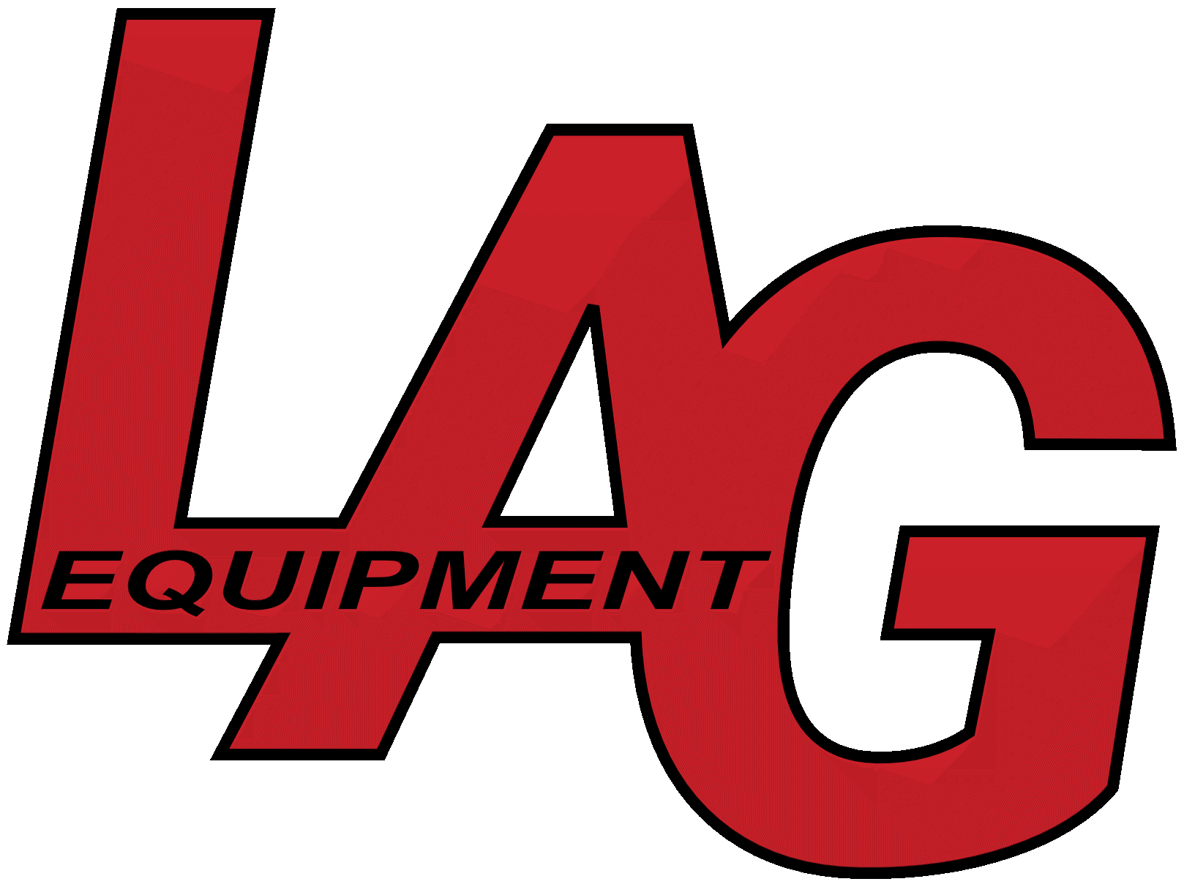

FORGED BY EXPERIENCE. ENGINEERED FOR SAFETY.
Louis A. Grant, Jr. Owner, LAG Equipment

Slide 2
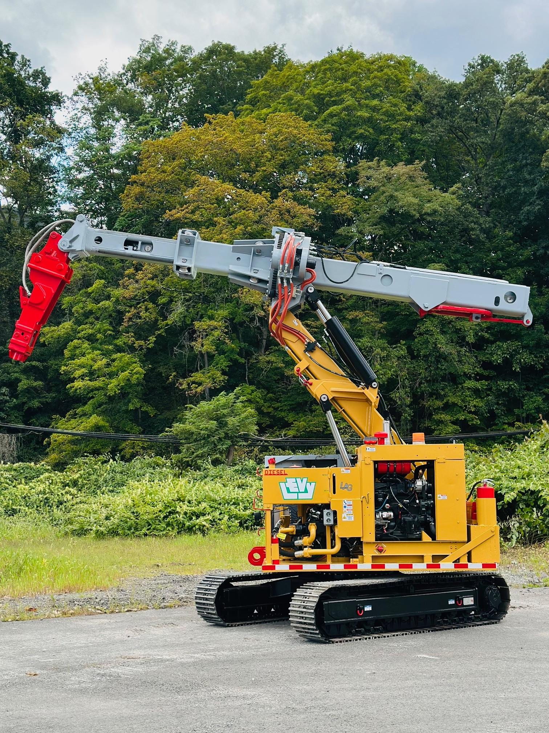
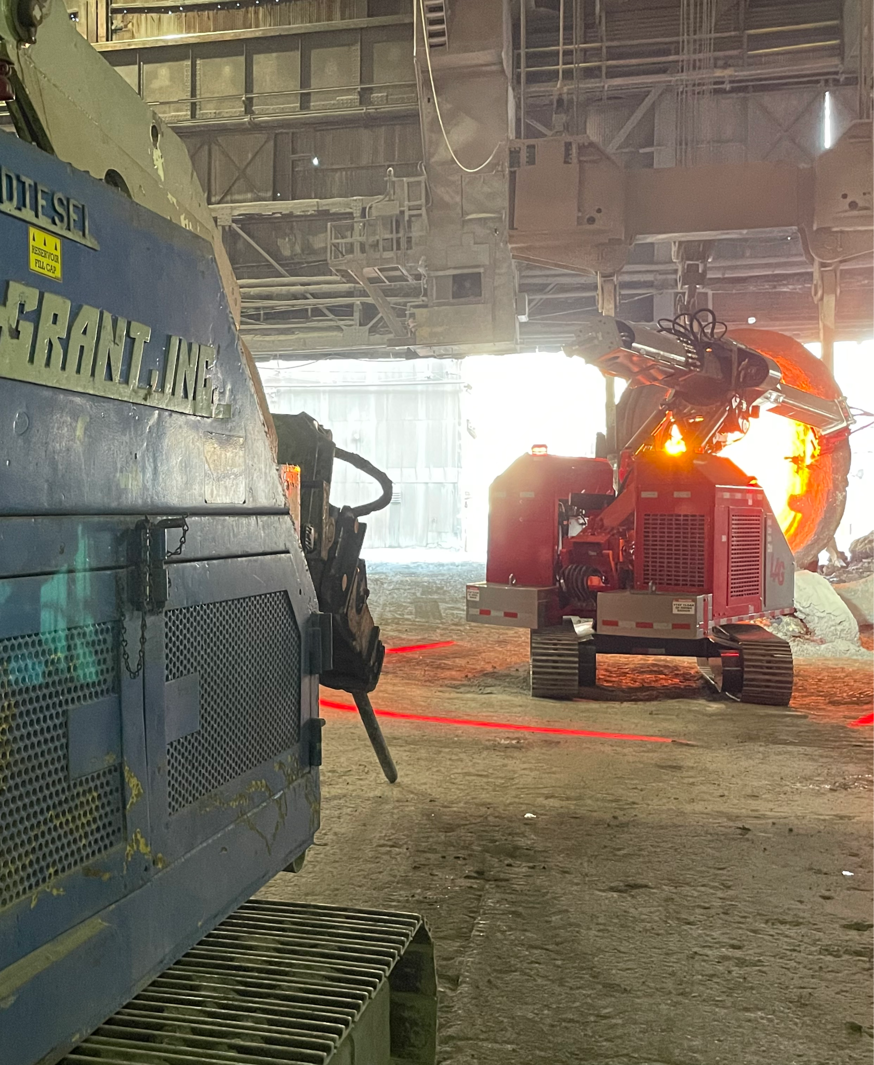
FORGED BY EXPERIENCE

Slide 3
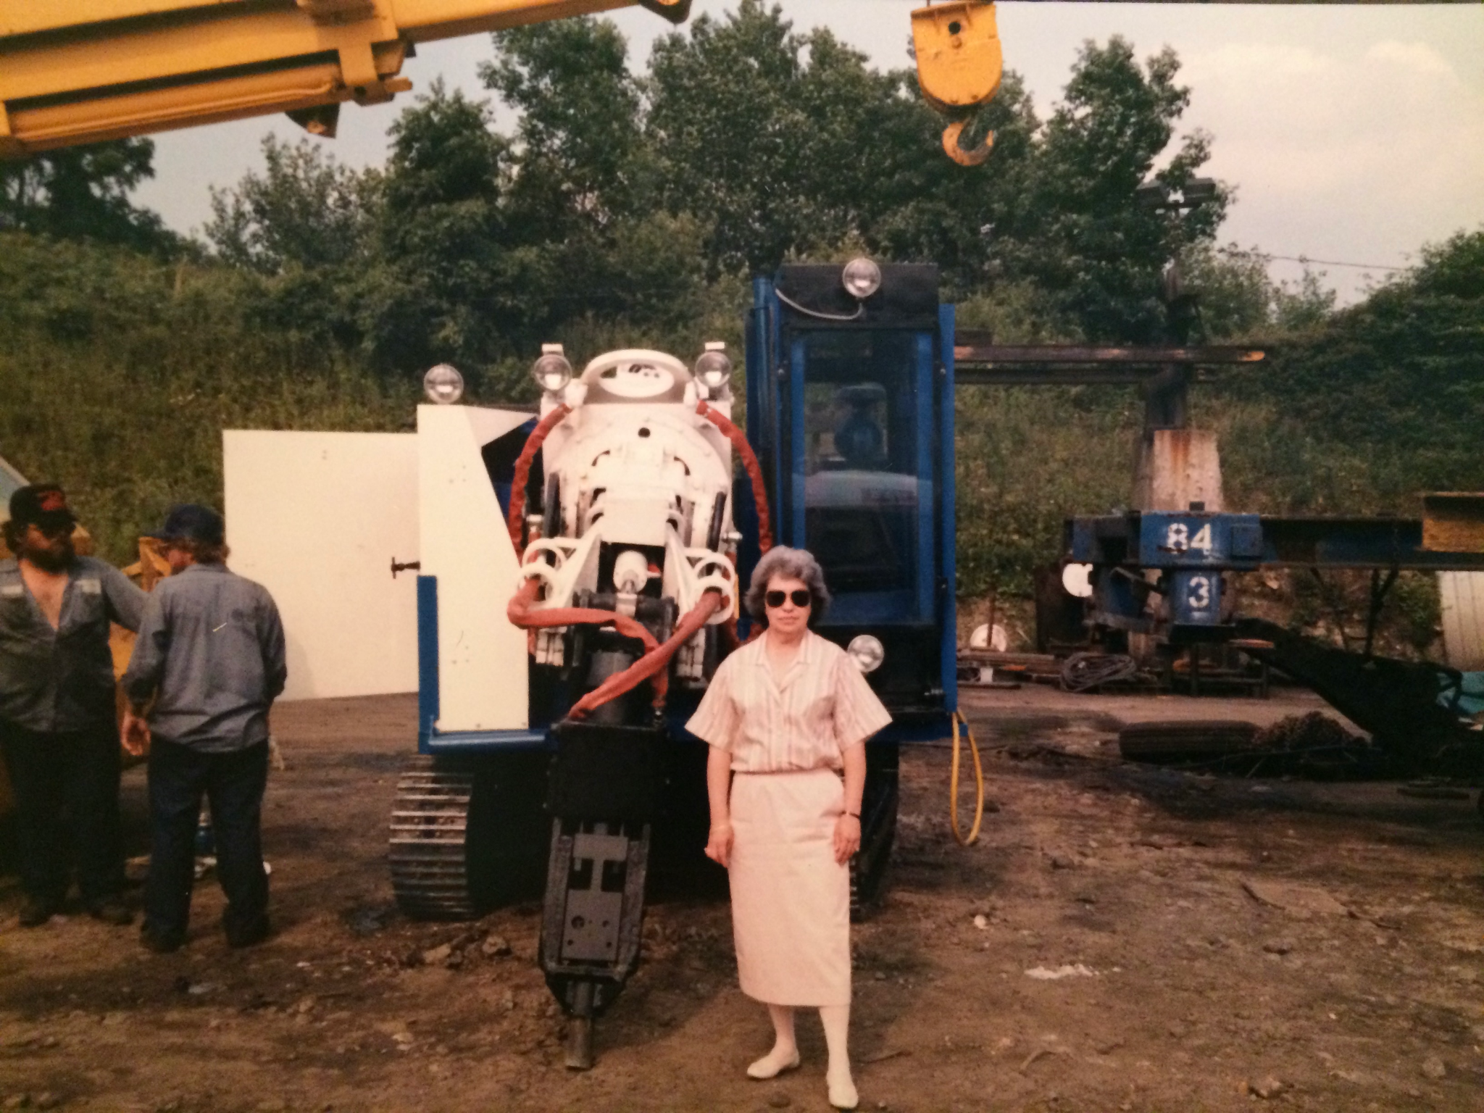

FORGED BY EXPERIENCE
In 1951, Louis A. Grant Company was founded in Pittsburgh, Pennsylvania as a family owned business
Set the standard for innovation in the steel industry
Improved equipment availability, operation and process efficiencies, and most importantly an increase to overall safety and production
Louis A. Grant, Inc. capabilities and diversified to include subsidiaries: Furnace Services Industries (FSI) serving the Chicagoland Lakefront Area
In 2000, Louis A. Grant, Inc., acquired Keibler Thompson to create The New Keibler Thompson, reorganizing logistics, operations and management.
Over the next seven years, Louis A. Grant, Inc., grew from 110 employees to over 400 employees

Slide 4
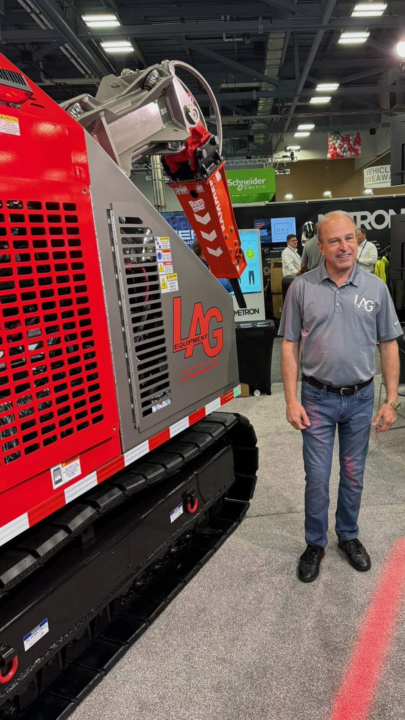
LIFETIME DEDICATED TO THE INDUSTRY
Increased KT-Grant revenues from $6MM to over $100MM gross sales during his tenure
Diversified product portfolio and expanded global footprint from domestically 34 states to 17 foreign countries
Designed and held patents which were a part of the sale of the business in 2007: U.S. Pat. No. 5,179,757; and U.S. Pat. No. 5,594,973
All US Patents since have expired
SAFETY AND TRAINING
In 2007 (upon sale to Stein): over 400 employees; multi-million hours of labor; achieved industry leading record of only .5 lost days
Established and integrated training, sales and safety protocols upon acquisition of Keibler Thompson
LOUIS A. GRANT JR

Slide 5
A NEW ERA
SAFETY & INNOVATION

Slide 6
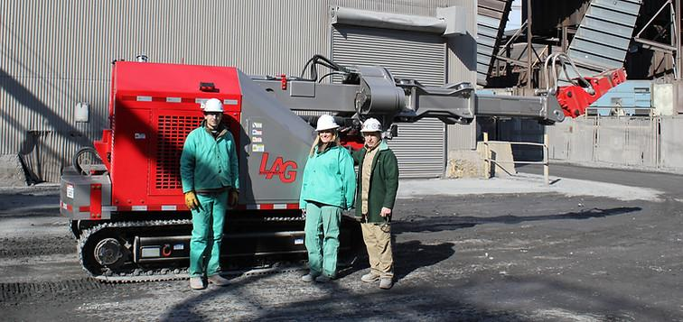
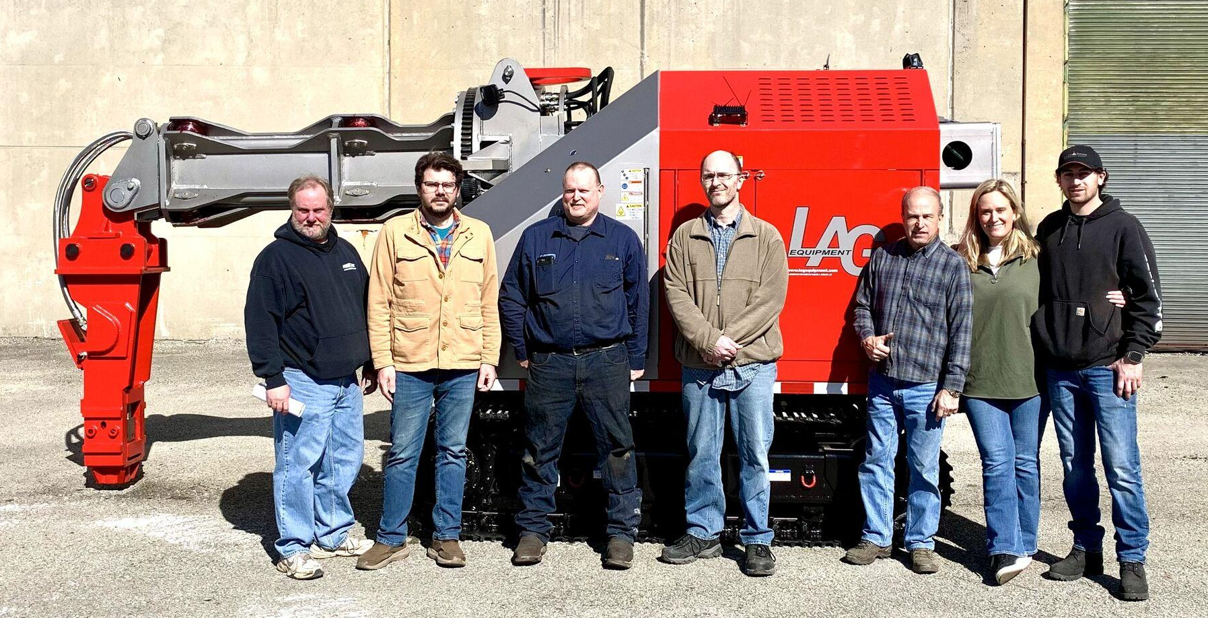
In 2021, Louis A. Grant, Jr., former owner the company now known as KT-Grant Inc, originally Louis A. Grant, Inc., in response to market feedback formed LAG Equipment to design and engineer, manufacture, market and distribute the most innovative, safe and cost-effective, remote-controlled refractory, demolition machines.
LAG’s team has a combined 100+ years of institutional and industry knowledge focusing on operator safety, efficient machine design and exceptional customer service.

Slide 7
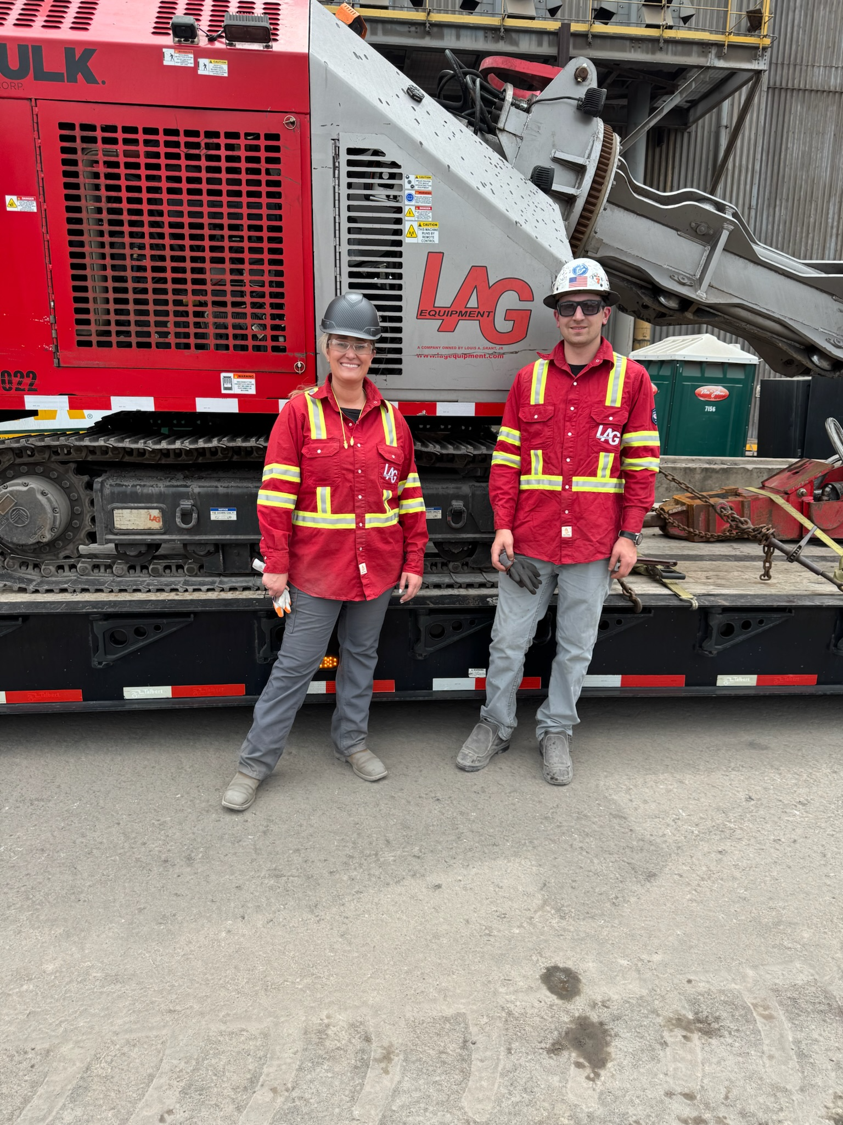
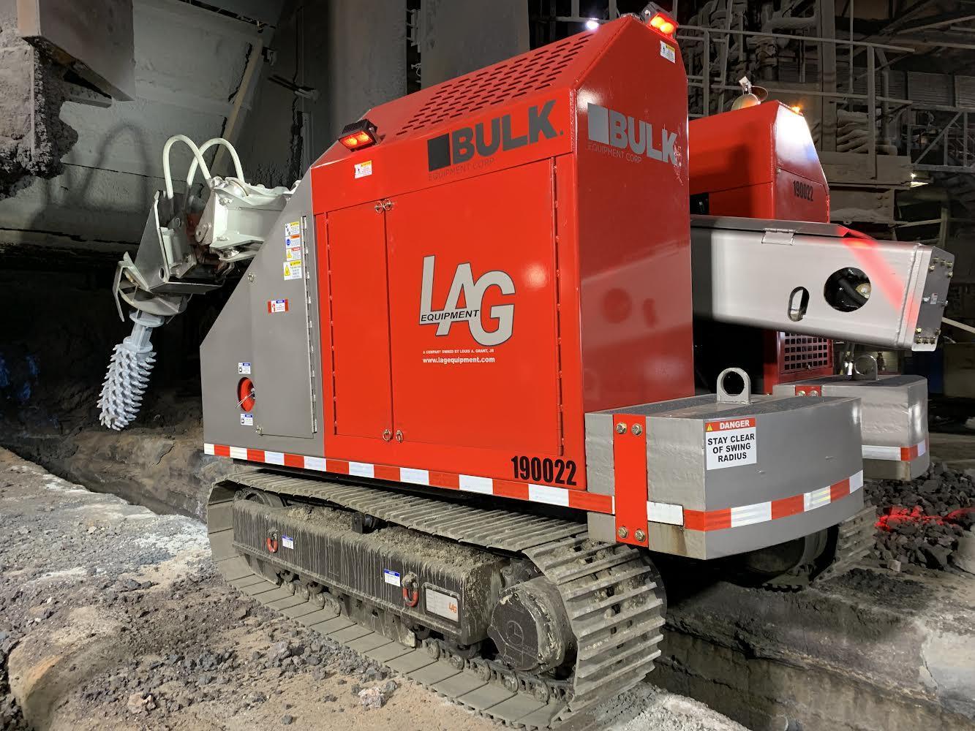
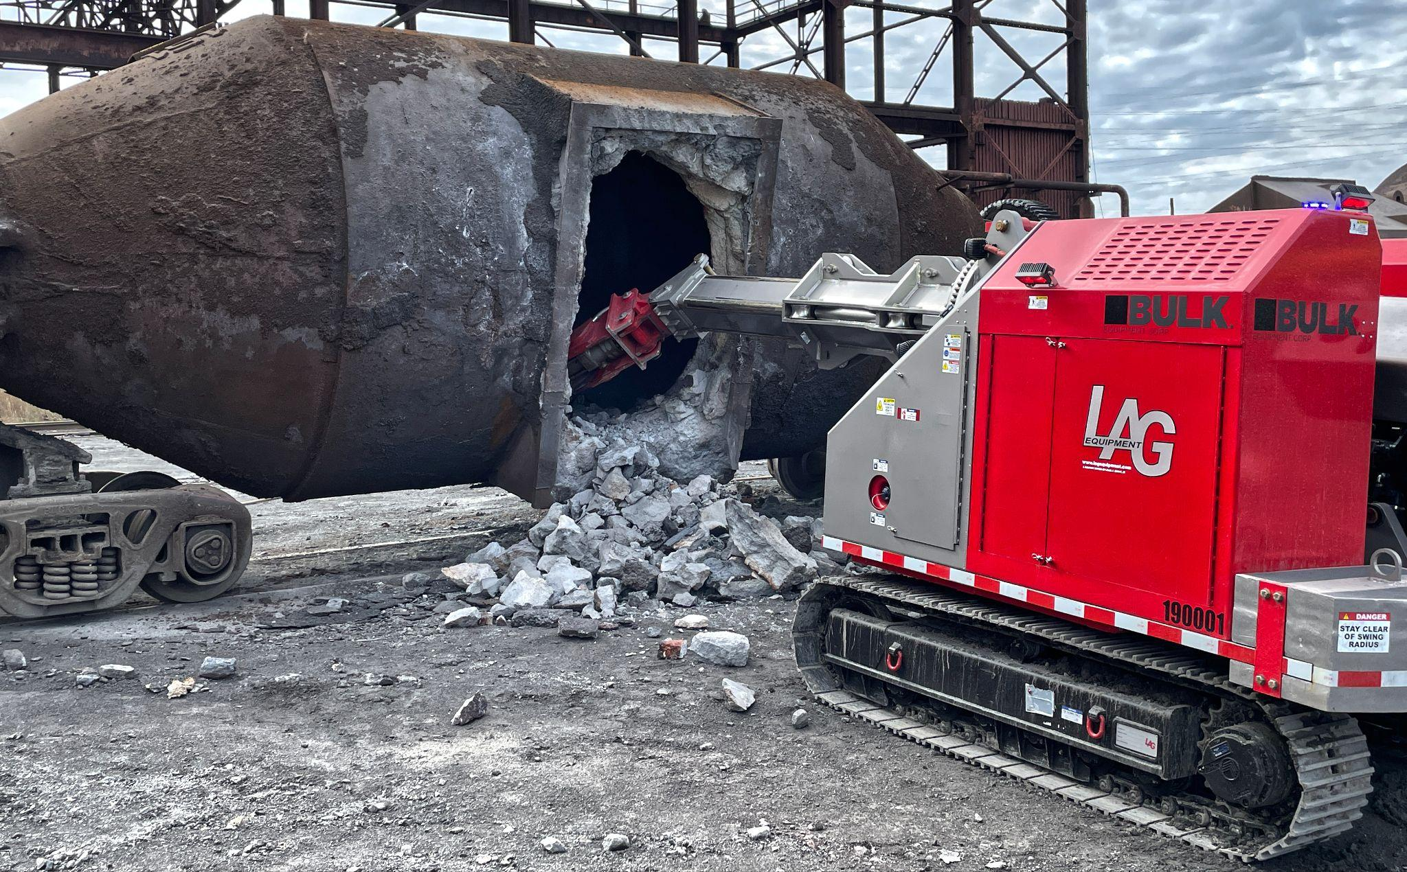
Family owned business centered on safety providing the industry with best-in-class customer service and top of the line equipment offerings:
Custom-tailored solutions: equipment (buy or lease through National Slag Association member) and receive turnkey service
Equipment with modern electrical and hydraulic controls
Improves safety, operating training experience, and maintenance performance

Slide 8
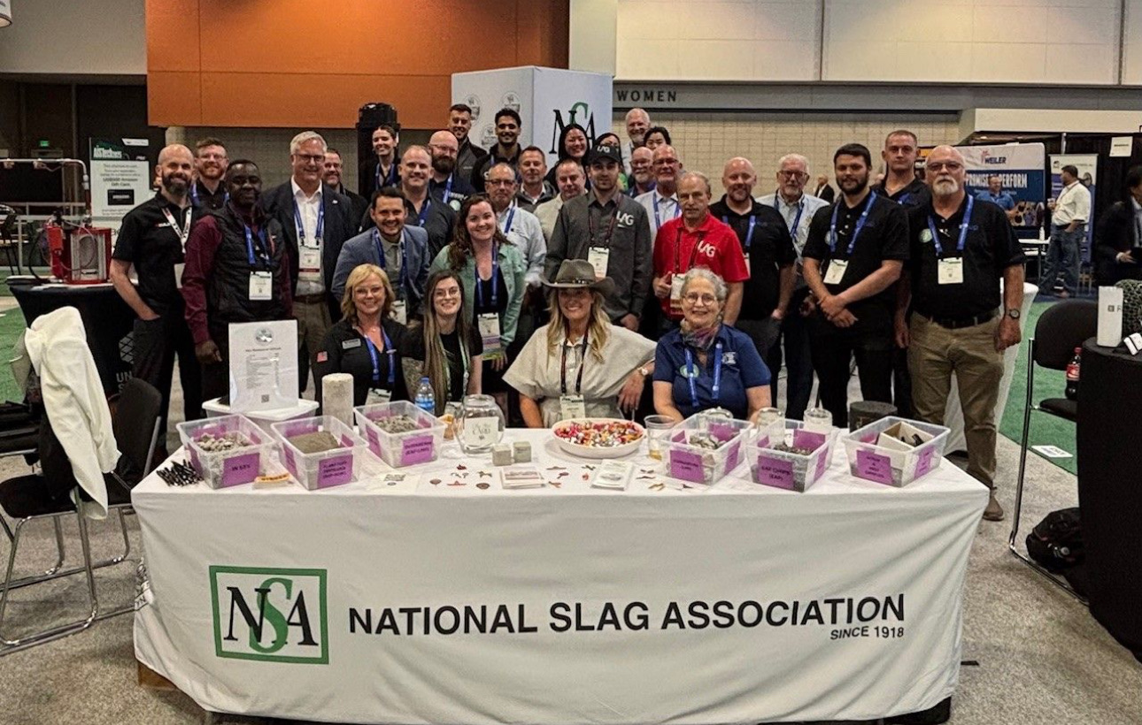
Priorities when working with NSA Members:
Supply your teammates safe, innovative and ergonomic equipment to send you home the way you came to work
Continue to innovate our equipment and offerings based on your experience and feedback by providing excellent customer support. 24/7/365 access to our team
Provide multi-day training backed by experience ensuring your safety and maximize your productivity

Slide 9
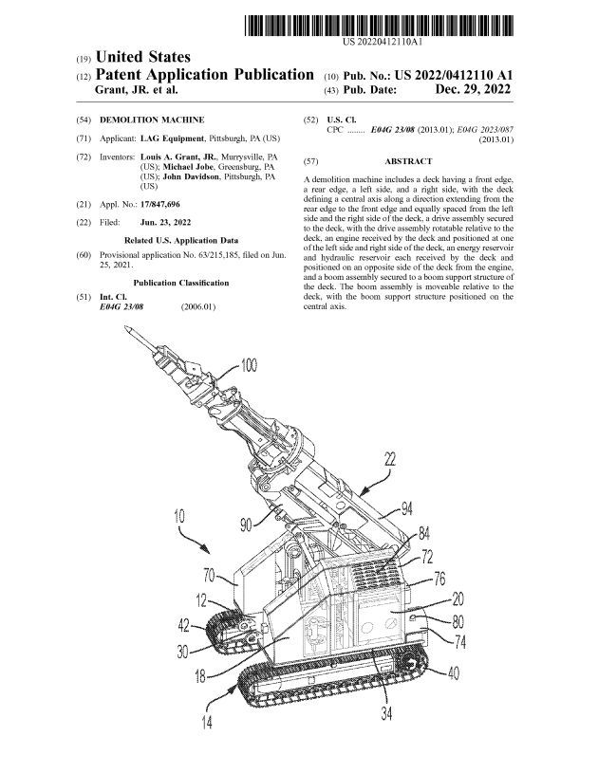
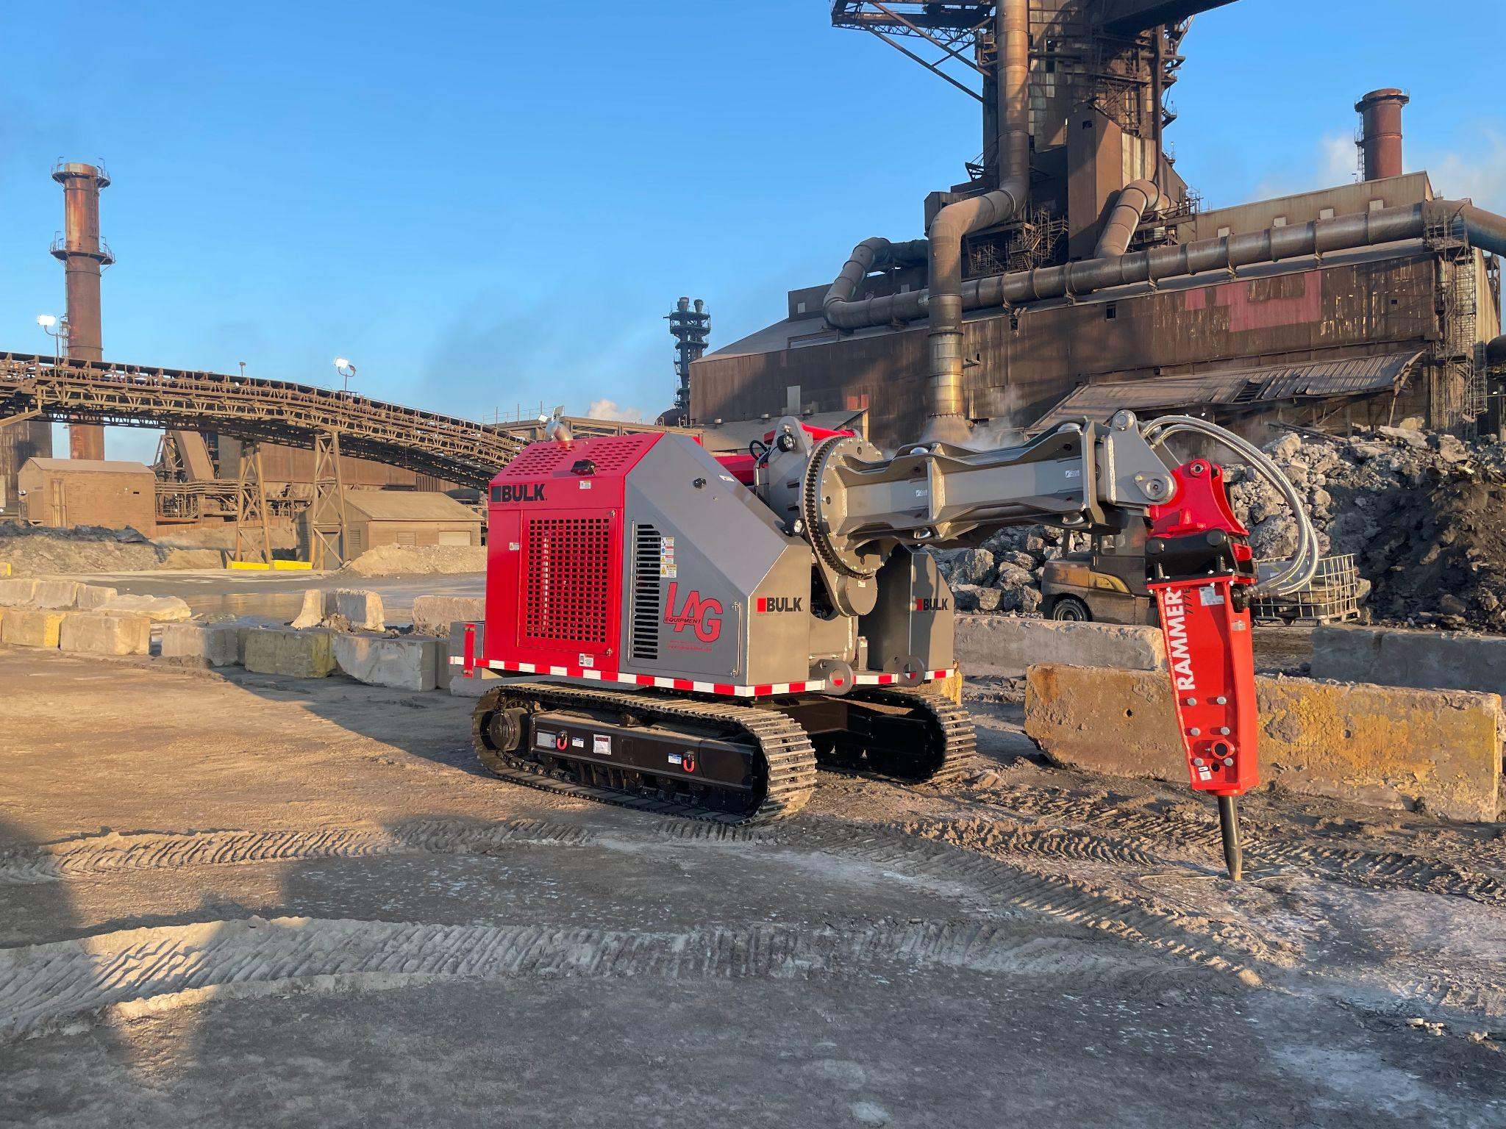
INNOVATION ACKNOWLEDGED
AWARDED A U.S. PATENT

Slide 10
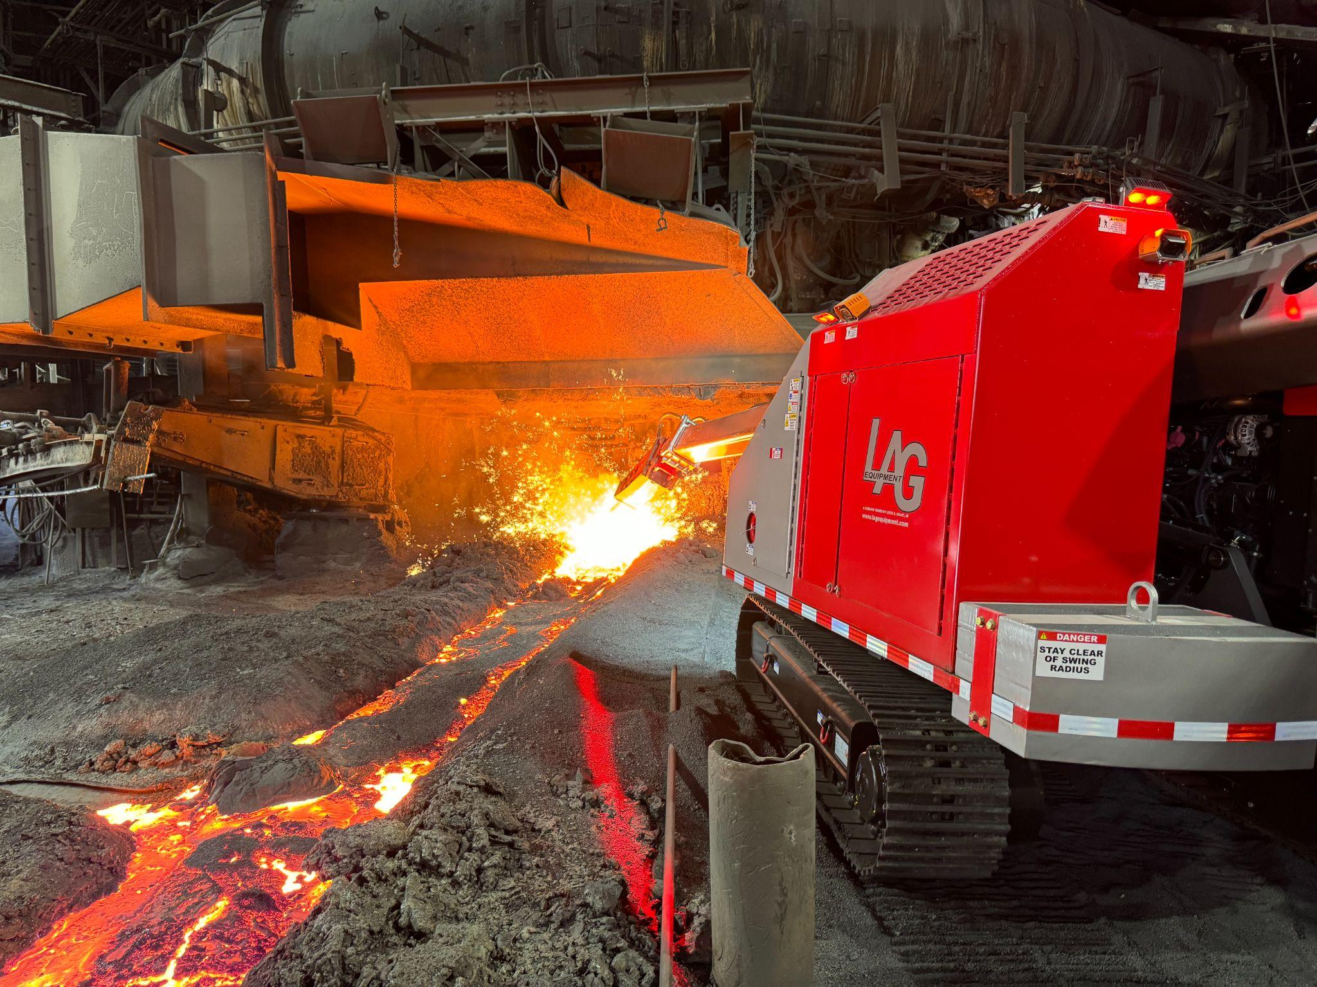
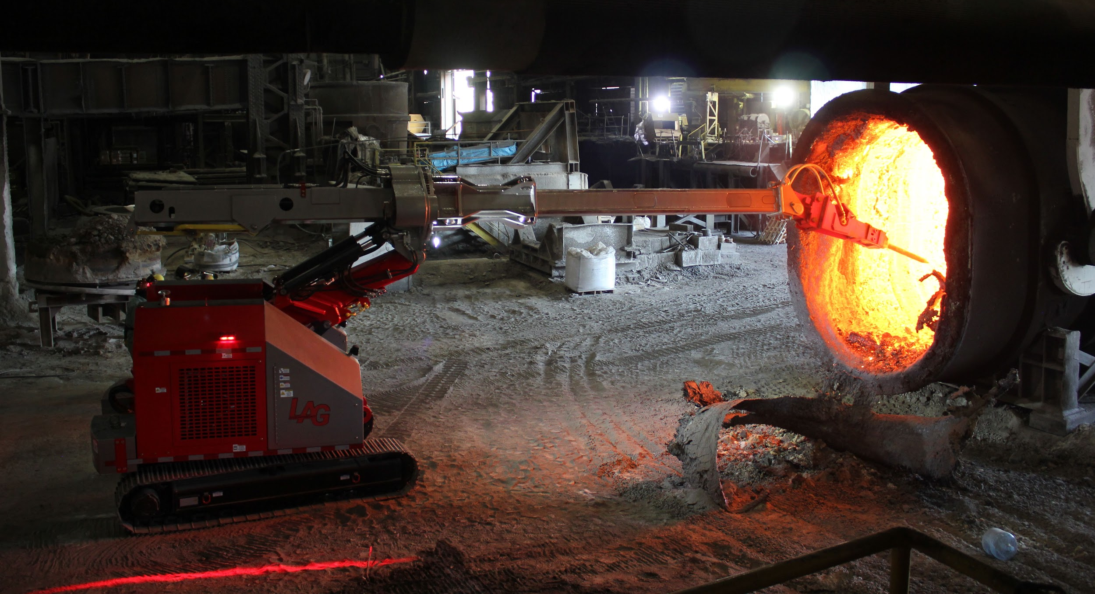
LAG-2800
LAG-3400

Slide 11
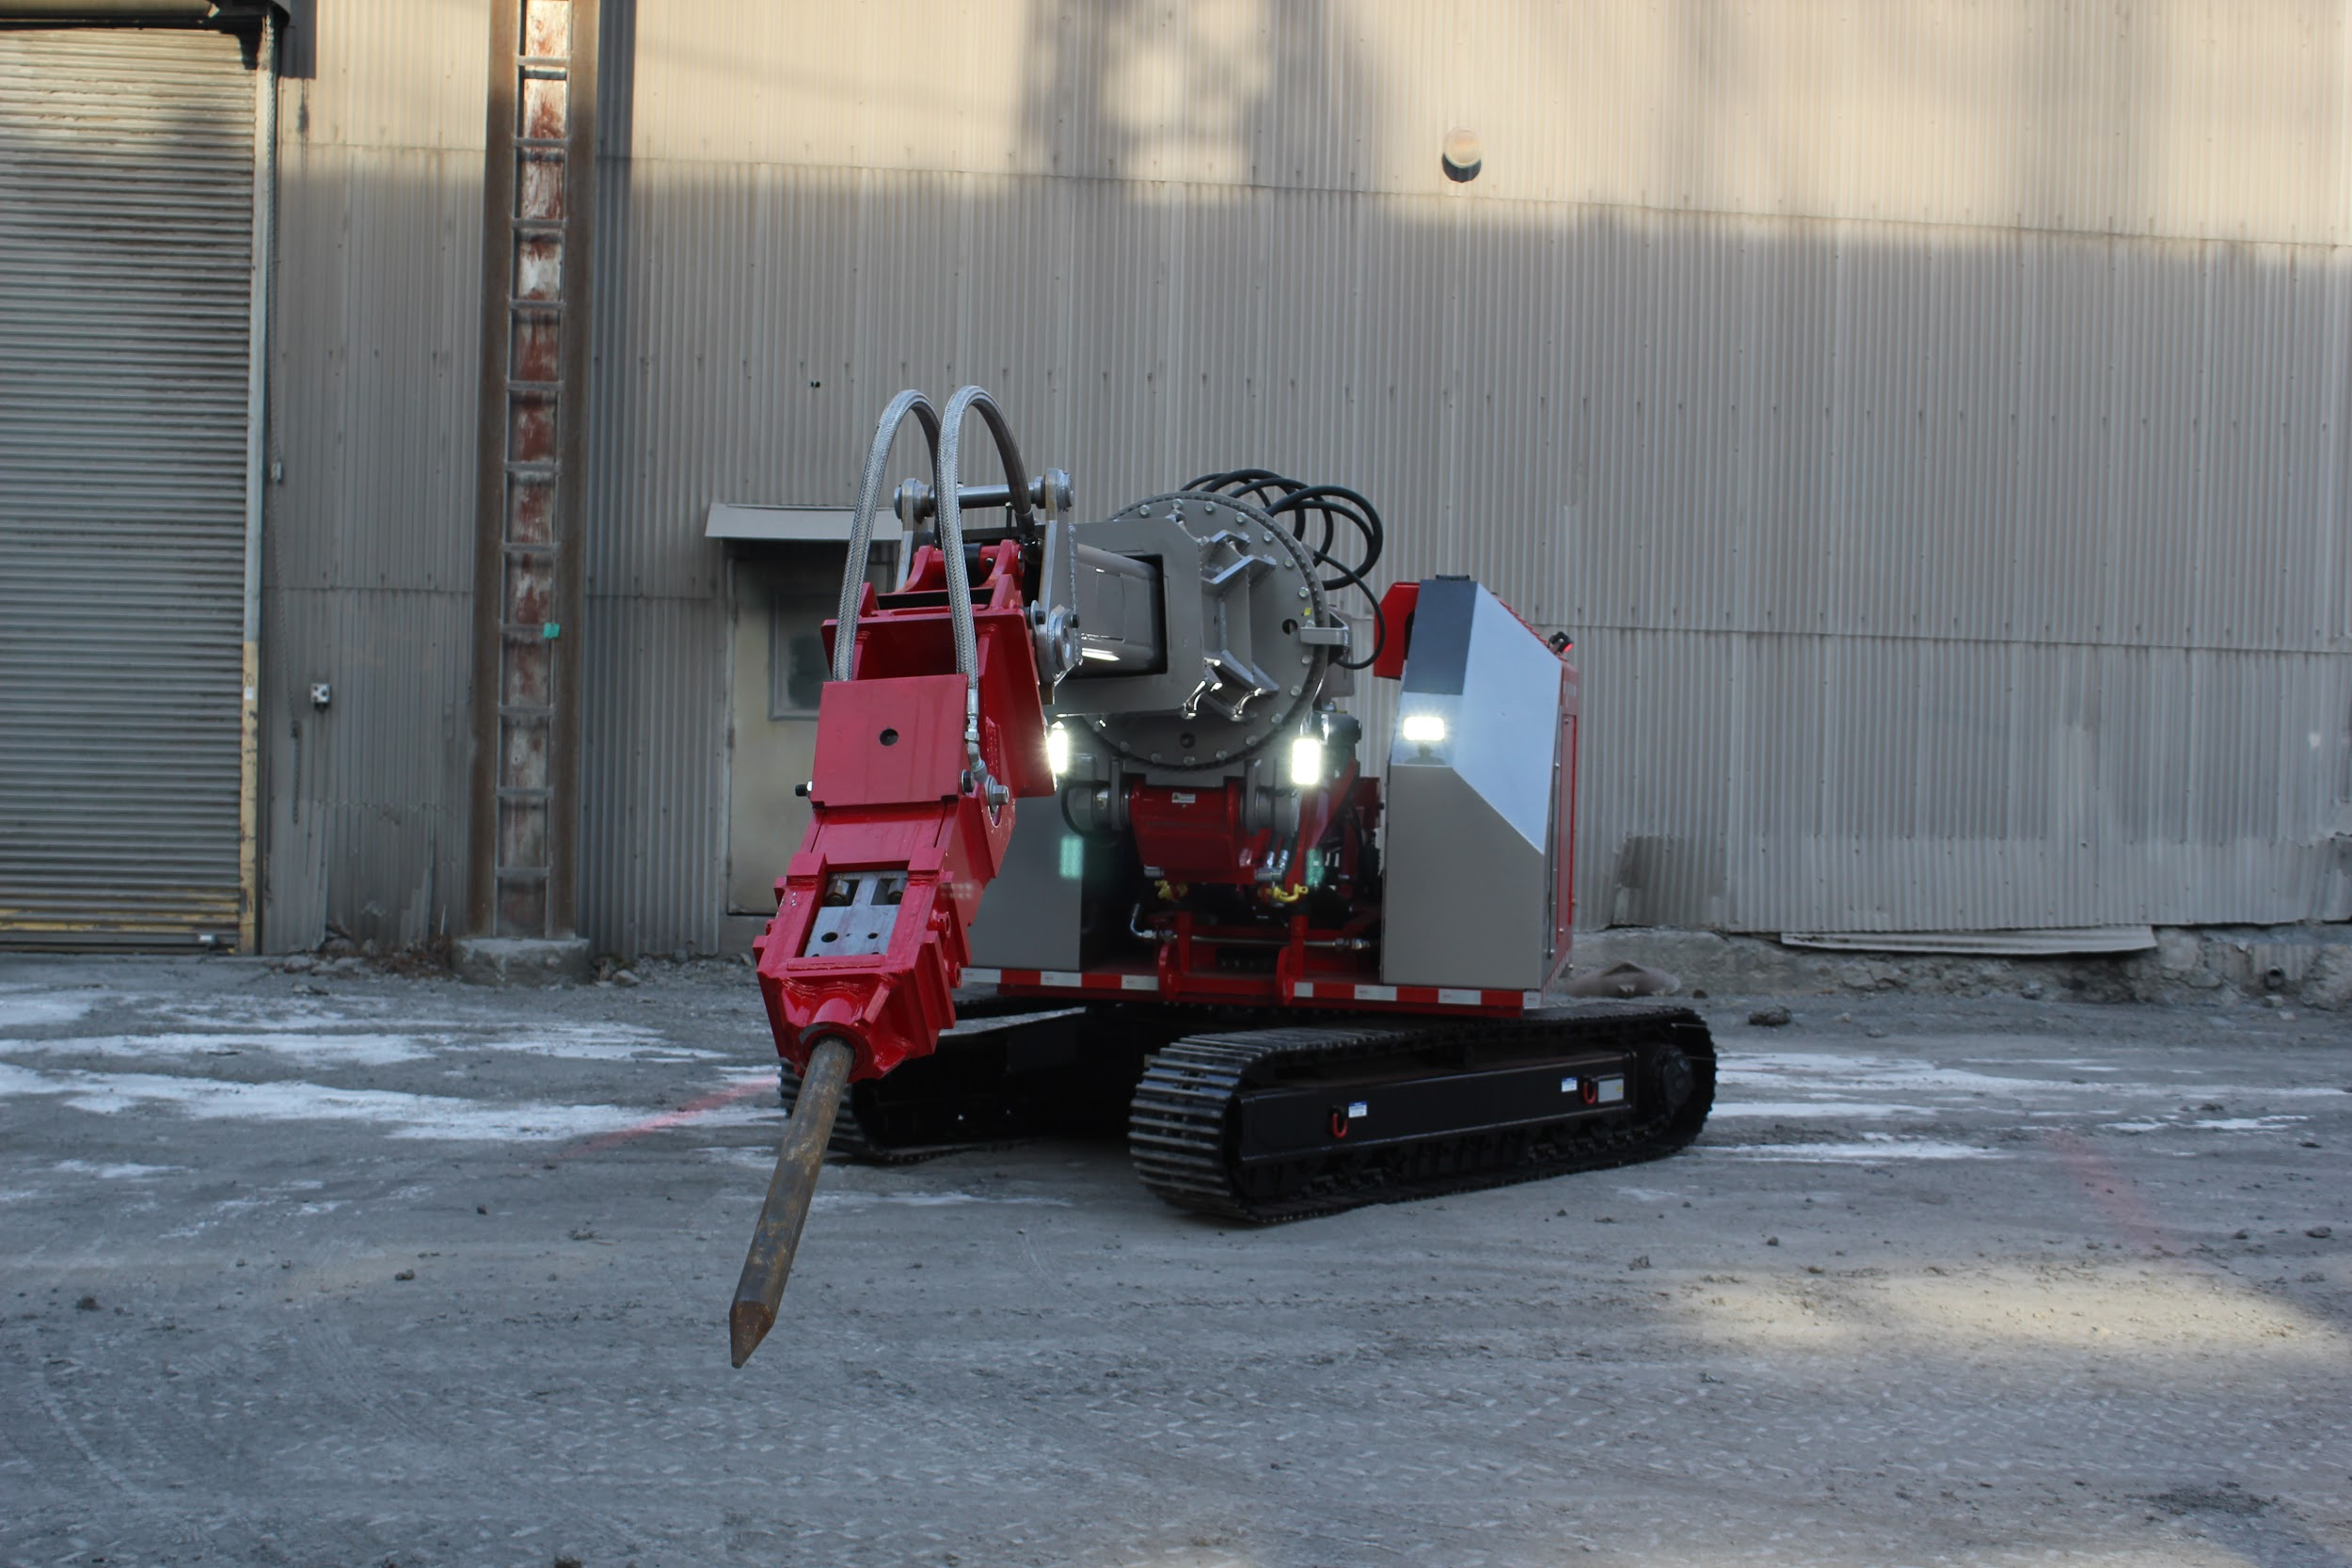
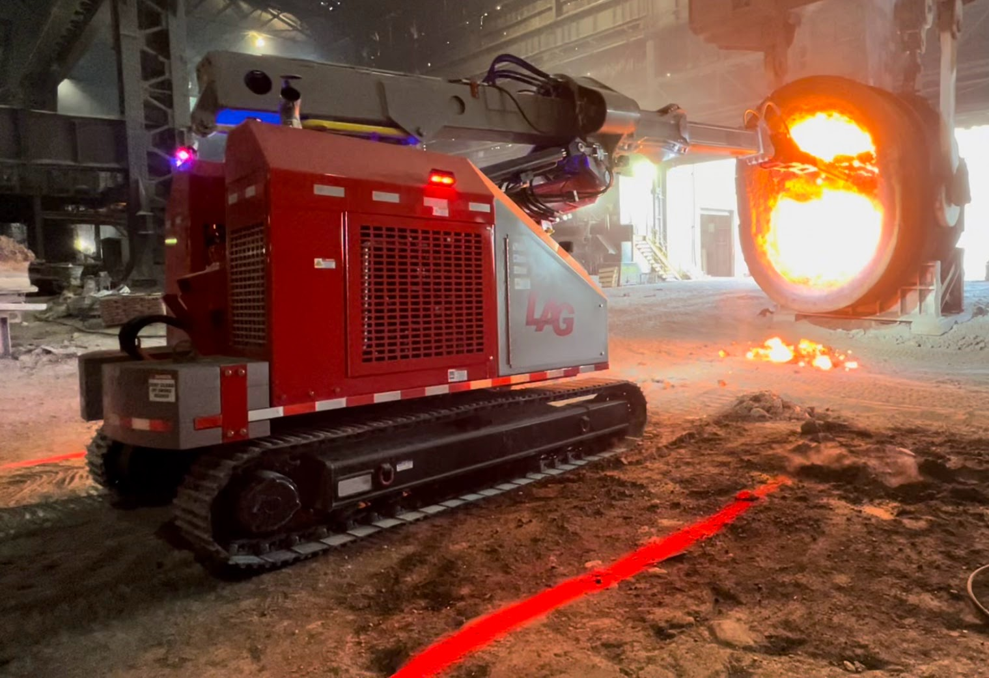
Introducing LAG Equipment’s LAG-3400 and LAG-2800 refractory tear-out machines. Taking decades of experience and knowledge, LAG Equipment developed an innovative duo of machines from the ground up, keeping safety front of mind. Using the latest technology, the machines effortlessly tear out refractory or clean out a vessel while allowing the operator to keep a safe distance.

Slide 12
KEY SAFETY POINTS
VISUAL & PPE
Parameter Safety Zone Lighting
AI Powered Personnel Detection System
HYDRAULICS
Integrated counterbalance valves on hoist/stick cylinders
High pressure/low flow travel motor and high torque hub effortlessly turn machine
High pressure/low flow proportional hydraulic system
Fewer hydraulic components allow for a simplified, yet powerful system
Active kidney loop hydraulic cooling system
STRUCTURAL
Ground level fill eliminates fall protection on fuel tank and hydraulic reservoir
Fuel tank and hydraulic reservoir certified pressure tested
Undercarriage D-rings allow for safe tie-down for transportation
Unmatched stability and travel performance with machine’s center of mass over undercarriage
Lifting balance centered to machine
Significantly reduced structural fatigue through FEA analysis
All major deck hydraulic components (fuel, hydraulic and DEF tanks) are shielded by sloped enclosures

Slide 13
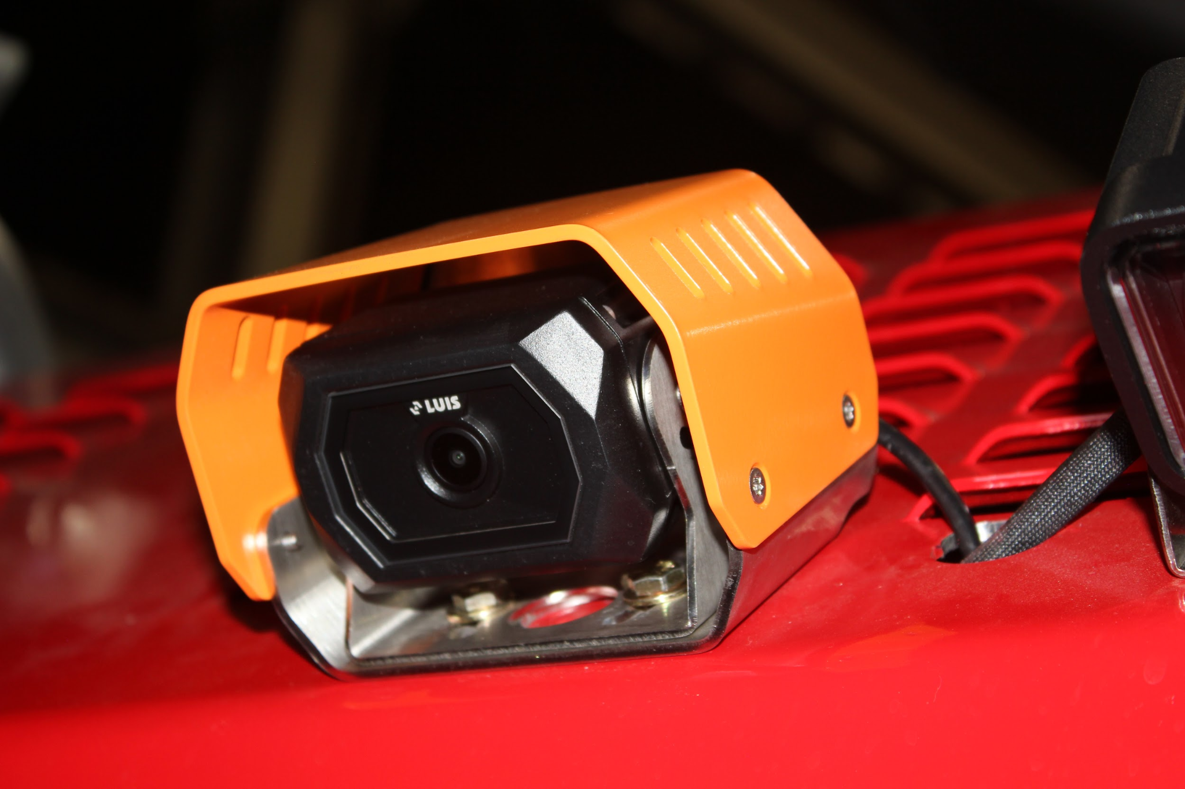
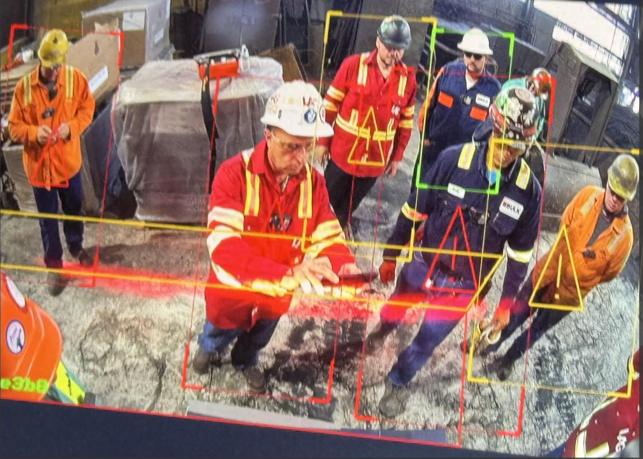
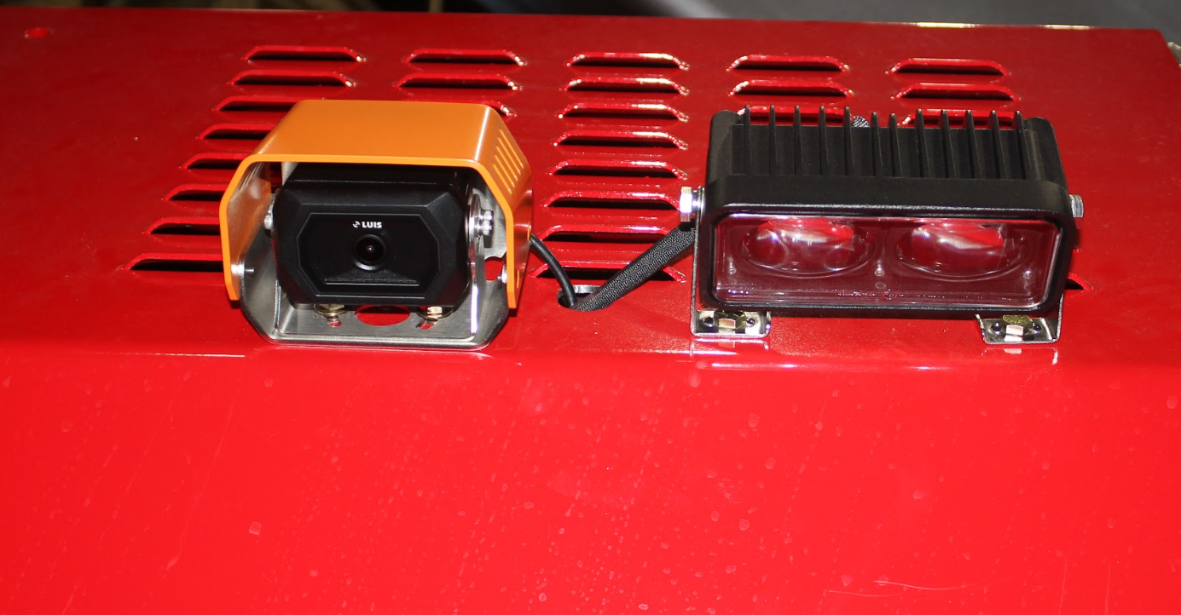
WHY WAIT FOR THE WORST? SAFETY FIRST
LAG’s state-of-the-art AI POWERED PERSONNEL DETECTION system six mounted cameras provide optimal visibility at all times. Each camera has a custom range detecting up to 41 human targets each - keeping both operators and surrounding teammates safe. This system gives the flexibility to adjust the zones to the working environment.

Slide 14
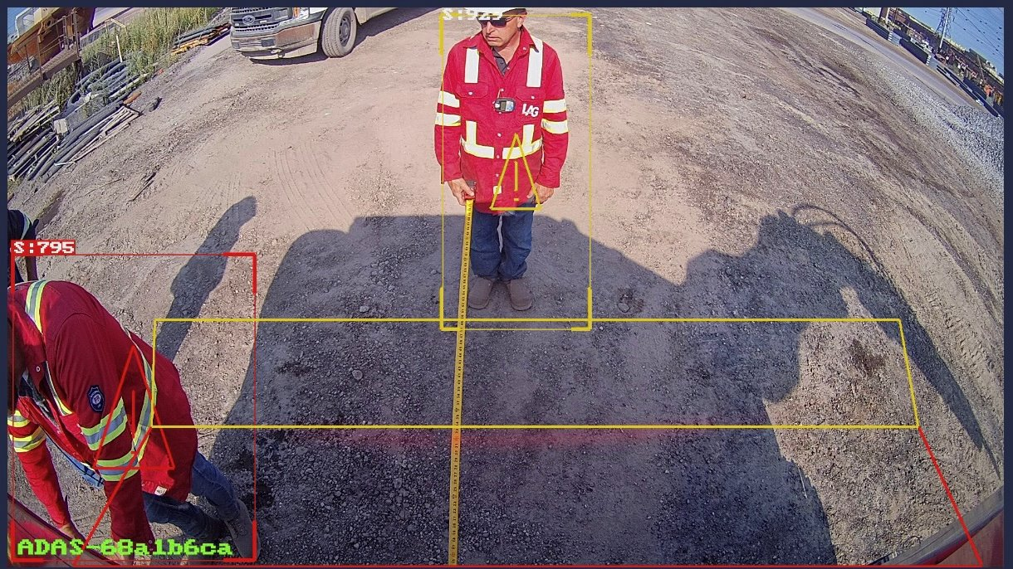
AI POWERED PERSONNEL DETECTION SYSTEM
Ability to detect up to 41 people based on custom predetermined safety zones
LAG mounts a total of six (6) cameras to ensure unobstructed view (i.e. no boom obstruction)
Each camera has two custom zones:
Yellow zone: Reduces the speed of travel of the unit and the swing function. Standard setting is six (6) feet.
Red Zone: Demobilization of machine both travel and swing. All other functions remain accessible. Standard setting is three (3) feet.
Immediate full regeneration once operator is within safe operating zone.

Slide 15
AI POWERED PERSONNEL DETECTION SYSTEM
IN-FIELD CASE STUDY
Customer wished to program LAG’s personnel detection system to protect the operator against boom.
YELLOW ZONE: Set to 11-14 feet in front of the machine. Entering the zone will slow travel and swing to 80%
RED ZONE: Set to 11 feet in front of the machine and three (3) feet from the width. Entry into this zone will completely mobility travel and swing immediately.

Slide 16
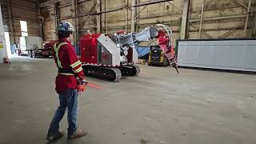
AI POWERED SAFETY PERSONNEL DETECTION SYSTEM

Slide 17
LACK OF PERSONNEL DETECTION SYSTEM
INCIDENT - NEAR MISS FATALITY
A large integrated steel manufacturer was operating a competitor machine without a proximity detection system. The operator was moving the equipment through a doorway, which obstructed their view while operating. Unfortunately, plant personnel were standing in front of the machine while observing a crane in operation. The personnel was struck in the back by the front of the machine. The operator was not notified or warned that personnel were in the vicinity of the machine resulting in a near miss fatality.
Lack of proper safety integration, customization and ability to accommodate to the working environment, the competitor’s machine did not protect personnel from being injured.

Slide 18
WHAT’S NEXT
SAFETY & INNOVATION

Slide 19
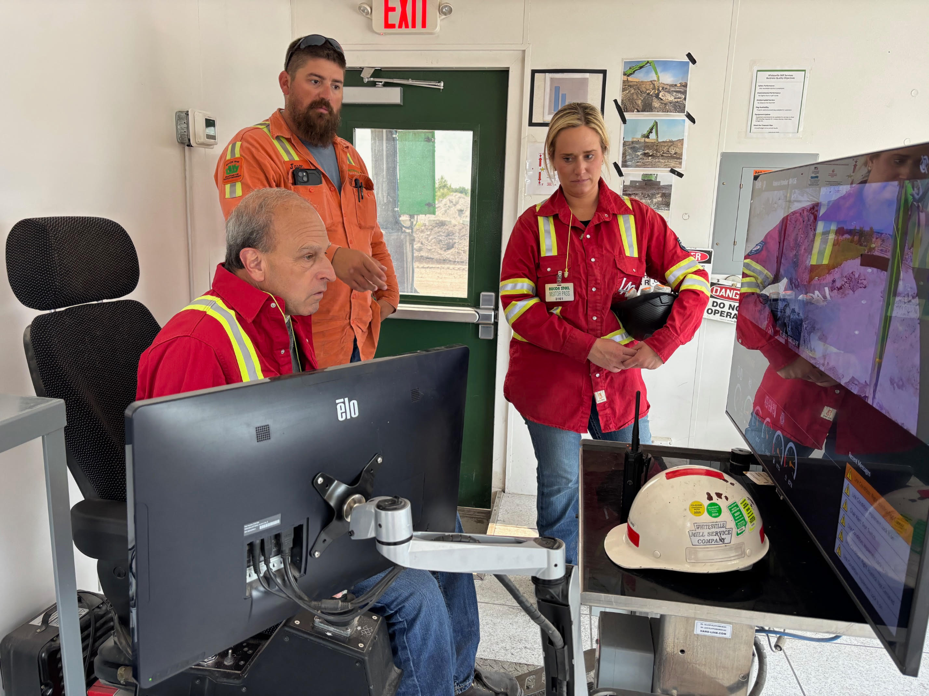
THE CHALLENGE
LAG approached by two customer at the corporate level to expand upon success with AI Powered Camera System
How can LAG keep more operators and surrounding teammates safe?
How can LAG help to avoid the recordables consistently?

Slide 20
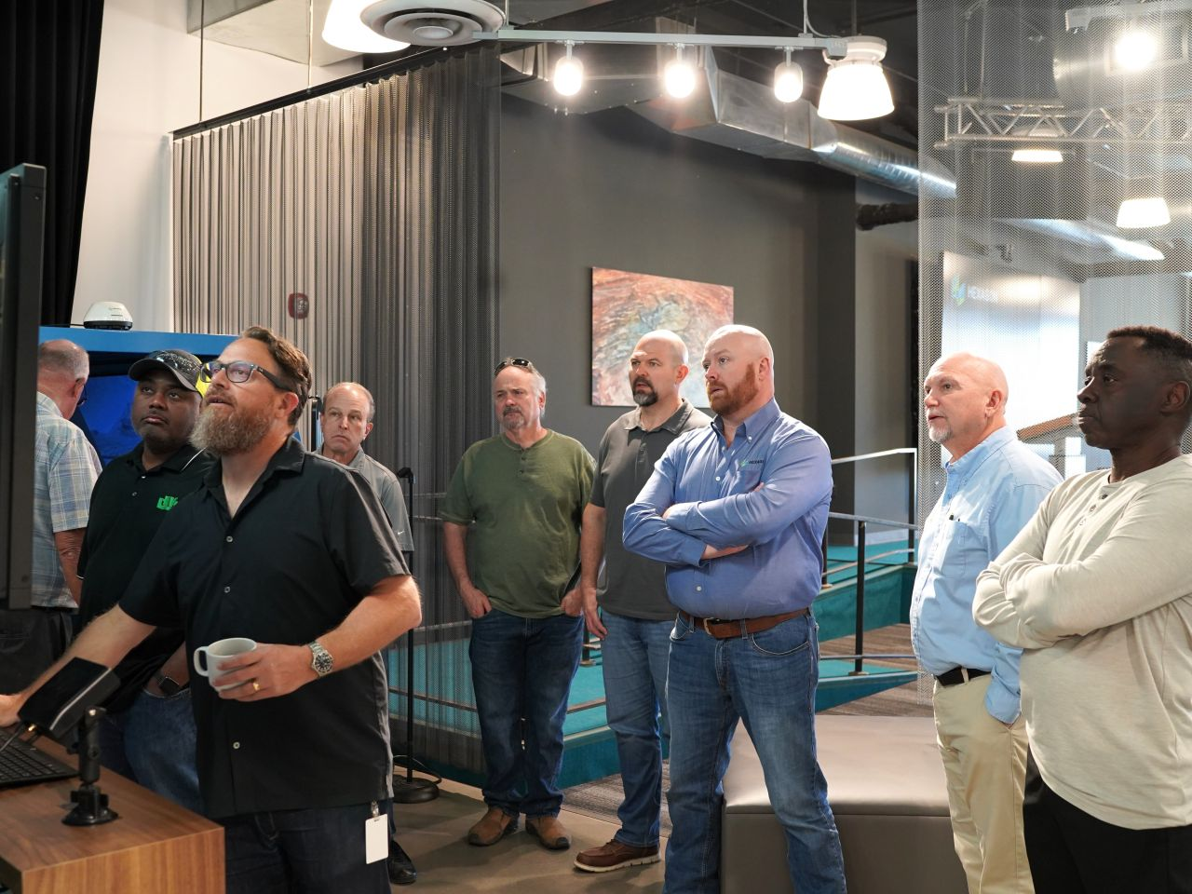
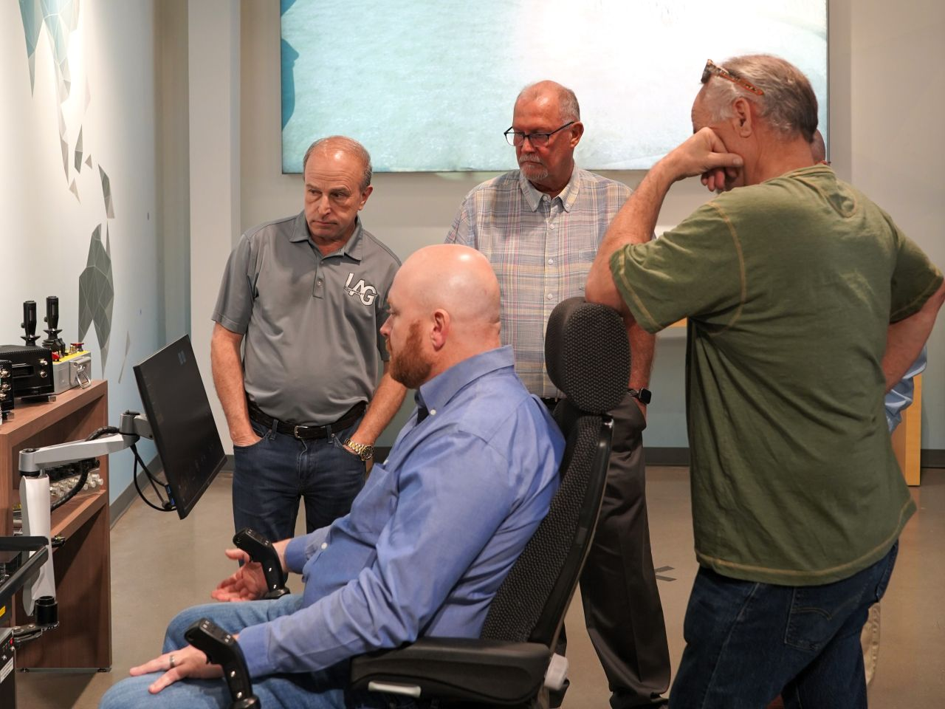
R&D EXPLORATION
LAG collaborated with other NSA Members to explore the latest on the market focused on safety
LAG has committed to creating autonomous equipment to apply across numerous applications utilizing LAG’s equipment portfolio
Final stages of preparing the LAG-3400 to be fully autonomous testing by year end 2025. Introducing to market for application in 2026.

Slide 21
INNOVATION & SAFETY
ADDITIONAL APPLICATIONS

Slide 22
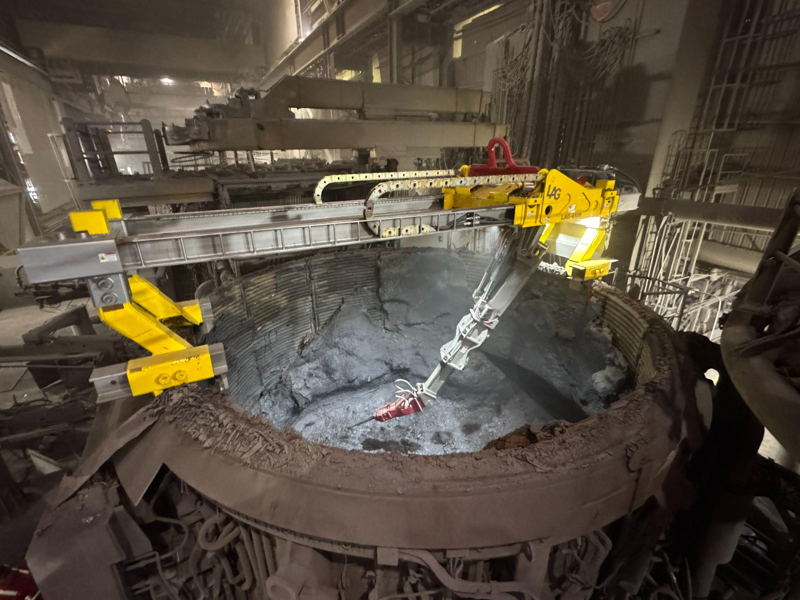
LAG-4500
EBT ELECTRIC FURNACE MACHINE

Slide 23
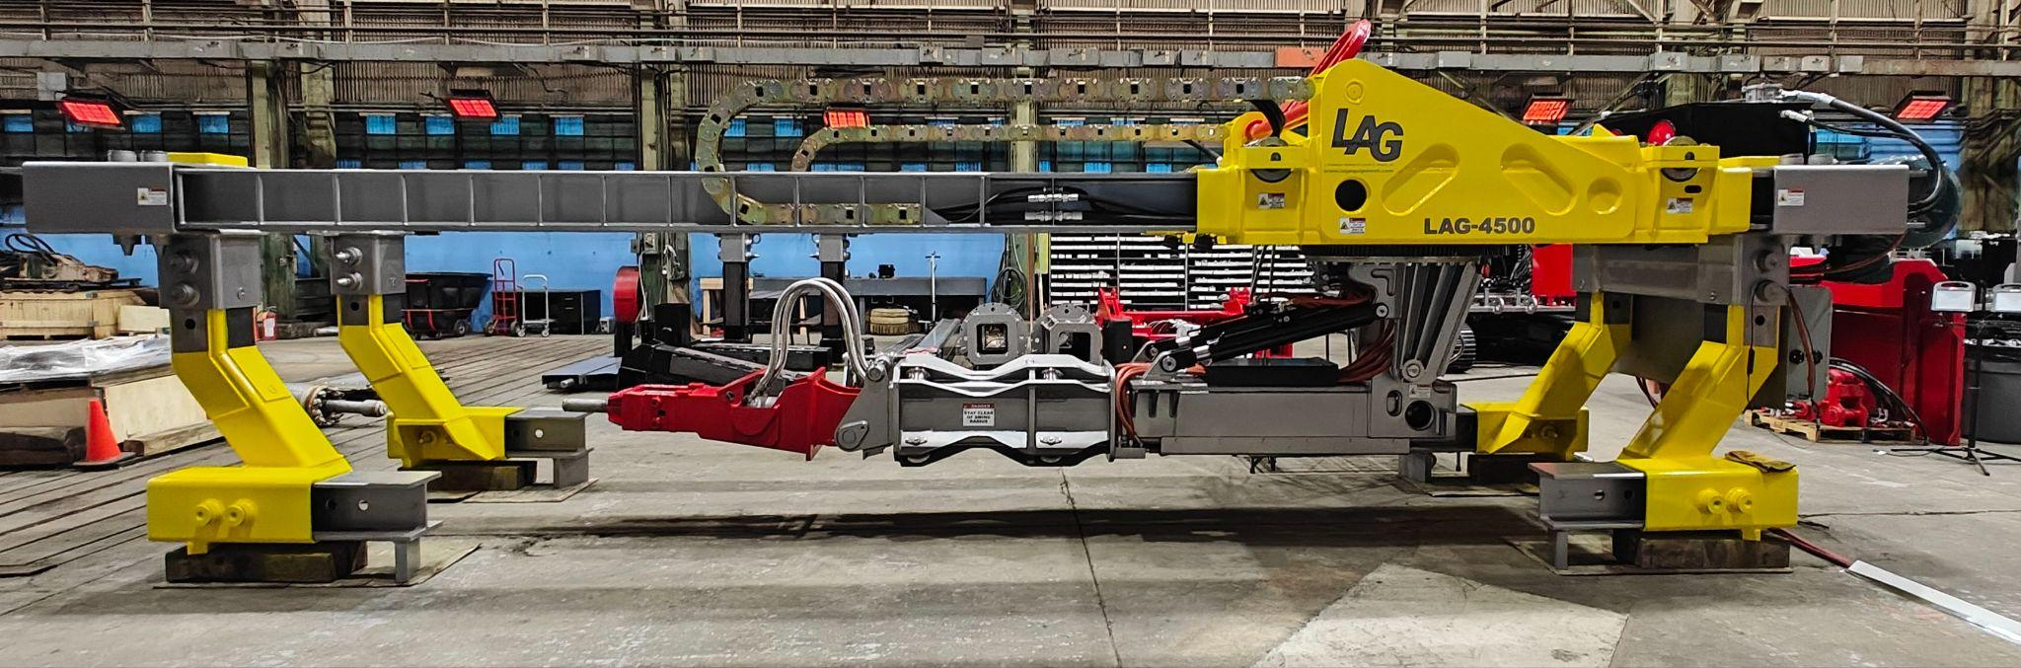
LAG-4500 EBT ELECTRIC FURNACE MACHINE
LAG Equipment’s LAG-4500 refractory tear-out machine was specifically designed for reliable tear-out for electric arc furnaces. Positioned on top of the furnace shell, the lining is quickly removed with minimum downtown. Multi-positional legs allow the machine to accommodate furnaces ranging from 75 to 350 tons.

Slide 24
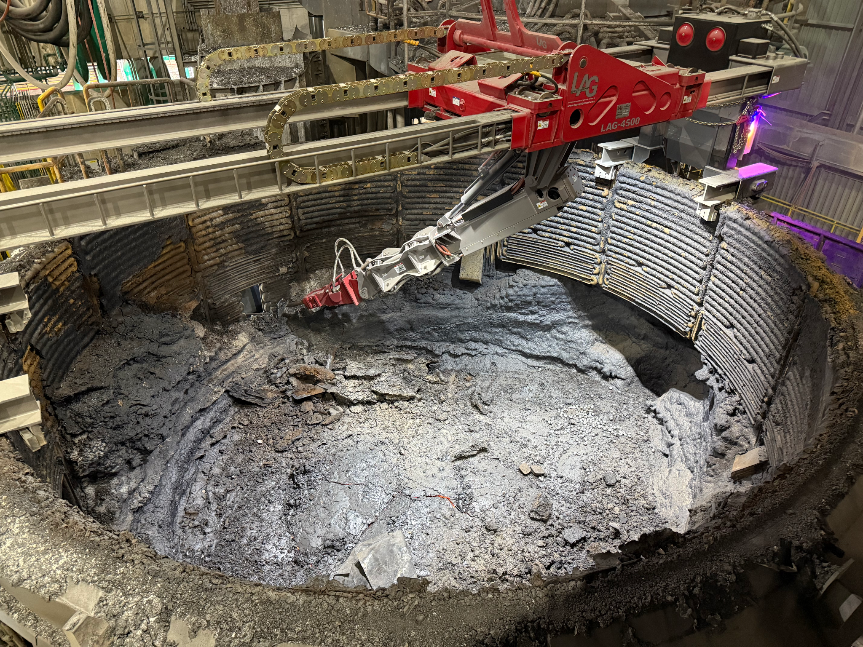
LAG-4500 SAFETY OVERVIEW
PPE
Integrated safety rails
Safety tie-off points
Light weight covers
HYDRAULICS
Operating pressure 3500 PSI
Integrated counterbalance valves on hoist cylinders
Emergency dump valve for hoist circuit
PLC controlled hydraulics
High pressure/low flow proportional hydraulic system
Fewer hydraulic components exposed to heat over furnace
Active kidney loop hydraulic cooling system
Shut-off valve on fluid supply
Hydraulic fluid is cleansed through multiply filter units

Slide 25
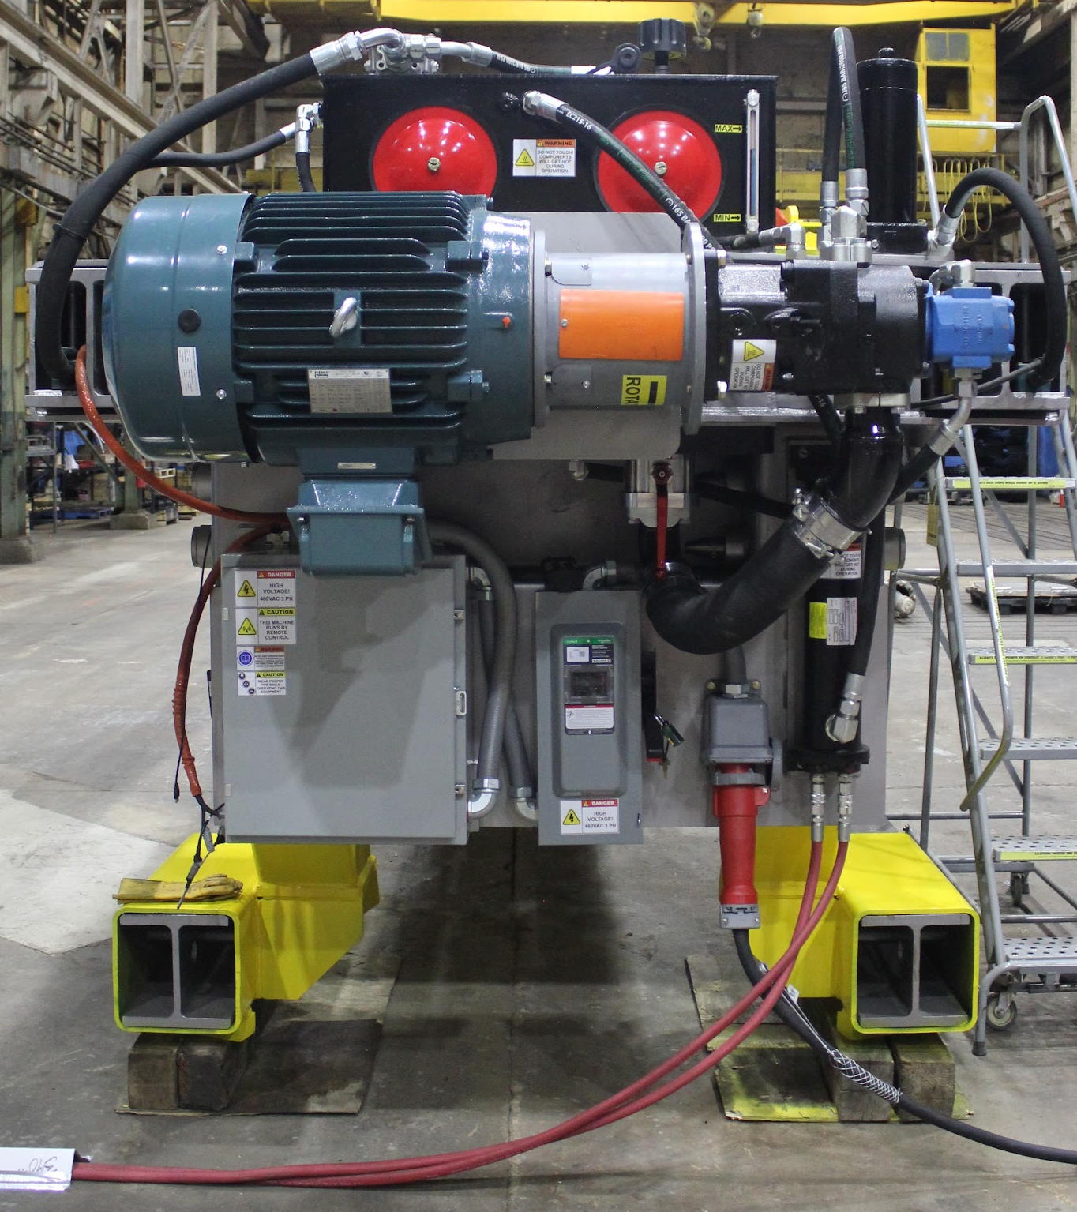
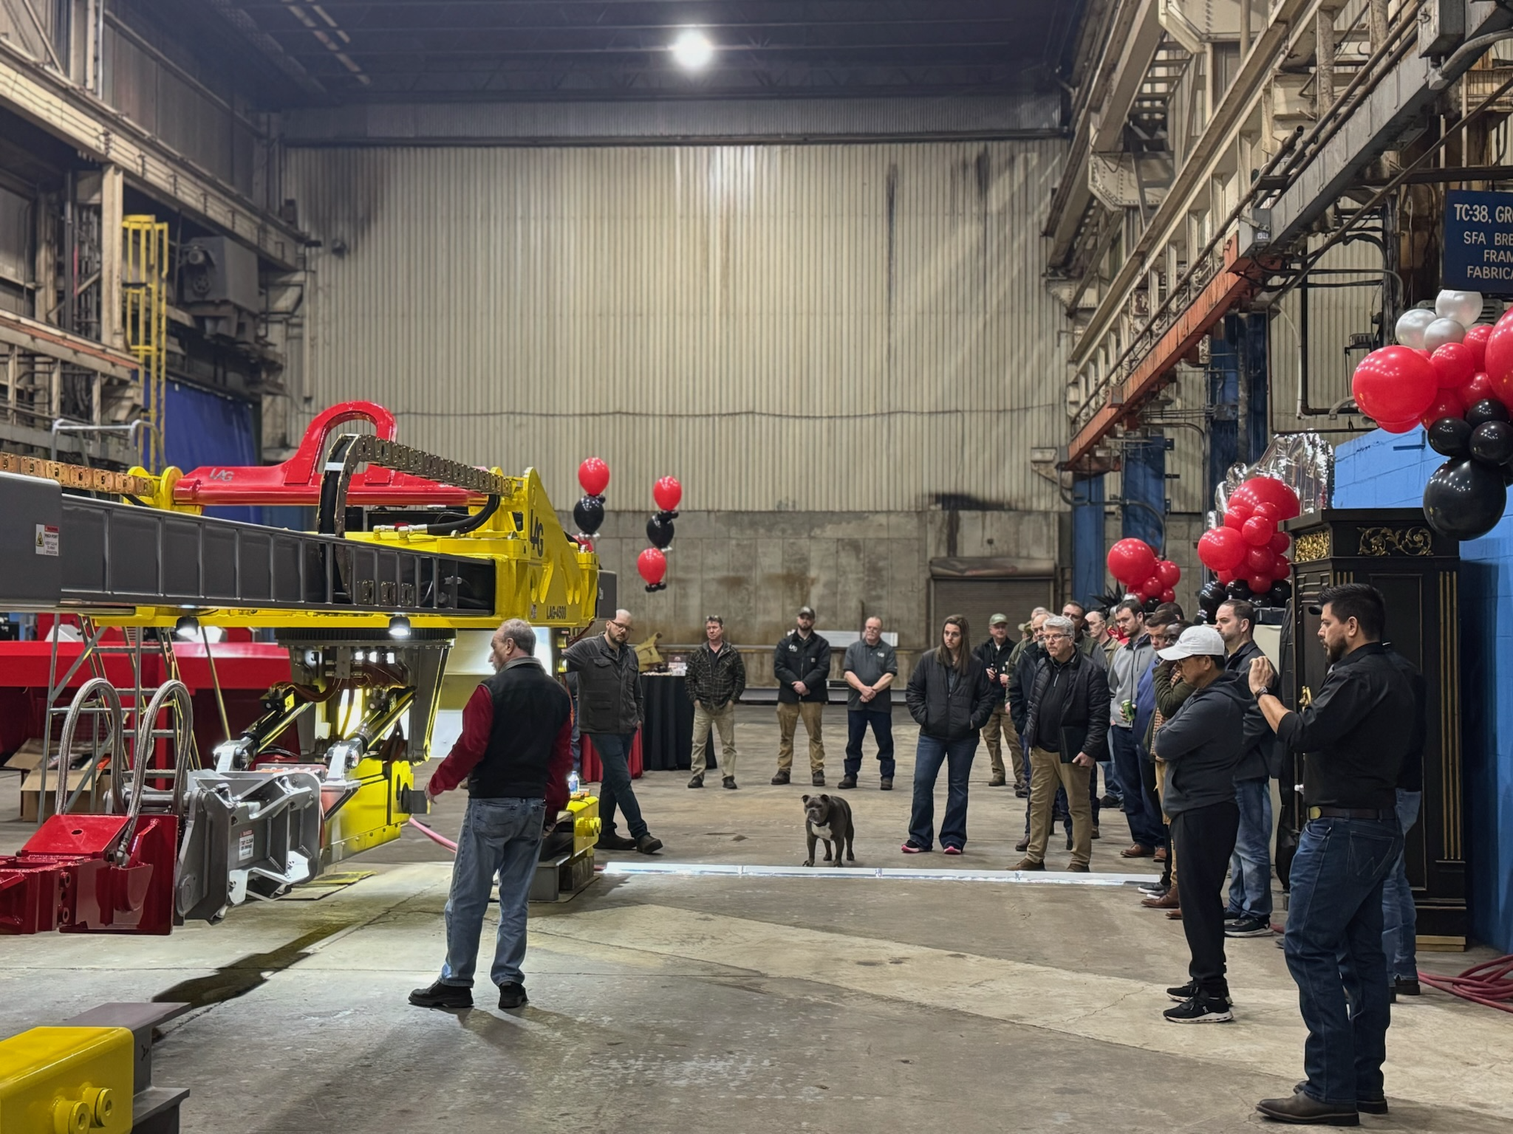
LAG-4500 SAFETY OVERVIEW
ELECTRICAL
Fused lockout/tagout disconnect enclosure
High voltage is only located at the power unit, 24 volt DC is run throughout the entire machine
Radio control only, no tethered connection

Slide 26
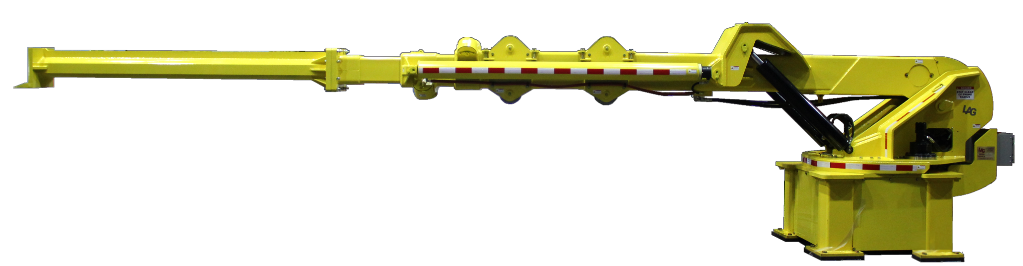
LAG-1200

Slide 27
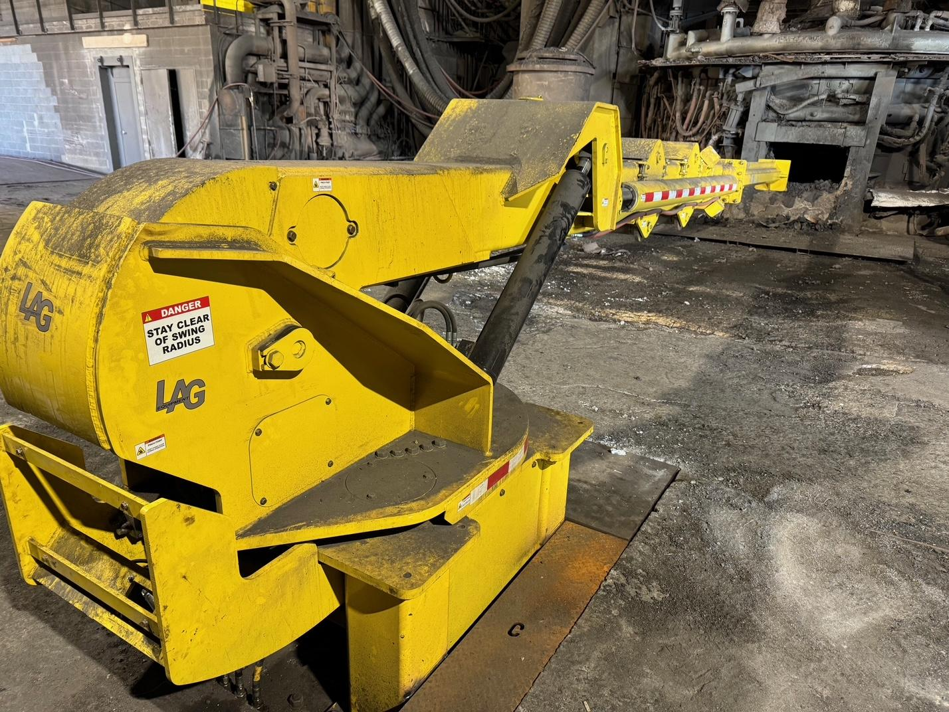
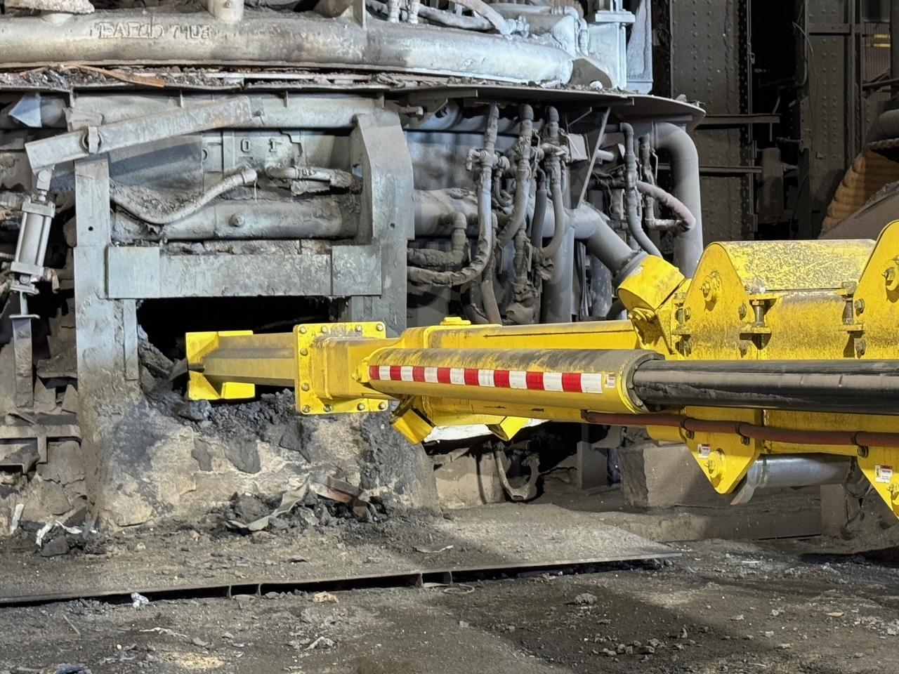
Introducing LAG Equipment’s LAG-1200 slag door maintenance machine. Taking decades of experience and knowledge, LAG Equipment has developed a machine that looks at safety first.
From the ground up, innovation and design are the foremost thoughts while keeping safety a priority. Using the latest technology, the machine was designed to work effortlessly to clear slag and scrap around an EAF slag door.

Slide 28
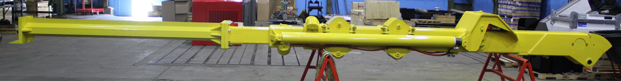
LAG-1200 BOOM ASSEMBLY
Roller boom design allows for increased operation and reduced maintenance costs.
Over 50,000 ft/lbs push force and 34,000 ft/lbs pull force.
Reduced in/out cycle time with the use of custom hydraulic system.
Notes:
Compare roller boom to other company boom.

Slide 29
LAG-1200 SLAG DOOR PUSHER
BASE
Various mounting pad configurations
Quick pin feet
Bolted feet
Welded feet
Shielded from debris and blow back
TRUNNION
Integrated counterbalance valves on hoist/stick cylinders
Shielded from debris and blow back
BOOM
Roller design allows for longer operation and better maintenance
Integrated counterbalance valves to prevent unsafe cylinder movement upon hose rupture
CONTROL SYSTEM
Proportional joystick controls (three available control consoles)
Remote radio control
Pedestal control console
Pulpit control console

Slide 30
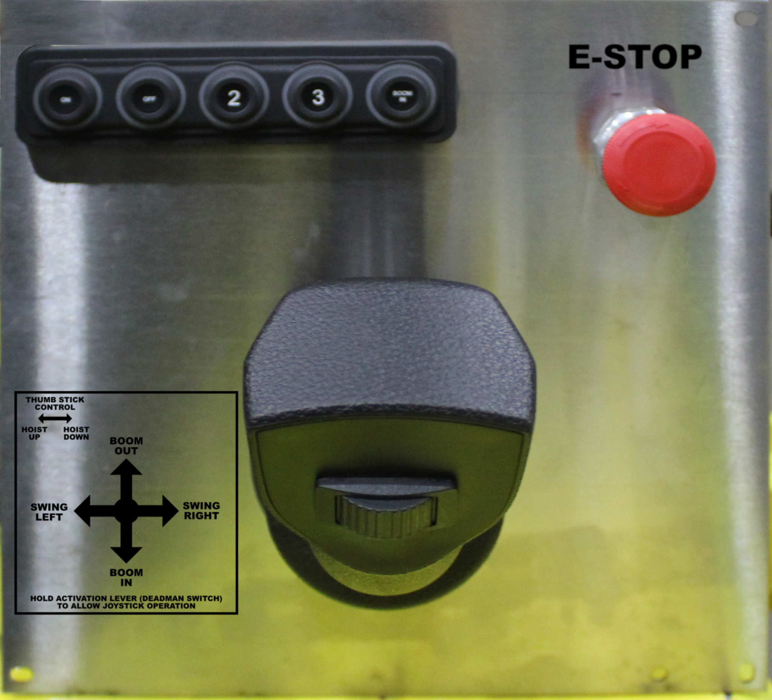
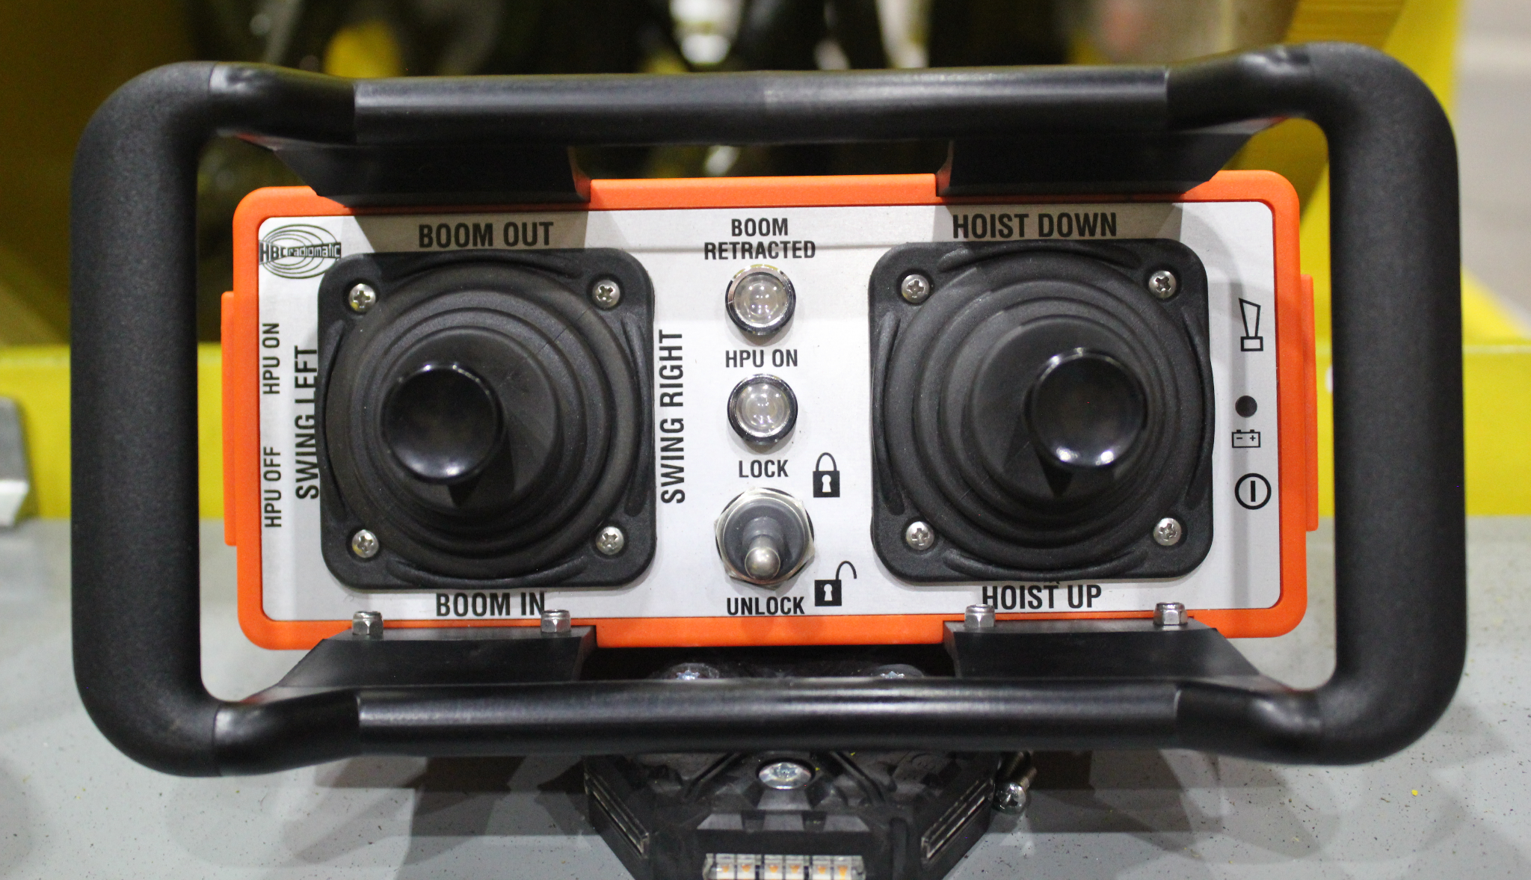
CONTROL SYSTEM
Proportional joystick controls, the following layouts are available:
Remote radio control
Pedestal control console
Pulpit control console
Simplified electrical system

Slide 31
LAG EQUIPMENT
ATTACHMENTS

Slide 32
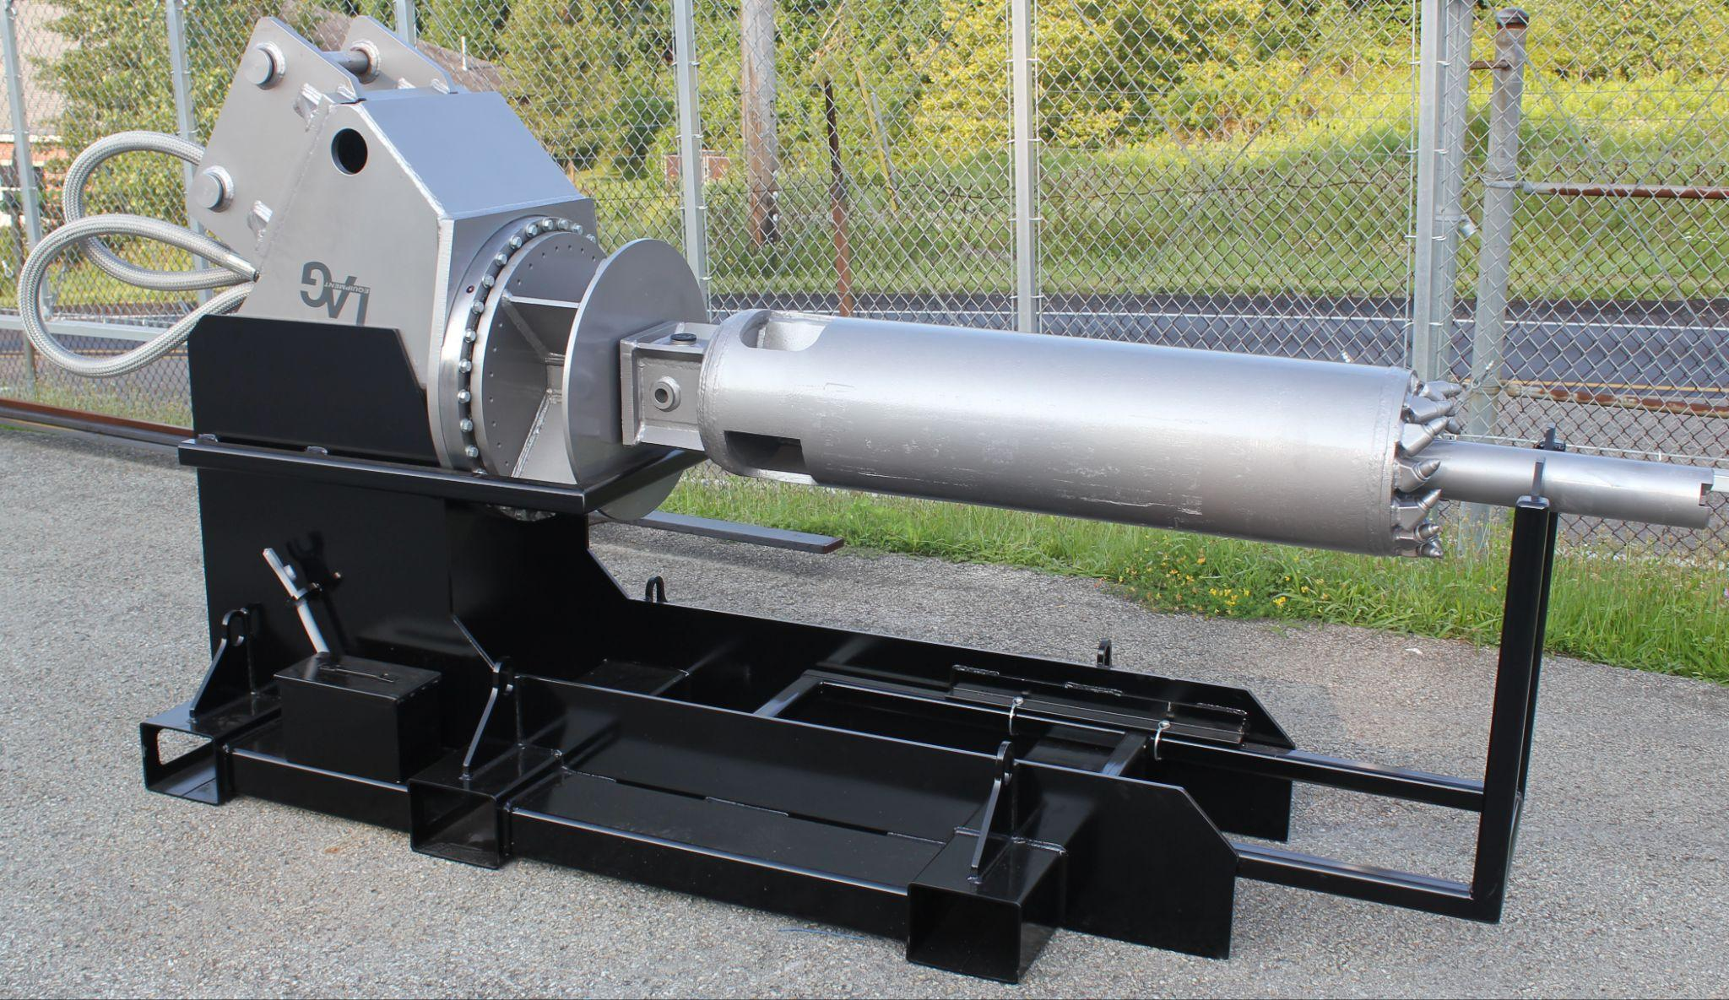
LAG EBT TAP HOLE CORE DRILL SYSTEM
The tap hole core drill employs a high-torque hydraulic motor/hub combination within a newly designed drive head assembly.
This assembly works in tandem with a custom sized carbide tipped drum with pilot assist. Once the drill is positioned at the opening of the taphole, it effortlessly removes the surround material.
This process typically takes 7-10 minutes* after which a new sleeve can be inserted using the optional insert tool.
*Times can vary based on tap hole size

Slide 33
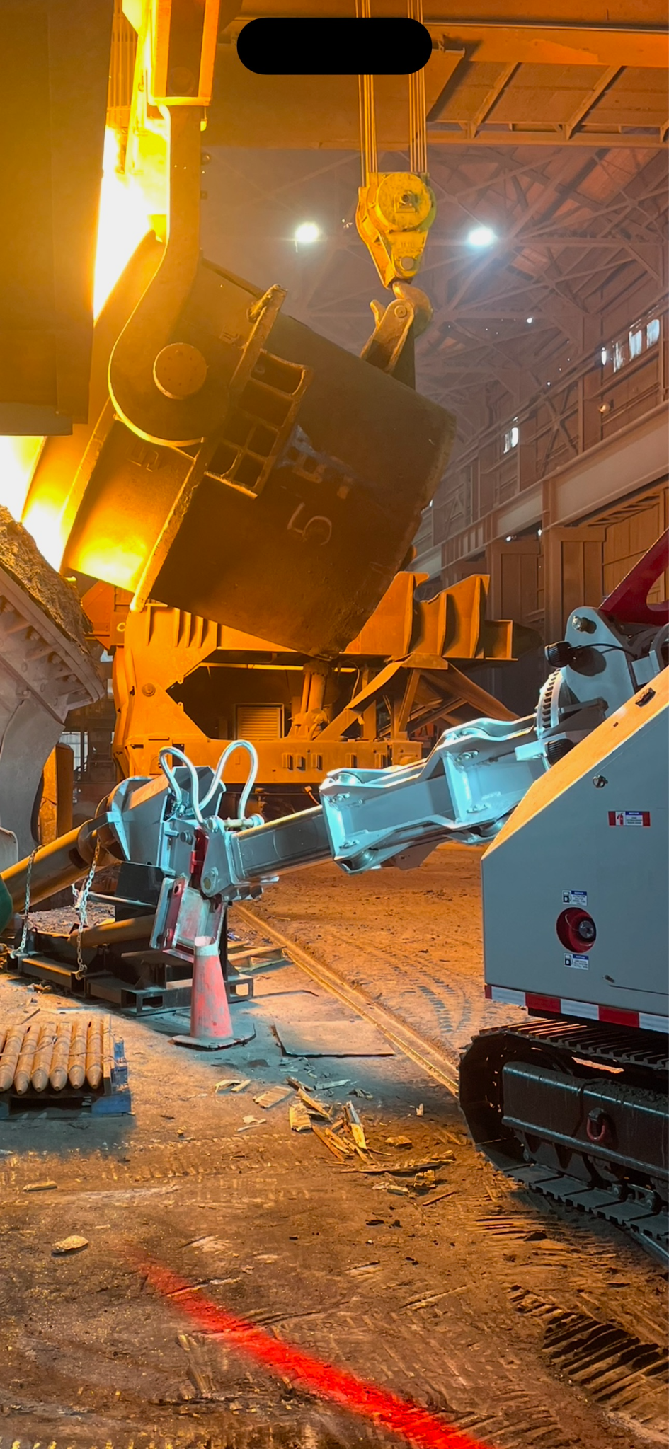
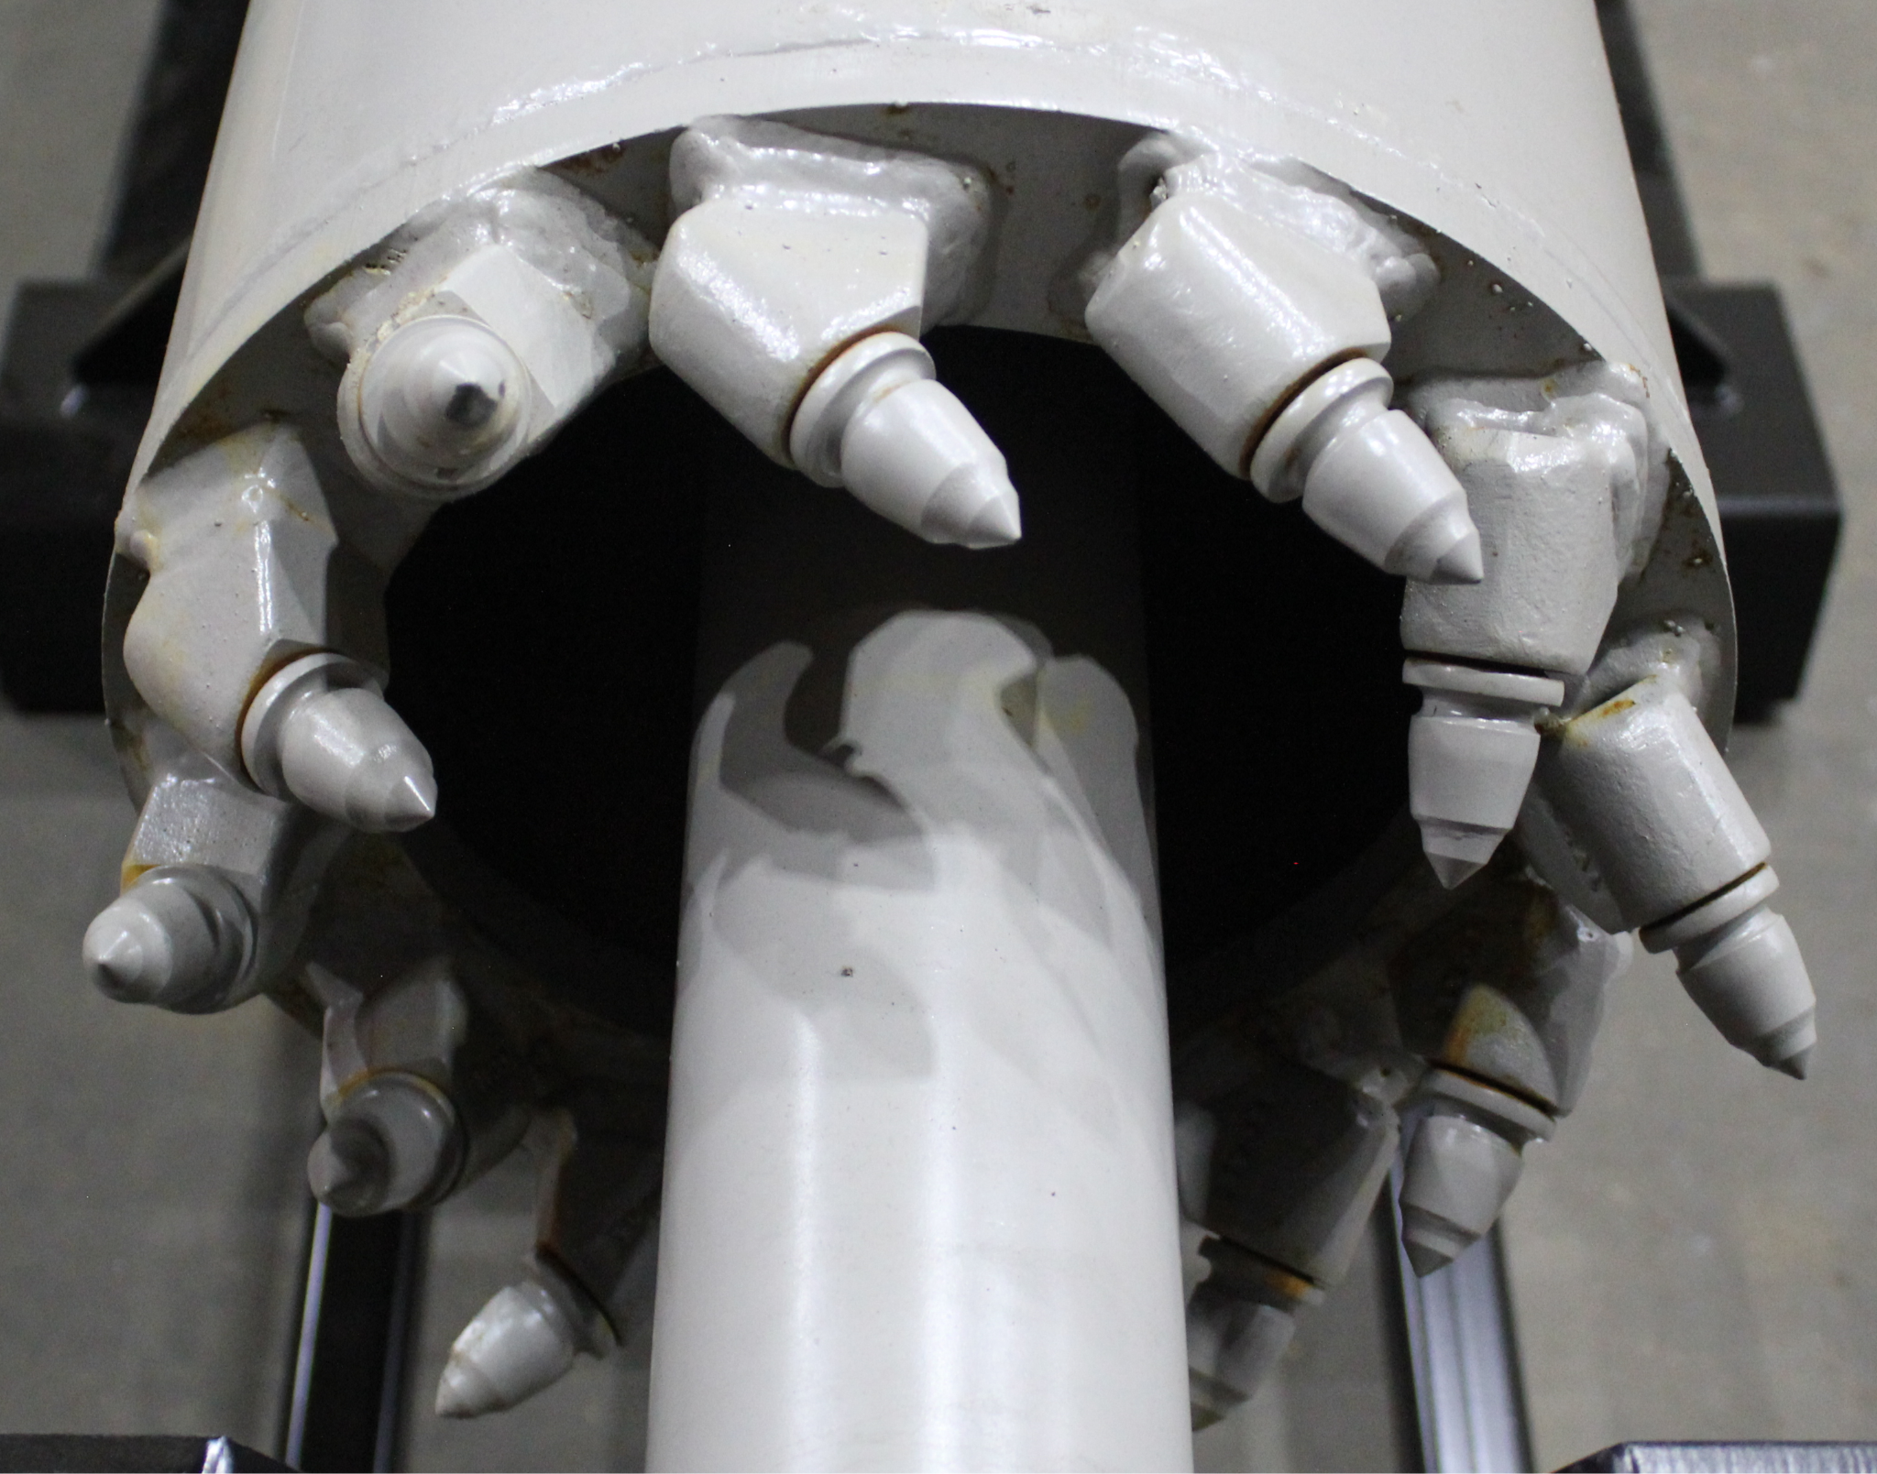
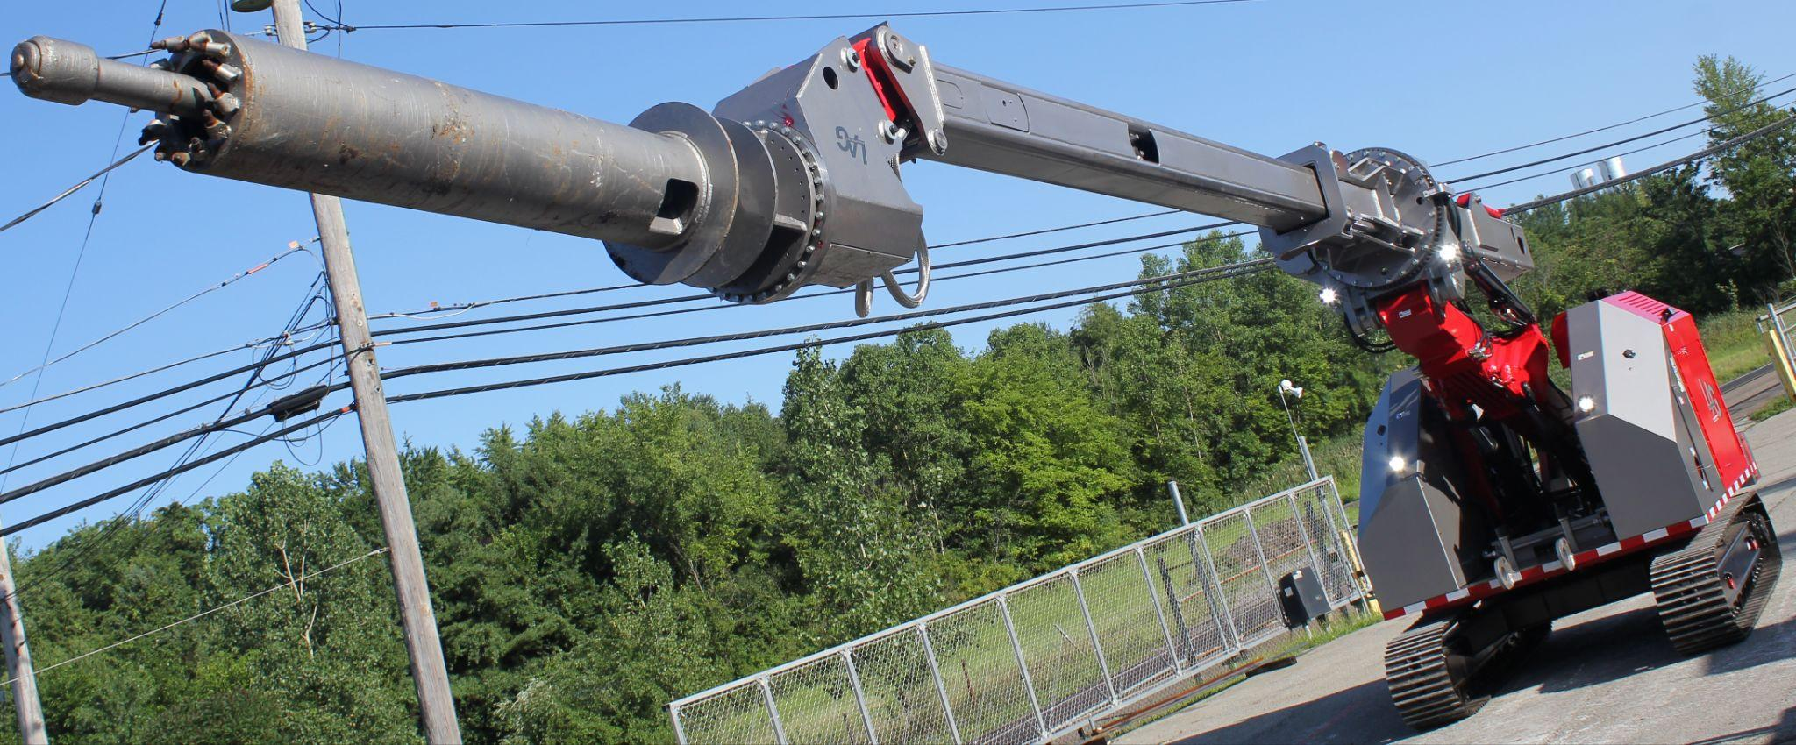
EBT TAP HOLE CORE DRILL SYSTEM

Slide 34
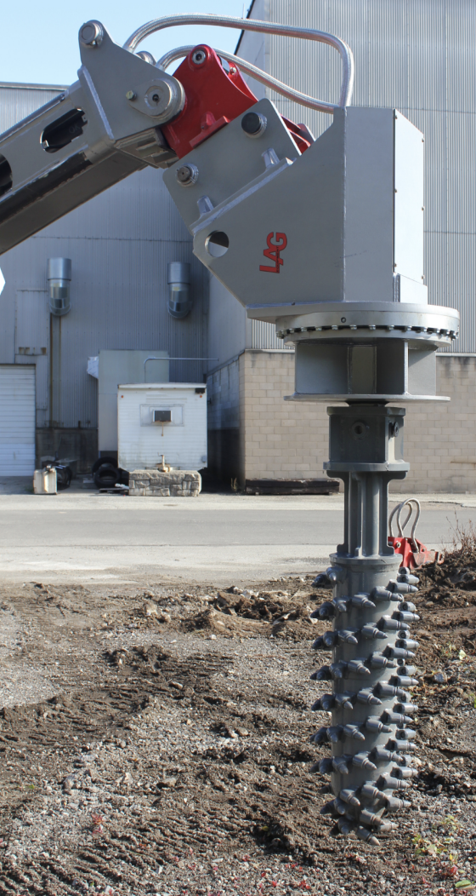
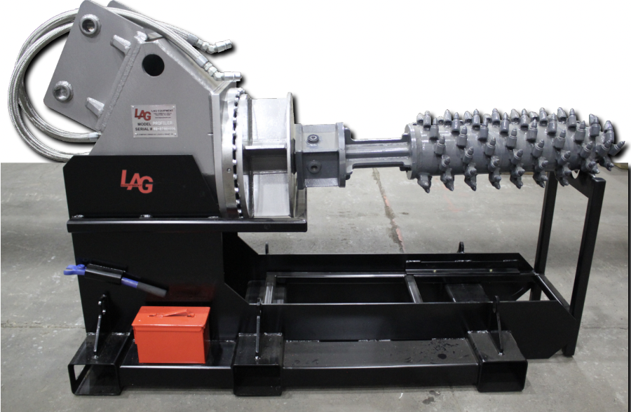
MILL MAINTENANCE PROFILER
The carbide tipped cleaning drum and high-torque hydraulic motor/hub effortlessly removes build-up along trough walls or cast-able refractory.
Using a LAG-3400 or LAG-2800, precise movement allows only the necessary material to be removed, leaving a rough surface for recasting.
67 RPM at 3000 PSI

Slide 35
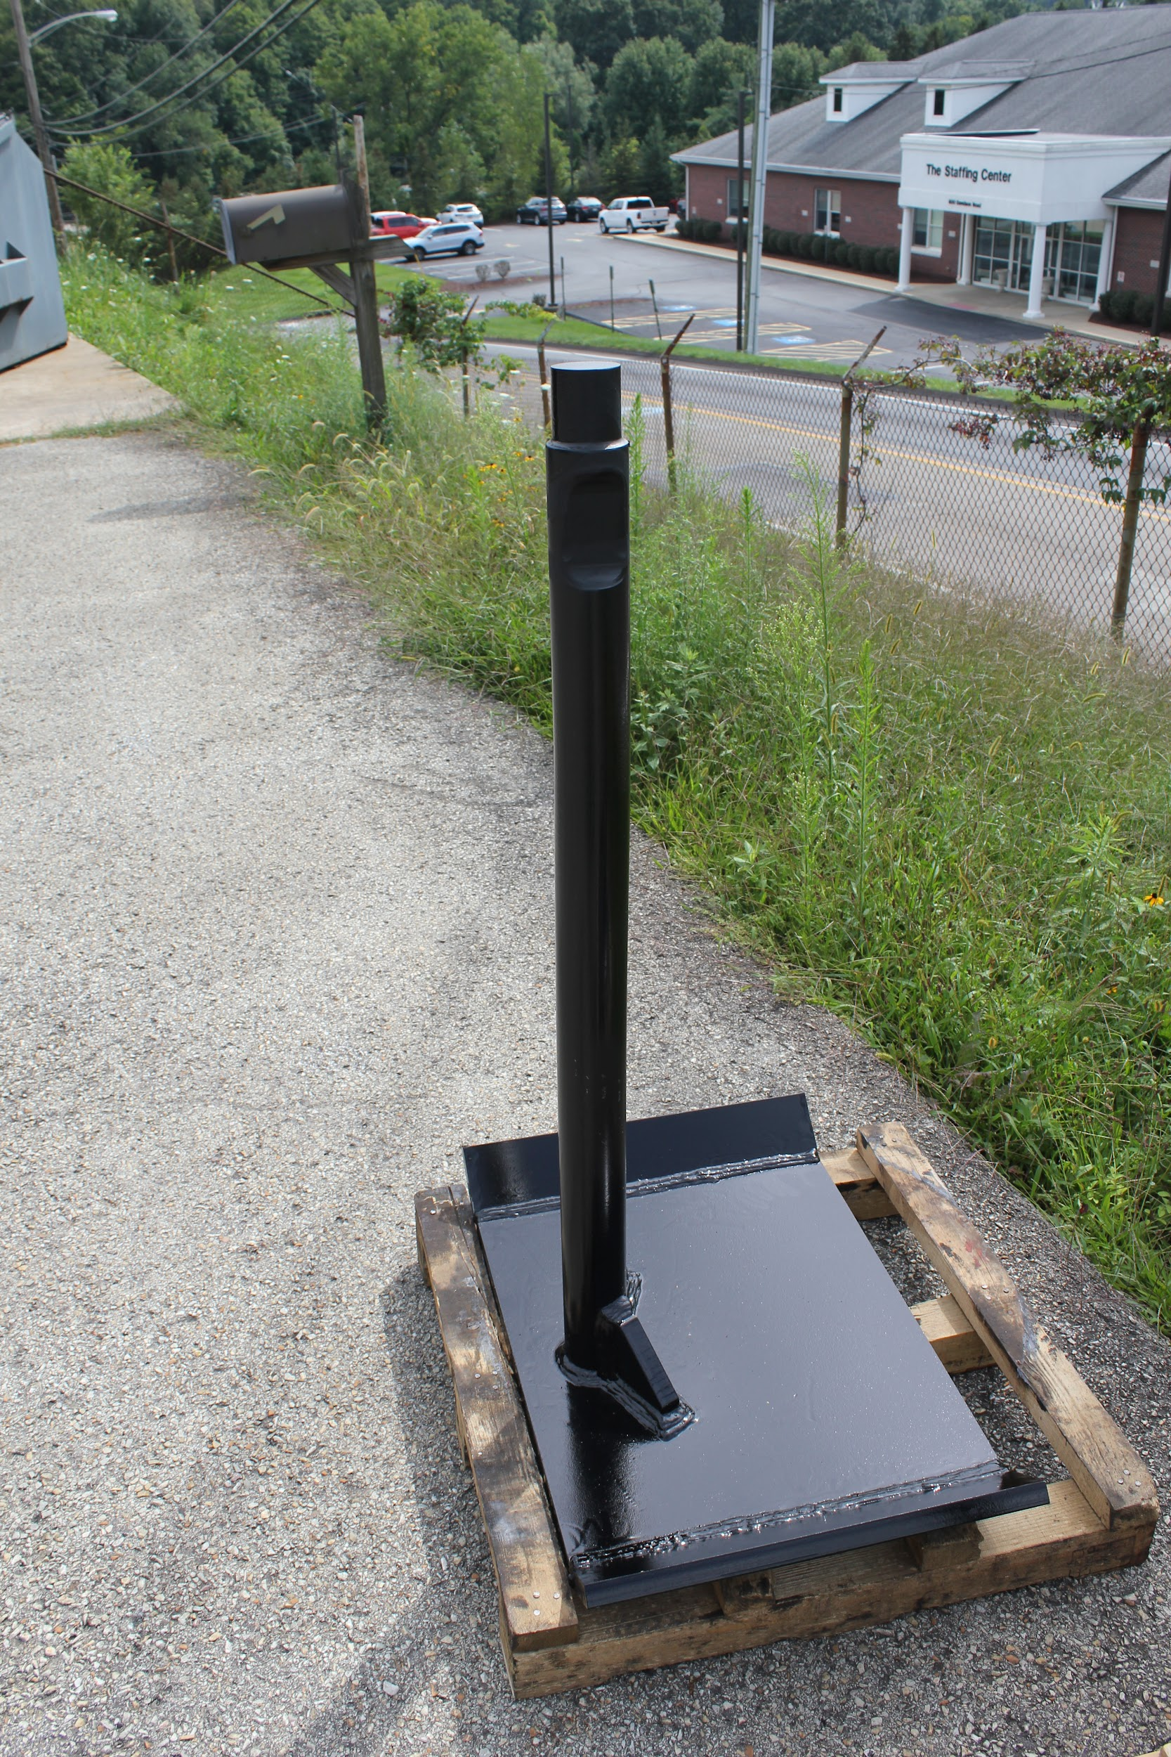
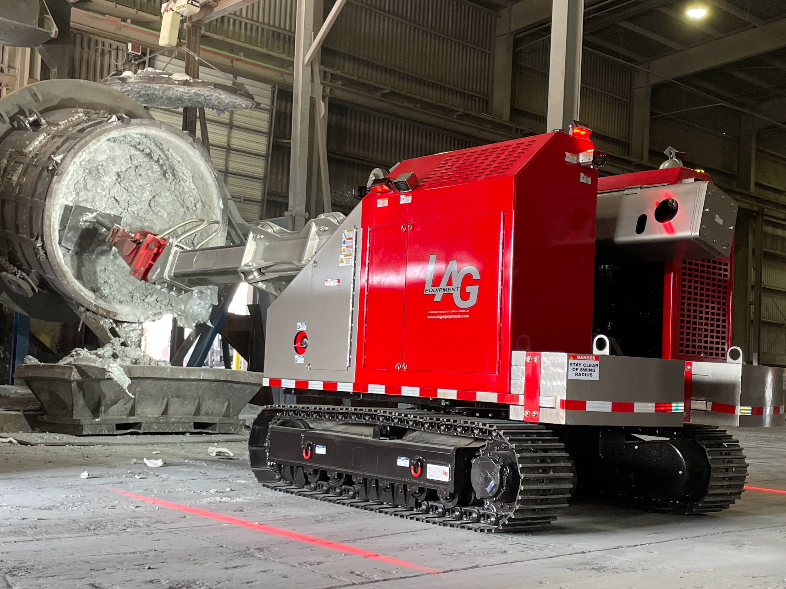
SCRAPERS
MULTI-PURPOSE SCRAPER
LADLE/CRUCIBLE SCRAPER

Slide 36
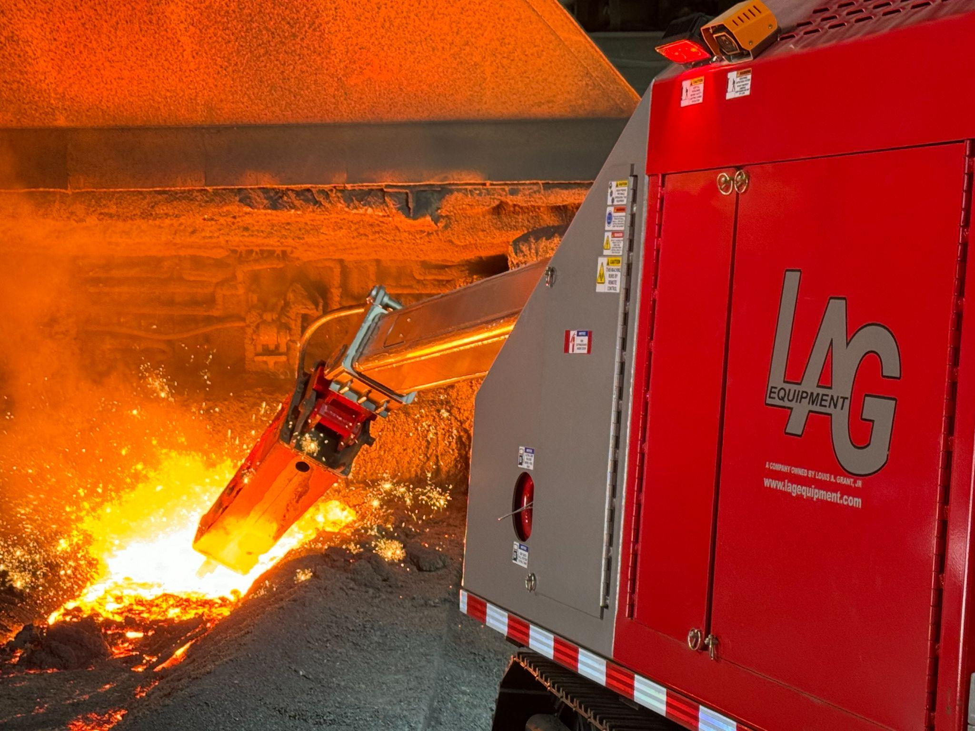
THANK YOU
lou@lagequipment.com

