Slide 1
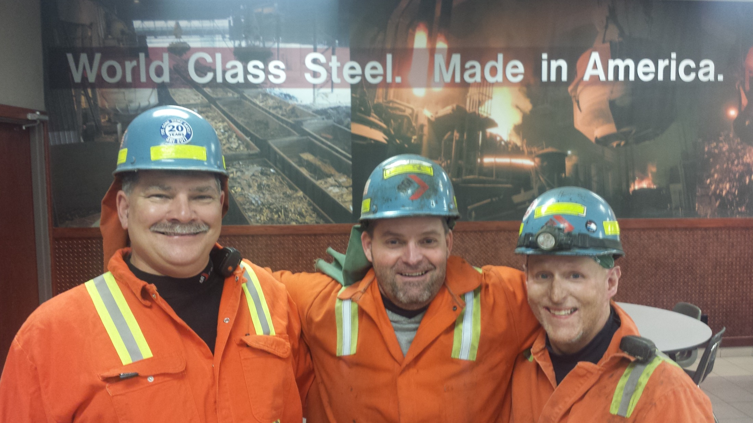

The Day We Will Remember
Ricky Rollins

Slide 2
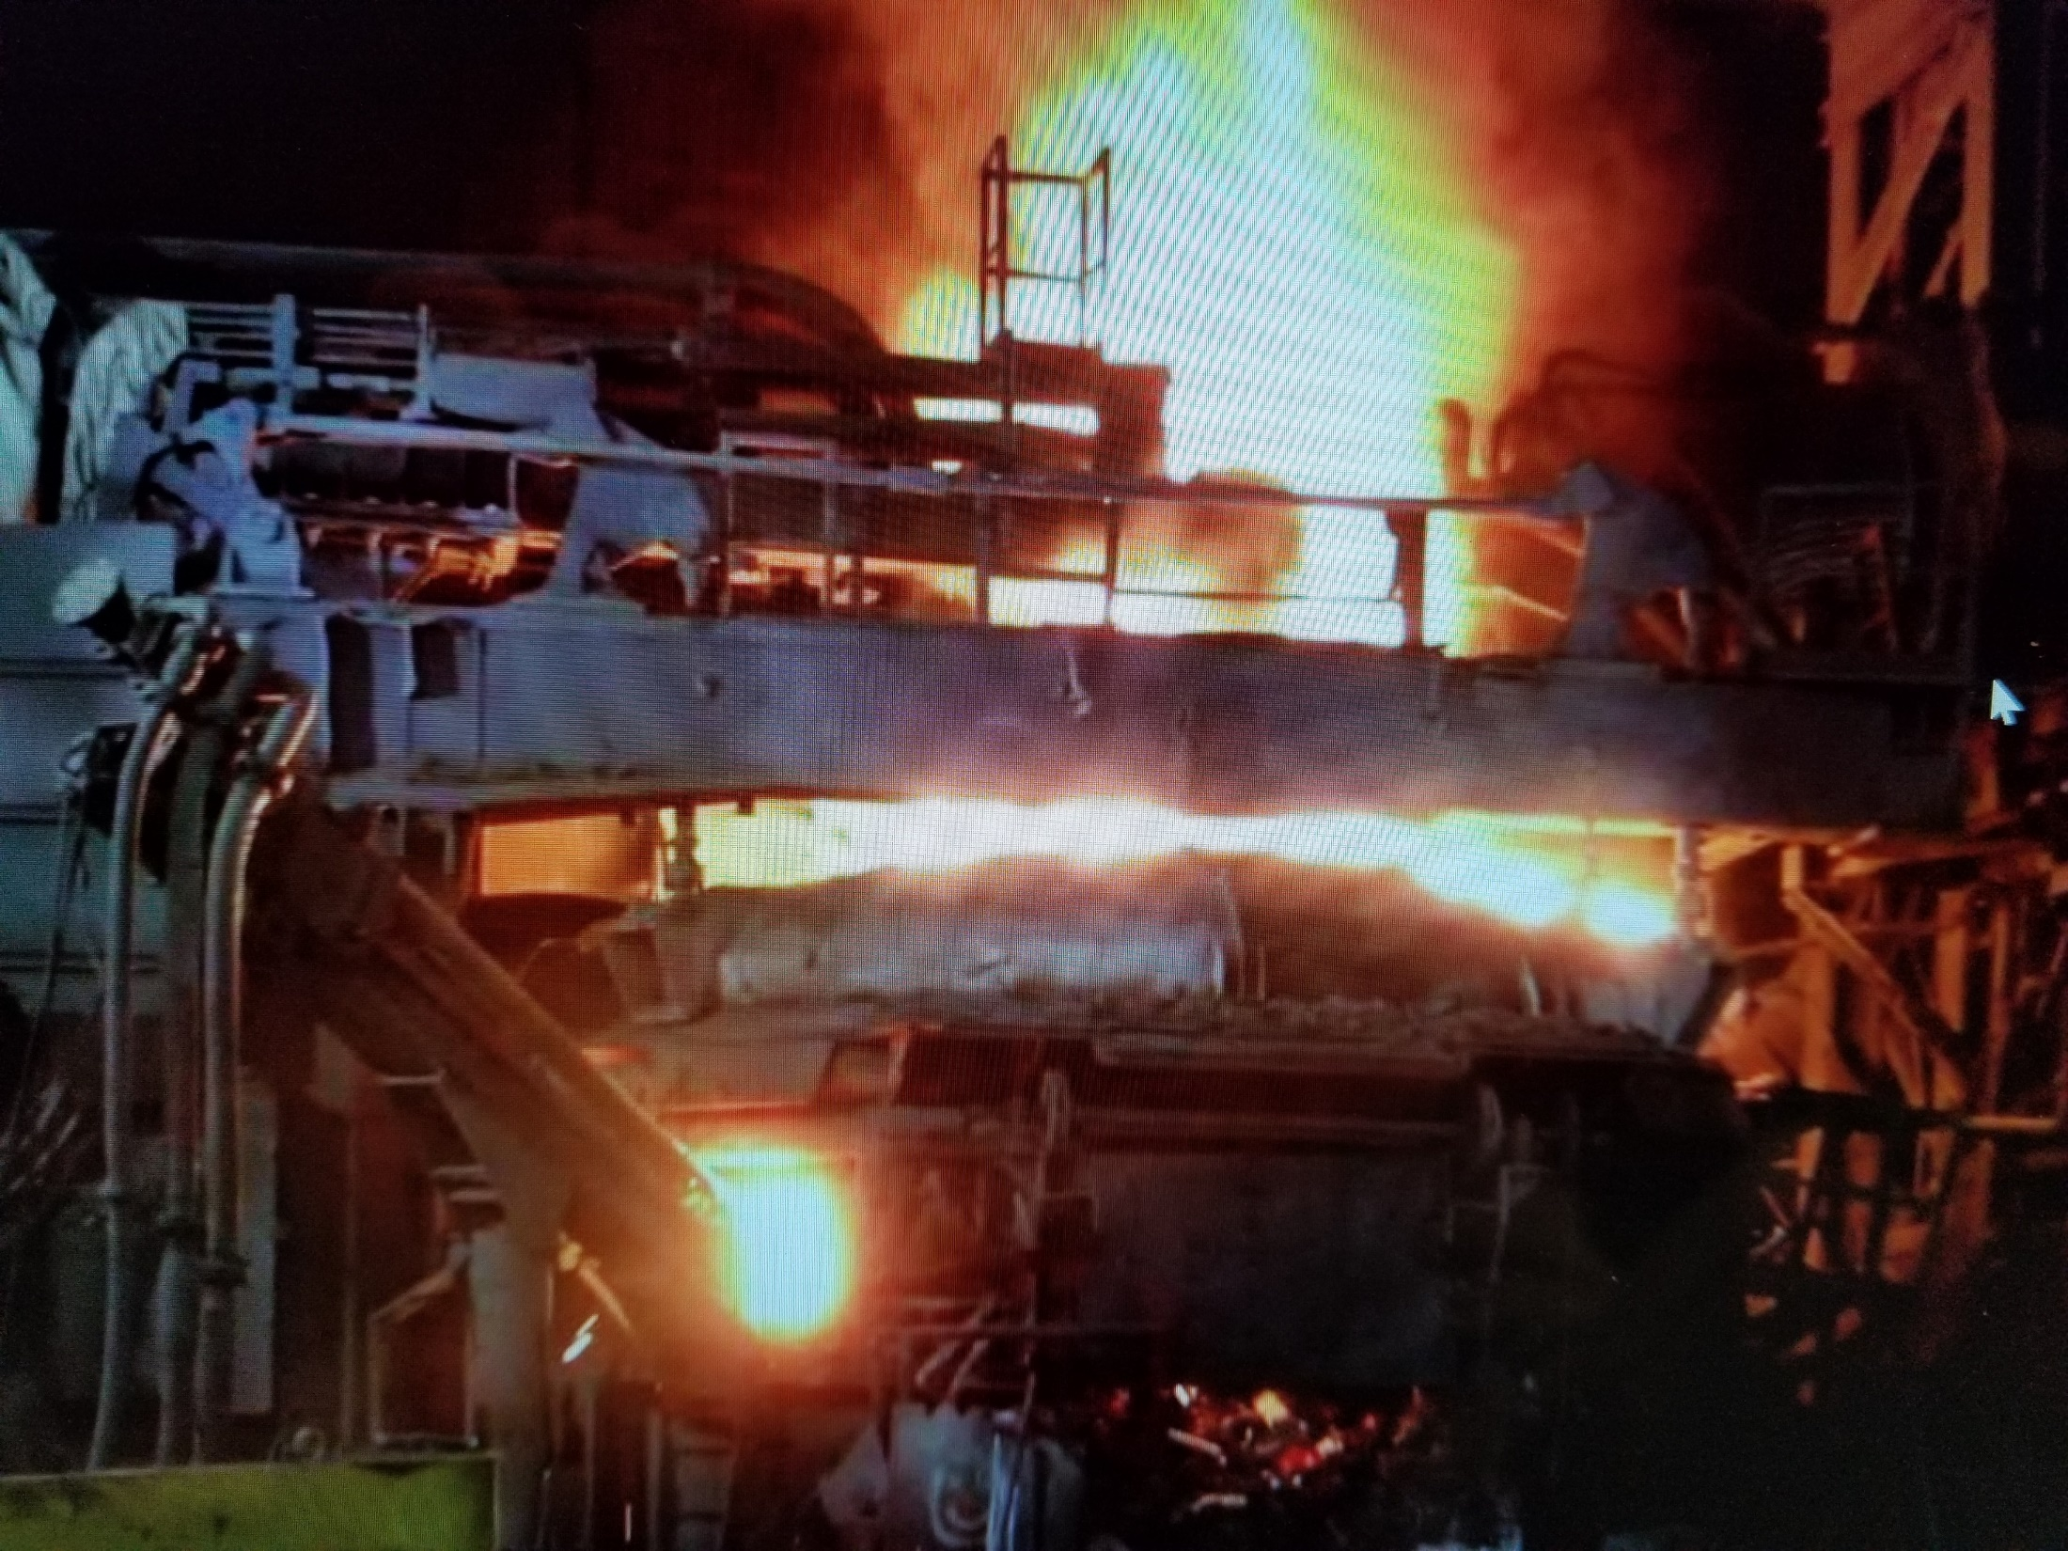

Slide 3
The Day We Will Remember
Ricky Rollins

Slide 4
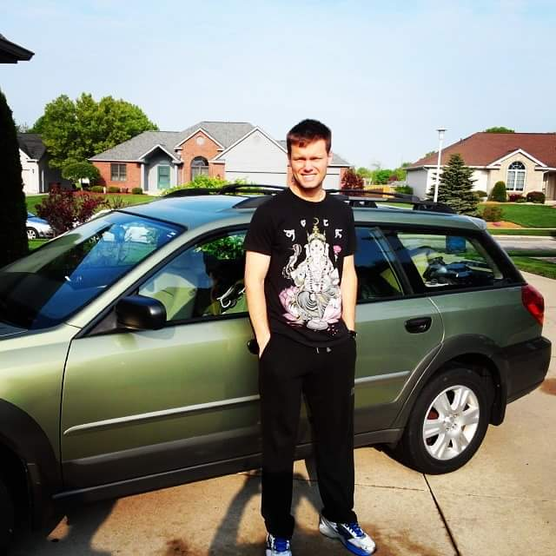

Slide 5
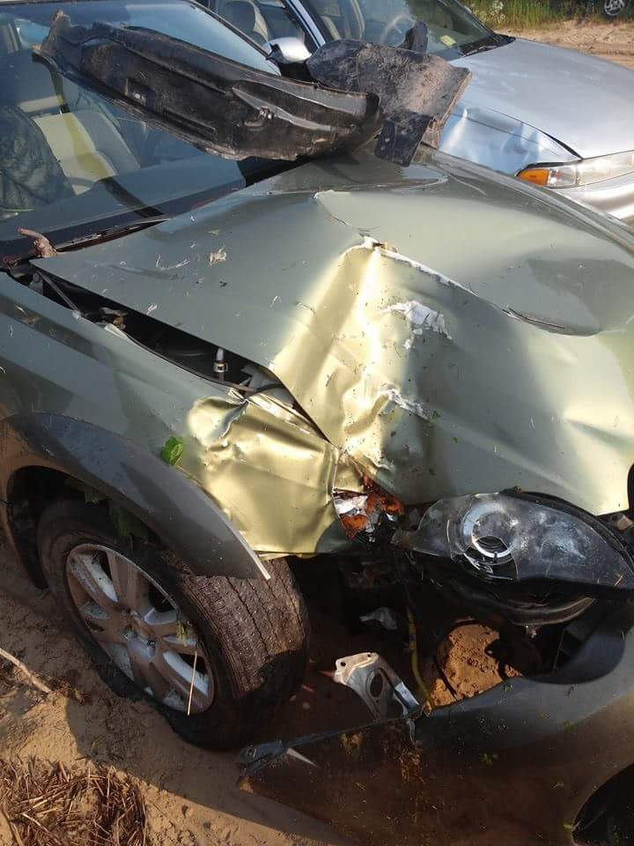

Slide 6
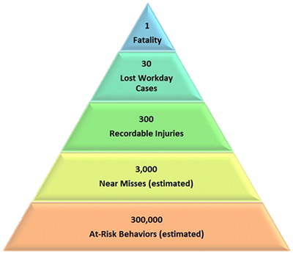

OSHA Safety Pyramid

Slide 7
OSHA Safety Pyramid

Slide 8
OSHA Safety Pyramid
LIFE
CHANGING
LOST TIME

Slide 9
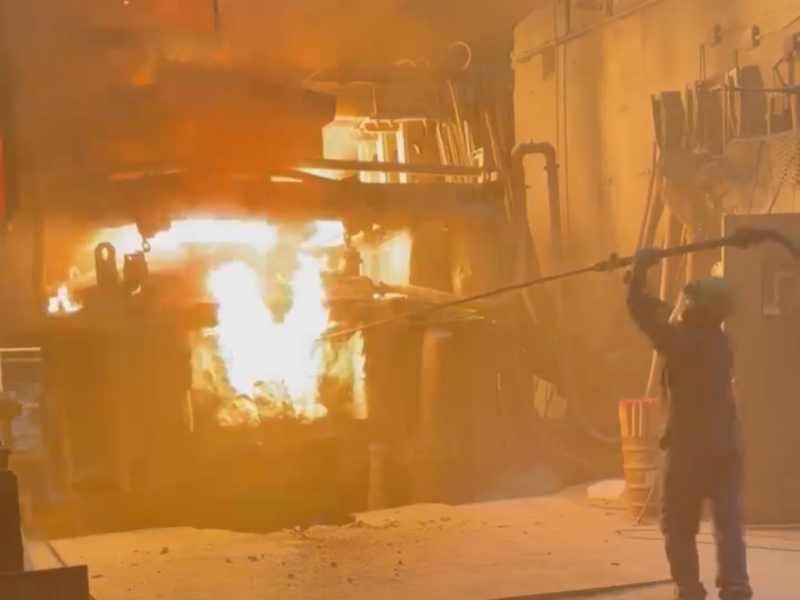

Slide 10
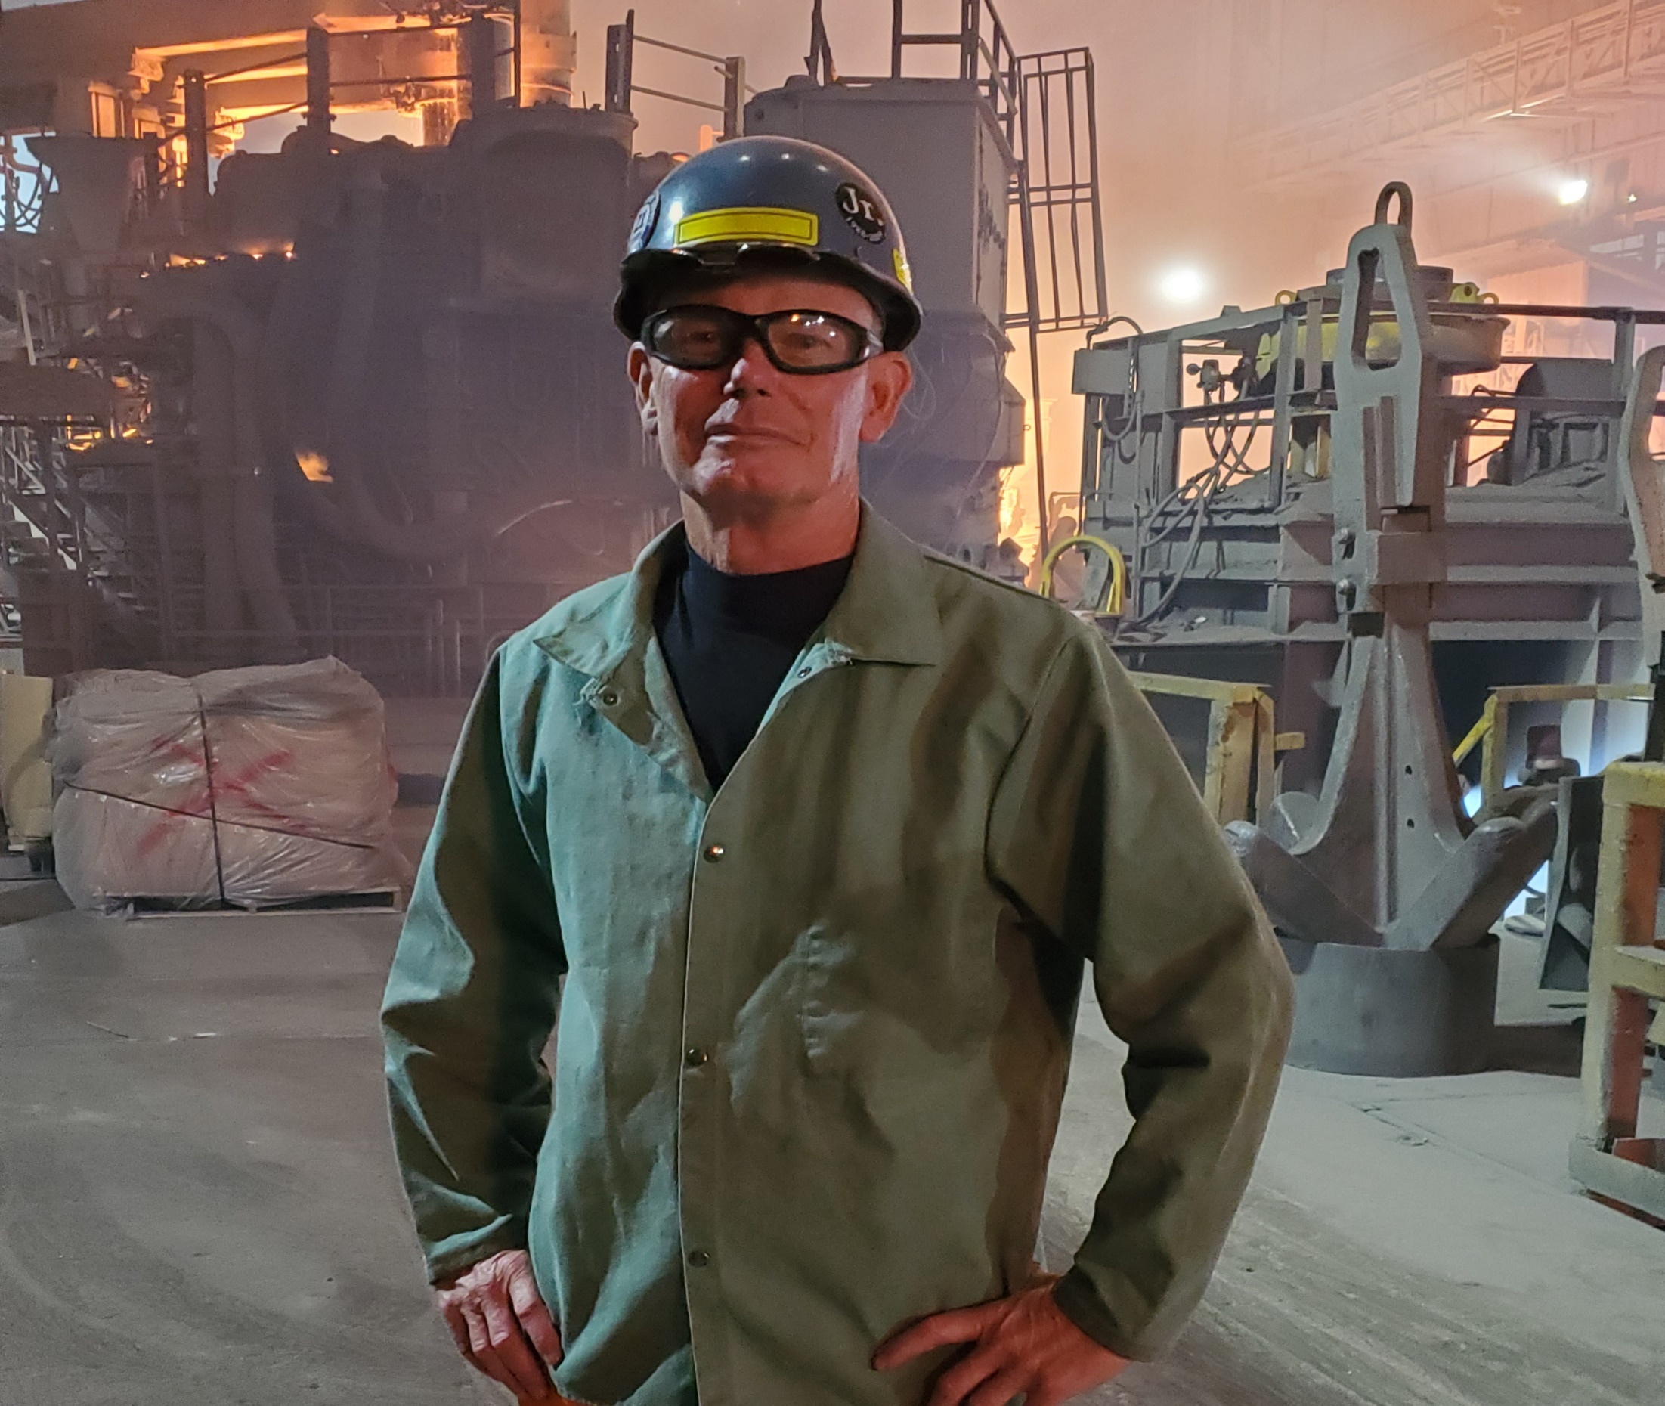

Slide 11
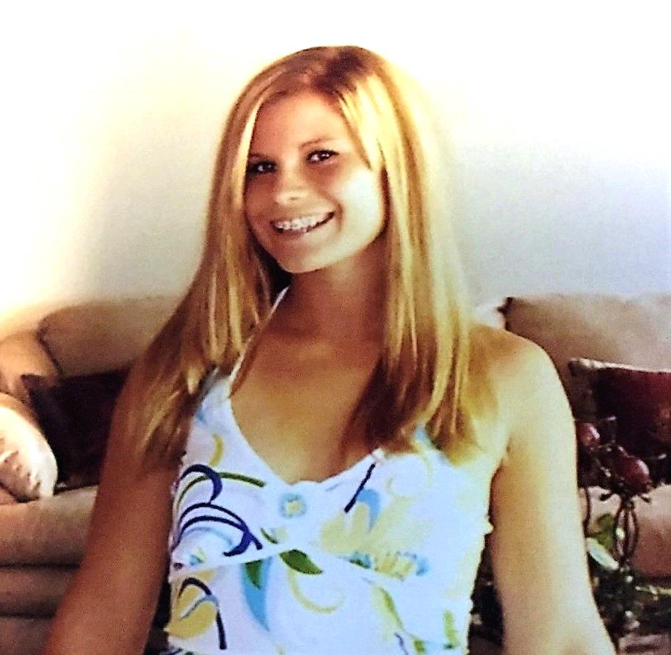

Slide 12
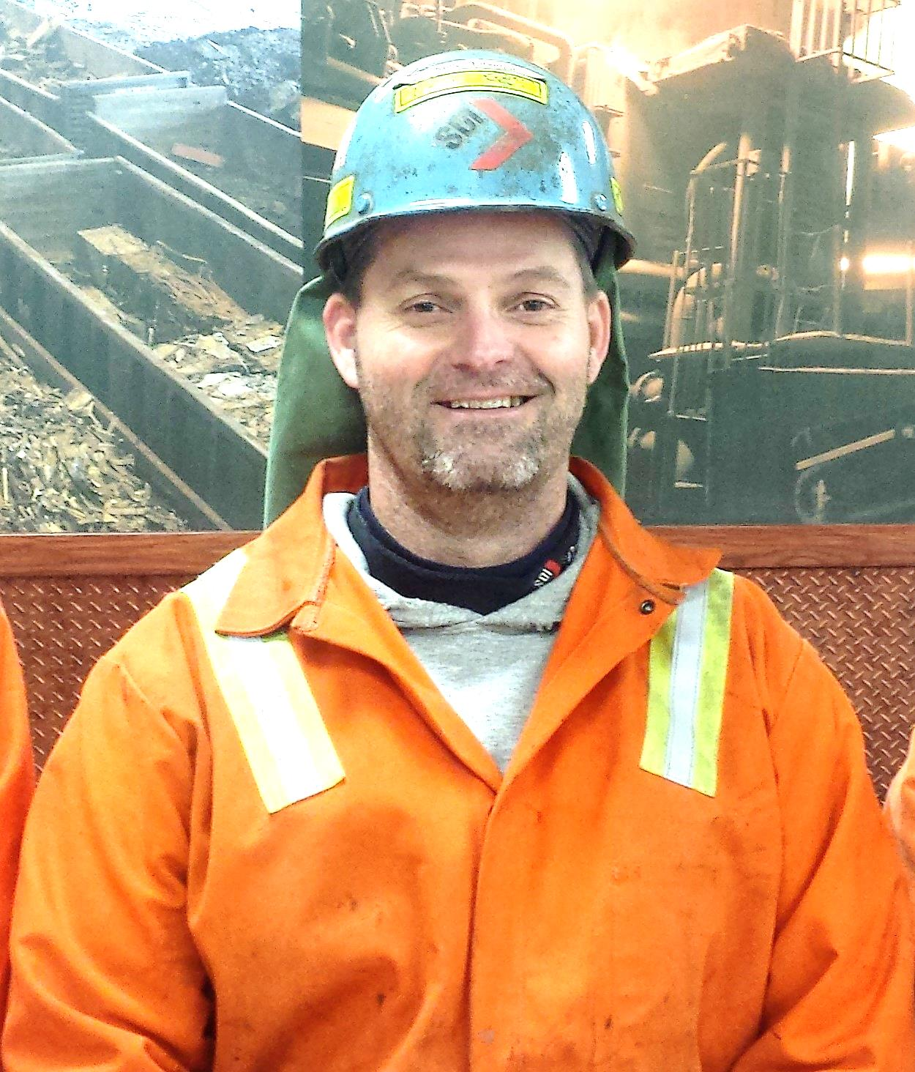

Slide 13


Slide 14
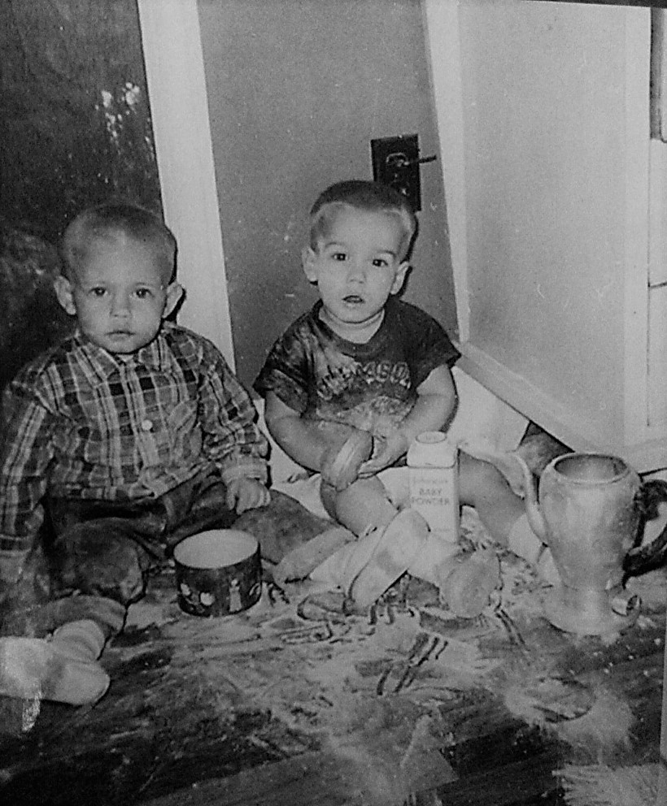

Slide 15
Safety Stats From The Beginning
Year | Recordable Cases | Recordable I.R. | Lost Time Cases | Lost Time I.R. | Hours Worked
1995 | 1 | 0.82 | 1 | 0.82 | 241,447
1996 | 12 | 4.2 | 3 | 1 | 570,862
1997 | 18 | 4.1 | 3 | 0.69 | 873,937
1998 | 12 | 2.16 | 5 | 0.9 | 1,113,331
1999 | 20 | 3.33 | 8 | 1.33 | 1,202,239
2000 | 20 | 3.36 | 4 | 0.67 | 1,191,397
2001 | 19 | 3.26 | 5 | 0.86 | 1,166,568
2002 | 17 | 2.87 | 6 | 1.01 | 1,183,557
2003 | 17 | 3.85 | 3 | 0.68 | 1,197,664
2004 | 27 | 4.32 | 13 | 2.08 | 1,249,912
2005 | 28 | 4.55 | 12 | 1.95 | 1,231,610
2006 | 18 | 2.8 | 7 | 1.09 | 1,287,542
2007 | 28 | 3.8 | 11 | 1.5 | 1,281,291
2008 | 12 | 1.6 | 6 | 0.8 | 1,501,556 | Year IDI added
2009 | 21 | 2.9 | 4 | 0.6 | 1,424,566
2010 | 16 | 2.13 | 7 | 0.9 | 1,501,708
2011 | 8 | 1.04 | 3 | 0.39 | 1,536,244
2012 | 19 | 2.42 | 3 | 0.38 | 1,568,418
2013 | 20 | 2.51 | 2 | 0.25 | 1,592,865
2014 | 16 | 1.95 | 8 | 0.97 | 1,645,141
2015 | 14 | 1.68 | 4 | 0.48 | 1,665,069

Slide 16
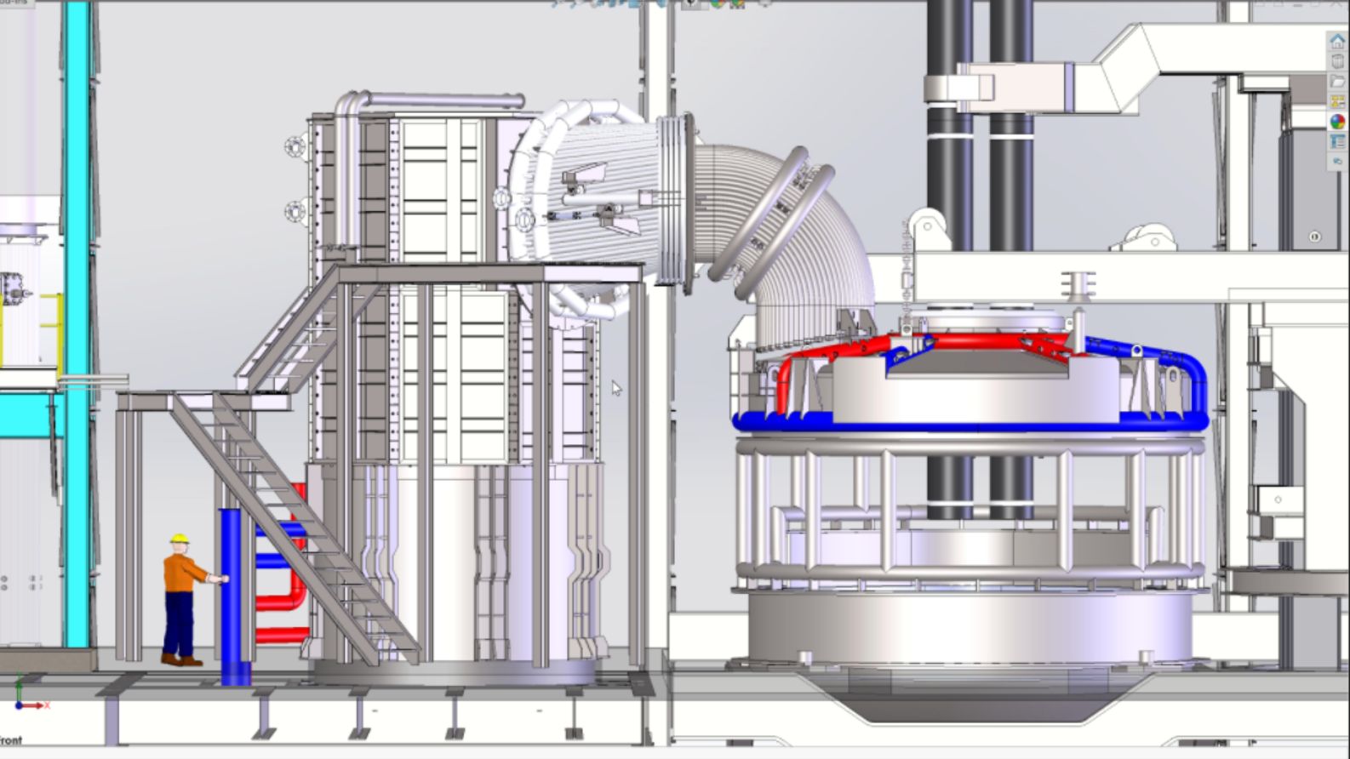

Slide 17
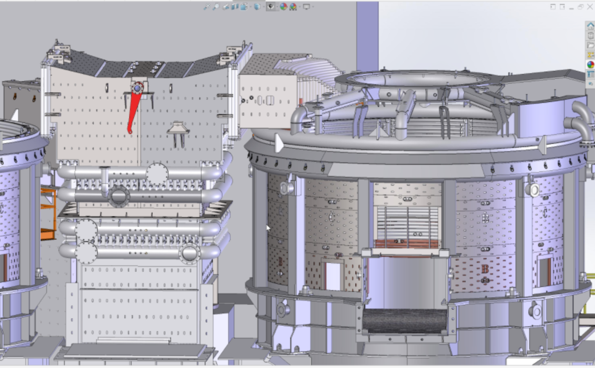

Slide 18
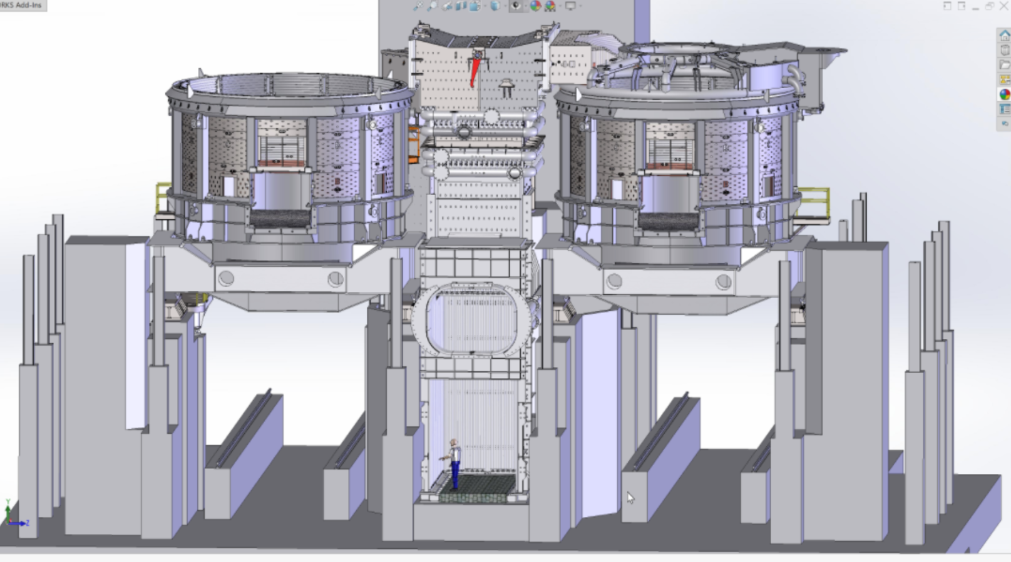

Slide 19
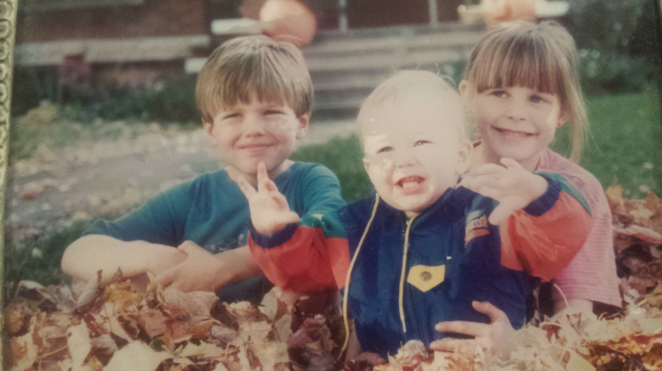

Slide 20
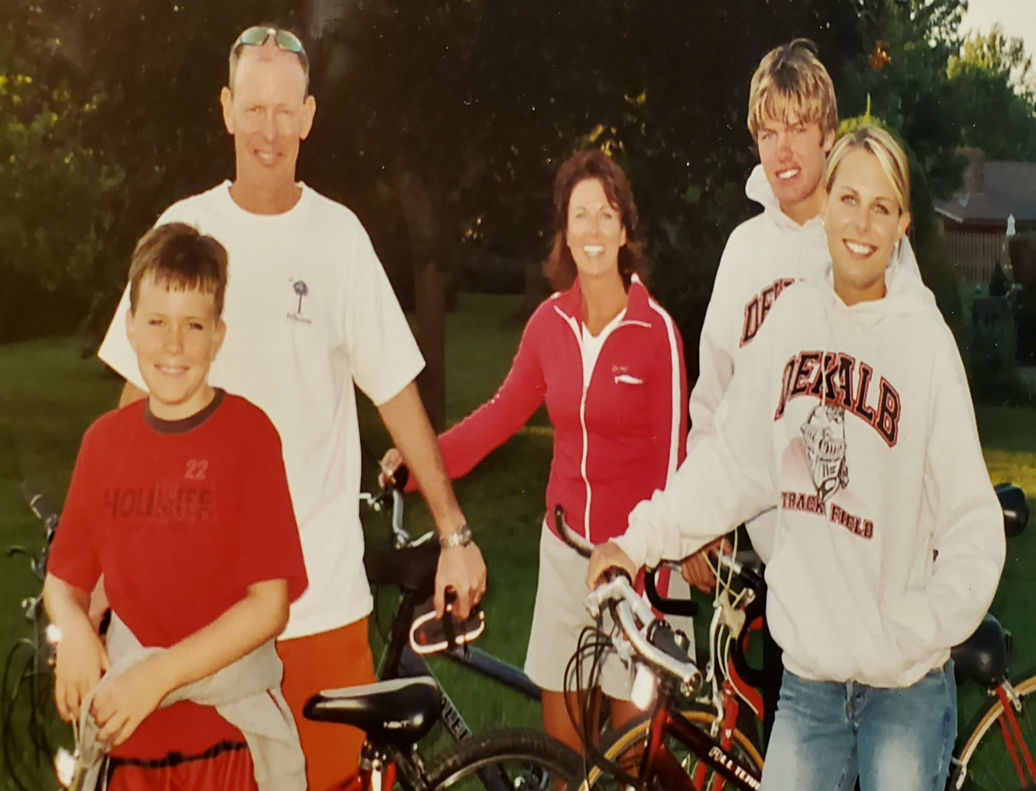

Slide 21
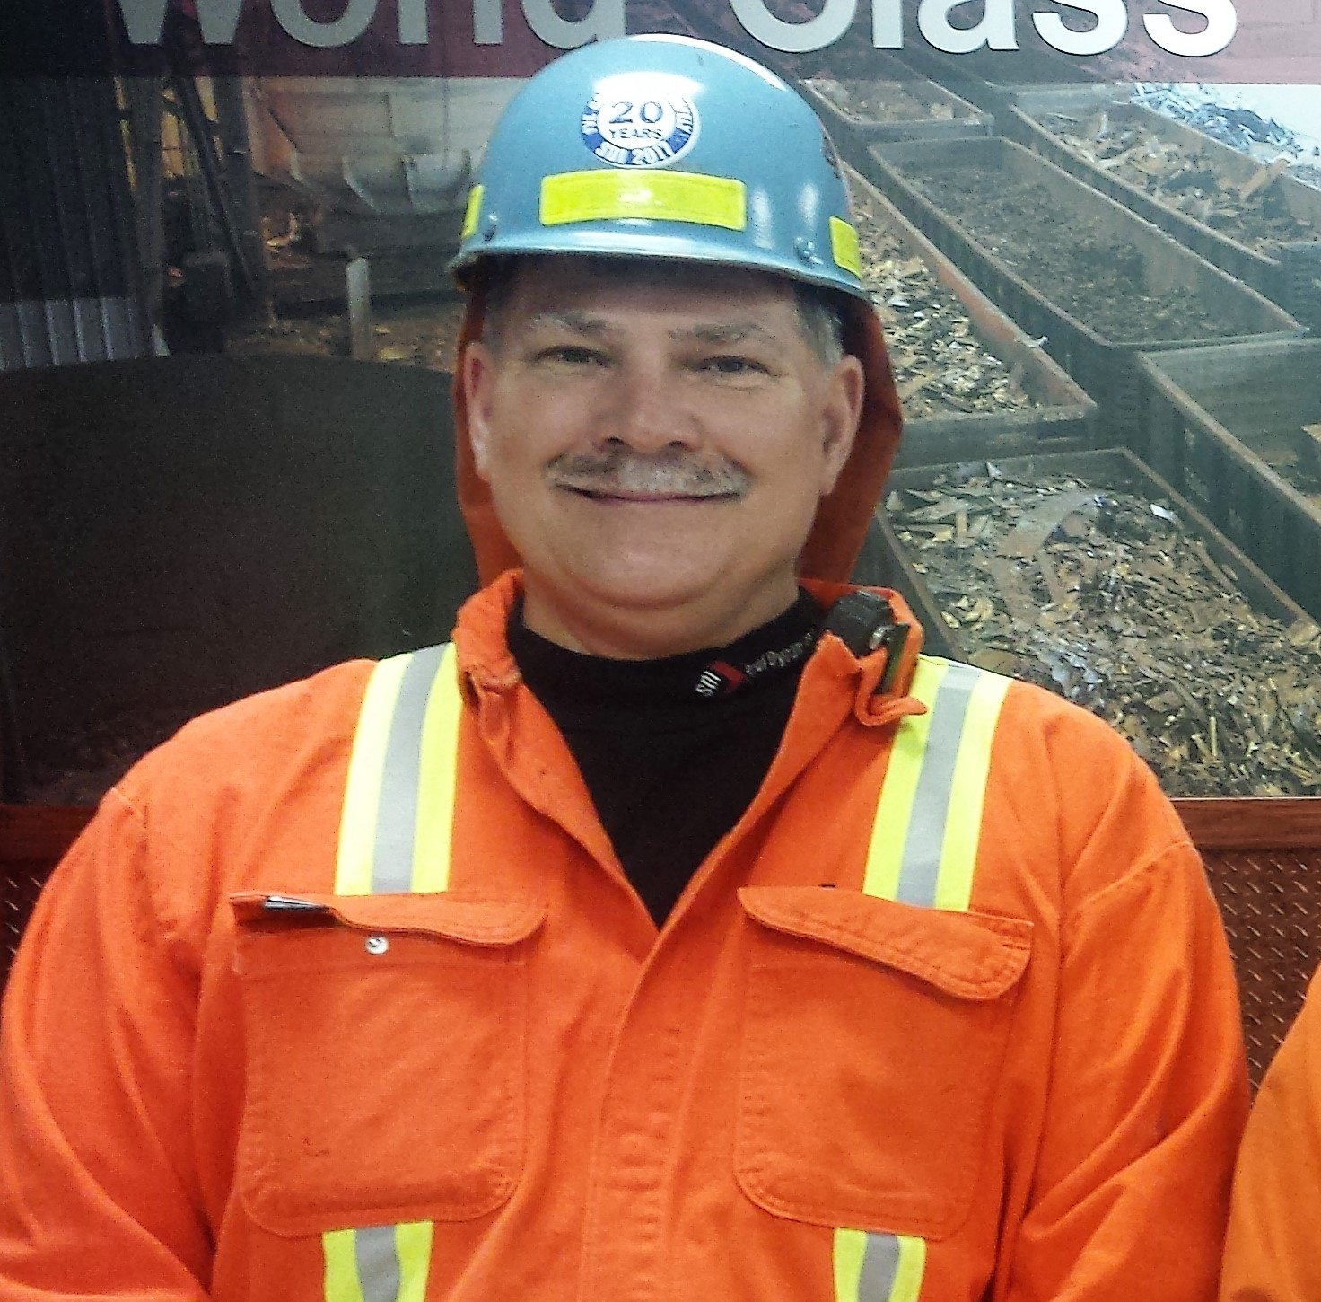

Slide 22
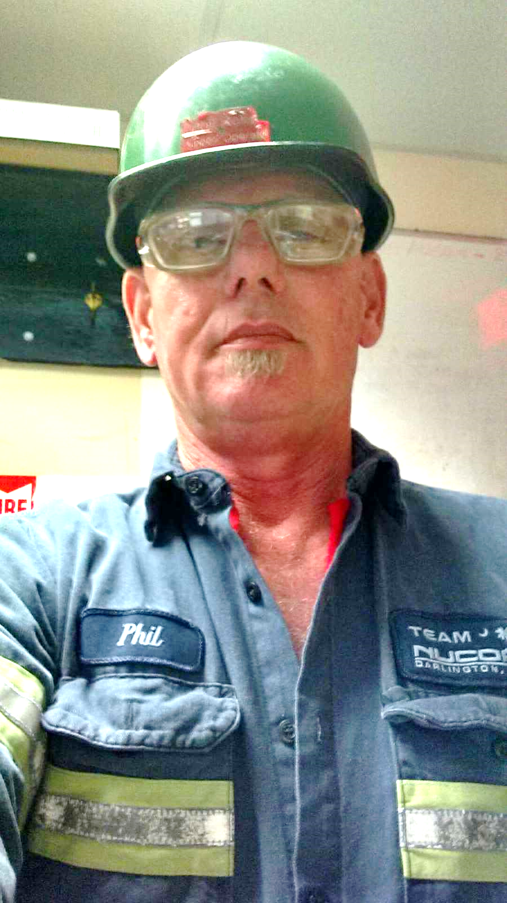
Who Am I?

Slide 23

Let’s Talk About Jim…

Slide 24
The Day We Will Remember
February 18, 2009

Slide 25
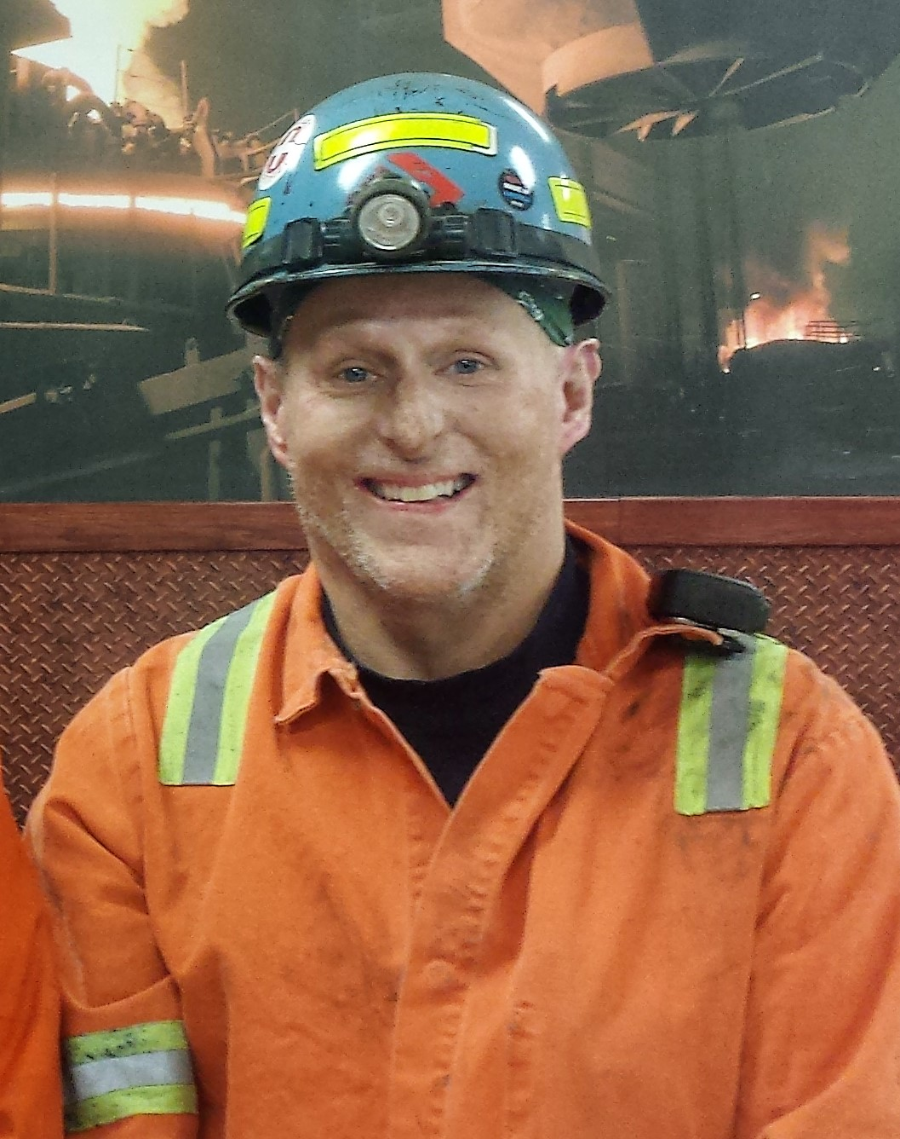

Slide 26
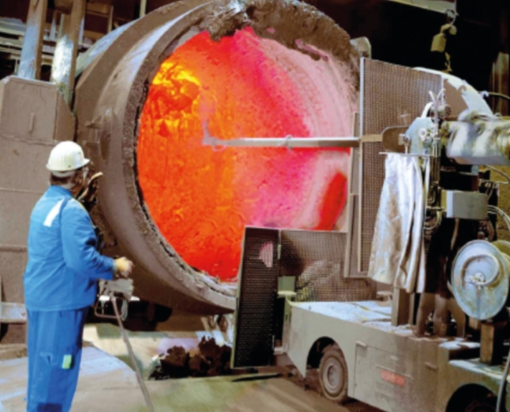

Slide 27
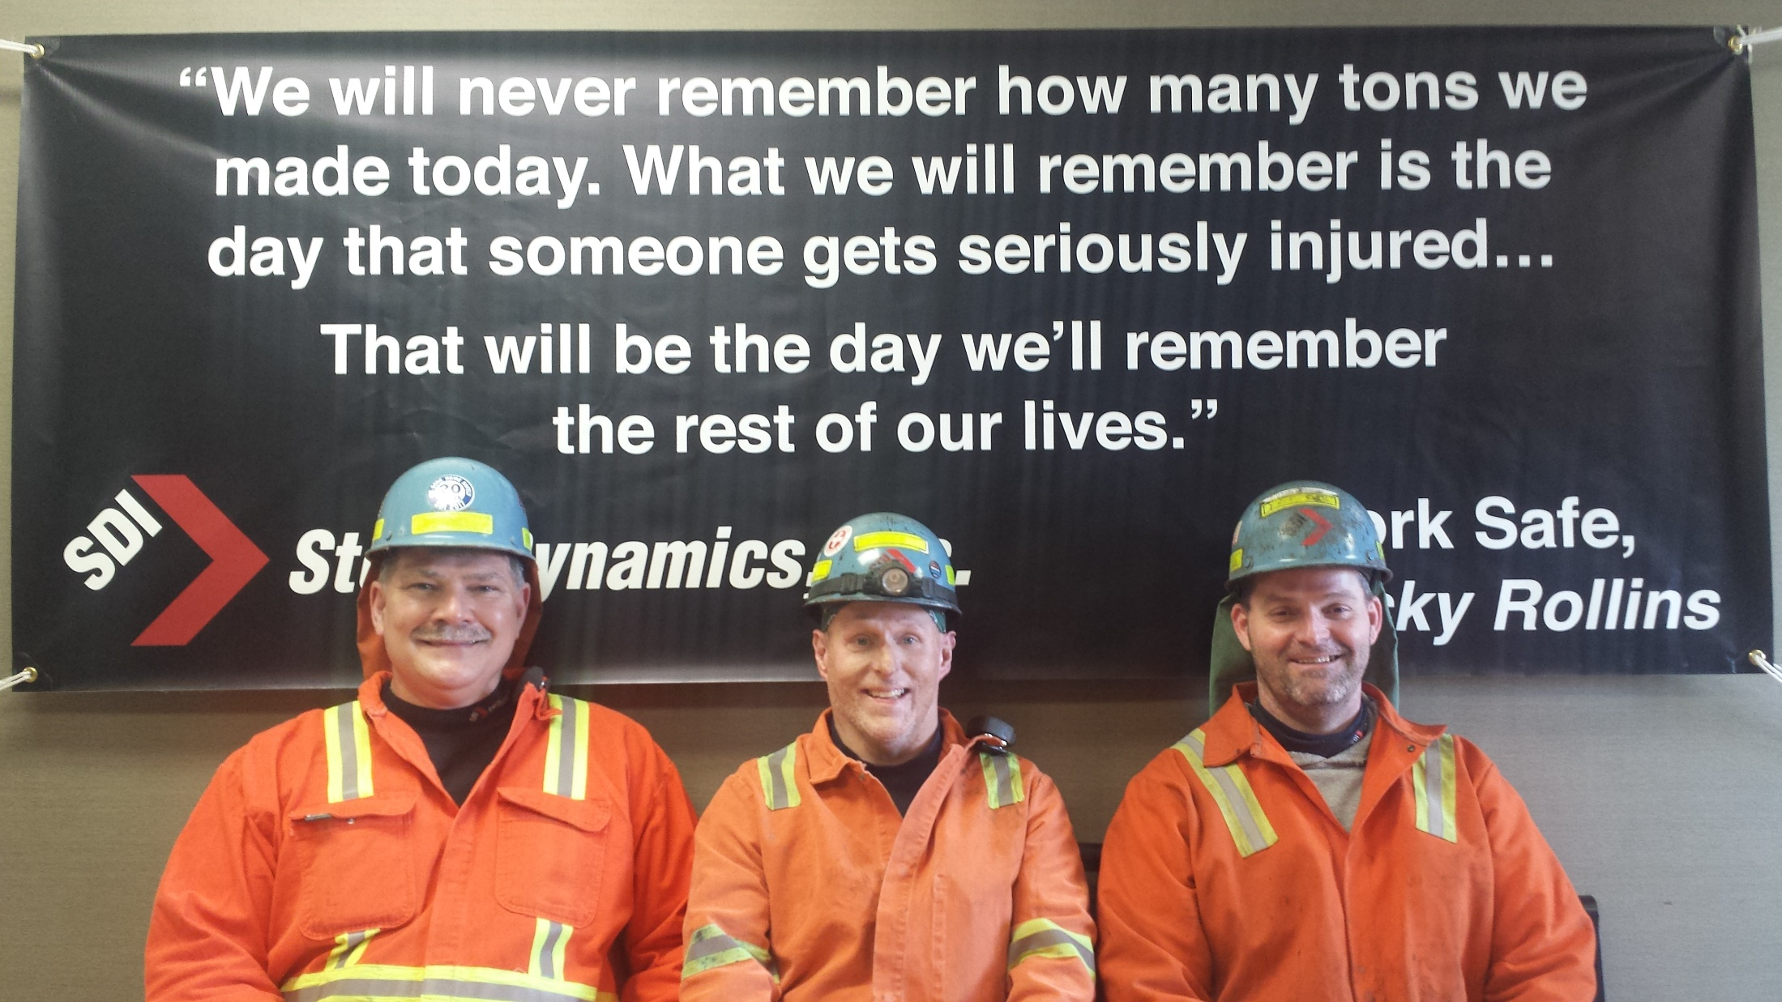

Slide 28
The Day We Will Remember
Ricky Rollins

Slide 29
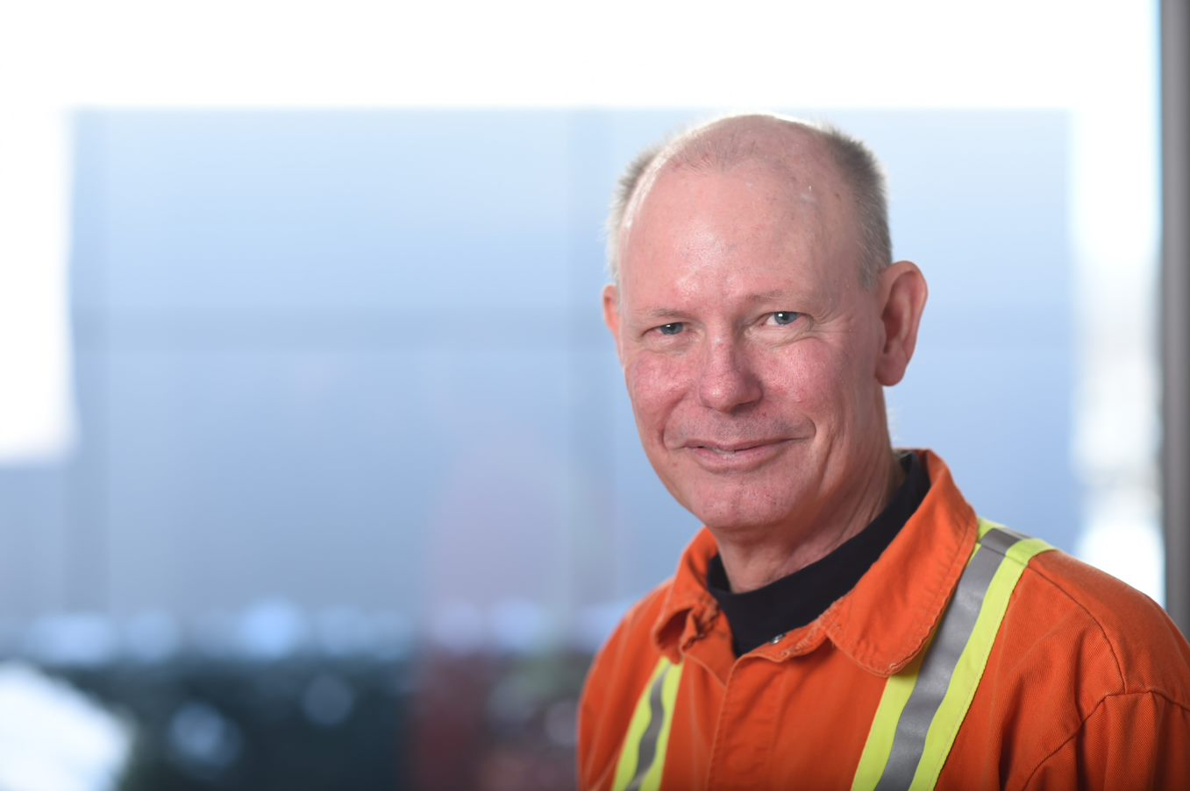
In Closing...
Ricky’s Serious Seven
1. Learn From Others
2. Use Your Influence
3. Don’t Let Ego/Pride Get In The Way
4. It’s Not About You
5. Brother’s Keeper Takes Two
6. Just Do Your Job
7. “WE WILL NEVER REMEMBER!”

Slide 31
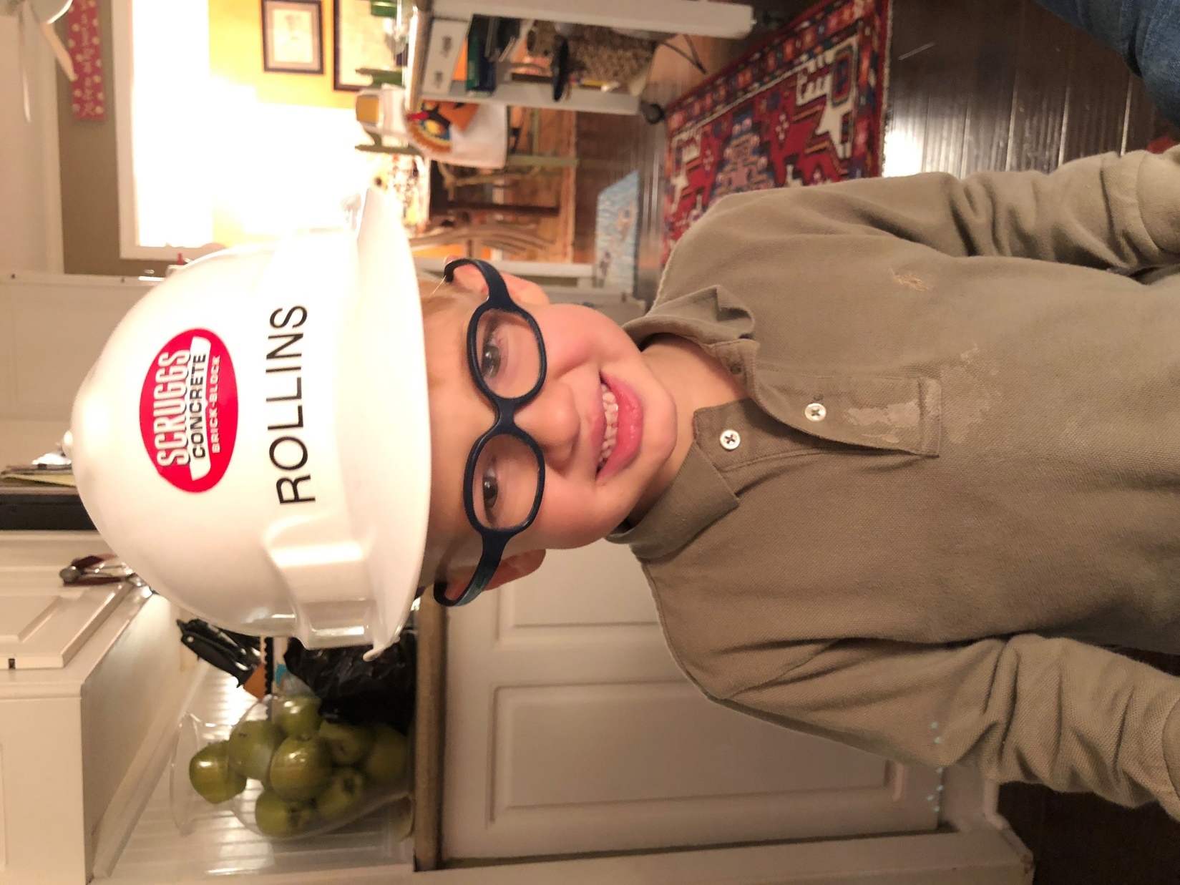
Thanks!
Make A Difference
In A Child’s Life!

Slide 32
Ricky Rollins Safety Speeches “The Day We Will Remember” Email rrollins@rrsafetyspeeches.com Cell – 260-908-6787 Website rickyrollinssafetyspeeches.com

